Slide 1
SECURE Act 2.0
January 2023

Slide 2
Jamie Hopkins, Esq.
MBA, CFP®, LLM, CLU®, ChFC®, RICP®
Managing Partner, Wealth Solutions
Finance Professor of Practice, Heider School of Business at Creighton University
American Bar Foundation Fellow
American Bar Association Top 40 Young Attorney
InvestmentNews Top 40 Under 40 Financial Services
Trusts & Estates Distinguished Author
Email: jhopkins@carsongroup.com
Jamie is not registered with CWM, LLC or any other firm as a registered representative or investment advisor and does not provide product recommendations or investment advice.
Notes:
Jamie will introduce himself – director of retirement research, finance professor of practice. Gives contact information for anyone with questions.

Slide 3
Expanded Savings
RMD and Enhanced Contributions
College Loans and Expenses
Emergency Funds
Roth Changes
Annuity Changes
SECURE 2.0 Overview

Slide 4
SECURE 2.0 Act
Signed into law
Part of the Consolidated Appropriations Act of 2023
$1.7 trillion in Federal Budget and Spending
SECURE Act 2.0 is relatively budget neutral

Slide 5
SECURE Act 1.0
More of a stealth tax increase bill
Pushed back RMDs to age 72
Created new credits for small business owners
Created some new annuity rules
Changed the inherited account rules for RMDs – 10-year rule

Slide 6
Expanded Savings Opportunities
Starter 401(k)
Saver’s Match
Expanded Mandatory Automatic Enrollment
Enhanced Credits for Small Business Retirement Plan Set Up

Slide 7
RMD and Contribution Changes
Increase in RMD Age
Index IRA Catch Up Limit for Inflation
Higher Catch-up Limits for Ages 60-63
Retirement Plan Sign Up Incentives
Additional Employer SIMPLE Plan Contributions
Reduction in missed RMD Penalty Tax
No RMDs for Roth Accounts pre-death

Slide 8
College Loan and Expense Changes
529 to Roth Rollover
Student Loan Repayment Match

Slide 9
Retirement Emergency Funds
Pension Linked Emergency Savings Accounts
Emergency Withdrawal Penalty Tax Exception
No 72(t) penalty tax for distributions to someone with a terminal illness
Up to $22,00 for Federal Disaster Relief Access – no penalty, taken into income over 3 years, can be repaid
No 10% penalty for domestic abuse survivors up to $10,000 distribution

Slide 10
Annuity Changes
Changes to IRA and Qualified Plan Life Annuity features to meet RMD Rules (return of premium and steady payment increases)
Expanded QLAC Contributions limits (no 25% and $200,000)
No partial account annuitization penalty for RMDs

Slide 11
Charitable Changes
QCDs – allow for a one time $50,000 split interest gift to a charitable gift annuity or a charitable trust (CRAT and CRUTs)
Increase the QCD amounts for inflation ($100,000)

Slide 12
Roth Changes
SIMPLE and SEP Roth tax treatment available by employee
Catchup up contributions are Roth over $145,000 previous year indexed for inflation
Matching contributions can be Roth account in 403b, 401k, and 457(b) if plan allows and employee opts into it

Slide 13
Additional Changes
National Lost and Found Retirement System
Updated Retirement Plan Family Attribution Rules to remove the minor children attribution for spouses and community property attribution
Allow sole proprietors starting a 401k to start plan after end of tax year till April 15 and fund but employer and employee side by tax return
Standardize Rollover Rules
Long-term Care Premium 10% Exception $2,500/yr

Slide 14
Deeper Dive Into 6 Areas of SECURE 2.0 Act

Slide 15
Required Beginning Date (RBD) Increase
Current Law
– RMDs began at age 70½ before January 1, 2020 (i.e. before SECURE 1.0)
– RMDs begin at age 72 current
SECURE 2.0

Slide 16
RMD Planning Points
Pushback of RMDs not always positive
Know what higher RMDs later does to other accounts and taxes like IRMAA
Use deferred time to do Roth or other distributions
Consider inherited taxes and account impact on estate
Overall makes Roth less appealing – why – less RMDs on traditional
Creates more flexibility but more useful is planning is done ahead of time

Slide 17
SECURE 2.0 lengthens window for post-retirement/pre-RMD tax planning
Thanks to SECURE 2.0, other planning decisions, the early retirement years have the potential be some of the lowest tax years in retirement
No taxable income from work
No RMDs until age 73 (lengthening to 75 in 2033 for those born in 1960 or later)
No Social Security income: Many affluent retirees have gotten the message about delaying Social Security

Slide 18
New retirees might accelerate tax realization in those low-tax, pre-RMD years
Converting traditional IRAs to Roth
Accelerating Traditional IRA withdrawals to reduce RMDs later on
Making qualified charitable distributions
QCD allowable at age 70.5
Amounts increased with SECURE 2.0 as $100,000 is indexed to inflation
QCD to fund split-interest entity like charitable remainder trust (up to $50,000)
Tax-gain harvesting in a lower bracket

Slide 19
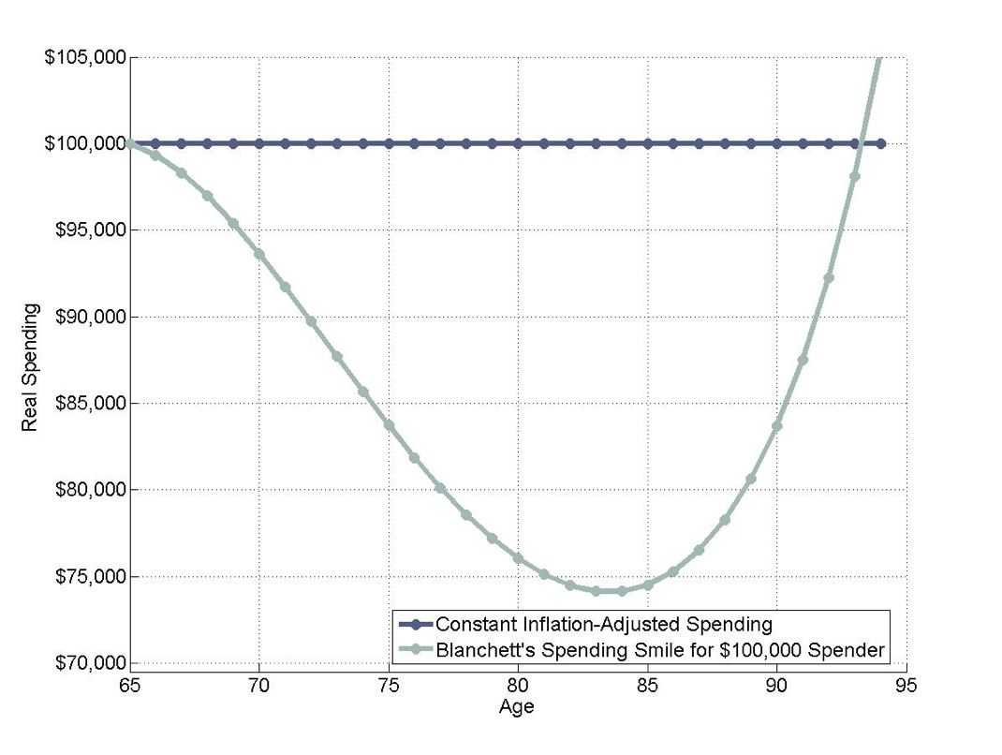
Reality is a countervailing force: These are often retirees’ high-spending years
Source: Retirementresearcher.com.

Slide 20
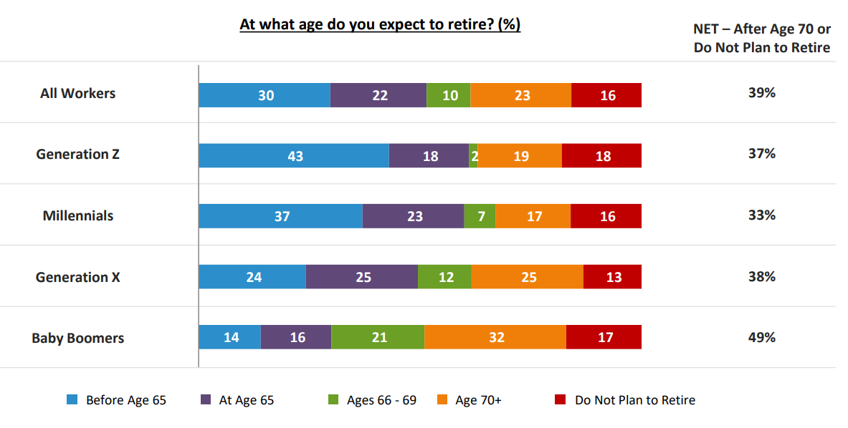
And clients may want to work during them!
Source: Transamerica Center for Retirement Studies

Slide 21
Delayed RMDs from 2.0 accentuates value of cash-flow planning for early-retirement years
Clients’ taxable accounts may be best source of funds during those years
May make sense to favor new contributions to taxable account to facilitate cash flows and tax planning in post-work, pre-RMD years
Taxable accounts’ asset allocation needs to be teed up to deliver cash flows during that period

Slide 22
Managing tax efficiency of taxable accounts and income distributions is also key
With higher yields available, tax on income distributions can add up
Munis may make sense for fixed-income, cash holdings
Downplay dividend-paying stocks (tax rate is the same as w/capital gains but dividends distributed more consistently)
Avoid actively managed funds (duh!)
Use specific share identification method of cost-basis elections
Facilitates surgical tax-loss selling/gain harvesting
Allows for sales of high-cost-basis shares to meet cash-flow needs

Slide 23
Roth Conversion Basics
25% Taxes
$2,500 taxes paid
Pay Taxes
Outside Taxable or Brokerage Account
$2,500 taxes owed
$500,000 Account
Traditional IRA
Converted Amount
Roth IRA
$490,000 Remaining value
$10,000
$10,000
Notes:
Here's an example we can use to understand Roth IRA basics.
Source
https://www.kitces.com/blog/how-to-do-a-backdoor-roth-ira-contribution-while-avoiding-the-ira-aggregation-rule-and-the-step-transaction-doctrine/

Slide 24
Considerations – Roth Conversions
Can you pay the taxes now?
Where are your income and tax rates?
Do you expect tax rates for yourself to go up or down?
Do you need tax diversification?
Notes:
Where do you expect tax rates and your income to go in the future? Strategic tax diversification can help you reduce your tax hit.

Slide 25
529 to Roth Rollovers
• Current law
– No mechanism to rollover unused 529 funds to retirement accounts
• SECURE 2.0:
– Allows for rollovers 529 plan funds to Roth IRAs
– 529 must be maintained for at least 15-years before the rollover
– Roth rollovers limited to the aggregate contributions (and attributable earnings) made at least 5- years
before the date of the distribution
– Must be a direct, trustee-to-trustee transfer to a Roth IRA account maintained for the benefit of the 529
plan beneficiary
– Rollover limited to the $6,500 (2023 plus $1,000 catchup) contribution limit (adjusted for inflation)
- Regular IRA contributions reduce eligible 529 rollovers
- Roth income limits don’t seem to apply
- Overall aggregate lifetime limit of $35,000
– Earnings and contributions from the 529 plan carryover for the Roth ordering rules
– Effective starting in 2024

Slide 26
529 Planning Points
$35,000 lifetime per beneficiary though – two spouses and three kids and 6 grandkids = $385,000!
IRA bene – not the owner is the rules
Uncertain on 15-year rule – can you add new beneficiary without triggering new 15 years?
Rollover can’t include anything earnings or contributions from past 5 years
Would count against the $6,500 annual contribution amount and be offset by it
No income limits to 529 – backdoor option? Contribute to 529 then rollover in 5 years to Roth
Also – a way around the earned income aspect – not needed for the rollover

Slide 27
529 Planning Points
Start a 529 soon
Consider a 2-year-old – 15 years from now that $35,000 could start moving to a Roth IRA for the child at age 17
What’s the benefit? 529 can be state income tax deductible – Roth is not – gets same tax-free growth
Can serve double purpose
Get the clock running

Slide 28
Emergency Expense Withdrawals
• SECURE 2.0
– A new penalty-free distribution for personal or family emergency expenses
– Limited to the lesser of: $1,000 or the non-forfeitable account balance in
excess of $1,000
– Limited to one distribution every 3-years unless the previous recent
distribution is re-contributed
– Available for: Qualified retirement plans, 403(b) plans, 457(b) plans, and IRAs – Plan administrators can rely on the employee’s certification
– Effective starting in 2024

Slide 29
Emergency Savings Accounts
- New account inside of retirement accounts possible
Section 127 of SECURE 2.0 Act
Allowed for those below $135,000 and not a 5% or more owner previous year
Contributions can go up to $2,500 (no more after that although interest can accrue)
Will be waiting on guidelines here within 12 months of passage on tax implications
Must be in a principal protected investment – cash or otherwise
Must allow at least 1 distribution per month and no penalty or fee for the first 4 in a year
Will be treated as a Roth account – tax and penalty free
Treated as a salary deferral

Slide 30
Emergency Fund Planning
What is the right about of liquidity for you
What is the right investment?
How much do you need?
Where does credit exist?
Where is Roth? Home equity? LOC? Cash?

Slide 31
Qualifying Longevity Annuity Contracts
• Current law
– QLAC is deferred income fixed annuity that allows RMD deferral – very few riders allowed (inflation, spousal, and return of premium)
– In 2022, a QLAC is limited to the lesser of 25% of their retirement funds or
$145,000
• SECURE 2.0:
– Eliminate the 25% limitation
– Increase dollar limitation to $200,000 in 2023 (will inflation adjusted
thereafter)
– Other technical changes

Slide 32
QLAC Planning Points
• Do you need to defer out or reduce RMDS?
Do you need lifetime income?
What is your longevity risk today?
What is your retirement income plan?
Can be an efficient way to reduce some longevity risk of outliving money

Slide 33
QCD for One-Time CRT Contribution
2006 Pension Protection act created QCDs – qualified charitable distributions – age 70.5 from IRA up to $100,000 a year
SECURE 2.0
– One time election to fund a CRT (or charitable gift annuity) with an
IRA distribution
– Limited to $50,000 (adjusted for inflation)
– Income interest must be payable to account owner or spouse
– The IRA distribution qualifies as a QCD to a CRT to the extent the
contribution would qualify as deductible under Section 170 (i.e. to
the extent the remainder interest exceeds the present interest)
– Effective starting in 2023
-- Adjust the 100,000 for inflation starting in 2024 also

Slide 34
QCD Planning Points
• Are you charitably inclined?
What is your giving goal?
Give more and pay less in taxes
CRUT – what is the benefit?
Can be done even with small dollar amounts
Donor Advised Funds still don’t qualify

Slide 35
Roth Plan Distributions
• Current law
– RMDs apply to qualified Roth contribution programs (e.g. Roth 401k
elective deferrals)
– However, retirees can avoid RMDs by rolling over plan assets into Roth
IRAs
• SECURE 2.0:
– Removes RMDs for qualified Roth contribution programs – during life
– Equalizes treatment to Roth IRAs
– Effective 2024

Slide 36
Catch-up Elective Deferrals Limited to Regular Contribution Limit
• Current Law
– Catch-up contributions available to those age 50 and over are generally pre-tax
– But can be designated as Roth (after-tax) contributions
• SECURE 2.0
– No deductible catch-up contributions from employees with wages from the employer
exceeding $145,000
- Prior year wage figure applies
- Indexed for inflation
– Limited employees can still make designated Roth contributions, if the plan allows
for it
– Revenue raising provision of the act
– Effective beginning in 2024

Slide 37
Roth Employer Match
• Current Law
– Employer matches are all pre-tax
• SECURE 2.0
– Allows employer match to be Roth (optionally)
– Revenue raising provision of the act
– Available for contributions made after enactment

Slide 38
Roth Roth Planning Points
Tax diversification
Why is Roth valuable in a rising tax rate environment?
RMD issues
Inherited account benefits under 10 year rule
High income creditor protections

Slide 39
Final Thoughts and Planning Opportunities
Notes:
– Tax-planning is very important, not just tax-filing
– Are you paying more taxes than your legally need to?
– Going to see legal changes throughout the year with tax-planning because of the response to the virus.

Slide 40
TO CONTACT
Jamie Hopkins, Esq.
MBA, CFP®, LLM, CLU®, ChFC®, RICP®
Managing Partner, Wealth Solutions
EMAIL
jhopkins@carsongroup.com
WEB
CarsonGroup.com
TWITTER
@RetirementRisks
Notes:
Get in touch with questions!

Slide 41
Appendix Slides

Slide 42
Changes to the: SAVER’S CREDIT
• Current Law
Table created by the joint tax committee.

Slide 43
Changes to the: Saver’s CREDIT Match
SECURE 2.0
Refund made as a direct contribution to a retirement account
The credit would also be restructured:
Equal to 50% of up to $2,000 (not indexed) of contributions
Includes any elective/voluntary contributions; reduced by distributions over a 2-year testing period
The 50% rate would be phased-out to 0% over a MAGI range (indexed for inflation):
MFJ: $41,000 - $71,000
HoH: $30,750 - $53,250
Single: $20,500 - $35,500
Taxpayer must have attained age 18 and not claimed as a dependent
Effective starting in 2027

Slide 44
Indexing IRA Catch-up Limit
Current Law
– Taxpayers over age 50 can contribute an additional $1,000 to their IRA annually
– Applies to both Traditional & Roth IRAs
– The $1,000 limit is not indexed for inflation
– No income limitation
– Each spouse may make the additional contribution
SECURE 2.0
– Index the catchup limit for inflation
– Effective starting in 2024

Slide 45
Higher Retirement Plan Catch-up Limits
Current law
– Taxpayers over age 50 can contribute an additional $6,500 to their 401(k), 403(b) and
457(b) plans annually
SECURE 2.0
– Change applies to those aged 60-63 (attained at least 60, but not 64 during the tax-year)
– Increases the catch-up limit to $10,000 (basically; inflation adjustments apply)
– Increases the catch-up limit for SIMPLE IRAs
– ALL CATCHUP CONTRIBUTIONS TREATED AS ROTH CONTRIBUTIONS
– Effective starting in 2025

Slide 46
Matching for Student Loan Payments
• SECURE 2.0
– Treat student loan payments as contributions in order to be eligible for an
employer match
– Treatment limited to the elective deferral limit, reduced by any actual elective
deferrals
– Available for 401(k) plans, 403(b) plans, 457(b) plans and SIMPLE IRAs
– For testing purposes: student loans payments will not be treated as a
contribution, however they will be considered an elective deferral
– Employers will need to update plans
– Plan administrators can rely on the employee’s certification
– Effective starting in 2024

Slide 47
Emergency Expense Withdrawals
• SECURE 2.0
– A new penalty-free distribution for personal or family emergency expenses
– Limited to the lesser of: $1,000 or the non-forfeitable account balance in
excess of $1,000
– Limited to one distribution every 3-years unless the previous recent
distribution is re-contributed
– Available for: Qualified retirement plans, 403(b) plans, 457(b) plans, and IRAs – Plan administrators can rely on the employee’s certification
– Effective starting in 2024

Slide 48
ABLE Accounts
• Current Law
– Requires certain eligible individuals to be disabled before age 26
• SECURE 2.0
– Changes the age the disability must occur to before age 46
– Effective beginning in 2026

Slide 49
Remove RMD Barriers for Life Annuities
• Current law
– Limitations of annuities in plans
• SECURE 2.0:
– Allows for certain increasing annuity
payments and lump-sum payments
– Effective starting 2023

Slide 50
Failed RMD Penalty
• Current Law
– 50% excise tax (basically a penalty) on failed RMDs
– Excise is in addition to income tax assessed on the distribution
• SECURE 2.0:
– Reduces the excise tax to 25%
– 10% in the case of timely corrections – the “correction window”
- Before the mailing date of a notice of deficiency
- Before the date the 25% excise tax is assessed
- Before the end of the third calendar year of when the tax was imposed
– Effective starting in 2023

Slide 51
Retirement Plan Lost & Found
• The proposal would require Treasury to create an online searchable database

Slide 52
Expansion of Employee Plans Compliance Resolution System
• Current Law
– Employee Plans Compliance Resolution System (EPCRS) – allows for
self-correction of inadvertent errors
• SECURE 2.0
– Expands the system to IRA custodians

Slide 53
Repayment of Qualified Birth or Adoption Distributions
• Current Law
– Qualified birth and adoption distributions are exempt from the 10%
penalty
– Repayments of these distributions are allowed
• SECURE 2.0
– Limits repayments to a 3-year window (provides clarity)

Slide 54
Self-Certified Hardship Distributions
• SECURE 2.0
– Allow employers to rely on employee certification that hardship
distribution conditions are met

Slide 55
IRA Excise Tax Statute of Limitations
• Current Law
– There is not statute of limitations (SOL) for excise tax on excess
contributions and accumulations
• SECURE 2.0
– 3-year period if the taxpayer is not required to file a return
– 6-year period if the taxpayer filed an income tax return
– No SOL for certain acquisitions

Slide 56
Penalty-Free Withdraws for Domestic Abuse
• SECURE 2.0
– Adds an exception to the 10% early withdraw penalty for domestic abuse
victims
– Exception applies to a 1-year period after the abuse
– Exception limited to the lessor of:
- $10,000 OR
- 50% of the account value
– Allow domestic abuse victim distributions to be recontributed within three
years after the day it was it was received
– Self-certification procedures
– Effective 2024

Slide 57
IRA Prohibited Transactions
• Current Law
– PT disqualifies entire IRA
– IRA immediately fully taxable as if distributed
• SECURE 2.0
– Allows IRAs to be considered separately
– Effective 2023

Slide 58
SEPP Clarifications
• Current Law
– A Series of Substantially Equal Periodic Payments (SEPPs) is an exception to the 10% early withdrawal
penalty for pre59½ distributions
– Payments must be computed according to one of three permissible methods
– However, under current law, if the series of payments is modified or terminated within 5-years of starting
or before age 59½ the entire series of payments is subject to the 10% penalty; modifications include
- Change in the payment amount (generally)
- Additional funds contributed or rolled over to the account
- Rollover of the account to another plan
• SECURE 2.0
– Allows rollovers to occur and not be considered a modification to the SEPP, provided the payments continue as
required as if the rollover didn’t occur
– Includes relief for certain SEPP annuities and provides relief for certain reporting requirements

Slide 59
Elimination of Addition Tax on Corrective Distributions of Excess Contributions
• Current Law
– The 10% early distribution penalty can apply if a corrective distribution is
made to remove an excess contribution
• SECURE 2.0
– Exempts corrective distributions of excess contributions from the 10%
penalty
– To be eligible for the exemption:
- The corrective distribution (with any income earned thereon) must be distributed by the
return due date (including extensions)
- The taxpayer did not claim a deduction for the excess contribution
– Effective 2024

Slide 60
Treasury Guidance on Rollovers
• Current Law
– “Bungled” rollovers are common and difficult to correct
• SECURE 2.0
– Requires the Secretary to develop and release sample forms no later than
1/1/2025
– Forms would be for:
- Direct rollovers from employer plans to another employer plan or IRA
- Trustee to trustee transfers from an IRA to another IRA or retirement plan

Slide 61
Roth Plan Distributions
• Current law
– RMDs apply to qualified Roth contribution programs (e.g. Roth 401k
elective deferrals)
– However, retirees can avoid RMDs by rolling over plan assets into Roth
IRAs
• SECURE 2.0:
– Removes RMDs for qualified Roth contribution programs – during life
– Equalizes treatment to Roth IRAs
– Effective 2024

Slide 62
Terminal Illness Exception
• SECURE 2.0
– Creates a new exception to the 10-percent early withdrawal penalty tax for
terminal illness
– terminally ill individual means an individual who has been certified by a
physician as having an illness or physical condition that can reasonably be
expected to result in death in 84 months or less after the date of the
certification
– Effective to distributions made after enactment

Slide 63
Surviving Spouse Election to be Treated As Employee
• SECURE 2.0
– Permits a Surviving Spouse of an employee who dies before RMDs begin to
elect to be treated as the employee to determine when distributions begin.
– Also permits the spouse to apply the present-law rule that treats the spouse
as the employee for purposes of determining the distribution period in cases
where the spouse dies before distributions begin.
– Effective for calendar years beginning after 12/31/23.

Slide 64
Long-term Care Contracts
• SECURE 2.0
– Repeals government plan direct pay requirement for long-term care insurance
– Payments to the insured, who in turn pays the premium permitted
– Reporting merely requires an attestation that the reduced taxable amount is
correct
– Applies to distributions made after enactment

Slide 65
Early Withdrawal Penalty Exemption Age
• Current law
– Qualified public safety employees can avoid the early withdraw penalty at age
50
– IRC § 72(t)(10)
• SECURE 2.0
– Statutory change: “Age 50 or 25 years of service under the plan, whichever is
earlier”
– Adds certain corrections employees to the exemption
– Effective to distributions made after enactment

Slide 66
Federally Declared Disasters
• Current law
– On an event-by-event basis, Congress has allowed those suffering from a disaster to access
their retirement funds without penalty
• SECURE 2.0
– Adds IRC § 72(t)(11)
– Allows for penalty-free distributions within 180-days of a Presidentially declared disaster
– To those who principal place of abode is located in the disaster area (as declared)
– And who sustained an economic loss by reason of the disaster
– Penalty-free distributions in all taxable years limited to $22,000
– Distribution income recognized ratably over a 3-taxable year period; election out available
– 3-year repayment period beginning the day after the distribution
– Allows for $100,000 plan loans (compared to the $50,000 general limit)

Slide 67
Elimination of Additional Tax on Corrective Distributions of Excess Contributions
• Current law
– The 10% early distribution penalty can apply to corrective distributions
• SECURE 2.0
– Adds IRC § 72(t)(2)(ix) to the list of distributions to which the early distribution penalty
doesn’t apply to
– New statutory language: [the 10% penalty shall not apply to distributions:] “attributable to
withdrawal of net income attributable to a contribution which is distributed pursuant to
section 408(d)(4).’’
– 408(d)(4) applies to contributions returned before the return due date
– New law applies to any determination of tax after enactment

Slide 68
Long-term Care Contracts
• SECURE 2.0:
– Permits a defined contribution plan to allow for distributions to purchase
qualified long-term care insurance
– Limit: premium paid, 10% of the accrued benefit, or $2,500 (inflation
adjusted)
– These distributions would be includable in income, but exempt from the 10-
percent penalty

Slide 69
“Inherited” IRAs Payable to Special Needs Trusts
• Current Law:
– SECURE 1.0 required “inherited” IRAs to be distributed within 10-year, however it exempted
disabled beneficiaries and instead allows them to be life expectancy-based distributions
– However, the proposed regulations implementing this failed to find a solution for IRAs
payable to Special Needs Trusts (SNT) to make life-expectancy based distributions
• SECURE 2.0:
– Fixes this problem by allowing a SNT to have a charitable beneficiary and remain a qualified
designated beneficiary (a charity usually causes the trust to fail because the actual persons
who could potentially receive the retirement funds can’t be identified)
– The problem may remain for some trusts that can make distributions to other family
members before the death of the disabled beneficiary
– Effective starting in 2023

Slide 70
SIMPLE & SEP Roth IRAs
• Current Law
– No Roth contributions to Simple and & SEP IRAs
• SECURE 2.0
– Allows SIMPLE and SEP Roth contributions
– Revenue raising provision of the act
– Effective beginning in 2023

Slide 71
Catch-up Elective Deferrals Limited to Regular Contribution Limit
• Current Law
– Catch-up contributions available to those age 50 and over are generally pre-tax
– But can be designated as Roth (after-tax) contributions
• SECURE 2.0
– No deductible catch-up contributions from employees with wages from the employer
exceeding $145,000
- Prior year wage figure applies
- Indexed for inflation
– Limited employees can still make designated Roth contributions, if the plan allows
for it
– Revenue raising provision of the act
– Effective beginning in 2024

Slide 72
Roth Employer Match
• Current Law
– Employer matches are all pre-tax
• SECURE 2.0
– Allows employer match to be Roth (optionally)
– Revenue raising provision of the act
– Available for contributions made after enactment

Slide 73
Three Levers to Win with Carson Wealth
M&A
Retail Growth
Efficiency
Goal: Support M&A growth and drive top of funnel relationships and onboarding
Help create sustained M&A relationships
Deliver an efficient onboarding process
Goal: Increase Organic growth rate by 5% in 2023
Right size compensation to drive growth
Build out sales/growth coaching and training
Solve for an efficient model that can be scaled.
Compensation
Organization structure
Define What is Carson Wealth?

Slide 74
Three Concluding Thoughts
Nurture Program 1
Continue developing our Lead Nurture program through Phase 2 and Phase 3, including the launch of audience-based segmentation
Lost Lead Program 2
Leverage the scalability of email and the volume of unconverted leads to create a ‘lost lead’ program to capture customers from the large pool that originally picked a different FA
Referral Program 3
Use customer email contacts and customized referral nurture journeys to drive increased new acquisitions in a cost-effective manner

Slide 75
Thank You

