Slide 1
Notes to Advisors
Select a Presentation Title Page and End Page
Select the presentation cover from the three options that follow (slides 2-4).
Delete the other options.
Insert Your Logo into the Cover and Back Page
Delete the current text box with Insert Logo Here.
Select the Insert Tab > Picture > find the location on your computer and select Insert.
Resize logo by holding down the shift key and dragging one corner in (to make smaller) or out (to make larger).
Note: holding the shift key while dragging will proportionally change the size of your logo and not distort it.
Delete This Page
Delete this page from your presentation.

Slide 2
Half-Time 2023
Are We There Yet?
Landing the U.S. Economy
Insert Logo
Notes:
Image: https://www.gettyimages.com/detail/photo/two-road-in-forest-royalty-free-image/690192102?adppopup=true

Slide 3
Half-Time 2023
Are We There Yet?
Landing the U.S. Economy
Insert Logo
Notes:
Image: https://www.gettyimages.com/detail/photo/car-trip-royalty-free-image/1098303850?adppopup=true

Slide 4
Half-Time 2023
Are We There Yet?
Landing the U.S. Economy
Insert Logo
Notes:
Image: https://www.gettyimages.com/detail/photo/different-approach-different-direction-royalty-free-image/1175911351?adppopup=true
Welcome to Forecast 2023. We're glad you're here.

Slide 5
Half-Time 2023
Insert Broker/Dealer Disclosure
The opinions voiced in this material are for general information only and are not intended to provide specific advice or recommendations for any individual. To determine which investment(s) may be appropriate for you, consult your financial professional prior to investing. All performance referenced is historical and is no guarantee of future results. All indices are unmanaged and cannot be invested into directly.
Risk Considerations: The economic forecasts set forth in this presentation may not develop as predicted and there can be no guarantee the strategies promoted will be successful. Stock investing involves risk including loss of principal. Bonds are subject to market and interest rate risk if sold prior to maturity. Bond values will decline as interest rates rise and bonds are subject to availability and change in price. International and emerging market investing involves special risks such as currency fluctuation and political instability and may not be suitable for all investors.
Notes:
*Insert Broker/Dealer Disclosure
The opinions voiced in this material are for general information only and are not intended to provide specific advice or recommendations for any individual. To determine which investment(s) may be appropriate for you, consult your financial professional prior to investing. All performance referenced is historical and is no guarantee of future results. All indices are unmanaged and cannot be invested into directly.
Risk Considerations: The economic forecasts set forth in this presentation may not develop as predicted and there can be no guarantee strategies promoted will be successful. Stock investing involves risk including loss of principal. Bonds are subject to market and interest rate risk if sold prior to maturity. Bond values will decline as interest rates rise and bonds are subject to availability and change in price. International and emerging market investing involves special risks such as currency fluctuation and political instability and may not be suitable for all investors.

Slide 6
The economy
Financial markets
What may be ahead
Agenda
Notes:
In 2023, we've seen a variety of factors affect financial markets, but none has had as much influence as rate hikes. Investors' perceptions of the market have been greatly influenced by Federal Reserve policy and expectations around the direction of interest rates. Today, we’re going to talk about investors' expectations, as well as what has happened in the economy and financial markets. We’ll also share our thoughts on what may be ahead. Before we get started, let’s get your brains warmed and find out what you know about pet influencers.

Slide 7
What breed of dog is most likely to become an influencer?
Corgis
Huskies
Golden Retrievers
Mixed-breed pups
Notes:
Photo source: https://www.gettyimages.com/detail/photo/many-different-breeds-of-dogs-on-the-grass-royalty-free-image/874937848?phrase=various+dog+breeds&adppopup=true
Source: https://www.centurylinkquote.com/resources/dog-breeds-to-become-influencers/
Pet influencers are dogs, cats, bunnies, and other animals that have gathered a following on social media. The pets have gained influence and offer product endorsements. What breed of dog is mostly likely to become an influencer, according to a survey done by Century Link?
Corgis
Huskies
Golden Retrievers
Mixed breed pups

Slide 8
Mixed-breed pups
Notes:
Photo source: https://www.gettyimages.com/detail/photo/goldendoodle-puppy-at-home-royalty-free-image/1169785962?phrase=mix+breed+dog&adppopup=true
The answer is mixed-breed pups.

Slide 9
How wealthy is influencer Nala the Cat?
She gets paid in catnip and had to rent an extra-large storage unit for it
She is among the top 1% of wealthy Americans
She receives 10 pounds of Yellowfin Tuna loin each week
She’s richer than Elon Musk
5 million followers
Notes:
Photo source: https://www.gettyimages.com/detail/photo/close-up-view-of-gray-tabby-cute-kitten-pets-and-royalty-free-image/1185437742?phrase=grey+cat&adppopup=true
Source: https://www.statsocial.com/national-pet-day-insights-and-influencers
https://www.dailymail.co.uk/femail/article-11798321/Meet-cat-amasses-4-4-million-Instagram-followers-net-worth-100-million.html
Nala the rescue cat has 4.4 million followers. She holds the Guinness World Record for being the most popular cat on one social media site. (The Tabbby-Siamese mix resembles the cat pictured here.) Nala has her own line of grain-free cat food. How wealthy is Nala?
She gets paid in catnip and had to rent an extra-large storage unit for it
She’s as wealthy as the top 1% of Americans
She receives 10 pounds of Yellowfin Tuna loin each week.
She’s richer than Elon Musk

Slide 10
Nala the Cat is among the top 1% of wealthy Americans. Her net worth is:
$100 million+
Notes:
Source: https://www.dailymail.co.uk/femail/article-11798321/Meet-cat-amasses-4-4-million-Instagram-followers-net-worth-100-million.html
The answer is b. Nala the Cat would be among the top 1% of wealthy Americans.

Slide 11
What percentage of pet owners would like to make their pets stars on social media?
25%
50%
75%
95%
Notes:
Photo source: https://www.gettyimages.com/detail/photo/dog-boss-royalty-free-image/1142921692?phrase=dogs+working&adppopup=true
Source: https://www.audacy.com/kluv/latest/25-of-pet-owners-trying-to-turn-animals-into-influencers
What percentage of pet owners would like to make their pets stars on social media?
25%
50%
75%
95%

Slide 12
25%
Notes:
Photo source: https://www.gettyimages.com/detail/photo/crazy-cat-lady-selfie-royalty-free-image/875017268?phrase=cats+with+camera&adppopup=true
The answer is 25%. One in four pet owners would like their animals to become influential.

Slide 13
SWAGGY WOLFDOG
7.5 million followers
Notes:
Image: https://www.gettyimages.com/detail/photo/cool-dog-royalty-free-image/1049869360?phrase=husky+dog&adppopup=true
The answer is Swaggy Wolfdog, who may resemble the pup in this picture. (We can’t use a picture because of copyright.) He has 7.5 million followers on one social media site. Pet influencers – like human influencers – are participating in and contributing to the global economy.
Let’s turn our attention to the economy.

Slide 14
Name that influencer!
“[This pet’s] situation isn’t like most influencer dogs. He’s fending off paparazzi on Hollywood Boulevard, throwing pool parties with a horde of bikini-clad models, getting chin scratches from [rappers] and hanging backstage at a music festival…”
– Amanda Silberling Tech Crunch April 8, 2023
Who was she describing?
Dylan the Wonder Wolf
Loki the Wolfdog
Swaggy Wolfdog
Vulric, the Wolfdog of London
Notes:
Photo source: https://www.gettyimages.com/detail/news-photo/various-breeds-of-dog-being-walked-on-the-upper-west-side-news-photo/1465694881?adppopup=true
Source: https://techcrunch.com/2023/04/08/pet-influencer-taxes/
Last April, Amanada Silbering described a pet influencer this way, ““A dog-tired husky with bright pink ears rests on the marble hotel floor, napping before his next meet-and-greet. The stone resting spot isn’t as comfortable as the luxury pet bed he’s accustomed to, but the pup’s plush Louis Vuitton doggie vest cushions him as he recovers from the packed routine of an elite dog influencer.”
Which pet influencer was she describing?
Dylan the Wonder Wolf
Loki the Wolfdog
Swaggy Wolfdog
Vulric, the wolfdog of London

Slide 15
The Economy
Notes:
Photo source: https://www.gettyimages.com/detail/photo/passenger-airplane-getting-ready-for-flight-royalty-free-image/1149089650?adppopup=true
The United States economy has continued to confound many economists and analysts by performing better than expected. If you think of the economy as a jumbo jet, when the pandemic ended and restrictions were lifted in the third quarter of 2020, a lot of people thought the economy would be parked at the gate or, at best, trundling down a taxiway. But that wasn’t the case. The economy had already taken off.

Slide 16
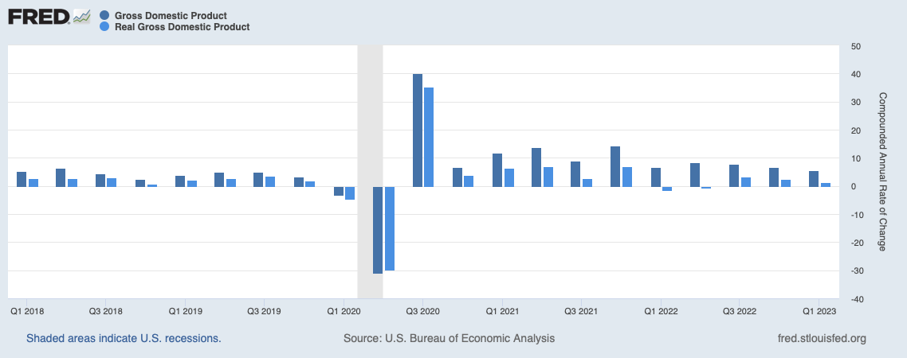
The United States economy was flying
Federal Reserve began raising rates,
March 2022
Source: FRED
Notes:
Source: U.S. Bureau of Economic Analysis, Gross Domestic Product [GDP], Real Gross Domestic Product [GDPC1], retrieved from FRED, Federal Reserve Bank of St. Louis; https://fred.stlouisfed.org/series/GDP, June 5, 2023.
Pandemic stimulus had put money in the pockets of people and businesses, and they were ready to spend it. Since consumer spending is the economic fuel that powers the U.S. economy, the economy soared. It wasn’t a smooth flight. The world wasn’t producing enough goods to meet high demand and prices began to rise. Here you see economic growth measured using gross domestic product, which is the value of all goods and services produced each quarter. GDP is the dark blue line. Real GDP, which is economic growth after inflation, is the light blue line. The dark blue line shows the economy rebounded and then continued to grow after the pandemic. The light blue line shows how inflation affected economic growth. In 2022, the economy contracted after inflation was factored in. That spurred the Federal Reserve to take action. In March of 2022, the Fed began aggressively raising the federal funds rate to slow overall economic growth and bring inflation down. As this shows, economic growth has slowly been losing altitude, indicating the economy may be ready for landing.

Slide 17
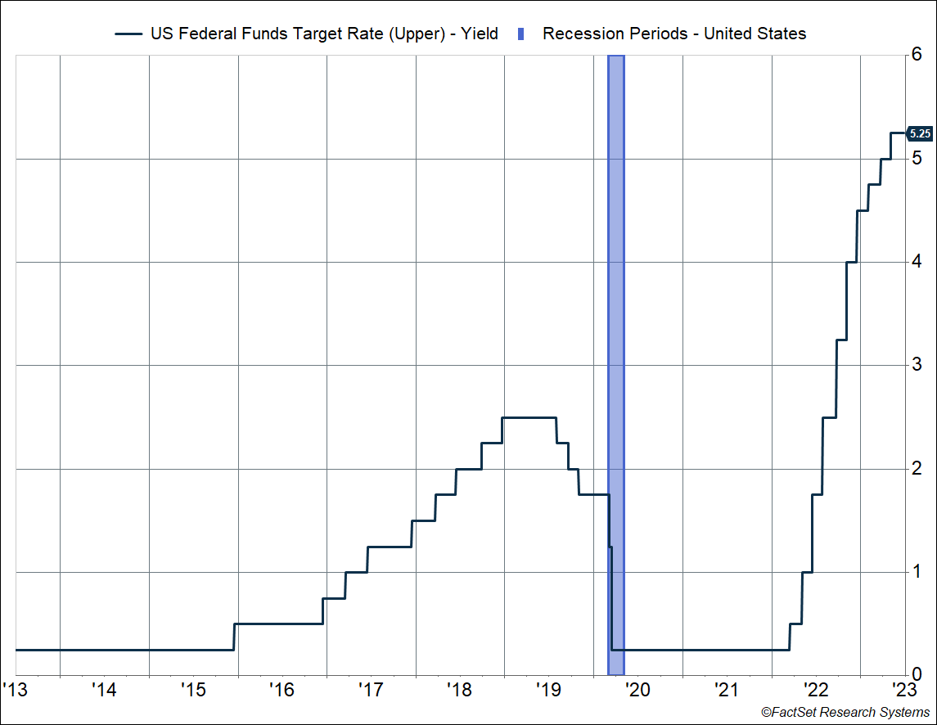
The Federal Reserve raised rates
10 rate hikes in 14 months
From 0.00% to 0.25% in 2022
To 5.00% to 5.25% in 2023
Source: Carson Research and FactSet Research Systems
Notes:
Source: Carson Investment Research, FactSet Research Systems
https://www.newyorkfed.org/markets/reference-rates/effr
The Fed guided the U.S. economy to its current state primarily using the blunt instrument of interest rate changes. Since March of last year, it has raised rates 10 times as it worked to bring inflation down. Currently, the federal funds rate is 5.00 percent to 5.25 percent.

Slide 18
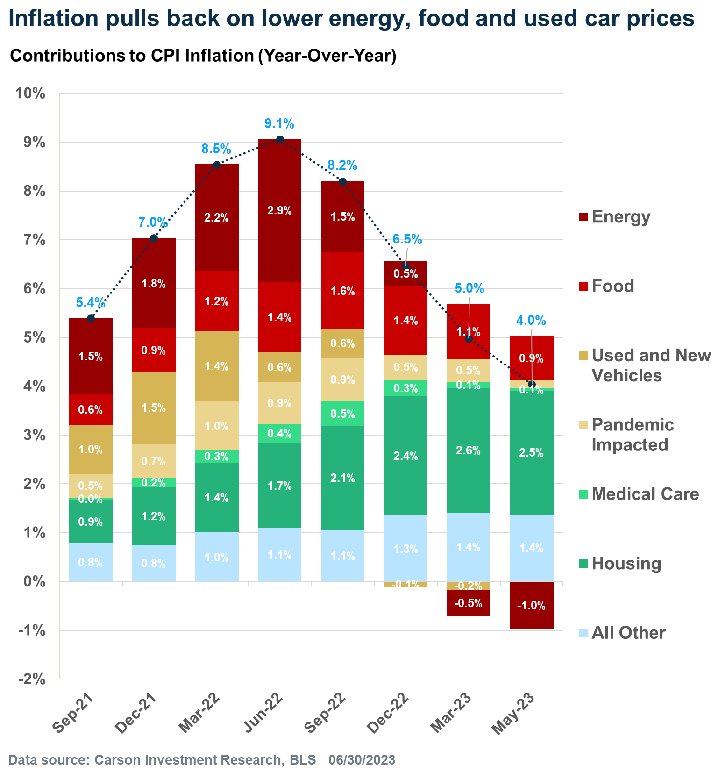
Pandemic-impacted categories include car and truck rentals, furnishings and supplies, apparel, airline fares, lodging away from home including hotels and motels. Housing includes rent of primary residence and owners' equivalent rent. Medical care includes medical care commodities and services.
Notes:
Source: Carson Investment Research, Bureau of Labor Statistics
The aggressive hikes have helped quell inflation. Here you see inflation since the pandemic ended. The headline inflation rate – in blue – peaked in June of last year and headed lower.

Slide 19
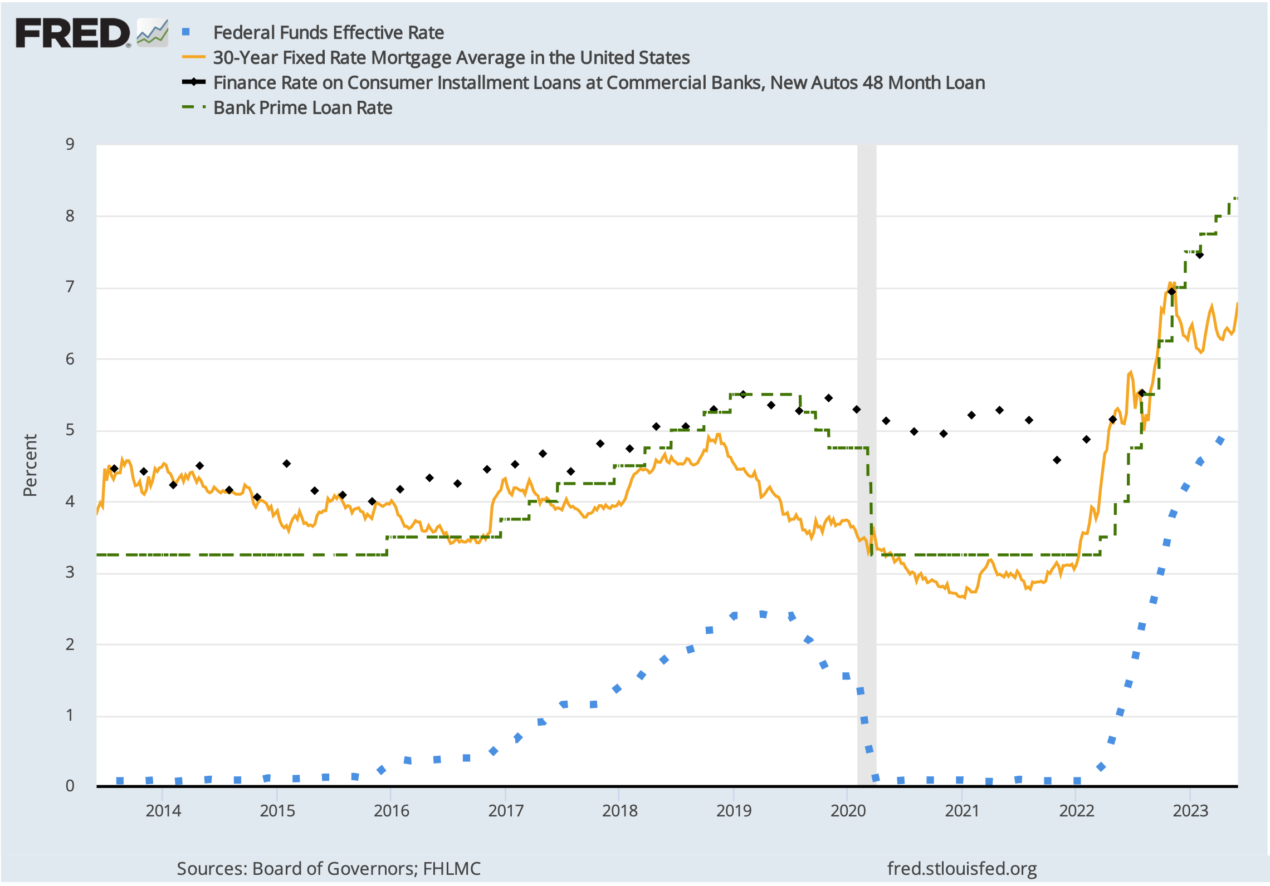
Rate hikes are not
precision instruments
Source: FRED, as of 7/3/2023
Notes:
Photo source:
https://www.gettyimages.com/detail/photo/wright-brothers-royalty-free-image/458134215?phrase=the+wright+brothers&adppopup=true
Sources: https://www.stlouisfed.org/en/on-the-economy/2017/october/increases-fed-funds-rate-impact-other-interest-rates
Board of Governors of the Federal Reserve System (US), Federal Funds Effective Rate [FEDFUNDS], retrieved from FRED, Federal Reserve Bank of St. Louis; https://fred.stlouisfed.org/series/FEDFUNDS, July 3, 2023.
While prices are rising more slowly, rate hikes are not precision instruments. The Federal Reserve's tools are a bit like the Wright brothers rudimentary flight controls. When the Fed raises the federal funds rate, other rates tend to move higher. The federal funds rate is the dotted blue line on this chart. As it rose, the rates on 30-year fixed mortgages, auto loans, and business and personal loans increased, too. Typically, when rates rise, demand for goods and services falls because borrowing becomes more expensive—and that slows economic growth, which is the Fed's goal.

Slide 20
… the whole reason the Fed hikes rates is to slow a booming economy and prevent overheating. Against this prosperous backdrop while the Fed is hiking, businesses and consumers tend to feel confident spending. Ultimately though, the tighter financial conditions slowly trickle into business decision-making and household spending, which often precipitates the pause in hiking.
– Justin Christofel and Michael Fredericks, BlackRock December 14, 2022
Notes:
Photo source: https://www.gettyimages.com/detail/photo/funny-dog-with-orange-glasses-royalty-free-image/1263850669?adppopup=true
Source: https://www.blackrock.com/us/individual/insights/fed-pivot
Justin Christofel and Michael Fredericks of BlackRock explained, “…the whole reason the Fed hikes rates is to slow a booming economy and prevent overheating. Against this prosperous backdrop while the Fed is hiking, businesses and consumers tend to feel confident spending. Ultimately though, the tighter financial conditions slowly trickle into business decision-making and household spending, which often precipitates the pause in hiking.”
Their point is that rate hikes are blunt tools that don’t have an immediate effect. It typically takes 12 to 18 months for higher rates to affect consumer spending and slow the economy.

Slide 21
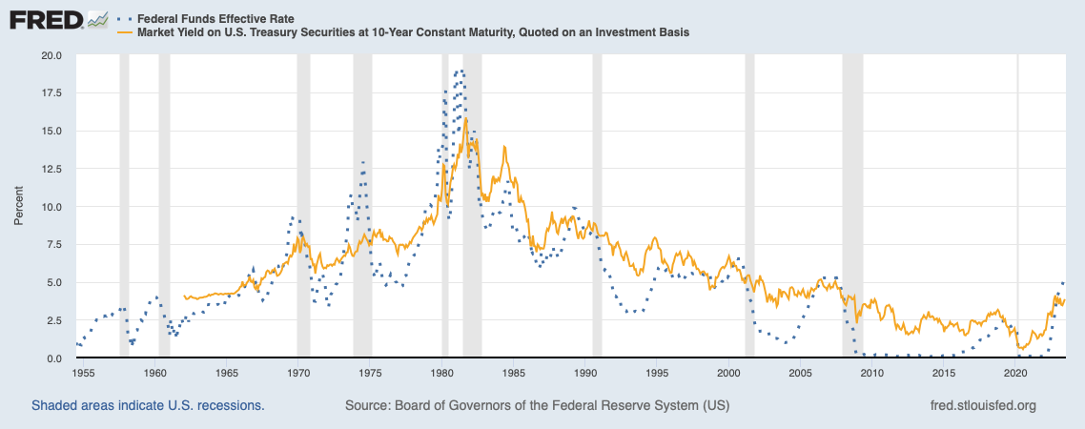
The bond market does not always move in tandem with the Fed
Source: FRED, as of 7/3/2023
Notes:
Source: Board of Governors of the Federal Reserve System (US), Federal Funds Effective Rate [FEDFUNDS], retrieved from FRED, Federal Reserve Bank of St. Louis; https://fred.stlouisfed.org/series/FEDFUNDS, July 3, 2023. Board of Governors of the Federal Reserve System (US), Market Yield on U.S. Treasury Securities at 10-Year Constant Maturity, Quoted on an Investment Basis [DGS10], retrieved from FRED, Federal Reserve Bank of St. Louis; https://fred.stlouisfed.org/series/DGS10, July 3, 2023.
Rapid Federal Reserve rate hikes also affect bond yields. The chart shows the federal funds rate in blue and the yield on the benchmark 10-year U.S. Treasury in orange. We experienced a multi-decade bull market in bonds. In July 2020, the 10-year Treasury yielded less than one percent. Today, it yields more than 4 percent. It’s notable that, in recent months, Treasury rates have not been moving in tandem with the federal funds rate. This suggests that the bond market thought inflation had peaked, economic growth was slowing, and the Fed's rate hiking cycle was near an end.

Slide 22
Giving the Federal Reserve reason to pause
Three U.S. banks collapsed
Federal Reserve and U.S. Treasury acted quickly to support banks and provide market liquidity
Bank lending standards tightened, making loans more expensive and harder to get
Notes:
Image: https://www.gettyimages.com/detail/photo/bank-collapse-background-royalty-free-image/1473486720?phrase=bank+collapse&adppopup=true
Source: https://www.bloomberg.com/news/articles/2023-03-29/svb-collapse-shows-us-treasuries-aren-t-a-risk-free-asset
https://www.npr.org/2023/04/09/1168746307/credit-crackdown-weighs-on-businesses
The idea that the Fed is ready to pause rate hikes was reinforced by the March banking crisis. The rapid rise in the Fed funds rate and the corresponding rise in Treasury rates contributed to the banking crisis. Earlier this year, four U.S. banks ran into trouble, and a Swiss bank was taken over by another bank. Some of the banks held longer-maturity Treasuries that were purchased when rates were ultra low. Do you know what happens to the value of a bond when rates rise? [Wait for answers] The value of the bond falls. If you hold to maturity, you can expect to receive a return of principal. But one of the U.S. banks had to sell the bonds before maturity to raise cash to pay depositors, this concerned depositors, and there was a run on the bank. The Federal Reserve and U.S. Treasury acted quickly to support banks and provide market liquidity; however, bank lending standards tightened, making loans more expensive and harder to get. This should cool business spending and help slow economic growth, moving us closer to an economic landing.

Slide 23
How will the economy land?
Soft Landing
Hard Landing
Economic growth slows then picks up
Inflation drops
No recession, economic growth may be steady or pick up
Fed holds steady or lowers rates
Economic growth contracts
Inflation drops
Recession
Fed lowers rates
Notes:
Image: https://www.gettyimages.com/detail/photo/small-airplane-wheel-on-the-airport-runway-royalty-free-image/879264490?phrase=Airplane+landing&adppopup=true
Source: https://www.investopedia.com/terms/s/softlanding.asp
https://finance.yahoo.com/news/heres-why-investors-far-too-024424431.html
https://www.reuters.com/markets/europe/hopes-economic-soft-landing-re-emerge-after-stormy-descent-2023-06-02/
If there is a soft landing, economic growth will slow, and inflation will drop. There is no recession, and the Fed holds rates steady. It may, eventually, lower rates to support stronger economic growth. If there is a hard landing, the economy will contract and there will be a recession and prices may fall. Typically, the Federal Reserve lowers rates during a recession to encourage economic growth.

Slide 24
Is the economy ready to land?
Economic data is mixed. The labor market remains resilient.
No change
April to May 2023
3.6%
June 2023
Faster
May to June 2023
Fewer
May to June 2023
Unemployment as of July 7, 2023
Wage growth
as of July 7, 2023
New jobs
As of July 7, 2023
Layoffs/Quits
As of July 6, 2023
Source: U.S. Bureau of Labor Statistics
Notes:
Sources: https://www.bls.gov/news.release/empsit.nr0.htm
https://www.bls.gov/news.release/jolts.nr0.htm
https://www.spglobal.com/marketintelligence/en/news-insights/latest-news-headlines/employers-hoard-labor-as-economy-weakens-boosting-odds-of-a-job-loss-wave-75601612
It’s possible the U.S. economy isn’t ready to land yet. Throughout the year, economic data has been mixed . While it appears that inflation peaked in the United States, the strength of economic data, and comments from Fed officials, suggest that getting to the Fed’s target may require rates to remain higher for longer. The labor market has shown remarkable resilience with unemployment at 3.6 percent in June. Wage growth – which contributes to inflation – slowed in May before rising in June. The number of jobs available declined in May and the number of layoffs, quits, and separations remained unchanged from April to May. There is some evidence employers are hoarding employees because they cannot find enough workers.

Slide 25
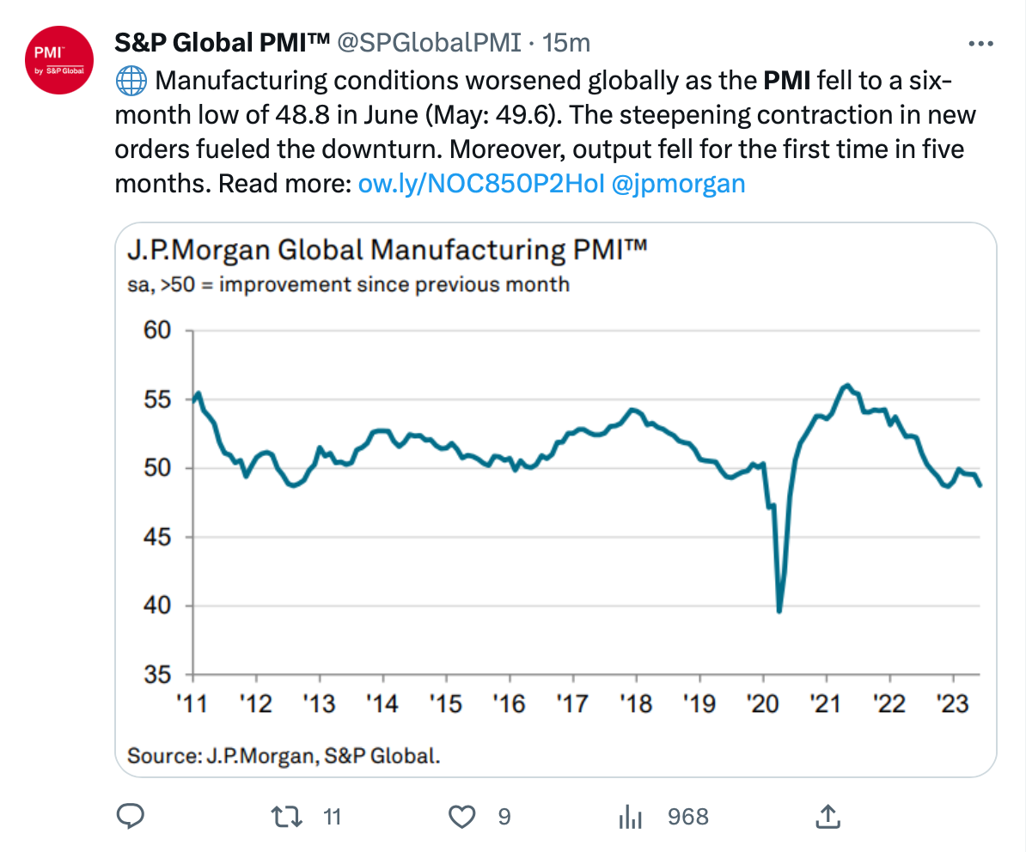
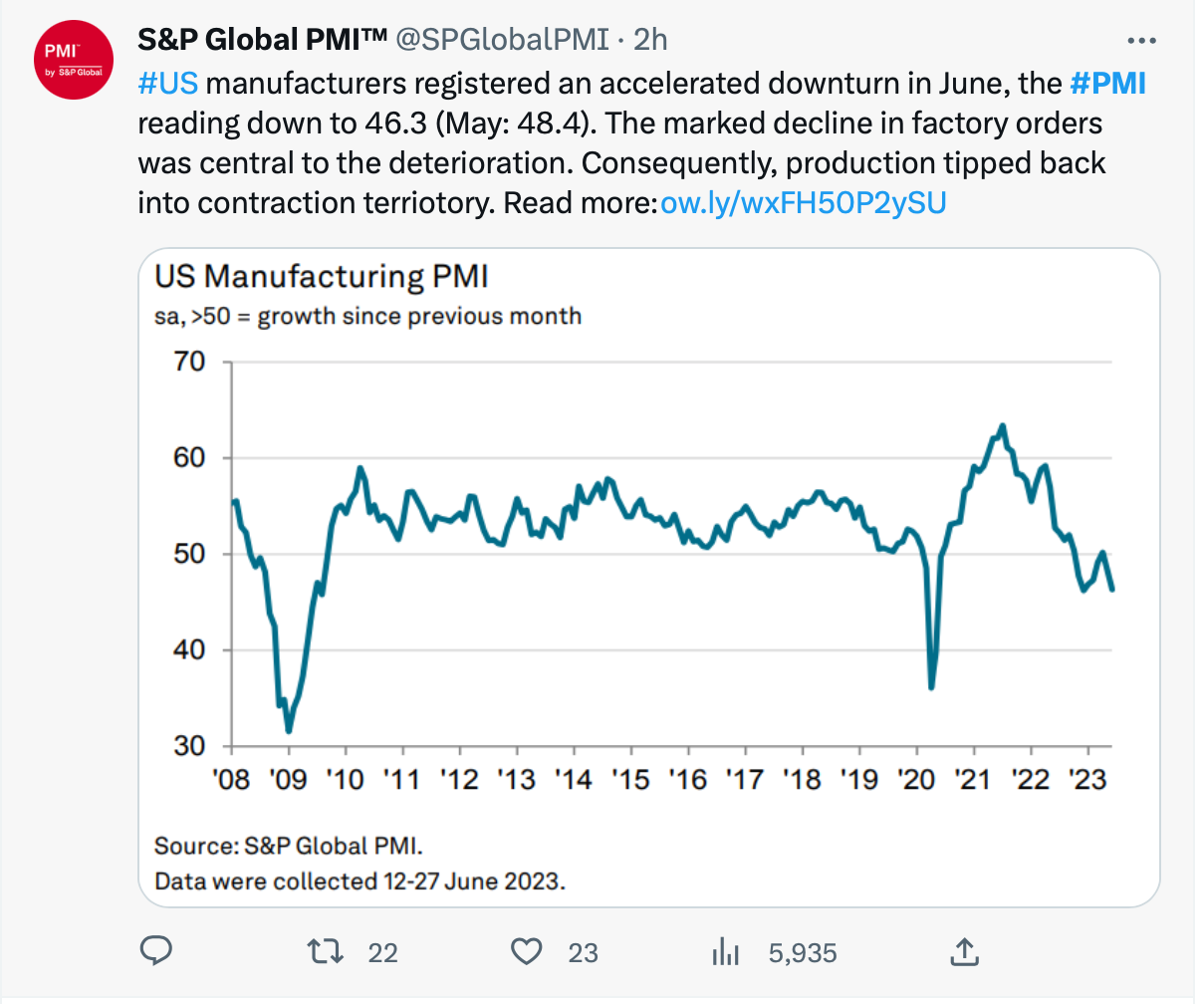
Global and U.S. manufacturing have been contracting
Notes:
Source: https://twitter.com/SPGlobalPMI/status/1675895924894101504
https://www.pmi.spglobal.com/Public/Home/PressRelease/347746d7505243f8b84ca01657a4410a
Labor signals are mixed and so are the messages from the S&P Global Purchasing Managers' Indices. The indices measure month-over-month change in economic activity. The June report showed manufacturing conditions contracted, globally and in the United States. In a Tweet, S&P Global reported, “Manufacturing conditions worsened globally as the PMI fell to a six-month low of 48.8 in June. The steepening contraction in new orders fueled the downturn. Moreover, output fell for the first time in five months.” In the United States, declining factory orders were instrumental to the decline in manufacturing.

Slide 26
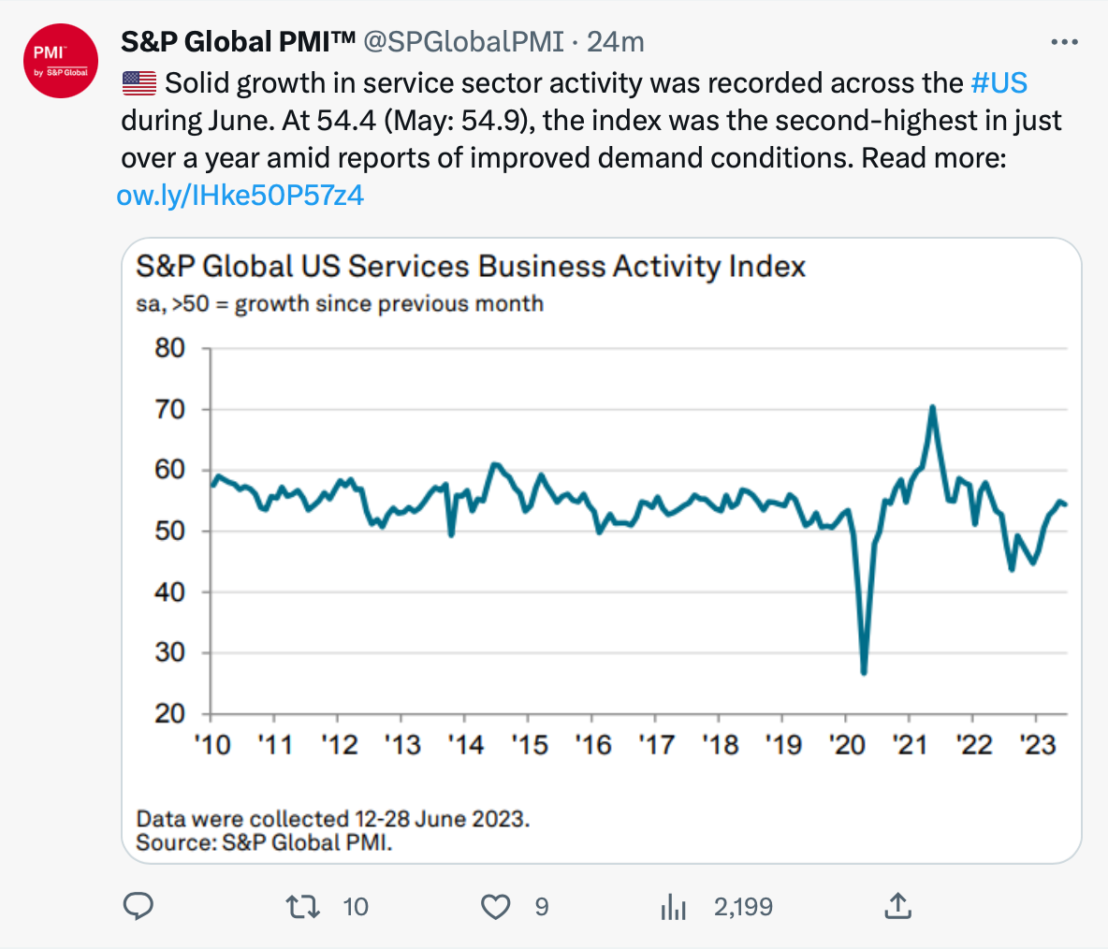
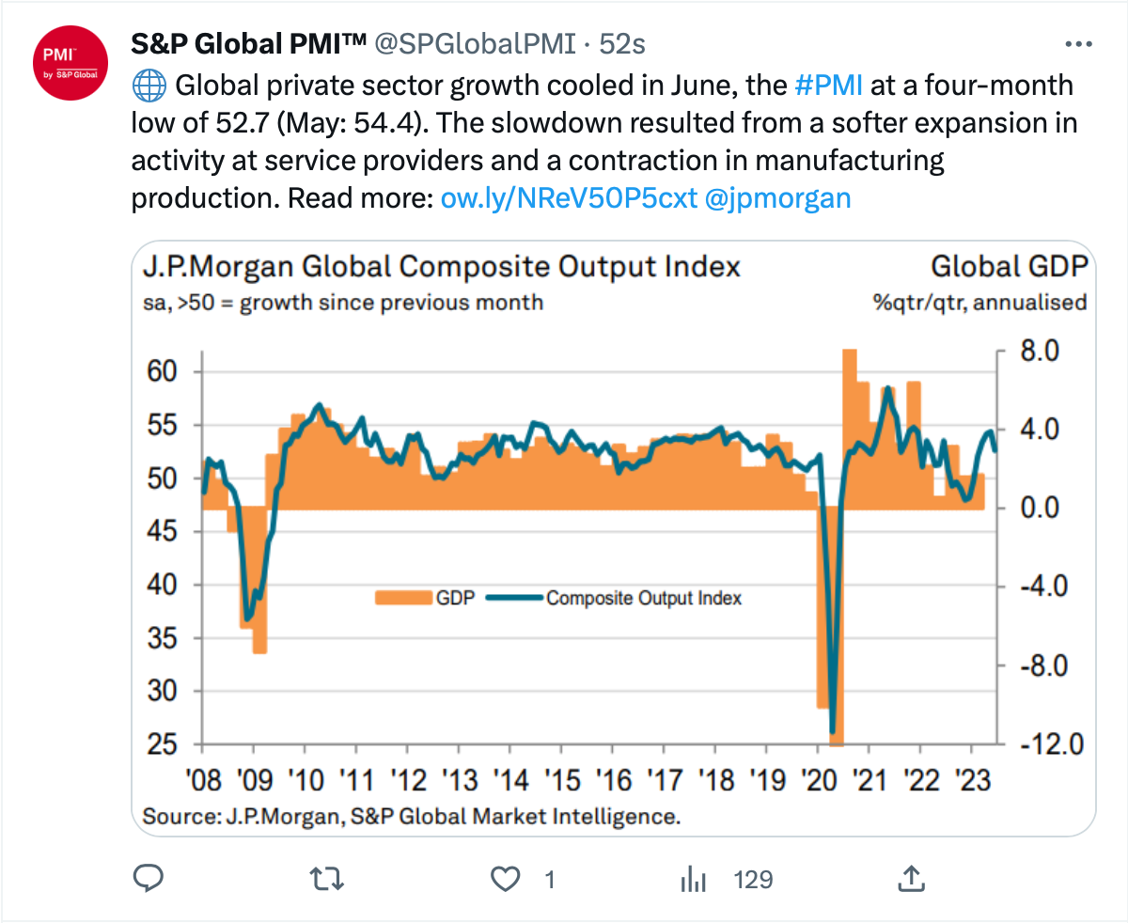
Global and U.S. services have been expanding
Notes:
Source: https://twitter.com/SPGlobalPMI?ref_src=twsrc%5Etfw%7Ctwcamp%5Eembeddedtimeline%7Ctwterm%5Escreen-name%3ASPGlobalPMI%7Ctwcon%5Es1_c1
https://www.pmi.spglobal.com/Public/Home/PressRelease/aa935e0542484ce8b942d07fe9eb55e0
While manufacturing contracted in the U.S., the services sector expanded with the Index at 54.4. The U.S. services expansion was supported by strong client demand and new business gains. The J.P. Morgan Global Composite Output Index, on the right, reflects manufacturing and services combined. "Global private sector growth cooled in June, the PMI at a four-month low of 52.7. The slowdown resulted from a softer expansion in activity at services providers and a contraction in manufacturing production."

Slide 27
The nascent recovery in the housing market comes sooner than expected, given that mortgage rates more than doubled in the past year and a half...homeowners who locked in record-low rates amid the pandemic are now reluctant to sell. And that is squeezing the nation’s supply of single-family homes at the same time that a wave of millennial first-time home buyers—buoyed by strong wage growth and healthy household savings—are looking to put down roots.
– Megan Cassella, Barron's
July 3, 2023
Notes:
Photo source: https://www.gettyimages.com/photos/small-house?assettype=image&sort=mostpopular&phrase=small%20house&license=rf,rm
Source: https://usafacts.org/data-projects/housing-costs
https://www.barrons.com/articles/housing-market-interest-mortgage-rates-fed-2bd4b18a (or go to https://resources.carsongroup.com/hubfs/Carson%20Coaching%20Online/Market%20Commentary/Presentations/2023/Half-Time%202023%20Sources/27_Halftime%202023_Barrons_The%20Housing%20Market%20is%20Heating%20Up.pdf)
Another important economic indicator is housing, and the market appears to be in the early stages of recovery. In early July, Barron's reported, "The nascent recovery in the housing market comes sooner than expected, given that mortgage rates more than doubled in the past year and a half...homeowners who locked in record-low rates amid the pandemic are now reluctant to sell. And that is squeezing the nation’s supply of single-family homes at the same time that a wave of millennial first-time home buyers—buoyed by strong wage growth and healthy household savings—are looking to put down roots."

Slide 28
Holding pattern: Stagflation
Slow economic growth
Inflation above target
Steady consumer demand
Rates stay high or move higher
Notes:
Photo source: https://www.gettyimages.com/detail/photo/man-upset-sad-and-angry-at-the-airport-his-flight-royalty-free-image/821828904?phrase=traveler%2Bat%2Bthe%2Bairport%2Bfrustrated
If the economy isn’t ready to land, we may see a period of slow economic growth and higher-than-desired inflation. One name for this type of economic holding pattern is stagflation. Typically, it features slow economic growth, inflation above the Fed’s target, steady consumer demand, and continued Fed rate hikes. Eventually, rate hikes should dampen consumer demand. Higher for longer rates are also likely to affect investor sentiment and financial markets.

Slide 29
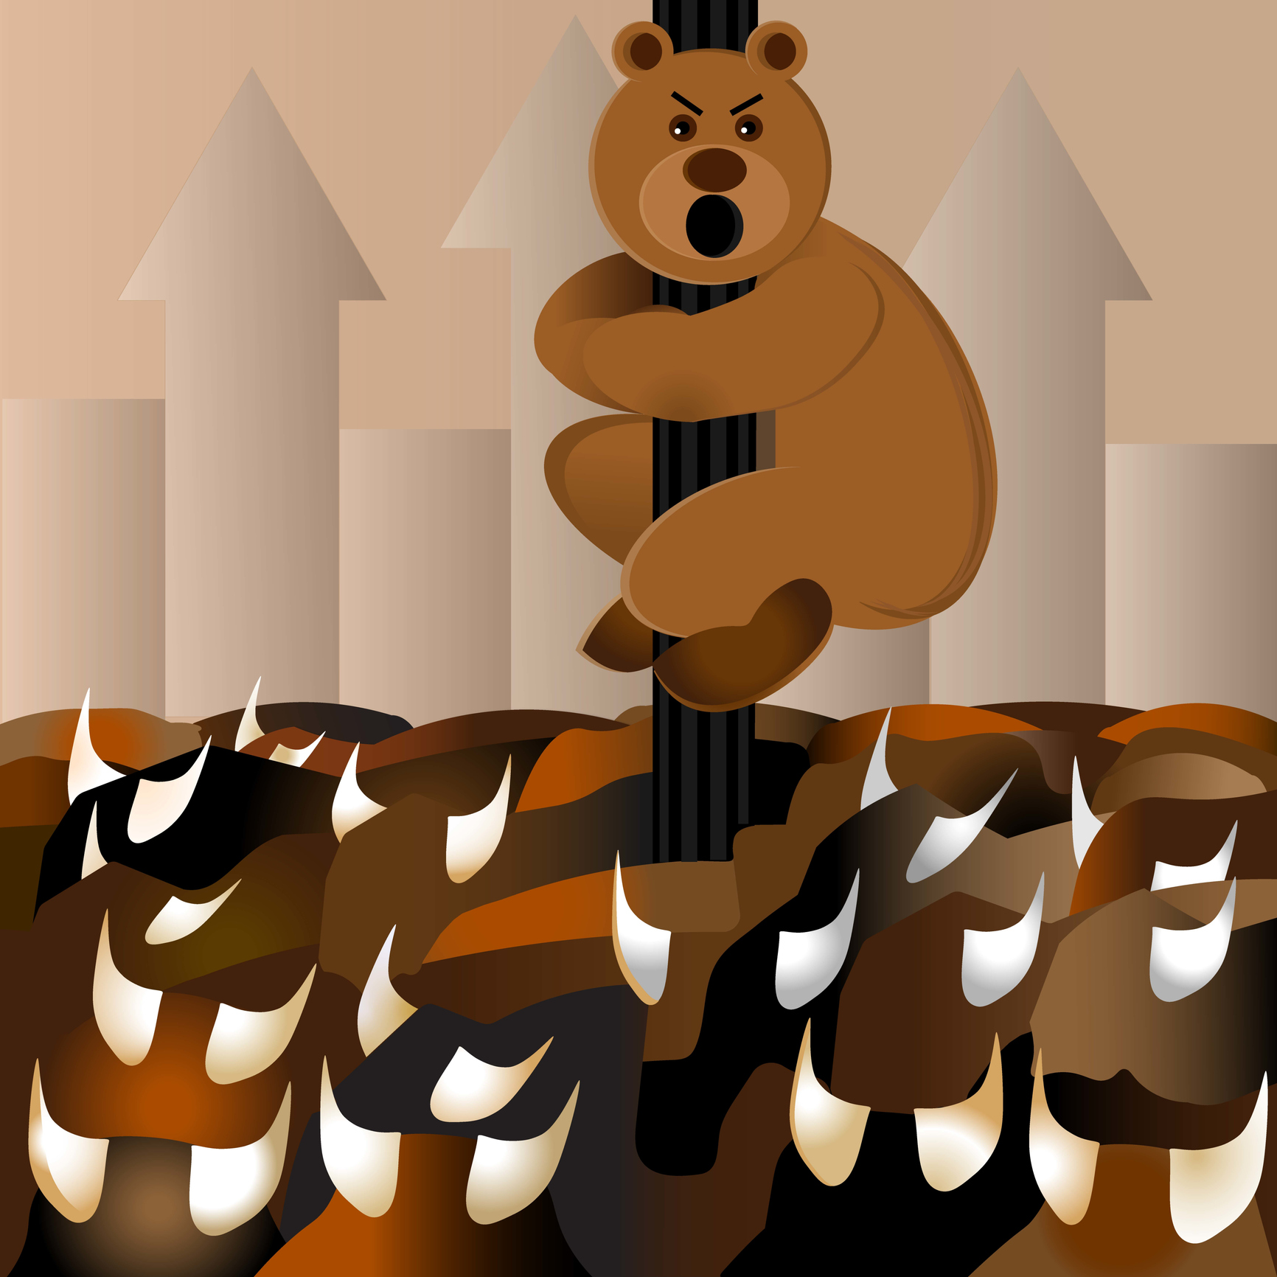
Financial Markets
Notes:
Photo source: https://www.gettyimages.com/detail/illustration/bear-holds-onto-a-pole-during-a-bull-run-bar-royalty-free-illustration/1208474154?phrase=bears+around+bulls&adppopup=true
Any questions about the economy? Then, let’s talk about financial markets. 2023 has been a good year for investors. The bulls have been running – although many bearish investors still believe that a recession is likely to be ahead.

Slide 30
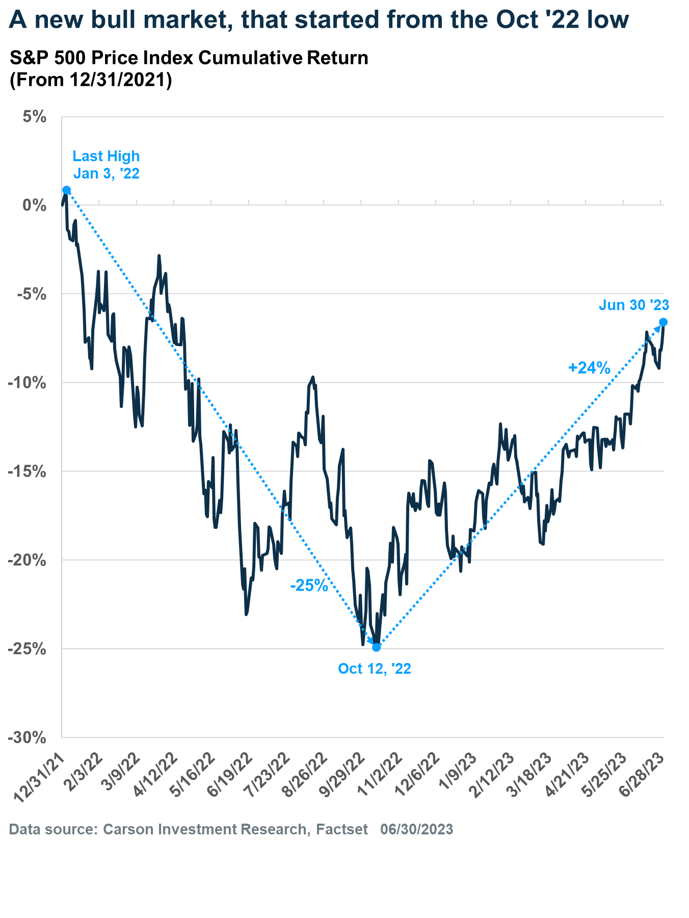
New bull market for the S&P 500 Index
Up 20% from the previous low
Notes:
Source: Carson Research
The Standard & Poor’s 500 Index entered a bull market in June as investors climbed the wall of worry. The “wall of worry” is an obstacle – or set of obstacles – that investors face. This year, the wall reached a considerable height as inflation, the war in Ukraine, U.S.-China tensions, slower earnings growth, the high cost of residential real estate, low demand for commercial real estate, tightening credit conditions, and other issues weighed on investor confidence and consumer sentiment. But the wall is not as tall as it once was. The banking crisis calmed. Debt-ceiling negotiations proved fruitful. The Federal Reserve may pause rate hikes. That was enough to boost investor optimism and cause a rally that lifted the S&P 500 Index 20 percent from its October 2022 low.

Slide 31
Notes:
Source: Carson commentary, June 12, 2023
The good news is once stocks are up 20 percent off the lows, research shows that continued strength is quite normal. In fact, since 1956 the S&P 500 has been higher 12 times and up a very impressive 17.7 percent on average one year after a 20 percent bounce. The only time stocks were down was during the vicious early 2000s tech bubble bear market. Taking it one step further, new lows were made after the market rose 20 percent only three times, while the lows held 10 times. Research found two occasions, both during the tech bubble, when stocks gained 20 percent and again moved to new lows, and it also happened during the global financial crisis of 2007-2009. Fortunately, conditions are not at all similar now to those very bleak times.

Slide 32
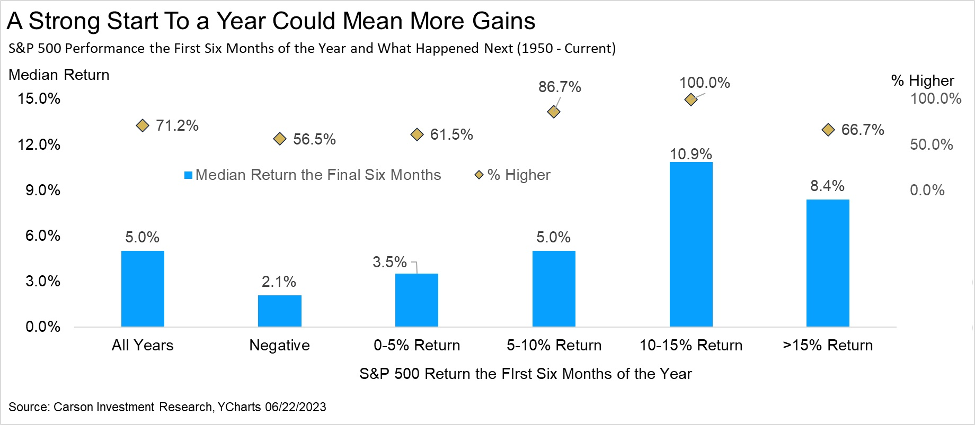
Notes:
Source: Carson commentary, June 22, 2023
Historically, when the stock market gets off to a good start, it tends to have a pretty good year. Since 1950, the S&P 500’s median return – the blue bar – for the final six months of the year has been 5.0 percent. The right-hand side horizontal axis shows the return for the S&P 500 during the first six months of the year (0-5 percent/5-10 percent/10-15 percent/and more than 15 percent). When stocks have risen 10-15 percent by the end of June, the final six months have seen markets move higher 12 out of 12 times, and they gained close to 11 percent. When they have risen more than 15 percent, they have moved higher 66.7 percent of the time.

Slide 33
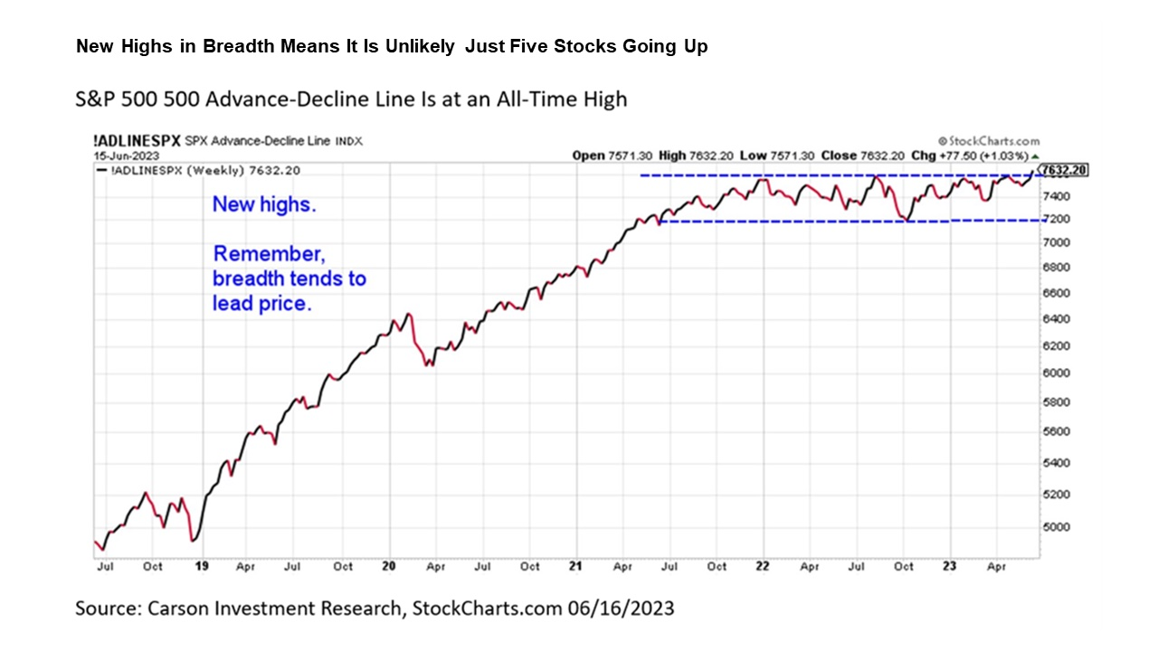
A few stocks
led the
charge and
then the rally
broadened
Notes:
Source: https://www.carsongroup.com/insights/blog/why-stocks-could-make-a-new-high-in-2023/
There was tremendous uncertainty around the S&P 500 Index's June rally. Early on, gains were driven by a handful of stocks in a few sectors while the majority of stocks in the Index lagged. The performance gap had some investors questioning whether the market was less resilient than it appeared to be. Others thought it was just a matter of time before gains became more widespread, as they were in markets outside the United States. Then, the S&P 500 Advance-Decline line closed at a new all-time high, a bullish signal that the trend higher is indeed higher. The advance-decline line is a cumulative daily tally of all the stocks that go up versus those that go down each day. When it makes a new high, it is a sign that overall market breadth– the number of stocks gaining during a rally – is quite strong. In general, breadth tends to lead price. At major market peaks, we tend to see stocks make new highs, while breadth weakens. Today, we see breadth making hew highs and price hasn’t yet. The key word being yet. Price will eventually make new highs, along with breadth, just as it has done many times throughout history, and there’s a good chance it’ll happen this year.

Slide 34
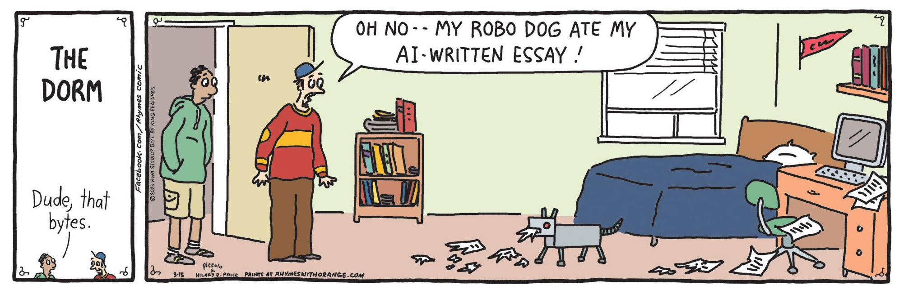
Source: CartoonStock.com
Notes:
Cartoon source: https://www.cartoonstock.com/search?type=images&keyword=artificial+intelligence&page=3&sort=latest_uploads&expanded=KF101412
Paid – June 13, 2023
Another driver of market performance has been investors’ enthusiasm for artificial intelligence and its many applications. [Read through the cartoon]

Slide 35
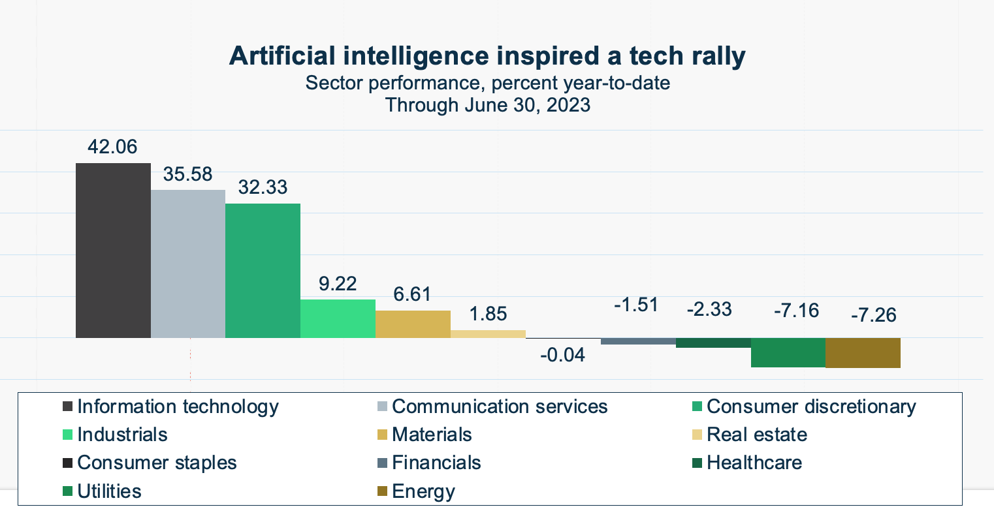
Source: Fidelity
Notes:
Source: https://eresearch.fidelity.com/eresearch/markets_sectors/sectors/si_performance.jhtml?tab=siperformance
https://markets.businessinsider.com/news/stocks/artificial-intelligence-ai-investing-bull-market-meltup-yardeni-tech-stocks-2023-6
https://www.investopedia.com/terms/m/melt-up.asp#:~:text=A%20melt%2Dup%20is%20a,fundamental%20improvements%20in%20the%20economy.
Many expect artificial intelligence to profoundly change the way global businesses operate. We have seen a rally in information technology and communication services sectors this year. However, AI is expected to affect industries and companies far more broadly. When a new technology arrives like this, it can disrupt the world as we know it and lead to melt-ups in markets. A melt-up happens when markets rise unexpectedly due to investor enthusiasm for the innovation. Excitement about AI was apparent when companies reported first quarter earnings, too. A higher number of companies mentioned AI or generative AI than ever have before.

Slide 36
First quarter earnings declined, but overall earnings were better than expected
Earnings declined 2.0% in Q1 2023
78% of S&P 500 companies reported better-than-expected earnings per share for the first quarter
8 of 11 sectors saw year-over-year revenue growth (the exceptions were IT, energy and materials)
11.5% was the blended net profit margin for companies in the S&P 500 Index
Source: FactSet
Notes:
Photo source: https://www.gettyimages.com/detail/photo/digital-stock-chart-royalty-free-image/157483233?phrase=company+profits&adppopup=true
Source: https://advantage.factset.com/hubfs/Website/Resources%20Section/Research%20Desk/Earnings%20Insight/EarningsInsight_052623.pdf
https://advantage.factset.com/hubfs/Website/Resources%20Section/Research%20Desk/Earnings%20Insight/EarningsInsight_060923.pdf
First quarter earnings season was better than expected. While earnings for companies in the Standard & Poor’s 500 Index declined overall, they did better than analysts expected. Seventy-eight percent of companies in the S&P 500 reported better-than-expected earnings. That number was higher than the 10-year average, and so was the magnitude of the earnings surprise. Eight of 11 sectors experienced year-over-year revenue growth and three saw revenue decline (IT, energy and materials). The blended net profit margin for the first quarter for the S&P 500 was 11.5%. That was higher than the previous quarter’s net profit margin, which was 11.3 percent, and below the last year’s first quarter net profit margin of 12.2 percent.

Slide 37
Jerome Powell
Notes:
Photo source: Public domain image: https://commons.wikimedia.org/wiki/File:Jerome_H._Powell.jpg
Source: https://www.marketwatch.com/story/theres-a-disconnect-between-stock-market-rally-and-fed-pivot-expectations-eccf1237
One factor that has greatly influenced stock market performance is the expectation that the Fed will pivot – meaning that it will stop raising rates and begin to lower them. Many investors seem to believe that a pause in rate hikes, or a reversal in Fed policy, will boost corporate profits. The thinking goes something like this: Higher rates usually hurt corporate profits because borrowing becomes more expensive, and companies often choose to spend less. This limits growth and profitability so, if rate hikes stop or rates decline, then corporate profits will get a boost and stocks will gain. Since investors look ahead, current stock market levels reflect investors expectation of a Fed pivot. However, Federal Reserve officials have been quite clear that they anticipate more rate hikes in 2023.

Slide 38
The Fed seems a little bit more realistic than the markets do on what it’s going to take…To get an equity rally from here, you have to have lower rates fairly quickly into a world where earnings are pretty good…
– Greg Jensen, Co-chief Investment Officer, Bridgewater
Bloomberg Odd Lots, July 3, 2023
Notes:
Photo source: https://www.gettyimages.com/photos/bunny-face?assettype=image&sort=mostpopular&phrase=bunny%20face&license=rf%2Crm
Source:https://www.bloomberg.com/news/articles/2023-07-03/bridgewater-co-cio-greg-jensen-sees-bad-outlook-for-bonds-and-stocks
As Greg Jensen of Bridgewater told Bloomberg, "The Fed seems a little bit more realistic than the markets do on what it’s going to take…To get an equity rally from here, you have to have lower rates fairly quickly into a world where earnings are pretty good…"

Slide 39
The money supply is contracting
M1: cash, coins, deposits, and anything that can be spent right now
M2: M1+ savings accounts, money markets, CDs
Source: U.S. Federal Reserve
Notes:
Sources: https://www.barrons.com/articles/m2-money-supply-fed-inflation-262c7234
https://www.fool.com/investing/2023/06/04/money-supply-since-great-depression-big-for-stocks/
https://twitter.com/nickgerli1/status/1633536085308366866?ref_src=twsrc%5Etfw%7Ctwcamp%5Etweetembed%7Ctwterm%5E1633536085308366866%7Ctwgr%5E7234a550257d5f8d38350e68f3e452b004a45c0e%7Ctwcon%5Es1_&ref_url=https%3A%2F%2F
https://www.federalreserve.gov/releases/h6/current/default.htm
The Federal Reserve has also been engaged in quantitative tightening, which is shrinking the money supply in the United States. The U.S. money supply is measured in two ways. M1 includes cash, coins and checking accounts – pretty much anything that can be spent right now. M2 is M1 plus savings accounts, money market funds, and certificates of deposit. I'm going to share a really ugly piece of data. This Tweet is from Nick Gerli of Reventure Consulting. He points out that the U.S. money supply has shrunk by two percent. That's a pretty rare occurrence. Since 1870, the M2 has declined by 2 percent year-over-year on five occasions. Four times between 1870 and 1933, and today. The prior events led to three depressions and a bank panic.
While that could be cause for concern, it may not be. The reason is pretty straightforward. The money supply was supercharged during the pandemic years by stimulus and other financially supportive programs. It grew by 267 percent in a single year in the biggest expansion of M2 in 153 years. In the past, contraction of the money supply was not preceded by an exceptional expansion of the money supply. In fact, it's clear that consumer spending has remained strong, despite inflation and the money supply contraction.

Slide 40
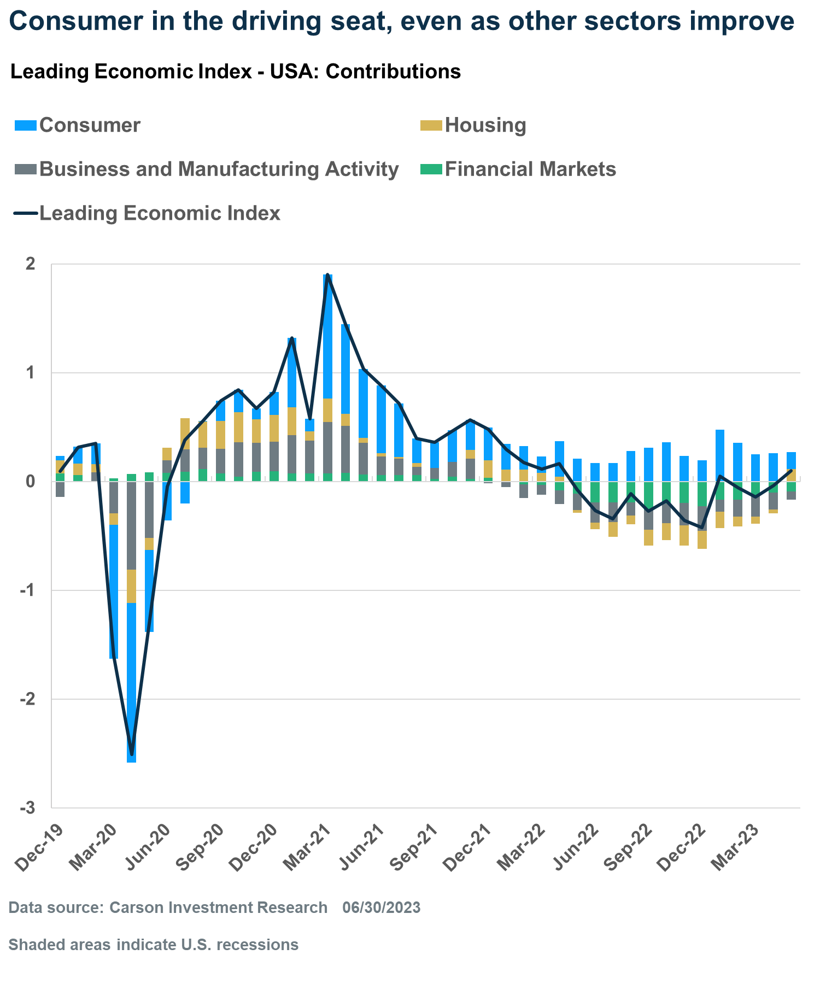
Consumer spending is strong and still fueled by stimulus money
Aggregate personal savings
Excess savings: $2.1 Trillion
Savings drawdown: $1.6 trillion
Source: Federal Reserve Bank of San Francisco, May 2023
Notes:
Source: https://www.frbsf.org/economic-research/publications/economic-letter/2023/may/rise-and-fall-of-pandemic-excess-savings/
In May, San Francisco Federal Reserve estimated that pandemic stimulus – including stimulus checks, PPP loans, and expanded unemployment benefits – helped Americans accumulate excess savings of about $2.1 trillion through August 2021. So far, Americans have spent about $1.6 trillion of those excess savings. If the drawdown continues at the recent pace, then excess savings are likely to support household spending into the fourth quarter of 2023 and possibly beyond. The chart shows economic growth over last three and a half years, including the COVID-19 pullback and subsequent recovery. Four major categories contribute to economic growth, and the primary contributor is consumer spending. It is clear that the consumer has remained strong over the past year. In fact, consumer indicators have been stronger this year than they were in late 2022.
So, we're experiencing a market rally, but people have very different opinions about its staying power.

Slide 41
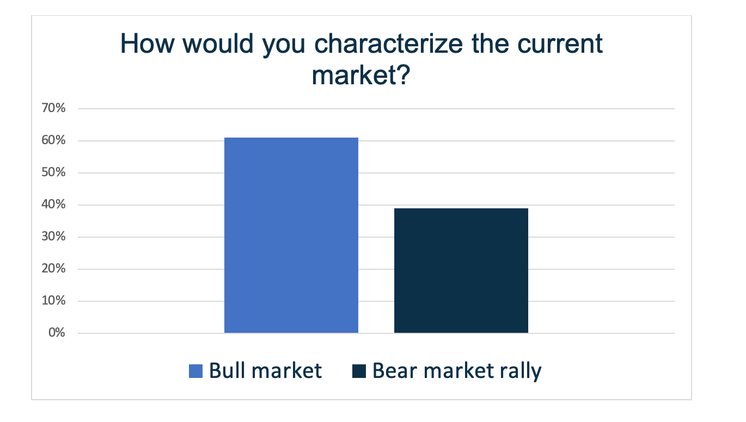
Bull market or bear market rally?
Source: CNBC survey, June 30, 2023
Notes:
Source: https://www.cnbc.com/2023/06/30/most-investors-believe-we-are-in-a-new-bull-market-and-there-will-be-no-recession-in-2023.html
In late June, CNBC polled about 400 chief investment officers, equity strategists, portfolio managers and other people who manage. The majority (61 percent) agreed this is a bull market. Almost one-third were confident we're experiencing a bear market rally. CIOs and equity strategists aren't the only ones who have opinions about the state of the economy and financial markets.

Slide 42
Sentiment can be a market indicator
University of Michigan Consumer Sentiment Index:
January 2023: 63.9
February: 67.0
March: 62.0
April: 63.5
May: 59.2
June: 63.9
AAII Investor Sentiment Survey
 | Bullish | Bearish | Neutral
January 5, 2023 | 20.5% | 42.0% | 37.5%
February 2 | 29.9 | 34.6 | 35.5
March 2 | 23.4 | 44.8 | 31.8
April 6 | 33.3 | 35.0 | 31.7
May 4 | 24.1 | 44.9 | 31.0
June 1 | 29.1 | 36.8 | 34.1
June 28 | 41.9 | 27.5 | 30.6
Historic average | 37.5 | 31.5 | 31.0
Sources: University of Michigan Consumer Sentiment Survey, AAII Investor Sentiment Survey
Notes:
Sources: http://www.sca.isr.umich.edu
https://isr.umich.edu/news-events/news-releases/consumer-sentiment-unmoved-amid-persistent-high-prices/#:~:text=April%2028%2C%202023&text=ANN%20ARBOR—Consumer%20sentiment%20was,time%20low%20from%20last%20June.
https://www.aaii.com/sentimentsurvey
https://www.barrons.com/articles/consumer-confidence-michigan-stock-market-43b6a113 (or go to https://resources.carsongroup.com/hubfs/Carson%20Coaching%20Online/Market%20Commentary/Presentations/2023/Half-Time%202023%20Sources/43_Halftime%202023_Barrons_Consumer%20Confidence%20Has%20Plunged%20That%20Could%20Be%20Good%20for%20Stocks.pdf)
Many investors look to consumer and investor sentiment for insight about where the market may be headed. The left-hand table shows consumer sentiment. It dropped quite low in May, falling to 59.2 before rising again in June. Some analysts have said that when the consumer sentiment Index drops below 59, it's a buying signal.
The right-hand table shows the AAII Investor Sentiment Survey, which many think is a contrarian indicator. Investors were bearish for most of the first six months of 2023. Then, in June, bullishness rose sharply. [Review the table.]

Slide 43
Shiller PE Ratio: The valuation of the S&P 500 Index remains lofty
Value of earnings
Historic average: 17.03
June 30, 2023: 31.1
Source: Multipl.com
Notes:
Source: https://www.multpl.com/shiller-pe (or go to https://resources.carsongroup.com/hubfs/Carson%20Coaching%20Online/Market%20Commentary/Presentations/2023/Half-Time%202023%20Sources/44_Halftime%202023_Schiller%20PE%20Ratio.pdf)
Sentiment, enthusiasm for AI, and expectations the Fed may soon pause rate hikes have all helped keep price-to-earnings (PE) ratios at lofty levels. PE ratios tell us how much investors are willing to pay for each dollar of earnings. The Schiller CAPE ratio calculates PE using average inflation-adjusted earnings from the previous 10 years. At the end of the second quarter, the Shiller PE ratio was ­­­­31.1. Its historic average is 17.03.
Any questions?
Let’s briefly review bond market performance.

Slide 44
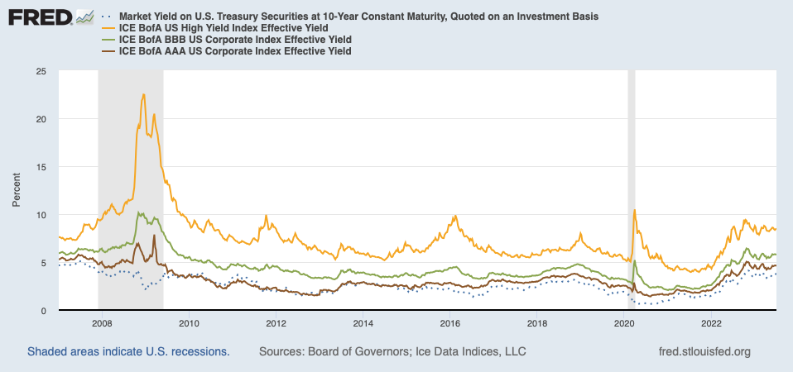
A challenging year for bond investors
Source: FRED, as of 7/3/2023
Notes:
Sources: https://www.schwab.com/learn/story/mid-year-outlook-fixed-income
Ice Data Indices, LLC, ICE BofA US High Yield Index Effective Yield [BAMLH0A0HYM2EY], ICE BofA AAA US Corporate Index Effective Yield [BAMLC0A1CAAAEY], ICE BofA BBB US Corporate Index Effective Yield [BAMLC0A4CBBBEY], retrieved from FRED, Federal Reserve Bank of St. Louis; https://fred.stlouisfed.org/series/BAMLH0A0HYM2EY, July 3, 2023.
Board of Governors of the Federal Reserve System (US), Market Yield on U.S. Treasury Securities at 10-Year Constant Maturity, Quoted on an Investment Basis [DGS10], retrieved from FRED, Federal Reserve Bank of St. Louis; https://fred.stlouisfed.org/series/DGS10, July 3, 2023.
While stock markets have delivered some attractive gains, it has been a turbulent year for bonds and a challenging year for bond investors. The Fed pushed rates higher. Then, the banking sector crisis sent rates lower as investors fled to perceived safe havens. Then, the debt ceiling standoff pushed rates higher on fears the U.S. government might default on its debt for the first time ever. It’s little surprise that volatility in the bond market, which reflects uncertainty about the direction of interest rates, was up this year. This chart shows the 10-year Treasury yield along with yields on investment grade and BBB-rated corporate bonds, and high yield bonds.

Slide 45
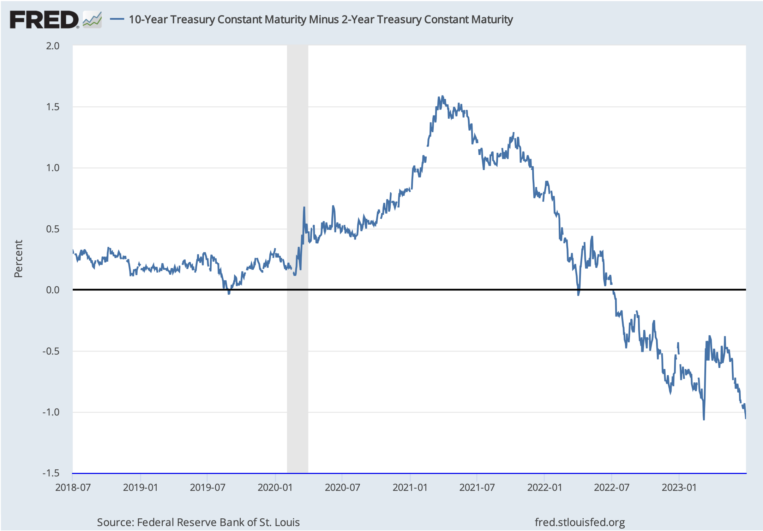
The yield curve remains inverted
Source: FRED,
as of July 3, 2023
Notes:
Source: Federal Reserve Bank of St. Louis, 10-Year Treasury Constant Maturity Minus 2-Year Treasury Constant Maturity [T10Y2Y], retrieved from FRED, Federal Reserve Bank of St. Louis; https://fred.stlouisfed.org/series/T10Y2Y, July 3, 2023.
One thing you have probably heard a lot about over the past year is the ”yield curve”. For most of this year, shorter maturity Treasuries have yielded more than longer-maturity Treasuries. It’s an unusual state of affairs because investors usually want to earn higher yields when they lend their money for longer periods. When yields on shorter-maturity Treasuries are higher than yields on longer-maturity Treasuries, we say the yield curve is inverted. This chart shows the difference in yield between 2-year U.S. Treasuries and 10-year U.S. Treasuries. In normal times, 10-year Treasuries would yield more than 2-year Treasuries and the difference (or spread) would be positive. Right now, it is negative. Yield inversions have foreshadowed previous recessions. However, the Cleveland Federal Reserve cautioned that, while “yield curves contain important information for business cycle analysis” it has not always been an accurate predictor.

Slide 46
Performance by Index, June 30, 2022 | Q2 return | YTD return
S&P 500 TR | 8.7% | 16.9%
MSCI ACWI NR USD | 6.2 | 13.9
MSCI EAFE NR USD | 3.0 | 11.7
MSCI EM NR USD | 0.9 | 4.9
Russell 2000 TR | 5.2 | 8.1
Bloomberg US Agg Bond TR | -0.8 | 2.1
Top YTD Style Box (M*): Large Growth | 12.8 | 32.6
Bottom YTD Style Box (M*): Mid Value | 2.5 | 1.2
Russell 1000 Value – Russell 1000 Growth (difference) | -8.8 | -23.9
Source: Carson Investment Research
Notes:
Source: Carson Investment Research
[Review performance]

Slide 47
What may be ahead
Notes:
Photo source: https://www.gettyimages.com/detail/photo/plane-flying-over-buildings-in-london-liverpool-royalty-free-image/1407291748?phrase=airplane%2Bbuildings%2Bfuture
Any questions? Let’s talk about what else may be ahead for markets and the economy.

Slide 48
Technology may change our lives
Immortality for sale
Digital olfaction
Super app domination
Virtual power plants
Source: CB Insights, 2023
Notes:
Photo source: https://www.gettyimages.com/photos/virtual-power-plant?assettype=image&phrase=virtual%20power%20plant&sort=mostpopular&license=rf%2Crm
Source: https://www.cbinsights.com/research-top-tech-trends (or go to https://resources.carsongroup.com/hubfs/Carson%20Coaching%20Online/Market%20Commentary/Presentations/2023/Half-Time%202023%20Sources/49_Halftime%202023_CB%20Insights_11%20Tech%20Trends%20to%20Watch.pdf)
It looks like rapid change is ahead. The top tech trends for 2023 include: Immortality for sale: Tech companies are taking advantage of more powerful AI tools and the ability to analyze and manipulate genetics with an eye toward selling longevity. The services may focus cellular processes, regenerating body parts, anti-aging supplements, and other goods and services designed to extend lifespans.
Digital olfaction: Surveys have found that scents have a powerful influence on our brains. Some tech companies are working on ways to digitally identify, re-create and transmit scents. This could help doctors identify diseases, people assess the freshness of food, and gaming companies offer immersive smell-o-vision experiences.
Super app domination: Many tech companies are developing super apps that combine online activities, such as search, e-commerce, social media, transactions and authentications, and more. The idea is that consumers will love their super apps and develop loyalty to them.
Virtual power plants: These are decentralized energy systems that cobble together diverse energy sources – residential solar panels, large-capacity batteries, wind farms, and other sources – and use a cloud-based system and AI tools to send energy where it’s needed.

Slide 49
Notes:
Source: https://www.oecd.org/newsroom/global-economic-outlook-improving-albeit-to-a-low-growth-recovery.htm
The International Monetary Fund expects economic growth to be uneven through 2023 and into 2024, differing from region to region. [Review slide.]

Slide 50
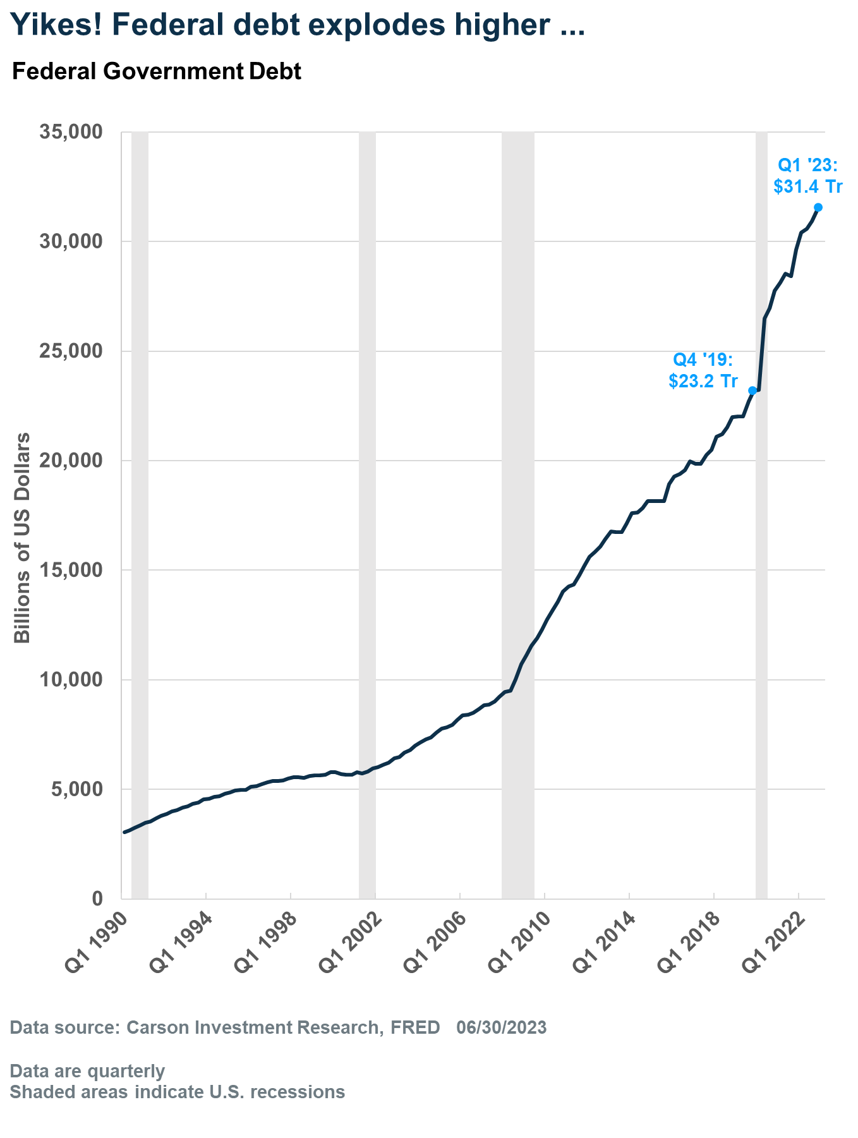
Source: Carson Investment Research, FRED, 5/24/2023
Notes:
Photo source: https://www.gettyimages.com/detail/photo/capitol-in-washington-dc-and-national-debt-text-royalty-free-image/1391625795?phrase=national+debt&adppopup=true
Source: https://fiscaldata.treasury.gov/americas-finance-guide/
In the United States, many people are concerned that the size of our national debt could affect economic growth. And the debt has been growing rapidly. From the end of 2019 through the end of 2022, U.S. government debt has increased by 35 percent to $31.4 trillion. That's an increase of $8.2 trillion!

Slide 51
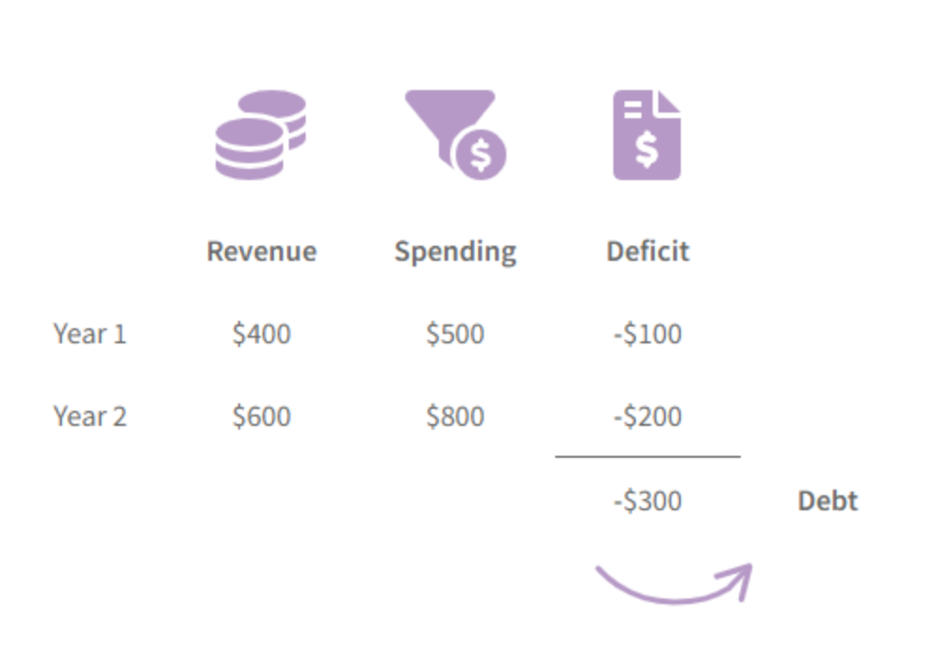
The national debt is all annual deficits (and any surpluses) added together
Source: U.S. Treasury, as of 7/3/2023
Notes:
Source: U.S. Office of Management and Budget, Federal Surplus or Deficit [-] [FYFSD], retrieved from FRED, Federal Reserve Bank of St. Louis; https://fred.stlouisfed.org/series/FYFSD, July 3, 2023.
https://fiscaldata.treasury.gov/americas-finance-guide/national-debt/
As a point of clarification, the national debt is the accumulation of all annual deficits. The U.S. government typically runs at a deficit each year, meaning it spends more than it takes in. When you add up all of the deficits (and subtract the very rare surplus) you have the national debt.

Slide 52
Source: U.S. Treasury
Notes:
Sources: https://fiscaldata.treasury.gov/americas-finance-guide/national-debt/
https://www.pewresearch.org/short-reads/2023/02/14/facts-about-the-us-national-debt/#:~:text=That%20made%20Social%20Security%2C%20for,holder%20of%20U.S.%20government%20debt.
Our national debt includes two types of borrowing. 78 percent is publicly held debt ($24.6 billion). This includes Treasury securities sold to investors at home and abroad. One of the biggest owners of public debt is the Federal Reserve system, which holds almost 20 percent of publicly held national debt, according to Pew Research. Publicly held debt has grown by 106% since 2013. 22 percent is intragovernmental debt ($6.9 trillion). The U.S. government owes this money to federal trust funds and accounts. One of the government’s biggest creditors is the Social Security system. Intragovernmental debt has grown by 40 percent since 2013.

Slide 53
Government debt declined between 2020 and 2022 in nearly 65 percent of countries, including more than 70 percent of advanced economies and 60 percent of [emerging markets and developing economies]…Strong growth and high inflation have played key roles in reducing debt-to-GDP ratios since 2020.
– M. Ayhan Kose, F. Ohnsorge, K. Stamm, N. Sugawara Brookings Institute, February 21, 2023
Notes:
Source: https://www.brookings.edu/blog/future-development/2023/02/21/government-debt-has-declined-but-dont-celebrate-yet/
It’s interesting to note that “Government debt declined between 2020 and 2022 in nearly 65 percent of countries, including more than 70 percent of advanced economies and 60 percent of [emerging market economies]…Strong growth and high inflation have played key roles in reducing debt-to-GDP ratios since 2020. Rapid growth and high inflation improve nominal incomes that are subject to taxation.’ There are two ways to adjust the debt: austerity and lower spending or more growth.

Slide 54
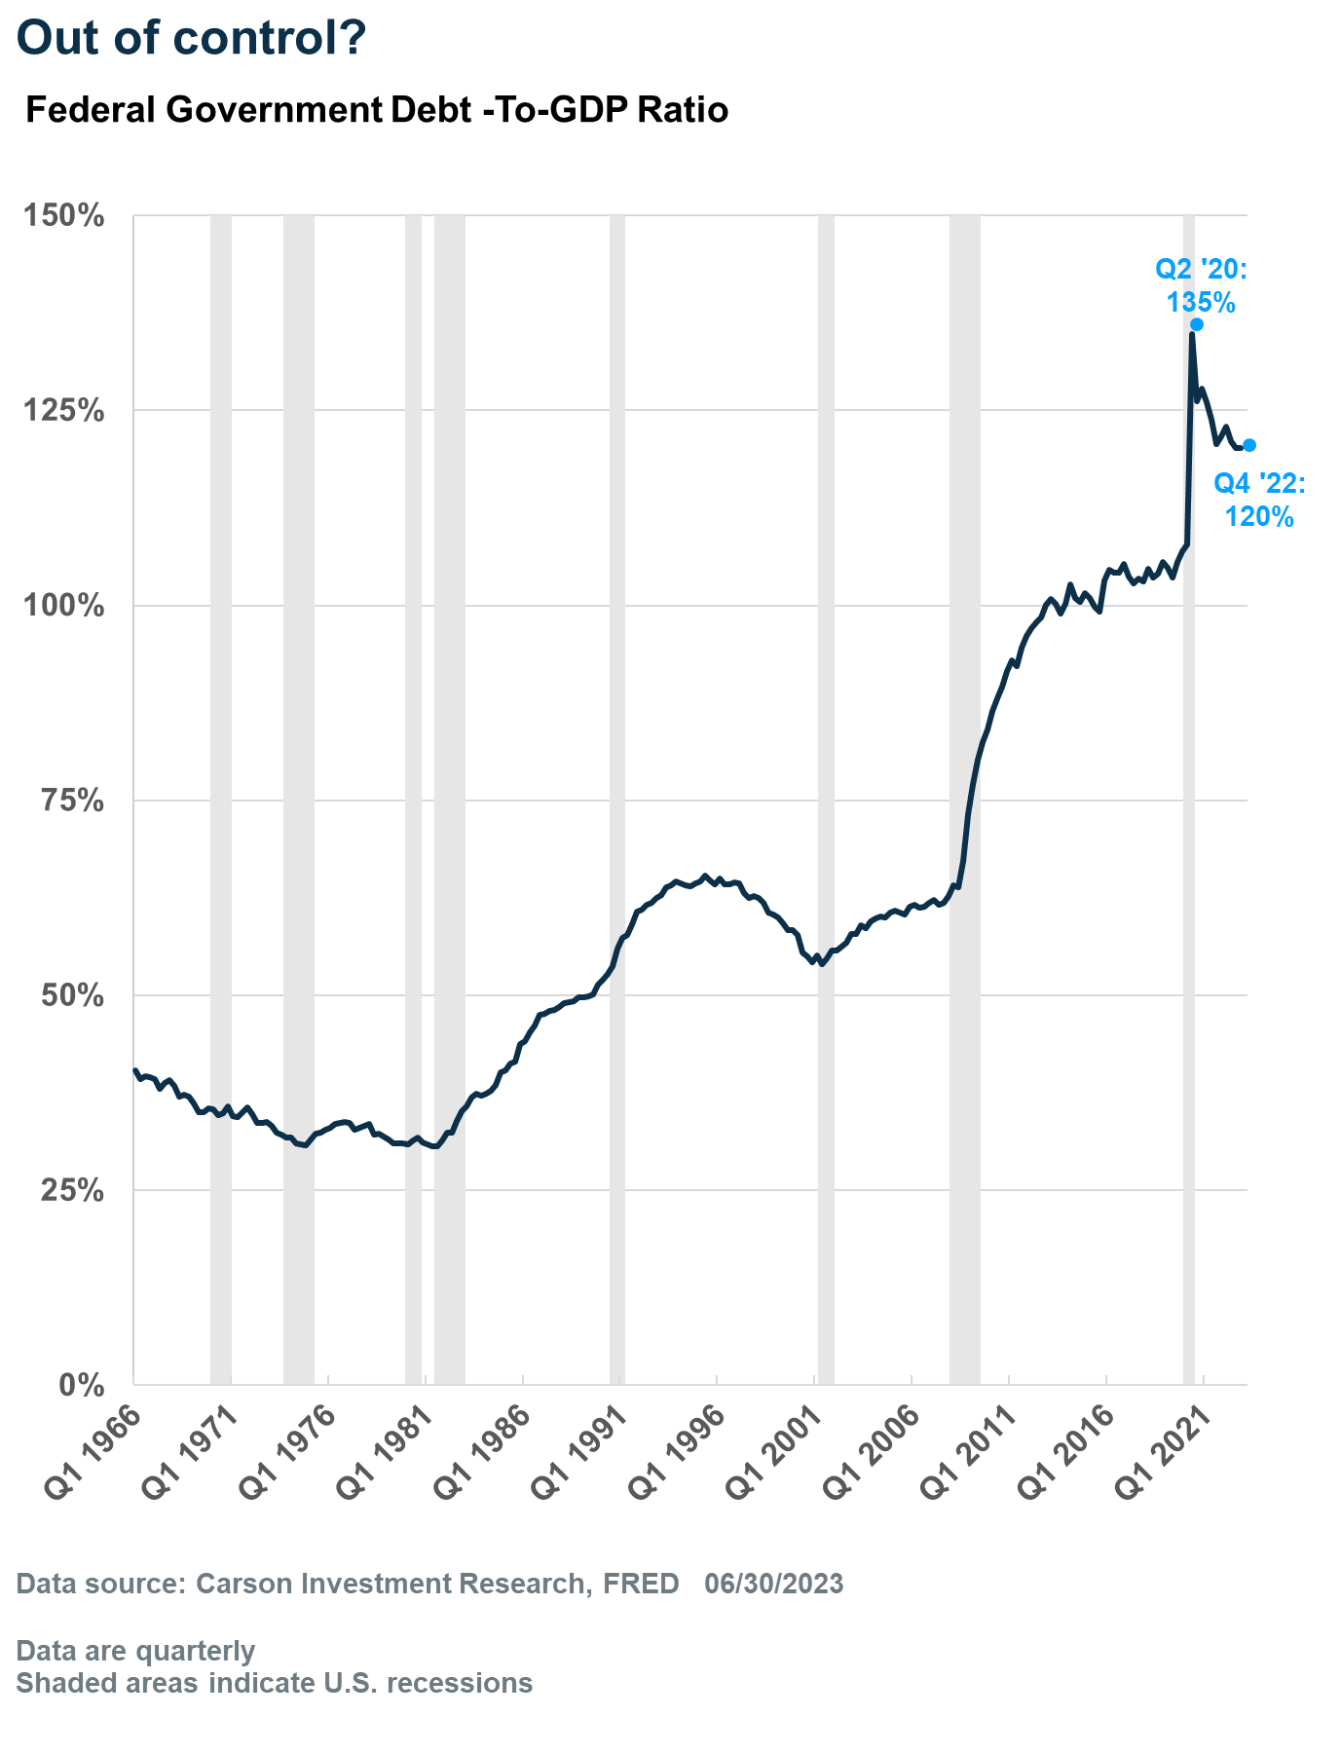
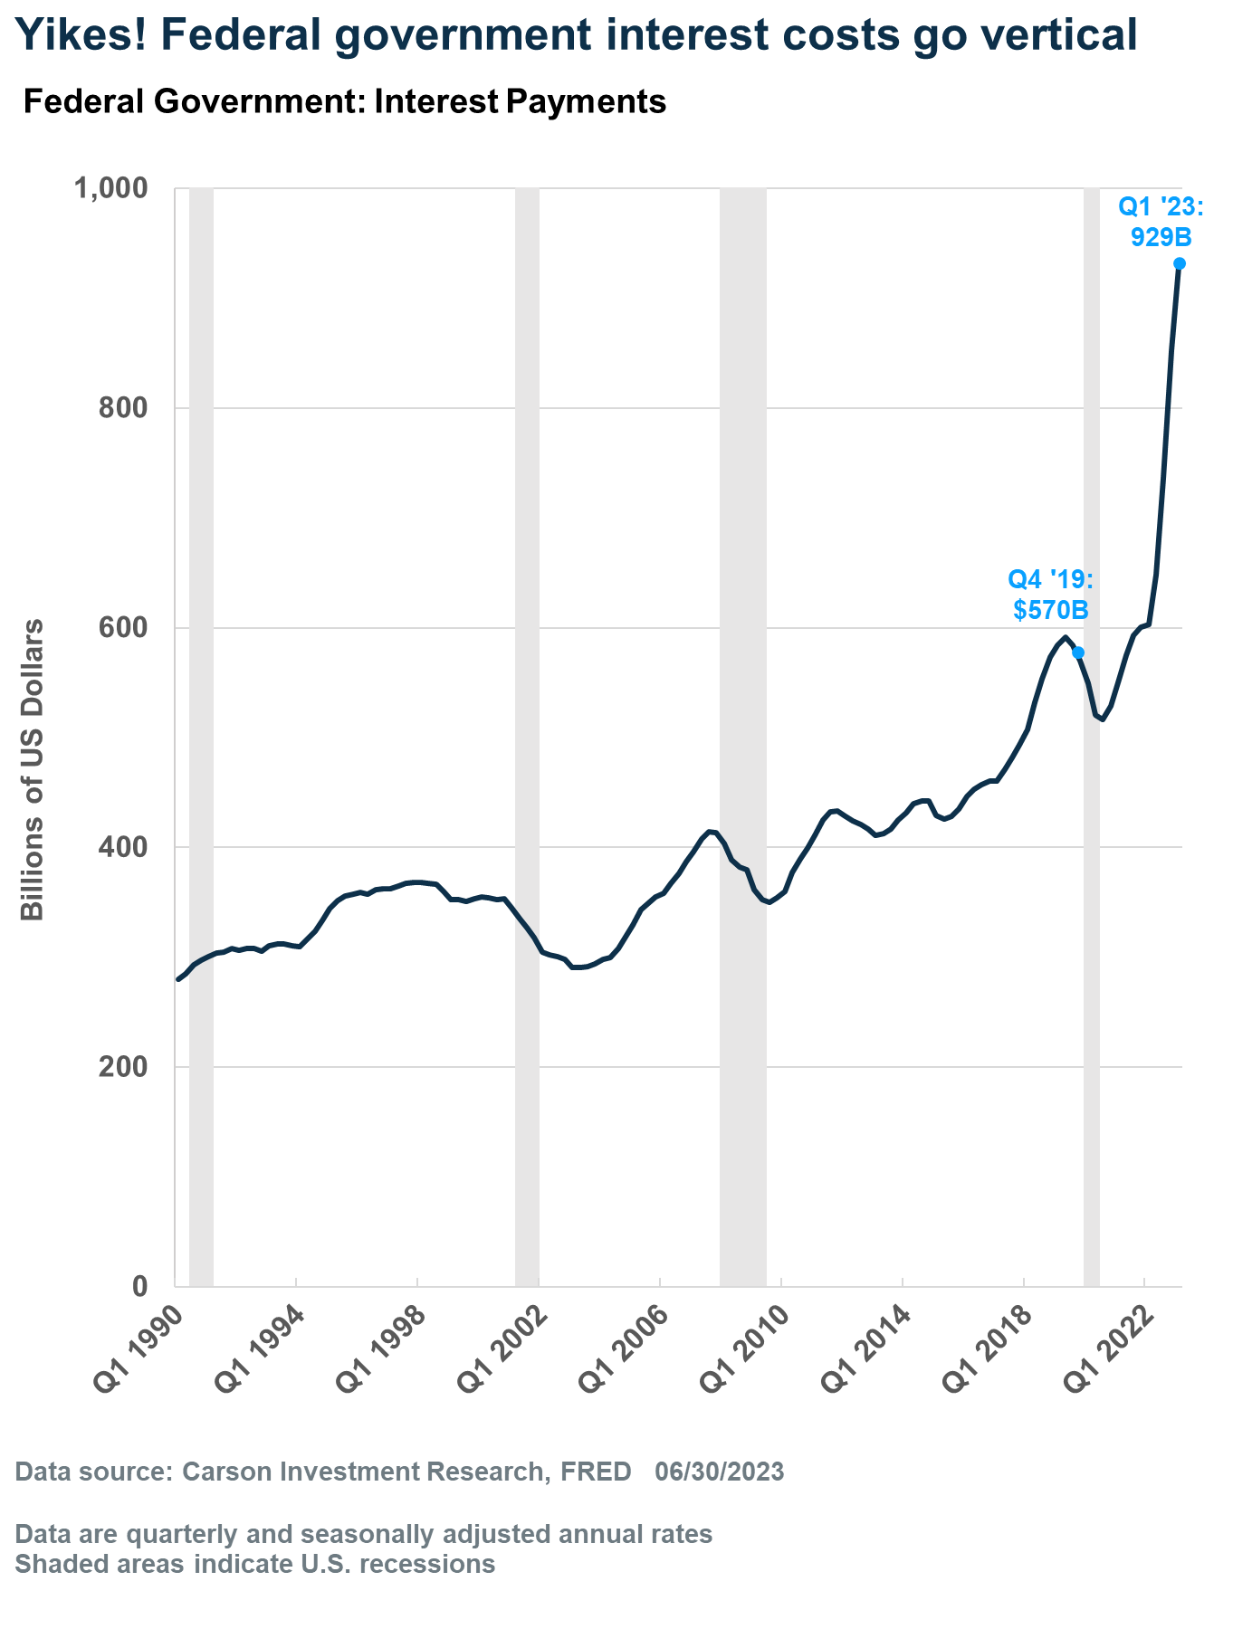
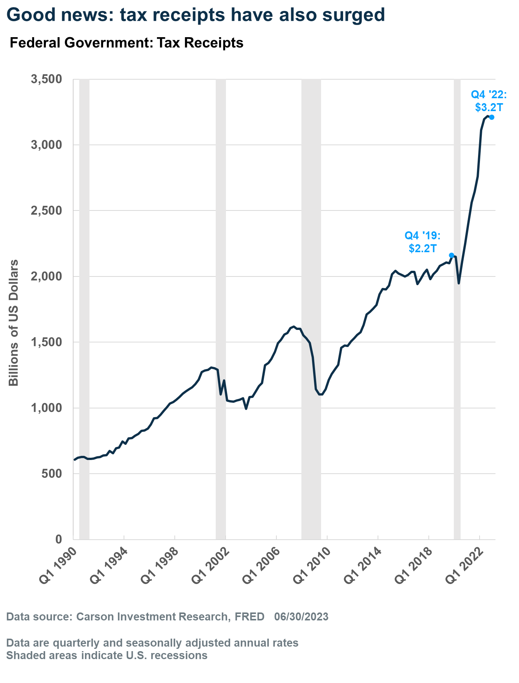
Economic growth and inflation have helped reduce U.S. debt
Notes:
Source: https://www.carsongroup.com/insights/blog/government-debt-has-exploded-higher-should-we-worry/
In the U.S., we've benefitted form strong economic growth. The left hand chart shows that the debt-to-GDP ratio in the U.S. jumped from 108 percent before the pandemic to 120 percent at the end of 2022. The only solace is that it’s fallen from 135 percent in the second quarter of 2020 – primarily because GDP increased by $4.4 trillion since then. Note that the denominator in the ratio is “nominal” GDP, i.e. it’s not adjusted for inflation. Nominal GDP has been increasing rapidly over the past two years thanks to inflation, rising 12 percent in 2021 and 7 percent in 2022. So, one way in which debt-to-GDP can fall is with higher inflation. Here’s the thing though: looking at debt-to-GDP is sort of like calculating your mortgage balance-to-income ratio. Using the average mortgage debt ($346,000 as of September 2021) and median household income of $71,000, the average household's “debt-to-income” ratio would be about 500%! It's not a very useful way of determining whether a family can afford a house. As to whether the government can afford its debt, the government's income is not GDP, its income is tax receipts. So, what really matters in determining the government’s ability to pay its debt are interest rates and tax receipts. Of course, the Fed has been aggressively raising rates to bring inflation down. Higher rates mean higher interest costs for the government, which the middle chart shows. Interest payments on the federal debt rose significantly from the end of the pandemic through the first quarter of this year and so did tax receipts, as the right-hand chart shows. Tax receipts were up, especially in 2021, as capital gains receipts increased, thanks to rising asset prices. In 2022, tax receipts were helped as 4.8 million more people gained jobs.

Slide 55
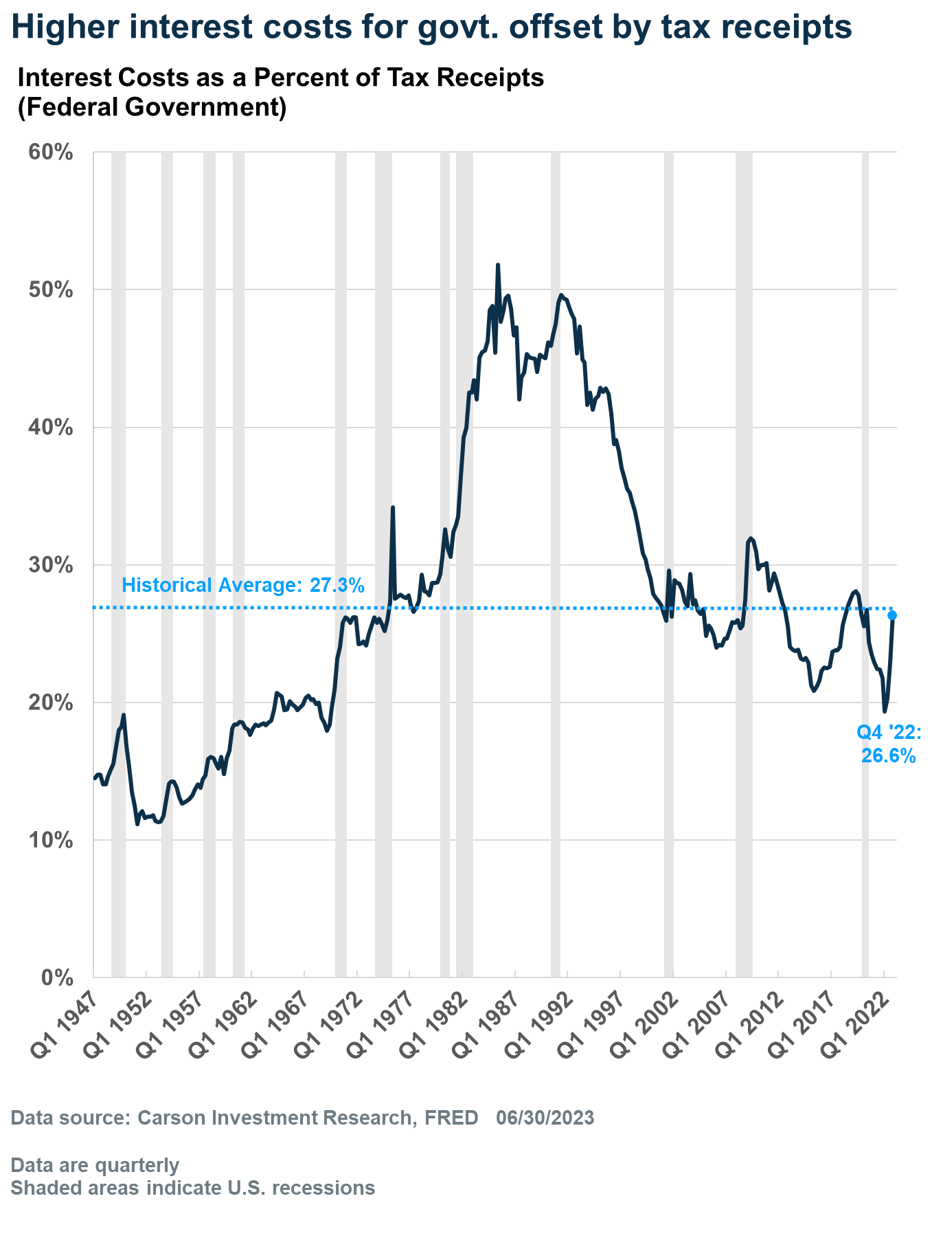
Interest payments are about average as a percent of tax receipts
Q1 2023: 31.5%
Notes:
Sources: U.S. Bureau of Economic Analysis, Federal government current expenditures: Interest payments [A091RC1Q027SBEA], Federal government current tax receipts [W006RC1Q027SBEA], retrieved from FRED, Federal Reserve Bank of St. Louis; https://fred.stlouisfed.org/series/A091RC1Q027SBEA, June 21, 2023.
Interest costs as a percent of tax receipts have moved higher over the last few quarters. At the end of last year, government interest costs as a percent of tax receipts were about 26.6 percent. The cost increased during the first three months of this year, but remains near the historical average of 27.3 percent, and well below previous highs. Ultimately, if the economy is growing, the debt-to-GDP ratio should remain stable (or fall), and tax receipts will continue to rise.

Slide 56
What the experts think

Slide 57
They haven’t separated the wheat from the chaff yet, but I do believe, unlike crypto, that A.I. is real and it could be as transformative as the internet.
– Stanley Druckenmiller, Founder, Duquesne Family Office,
cited by Will Daniel of Fortune
June 7, 2023
Notes:
Source: https://finance.yahoo.com/news/billionaire-investor-stanley-druckenmiller-warns-200255702.html
Legendary investor Stanley Druckenmiller sees potential in artificial intelligence. "They haven’t separated the wheat from the chaff yet, but I do believe, unlike crypto, that A.I. is real and it could be as transformative as the internet."

Slide 58
Nearly every strategist and economist told us the same thing, the economy was headed for a recession and stocks were going to crash during the first half of the year. As General Patton told us, 'If everyone is thinking alike, then somebody isn’t thinking.' The consumer remains extremely strong, employment solid, and housing is showing real signs of bottoming. We’ve been in the lonely camp that thought we would avoid a recession in 2023 and others are starting to come around to this realization...stocks lead the economy, and we think they are indeed suggesting better economic times are coming.
– Ryan Detrick, Chief Marketing Strategist, Carson Group
June 28, 2023
Notes:
Source: Ryan Detrick, June 25, 2023
Ryan Detrick of Carson Group said, "Nearly every strategist and economist told us the same thing, the economy was headed for a recession and stocks were going to crash during the first half of the year. As General Patton told us, 'If everyone is thinking alike, then somebody isn’t thinking.' The consumer remains extremely strong, employment solid, and housing is showing real signs of bottoming. We’ve been in the lonely camp that we would avoid a recession in 2023 and others are starting to come around this this realization. Lastly, stocks lead the economy and we think they are indeed suggesting better economic times are coming."

Slide 59
One of our theses around this rolling recession is that best case scenario is not really soft landing in the traditional sense but a continuation of the roll through such that, at some point...services might start to get hit (you’re seeing some cracks there) or the labor market gets hit, that you’ve got offsetting stability or strength in other areas.
– Liz Ann Sonders, Managing Director, Charles Schwab CNBC, Squawk on the Street, June 27, 2023
Notes:
Source: https://www.cnbc.com/video/2023/06/27/charles-schwabs-liz-ann-sonders-weve-been-in-a-rolling-recession-for-years-now.html
Liz Ann Sonders, Managing Director of Schwab said, "One of our theses around this rolling recession is that best case scenario is not really soft landing in the traditional sense but a continuation of the roll through such that, at some point, that services might start to get hit – you’re seeing some cracks there – or the labor market gets hit, that you’ve got offsetting stability or strength in other areas."

Slide 60
We see the near-term risk-reward as lousy, but if we look out to 2024-2025 – and this is what people are getting excited about – we see capital expenditure boom for reshoring, green energy, traditional energy, refitting buildings and now AI. So, this is exciting. The problem is that it’s a cost first and then it’s a productivity benefit.
– Mike Wilson, Chief U.S. Equity Strategist, Morgan Stanley, Bloomberg June 26, 2023
Notes:
Source: https://www.bloomberg.com/news/articles/2023-06-26/morgan-stanley-s-wilson-says-stock-risks-have-rarely-been-higher-ljcjlbkk [video]
Mike Wilson of Morgan Stanley told Bloomberg, “We see the near-term risk-reward as lousy, but if we look out to 2024-2025 – and this is what people are getting excited about – we see capital expenditure boom for reshoring, green energy, traditional energy, refitting buildings and now AI. So, this is exciting. The problem is that it’s a cost first and then it’s a productivity benefit.”

Slide 61
What recession? The consensus view that recession was virtually a slam dunk looks increasingly off base. Yes, there will eventually be one, but odds that a downturn is dead ahead are receding. There are a bunch of reasons why the economy is hanging tough. Here are my top three…First, excess savings...Second, labor hoarding...Third, low leverage. Households and businesses have borrowed prudently, and their debt service burdens are historically light.
– Mark Zandi, Chief Economist, Moody Analytics
June 11, 2023
Notes:
Source: https://twitter.com/Markzandi/status/1667862150784638976
Mark Zandi, Chief Economist of Moody Analytics asked, "What recession? The consensus view that recession was virtually a slam dunk looks increasingly off base. Yes, there will eventually be one, but odds that a downturn is dead ahead are receding. There are a bunch of reasons why the economy is hanging tough. Here are my top three…First, excess savings...Second, labor hoarding...Third, low leverage. Households and businesses have borrowed prudently, and their debt service burdens are historically light."

Slide 62
Half-Time 2023
The Standard & Poor’s 500 Index is a capitalization weighted index of 500 stocks designed to measure performance of the broad domestic economy through changes in the aggregate market value of 500 stocks representing all major industries.
The Consumer Price Index (CPI) is a measure of the average change over time in the prices paid by urban consumers for a market basket of consumer goods and services.
Personal Consumption Expenditures (PCE) is a measure of price changes in consumer goods and services, targeted towards goods and services consumed by individuals. PCE is released monthly by the Bureau of Economic Analysis (BEA).
The Price-to-Earning (P/E) ratio is a measure of the price paid for a share relative to the annual net income or profit earned by the firm per share. It is a financial ratio used for valuation: a higher P/E ratio means investors are paying more for each unit of net income, thus, the stock is more expensive compared to one with a lower P/E ratio.
The MSCI World Index is a broad global equity index that represents large and mid-cap equity performance across all 23 developed markets countries. It covers approximately 85% of the free float-adjusted market capitalization in each country.
The MSCI European Union (EU) Index captures large and mid cap representation across the 13 Developed Markets (DM) countries and 4 Emerging Markets (EM) countries in Europe*. With 321 constituents, the index covers approximately 85% of the free float- adjusted market capitalization in the European equity universe.
The MSCI USA Index represents 63% of the MSCI World Index1. It is designed to measure the performance of the large and mid-cap segments and aims to represent ~85% of the US market.
The MSCI United Kingdom Index represents 5% of the MSCI World Index1. It is designed to measure the performance of the large and mid-cap segments and aims to represent ~85% of the United Kingdom market.
The MSCI China Index covers 85% of the free float market cap of the China Equity Universe across H-shares, A-shares, B-shares, Red-chips, P‐chips and foreign listed shares.
The MSCI Emerging Markets Index includes large and mid-cap companies in 26 Emerging Markets (EM) countries. It covers approximately 85% of the free float-adjusted market capitalization in each country.
The MSCI Frontier Markets Index captures large and mid cap representation across 27 Frontier Markets (FM) countries*. The index includes 81 constituents, covering about 85% of the free float-adjusted market capitalization in each country.

