Slide 1
Notes to Advisors
Select a Presentation Title Page and End Page
  Select the presentation cover from the three options that follow (slides 2-4).
  Select the corresponding end page from the three options (slides 62-64).
  Delete the other options.
Insert Your Logo into the Cover and Back Page
  Delete the current text box with Insert Logo Here.
  Select the Insert Tab > Picture > find the location on your computer and select Insert.
  Resize logo by holding down the shift key and dragging one corner in (to make smaller) or out (to make larger).
  Note: holding the shift key while dragging will proportionally change the size of your logo and not distort it.
Delete This Page
  Delete this page from your presentation.

Slide 2

Forecast 2023
Insert Logo
Notes:
Image: https://www.gettyimages.com/detail/photo/lake-matheson-nature-panorama-at-sunrise-new-royalty-free-image/482684874?phrase=Adventure&adppopup=true
Welcome to Forecast 2023. We're glad you're here.

Slide 3

Forecast 2023
Insert Logo
Notes:
Image: https://www.gettyimages.com/detail/photo/multi-generation-family-enjoying-thanksgiving-royalty-free-image/1344621229?phrase=happy family candid&adppopup=true
Welcome to Forecast 2023. We're glad you're here.

Slide 4

Forecast 2023
Insert Logo
Notes:
Image: https://www.gettyimages.com/detail/photo/different-approach-different-direction-royalty-free-image/1175911351?adppopup=true
Welcome to Forecast 2023. We're glad you're here.

Slide 5
Forecast 2023
The opinions voiced in this material are for general information only and are not intended to provide specific advice or recommendations for any individual. To determine which investment(s) may be appropriate for you, consult your financial professional prior to investing. All performance referenced is historical and is no guarantee of future results. All indices are unmanaged and cannot be invested into directly.
Risk Considerations: The economic forecasts set forth in this presentation may not develop as predicted and there can be no guarantee the strategies promoted will be successful. Stock investing involves risk including loss of principal. No investment strategy or risk management technique can guarantee return or eliminate risk in all market environments. Bonds are subject to market and interest rate risk if sold prior to maturity. Bond values will decline as interest rates rise and bonds are subject to availability and change in price. International and emerging market investing involves special risks such as currency fluctuation and political instability and may not be suitable for all investors.
***Placeholder for B/D Disclosure
Notes:
The opinions voiced in this material are for general information only and are not intended to provide specific advice or recommendations for any individual. To determine which investment(s) may be appropriate for you, consult your financial professional prior to investing. All performance referenced is historical and is no guarantee of future results. All indices are unmanaged and cannot be invested into directly.
Risk Considerations: The economic forecasts set forth in this presentation may not develop as predicted and there can be no guarantee strategies promoted will be successful. Stock investing involves risk including loss of principal. No investment strategy or risk management technique can guarantee return or eliminate risk in all market environments. Bonds are subject to market and interest rate risk if sold prior to maturity. Bond values will decline as interest rates rise and bonds are subject to availability and change in price. International and emerging market investing involves special risks such as currency fluctuation and political instability and may not be suitable for all investors.

Slide 6
2022 in review
The economy
Financial markets
What may be ahead
Agenda
Notes:
Today, we’re going to talk about where we are. We’ll look back at what happened to the economy and financial markets during 2022. We'll also discuss what may be ahead in 2023. Before we get started, let’s get your brains warmed up with a brief quiz.

Slide 7
What Do You Know?

Slide 8

Which of the following was not a finalist for Merriam Webster’s 2022 Word of the Year?
  Loamy
  Gaslighting
  Goblin Mode
  Oligarch
Notes:
Photo: https://www.gettyimages.com/detail/photo/book-and-glass-loupe-royalty-free-image/133313561?phrase=dictionary&adppopup=true
Source: https://www.merriam-webster.com/words-at-play/word-of-the-year
Every year, dictionaries name a Word of the Year. Some select the word that was most frequently searched. Others put it to a vote. Which of the following was not among the top contenders for Merriam Webster’s 2022 Word of the Year?
Loamy
Gaslighting
Goblin Mode
Oligarch

Slide 9

Goblin Mode
Source:
Notes:
Photo source: https://www.gettyimages.com/detail/photo/middle-aged-man-with-beard-wearing-welding-glasses-royalty-free-image/1337576709?phrase=abnormal&adppopup=true
Source: https://www.merriam-webster.com/words-at-play/word-of-the-year
https://www.bbc.com/news/uk-63857329
Goblin mode did not make Merriam Webster’s short list, but it was Oxford Language’s Word of the Year. (Even though it’s actually two words.) Goblin mode is “a type of behavior which is unapologetically self-indulgent, lazy, slovenly, or greedy, typically in a way that rejects social norms or expectations”
Merriam Webster’s Word of the Year was gaslighting, which is “the act or practice of grossly misleading someone especially for one's own advantage.”

Slide 10
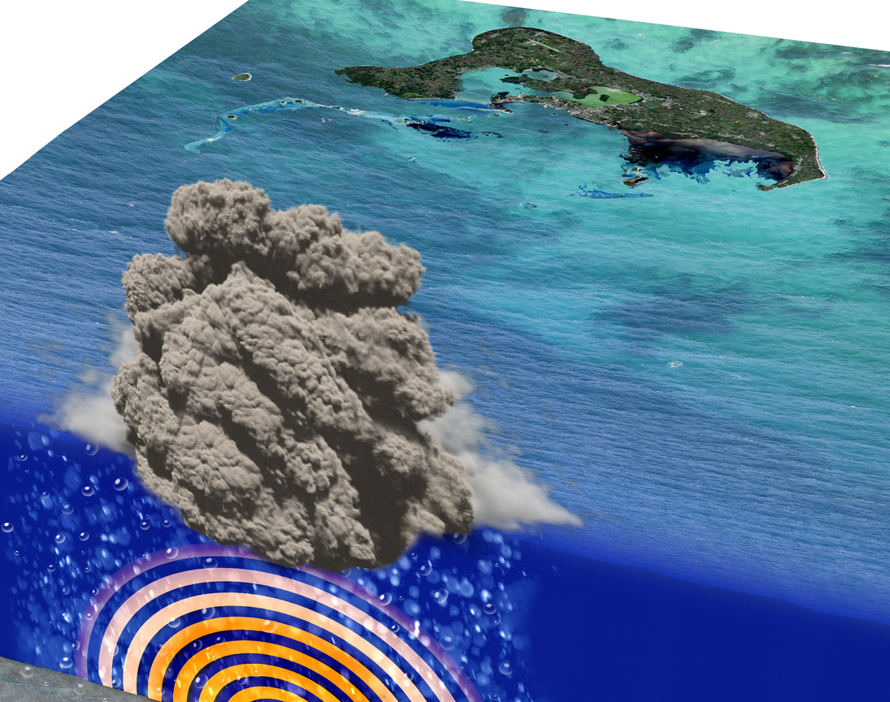
When the submarine Hunga Tonga volcano erupted, it:
Launched water vapor 93 miles above Earth
Created a sonic boom that was heard in Alaska
Disrupted the Earth’s geomagnetic field
All of the above
Notes:
Photo source: https://www.gettyimages.ca/detail/photo/eruption-of-the-underwater-volcano-near-the-island-royalty-free-image/1365177815?phrase=Hunga Tonga volcano&adppopup=true
Source: https://volcano.si.edu/faq/index.cfm?question=eruptionsbyyear&checkyear=2022
https://www.washingtonpost.com/science/2022/12/12/tonga-volcano-water-space/
https://lasp.colorado.edu/home/2022/12/09/hunga-tonga-agu/
As of late December, there were 77 confirmed volcanic eruptions from 74 different volcanoes during 2022. Some of the eruptions were new and some started in 2021 and continued to erupt during 2022. The Hunga Tonga undersea volcano sent tsunamis barreling across the ocean and destroyed underwater fiber optic communication cable. What else did it do?
Launched water vapor 93 miles above Earth
Created a sonic boom that was heard in Alaska
Disrupted the Earth’s geomagnetic field
All of the above

Slide 11
All of the above
“In January [of 2022], the record-breaking Tonga blast sent tsunamis across the Pacific Ocean and created a sonic boom that could be heard in Alaska. Experts estimate that the amount of energy released by the eruption was as much as 60 megatons, roughly equal to the most powerful hydrogen bomb ever detonated.”
—Joel Achenbach, The Washington Post
December 12, 2022
Source: The Washington Post
Notes:
Source: https://www.washingtonpost.com/science/2022/12/12/tonga-volcano-water-space/
The answer is all of the above. Scientists have been studying the powerful eruption. Joel Achenback of The Washington Post reported on their findings. “In January [of 2022], the record-breaking Tonga blast sent tsunamis across the Pacific Ocean and created a sonic boom that could be heard in Alaska. Experts estimate that the amount of energy released by the eruption was as much as 60 megatons, roughly equal to the most powerful hydrogen bomb ever detonated.”

Slide 12

What recipe did people search for more than any other in 2022?
Cincinnati chili
Marry Me chicken
Sugo
Mango pie
Notes:
Photo: https://www.gettyimages.com/detail/photo/happy-man-cooking-at-home-following-an-online-royalty-free-image/1391517636?phrase=recipe cards&adppopup=true
Source: https://trends.google.com/trends/yis/2022/US/
The pandemic reshaped the way that people eat. With time on their hands, many people taught themselves to cook. Instead of spending half of their food budgets on eating out, they spent just one-third. That’s a significant savings. In 2022, more people searched for one recipe than any other. What did they want to prepare?
Cincinnati chili
Marry Me chicken
Sugo
Mango pie

Slide 13

Sugo
Source: Google Trends
Notes:
Photo source: https://www.gettyimages.com/detail/photo/dinner-lunch-spaghetti-bolognese-sugo-parmesan-royalty-free-image/1407447038?phrase=sugo&adppopup=true
The answer – sugo – is a bit of a surprise since many Americans haven't heard of it. It is a legendary tomato-based Italian sauce that’s made by cooking tomatoes with onions, garlic, seasoning, and extra virgin olive oil.

Slide 14

At the end of 2022, which country had the most powerful passport?
Germany
United States
United Arab Emirates
Japan
Notes:
Photo: https://www.gettyimages.com/detail/photo/woman-with-pink-suitcase-and-amerian-passport-with-royalty-free-image/1326410030?phrase=passport&adppopup=true
Source: https://www.passportindex.org/about.php
https://www.passportindex.org/byRank.php
Once the pandemic ended, people were eager to travel. Two hundred and eight million Americans said they were going to travel last summer – that’s more than 80 percent of the population! One in five was planning to travel overseas. When you’re going overseas, you need a passport. Many people don’t know it, butt here is an index that tracks the relative power of passports. At the end of 2022, which country had the most powerful passport?
Germany
2. United States
3. United Arab Emirates
4. Japan

Slide 15

United Arab Emirates
Mobility score:
180
Source: Passport Index
Notes:
Photo source: https://www.gettyimages.com/detail/photo/famous-buildings-in-abu-dhabi-royalty-free-image/517465184?phrase=united arab emirates&adppopup=true
Source: https://www.passportindex.org/about.php
https://www.passportindex.org/byRank.php
The answer is the UAE, which has a mobility score of 180. Germany’s score was 173, the United States scored 172, and Japan 171, and The Passport Index ranks the power of passports based on mobility, which is measured by the whether a visa is required to travel to other nations and, if one is, what type of visa is required. When two passports tie, the United Nations Development Program Human Development Index, which measures the country’s perception abroad, is used to break the tie.

Slide 16

2022 in review: The economy
Notes:
Photo: https://www.gettyimages.com/detail/photo/woman-firmly-holds-mans-hand-during-flight-in-plane-royalty-free-image/1280183303?phrase=panic on airplane&adppopup=true
Video source: https://www.gettyimages.com/videos/turbulent-flight?assettype=film&sort=mostpopular&phrase=turbulent%20flight&license=rf%2Crr
Let’s talk about 2022. Have you ever been on a flight when turbulence hits and the plane jolts up or down or both? And you find yourself white-knuckling the armrests or the seat in front of you and thinking, “Am I going to get off this plane alive?” That's kind of what 2022 was like for investors. It is often said that markets hate uncertainty – and 2022 was chockful of uncertainty. Uncertainty about inflation. Uncertainty about Federal Reserve rate hikes. Uncertainty created by the war in Ukraine, COVID-19 outbreaks in China, and a shortage of labor. Financial markets jolted higher and lower, sometime without clear reasons. The good news is that, while turbulence makes flights bumpy and uncomfortable, it doesn’t stop passengers from reaching their destinations. The bad news is that there is still a lot of uncertainty. As a result, the bumpy ride may persist into 2023.

Slide 17




A lot of uncertainty
War in Ukraine, sanctions on Russia
COVID-19 policy change in China
Inflation
Rising interest rates
Source: Bloomberg, The Economist, Reuters
Notes:
Photos
https://www.gettyimages.com/detail/photo/war-in-ukraine-destroyed-ukrainian-building-and-royalty-free-image/1389267898?phrase=War in Ukraine&adppopup=true
https://www.gettyimages.com/detail/photo/young-asian-woman-wearing-a-protective-face-mask-to-royalty-free-image/1207793521?phrase=covid in china&adppopup=true
https://www.gettyimages.com/detail/photo/buying-convenient-food-royalty-free-image/1371981344?phrase=grocery shopping&adppopup=true
https://www.gettyimages.com/detail/photo/federal-reserve-of-usa-sybol-and-sign-royalty-free-image/1308151210?phrase=federal reserve &adppopup=true
Sources: https://www.bloomberg.com/news/articles/2022-12-01/russia-s-labor-starved-economy-pays-price-of-putin-s-war-call-up#xj4y7vzkg (or go to https://resources.carsongroup.com/hubfs/Carson%20Coaching%20Online/Market%20Commentary/Presentations/2023/Forecast%202023%20Sources/Slide%2017_1_Bloomberg_Russias%20Labor%20Starved%20Economy%20Pays%20Price%20of%20Putins%20Call%20Up.pdf)
https://www.economist.com/leaders/2022/12/01/xi-jinpings-zero-covid-policy-has-turned-a-health-crisis-into-a-political-one (or go to https://resources.carsongroup.com/hubfs/Carson%20Coaching%20Online/Market%20Commentary/Presentations/2023/Forecast%202023%20Sources/Slide%2017_2_The%20Economist_Xi%20Jinpings%20Zero-Covid%20Policy%20Turned%20Health%20Crisis%20into%20Political%20One.pdf)
https://www.reuters.com/world/china/how-many-people-might-die-why-if-china-loosens-covid-restrictions-2022-12-03/
The drivers of uncertainty are complex. The War in Ukraine and sanctions imposed on Russia disrupted global agriculture and energy markets. As a result, prices for food and energy increased significantly. Ukraine's economy has been devastated and the Russian economy has not fared well, either. After Russian military conscriptions and the departure of many citizens, Russia is in the midst of a labor crisis. Many Russian industries are in distress and economic growth has slowed dramatically.
In China, we saw lockdown after lockdown because of the country's zero-COVID policy. Lockdowns disrupted supply chains and contributed to global inflation. Not only have lockdowns been costly, they also have been very unpopular. Late last year, protests broke out and the country loosened its policy. That may not solve supply chain issues. A paper published by the Shanghai Journal of Preventive Medicine estimated that mainland China may have more than two million deaths when it moved away from its zero-COVID policy. As the disease spreads, the economy may experience a significant slowdown.
Food and energy shortages, supply chain disruptions, and labor shortages all contributed to rising global inflation. Prices increased in the United States and around the world – and central banks began raising rates to slow economic growth and bring inflation back down to targeted levels.

Slide 18
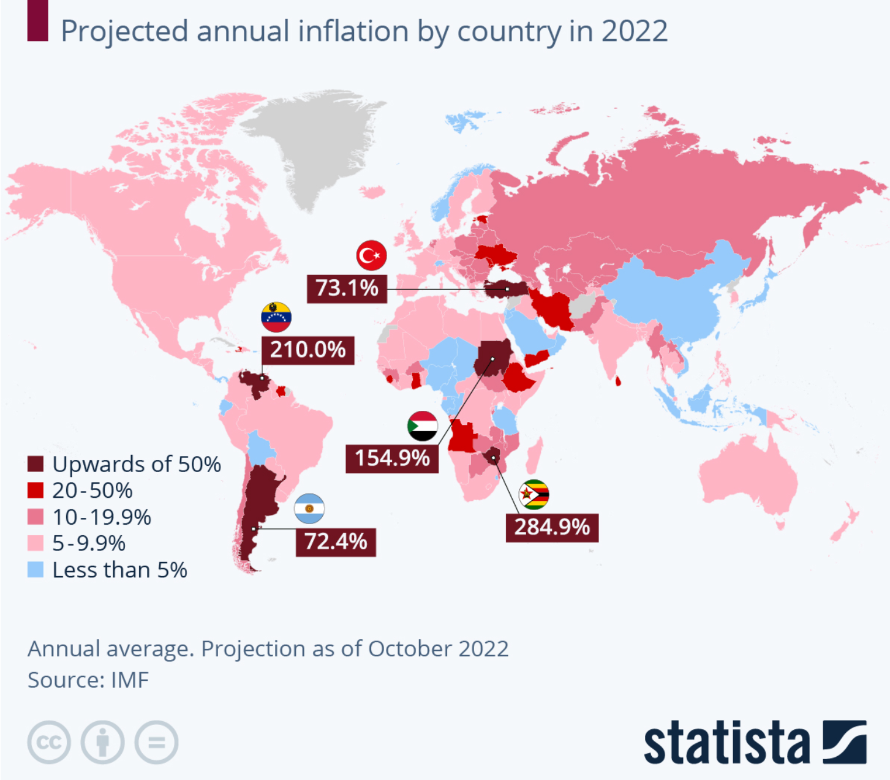
Inflation rose around the world
Notes:
Source: https://www.statista.com/chart/27480/projected-annual-inflation-by-country/
https://www.statista.com/chart/28458/biggest-concerns-globally/
By the end of 2022, inflation was a top concern around the world. Globally, inflation was expected to average about 8.8 percent in 2022. Countries that experienced conflict, upheaval, or economic challenges experienced the largest price increases (210% in Venezuela. 73.1% in Turkey. 154.9% in Sudan. 72.4% in Argentina. 284.9% in Zimbabwe).

Slide 19
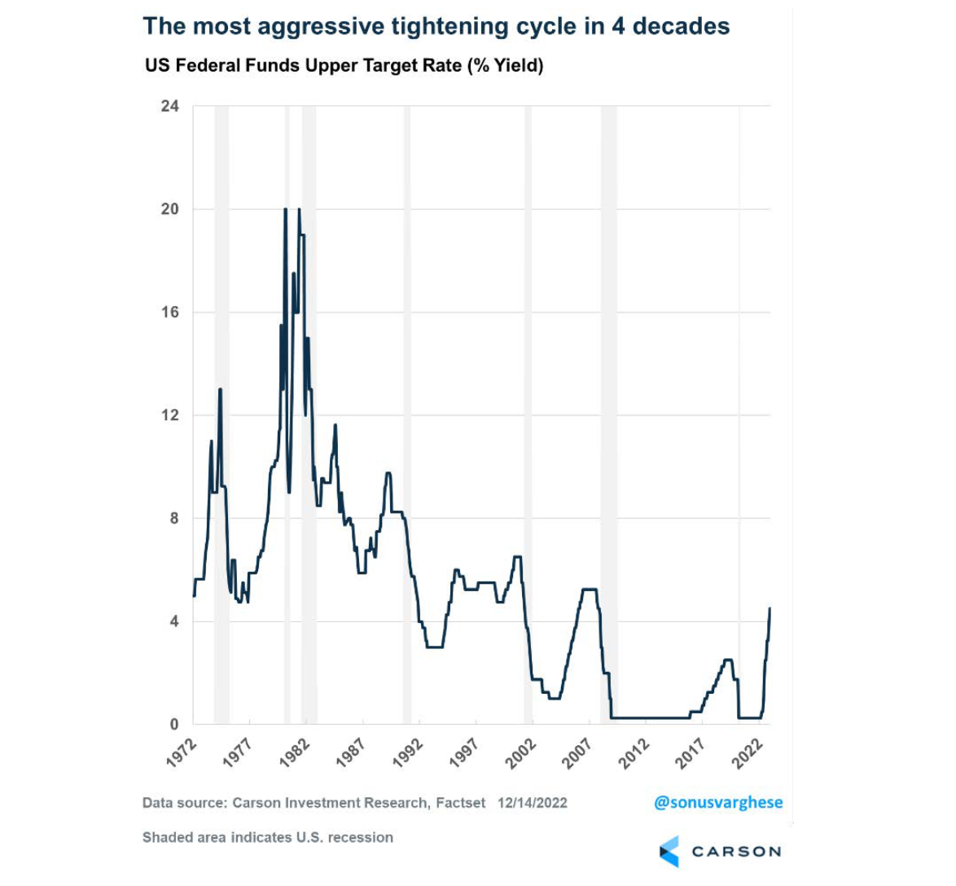
Central banks
raised rates
In the United States: from near zero to 4.33%
Federal Reserve quantitative tightening
Source: Federal Reserve Bank
Notes:
Sources: Board of Governors of the Federal Reserve System (US), Federal Funds Effective Rate [FEDFUNDS], retrieved from FRED, Federal Reserve Bank of St. Louis; https://fred.stlouisfed.org/series/FEDFUNDS, December 2, 2022.
https://www.newyorkfed.org/markets/reference-rates/effr
Many central banks raise rates to lower inflation. Interest rates are a tool central banks use to slow spending and economic growth, pushing inflation lower.
In the United States, the Federal Reserve was – and remains – hawkish. It raised rates at the fastest pace in four decades as it worked to slow economic growth and push prices lower. In 2022, the Fed raised rates seven times, lifting the federal funds rate from near zero to 4.33 percent. It also engaged in quantitative tightening to reduce its balance sheet.

Slide 20
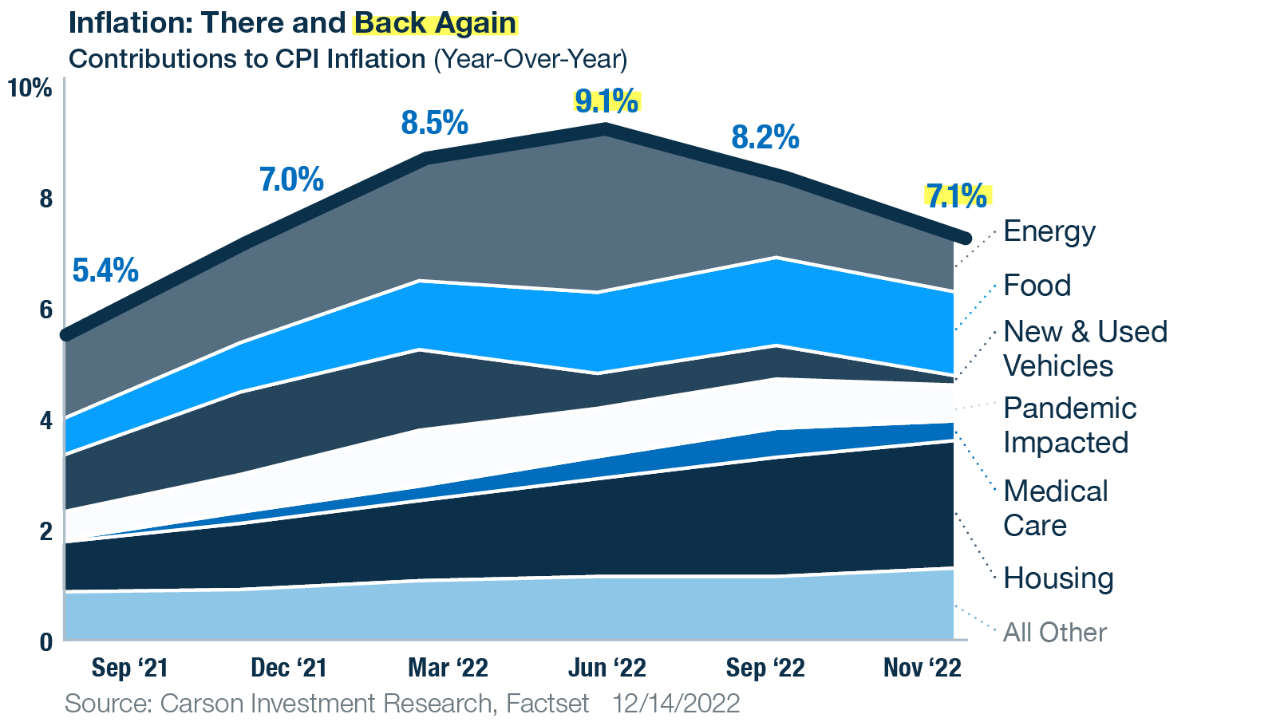
U.S. inflation eased
Source: Carson Investment Research, Factset 12.14.22
Notes:
Sources: Carson Research
https://www.bls.gov/news.release/archives/cpi_07132022.htm
The Fed’s policies had some success as inflation eased a bit in the United States. The Consumer Price Index showed headline inflation was 7.1 percent in November, year-over-year. That was down from 9.1 percent in June. Core inflation, which excludes food and energy, was 6.0 percent in November – slightly higher than was in June (5.9%).

Slide 21
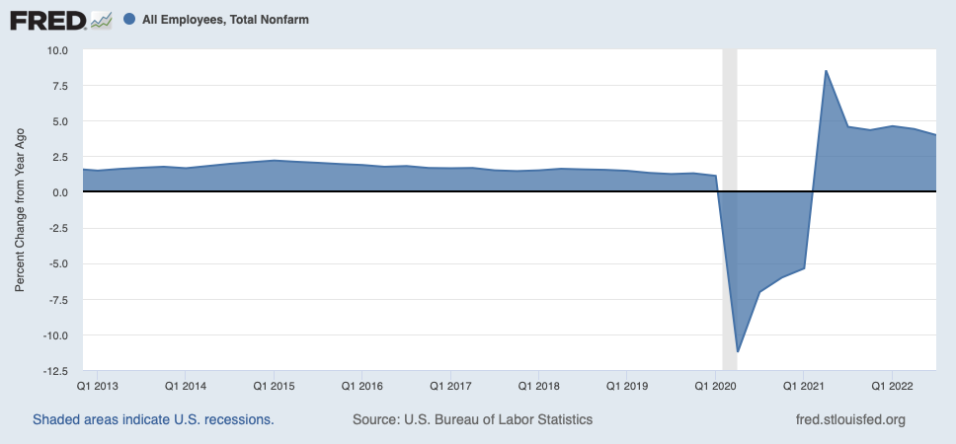
Jobs growth was strong
Source: U.S. Bureau of Labor Statistics
Notes:
Source: U.S. Bureau of Labor Statistics, All Employees, Total Nonfarm [PAYEMS], retrieved from FRED, Federal Reserve Bank of St. Louis; https://fred.stlouisfed.org/series/PAYEMS, January 2, 2023.
https://www.carsonwealth.com/insights/market-commentary/market-commentary-welcome-to-december/?j=1977737&sfmc_sub=110746231&l=380_HTML&u=26910629&mid=100016897&jb=4003
There was some uncertainty about whether the Fed's policies were working because, despite rising interest rates, the U.S. economy remained quite strong. For example, jobs growth slowed over the course of the year, but jobs were still being added at a very strong pace. In November 2022, 263,000 jobs were created. That was well above expectations of 200,000. Overall, the United States added more than 4.3 million jobs in 2022. That’s the second-best year for job creation since 1939 (2021 was the best year). The unemployment rate ended the year at 3.7%, which was close to a record low.

Slide 22
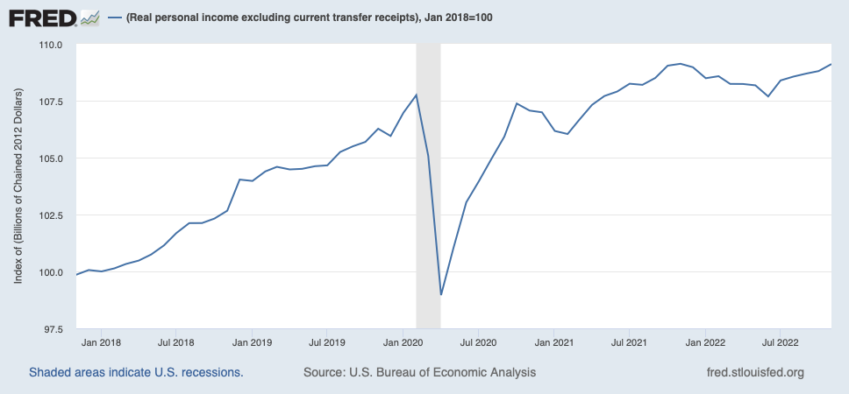
Real personal income increased
Source: U.S. Bureau of Economic Analysis
Notes:
Source: U.S. Bureau of Economic Analysis, Real personal income excluding current transfer receipts [W875RX1], retrieved from FRED, Federal Reserve Bank of St. Louis; https://fred.stlouisfed.org/series/W875RX1, January 2, 2023.
With unemployment low and the labor supply limited, workers negotiated better wages, and income increased. From June to November 2022, real income increased by 1.4%. Real income shows how much more people are earning after inflation has been factored in.

Slide 23


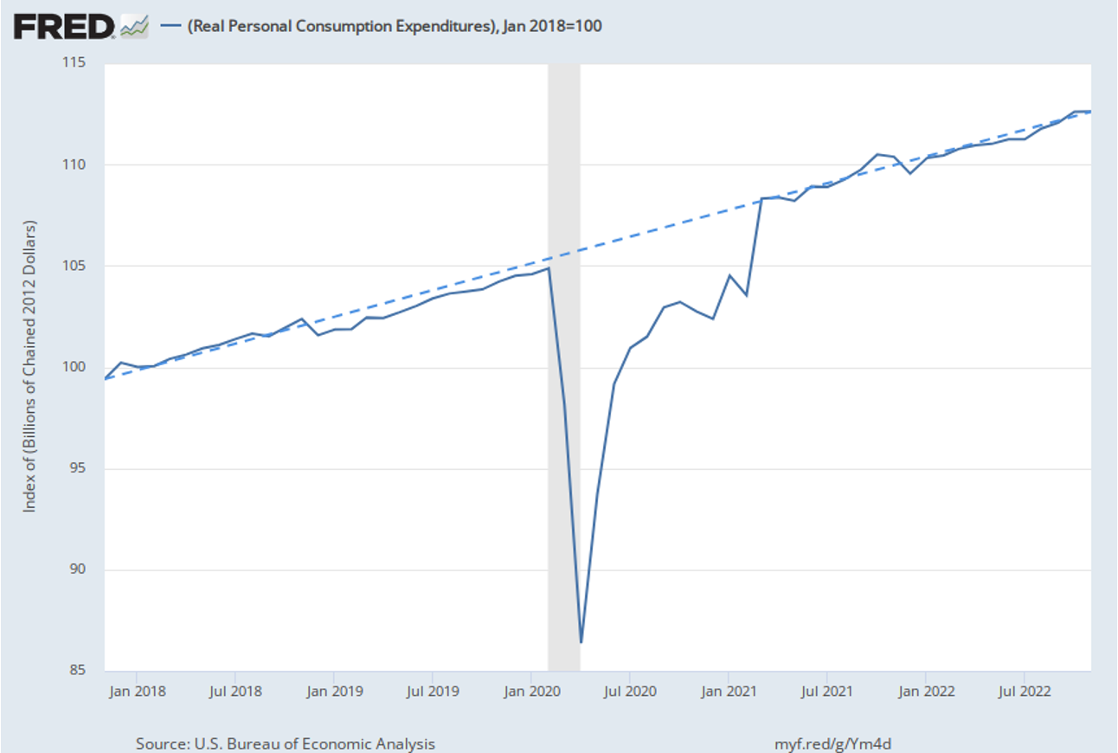


Consumer spending proved resilient
Source: U.S. Bureau of Labor Statistics
Notes:
Photos:
https://www.gettyimages.com/detail/photo/truck-with-custom-grill-royalty-free-image/139401743?phrase=pickups&adppopup=true
https://www.gettyimages.com/detail/photo/pediatricians-office-royalty-free-image/1266493570?phrase=doctor with kids&adppopup=true
https://www.gettyimages.com/detail/photo/house-with-solar-panels-royalty-free-image/181062267?phrase=solar roof&adppopup=true
https://www.gettyimages.com/detail/photo/business-travelers-arriving-at-hotel-reception-desk-royalty-free-image/1191193147?phrase=hotel&adppopup=true
As personal income rose, so did spending. Real personal consumption expenditures – spending after adjusting for inflation – accelerated for most of the year. People bought cars and light trucks. They spent money on health care, food services and accommodations, as well as housing and utilities. Spending began to slow during the fourth quarter.

Slide 24
Economic growth accelerated
 | 1Q 2022 | 2Q 2022 | 3Q 2022
GDP (Economic growth) | -1.6% | -0.6% | +2.9%
Consumer spending | +0.91 | +1.38 | +1.54
Government spending | -0.40 | -0.29 | +0.65
Business investment | +0.98 | -2.83 | -1.80
Net exports | -3.13 | +1.16 | +2.86
Source: U.S. Bureau of Economic Analysis
Notes:
Sources: https://www.bea.gov/sites/default/files/2022-12/gdp3q22_3rd.pdf [Table 2]
U.S. Bureau of Economic Analysis, Gross Domestic Product [GDP], retrieved from FRED, Federal Reserve Bank of St. Louis; https://fred.stlouisfed.org/series/GDP, June 2, 2022.; U.S. Bureau of Economic Analysis, Real Gross Domestic Product [GDPC1], retrieved from FRED, Federal Reserve Bank of St. Louis; https://fred.stlouisfed.org/series/GDPC1, June 2, 2022.
https://www.barrons.com/articles/us-gdp-first-quarter-51651096830
https://www.grantthornton.com/library/articles/advisory/2022/Economic-Analysis/Real-Time-Analysis/gdp-042822.aspx
Spending is important because it is the biggest contributor to economic growth in the United States. Despite the Fed’s efforts to slow economic growth, the economy did better as the year progressed. Of course, there were some extenuating factors in the first two quarters. The economy shrank during the first quarter when exports dropped sharply, and in the second it contracted due to weak business investment. In the third quarter, the economy expanded 2.9 percent. [Fourth quarter data will be released on January 27.]

Slide 25
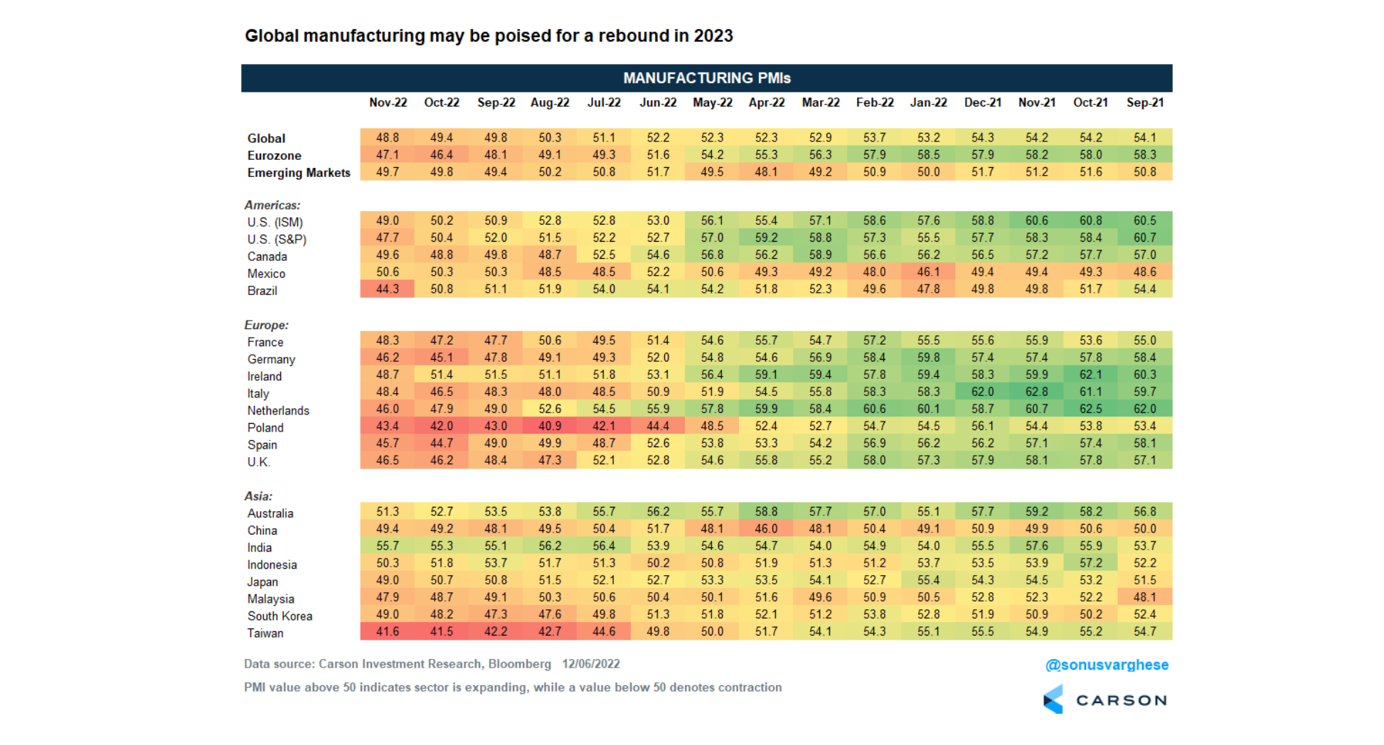
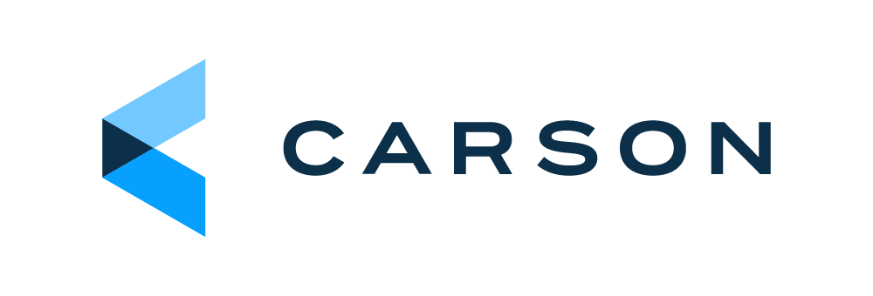
Notes:
Sources:
https://www.prnewswire.com/news-releases/manufacturing-pmi-at-57-1-march-2022-manufacturing-ism-report-on-business-301515115.html
https://www.prnewswire.com/news-releases/manufacturing-pmi-at-57-6-january-2022-manufacturing-ism-report-on-business-301472006.html
https://www.prnewswire.com/news-releases/manufacturing-pmi-at-56-1-may-2022-manufacturing-ism-report-on-business-301558163.html
https://www.prnewswire.com/news-releases/manufacturing-pmi-at-52-8-july-2022-manufacturing-ism-report-on-business-301596347.html
https://www.prnewswire.com/news-releases/manufacturing-pmi-at-50-9-september-2022-manufacturing-ism-report-on-business-301638361.html
There were some economic indicators that showed central bank policies were having an effect. Here you see manufacturing around the world. In the U.S., manufacturing activity slowed.

Slide 26
The Institute for Supply Management’s gauge of factory activity slid to 49 from 50.2 in the prior month, according to data released Thursday. The measure has fallen in five of the last six months and stands below 50, the threshold separating expansion and contraction, for the first time since the pandemic lockdowns.
—Jordan Yadoo, Bloomberg
December 1, 2022
Source: Bloomberg
Notes:
Source: https://www.bloomberg.com/news/articles/2022-12-01/manufacturing-in-us-contracts-for-first-time-since-may-2020
Bloomberg reported, “The Institute for Supply Management’s gauge of factory activity slid to 49 from 50.2 in the prior month, according to data released Thursday. The measure has fallen in five of the last six months and stands below 50, the threshold separating expansion and contraction, for the first time since the pandemic lockdowns.”

Slide 27
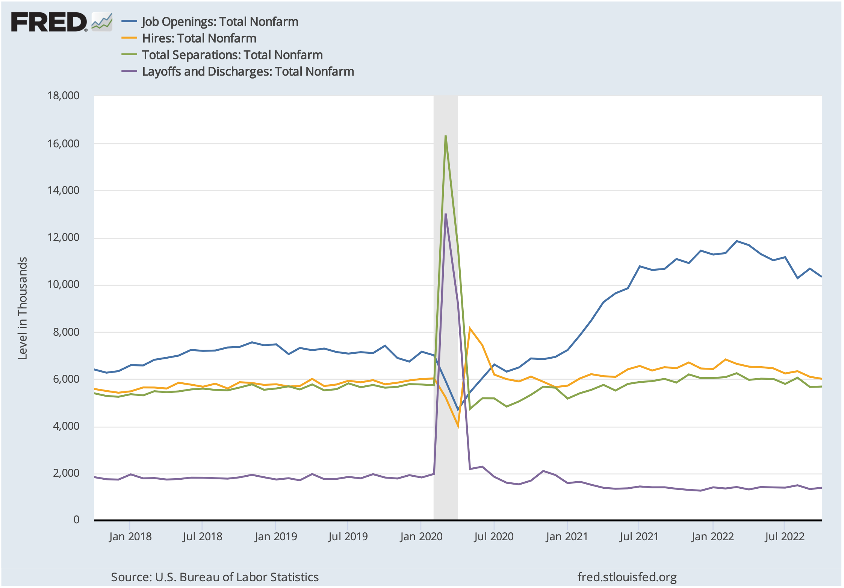
Job openings, hires, separations, and layoffs
Source: U.S. Bureau of Labor Statistics
Notes:
Source: U.S. Bureau of Labor Statistics, Job Openings, Hires, Total Separations, layoffs and discharges: Total Nonfarm [JTSJOL], retrieved from FRED, Federal Reserve Bank of St. Louis; https://fred.stlouisfed.org/series/JTSJOL, January 2, 2023.
Late in the year, there was some evidence the tight labor market was loosening as the number of job openings fell.

Slide 28


Home prices and rents cooled
Housing prices as of October 2022:
  +9.2% year-to-year
  -2.7% over 3 months
  Apartment rents as of November 2022:
  -2.2% over 3 months
Sources: Bloomberg, S&P CoreLogic Case-Shiller US National Index
Notes:
Photo
https://www.gettyimages.com/detail/photo/rental-sign-royalty-free-image/535398396?phrase=apartment for rent&adppopup=true
https://www.gettyimages.com/detail/photo/beautiful-luxury-home-exterior-with-green-grass-and-royalty-free-image/856794670?phrase=house&adppopup=true
https://www.gettyimages.com/photos/rent?assettype=image&license=rf&alloweduse=availableforalluses&family=creative&phrase=rent&sort=mostpopular
Source: https://www.bloomberg.com/opinion/articles/2022-12-01/housing-market-is-finally-giving-renters-a-break
https://www.spglobal.com/spdji/en/index-family/indicators/sp-corelogic-case-shiller/sp-corelogic-case-shiller-composite/#overview (or go to https://resources.carsongroup.com/hubfs/Carson%20Coaching%20Online/Market%20Commentary/Presentations/2023/Forecast%202023%20Sources/Slide%2028_S&P%20CoreLogic%20Case-Shiller%20Composite.pdf)
The housing market may be the place where the Fed's hikes have had the greatest impact. As mortgage rates rose, demand for homes fell. Nationally, home prices were still higher in November, year-over-year, but they were cooling quickly. Rents had begun to drop, too. Falling prices were exactly what the Fed wanted to see.

Slide 29
For many people, I suspect, 2022 will be a year to forget. However, for millions of home-builders, home-sellers and home-buyers, it will be remembered for the speed with which a housing boom turned into a housing bust. The reason, of course, has been a surge in mortgage rates. These rates look likely to stay high, at least over the next year, contributing to sharp declines in housing starts and home sales and a negative impact on GDP. Eventually, this could motivate the Federal Reserve to reverse course and cut rates.
—Dr. David Kelly, Chief Global Strategist, JP Morgan
November 22, 2022
Source: JPMorgan
Notes:
Sources: https://am.jpmorgan.com/us/en/asset-management/adv/insights/market-insights/market-updates/notes-on-the-week-ahead/
Dr. David Kelly, Chief Global Strategist for JP Morgan wrote, "For many people, I suspect, 2022 will be a year to forget. However, for millions of home-builders, home-sellers and home-buyers, it will be remembered for the speed with which a housing boom turned into a housing bust. The reason, of course, has been a surge in mortgage rates. These rates look likely to stay high, at least over the next year, contributing to sharp declines in housing starts and home sales and a negative impact on GDP. Eventually, this could motivate the Federal Reserve to reverse course and cut rates.”

Slide 30
What’s ahead?
Soft landing
Stagflation
Recession
35%
chance of a soft landing in 2023, according to
Goldman Sachs.
92%
of asset managers participating in a Bank of America survey expect slow growth and high inflation in 2023.
63%
chance of recession in 2023, according to economists surveyed by The Wall Street Journal
Source: Yahoo! Finance, Bloomberg, The Wall Street Journal
Notes:
Source: https://finance.yahoo.com/news/goldman-sachs-boss-ceo-david-solomon-recession-stocks-212005178.html
https://www.goldmansachs.com/insights/pages/gs-research/macro-outlook-2023-this-cycle-is-different/report.pdf
https://www.bloomberg.com/news/articles/2022-11-15/bofa-survey-shows-stagflation-fears-with-no-fed-pivot-in-sight
https://www.wsj.com/articles/economic-forecasting-survey-archive-11617814998 (or go to https://resources.carsongroup.com/hubfs/Carson%20Coaching%20Online/Market%20Commentary/Presentations/2023/Forecast%202023%20Sources/Slide%2030_Wall%20Street%20Journal_Economists%20Think%20They%20Can%20See%20Recession%20Coming.pdf)
Speculation about when the Fed would change its policy were a significant source of uncertainty last year. Many worried whether the Fed was making a policy mistake and would drive the economy into a recession. Analysts and market pundits made a lot of predictions – and opinions varied widely. In December, Goldman Sachs put the chance of a soft landing at 35 percent. A soft landing would be ideal. The economy would slow, inflation would fall, and then economic growth would pick up again. Ninety-two percent of asset managers surveyed by Bank of America agreed the U.S. was likely to experience stagflation – low growth and high inflation – this year. And financial professionals who participated in The Wall Street Journal's Forecaster Survey said there is a 65 percent chance of recession in 2023.

Slide 31
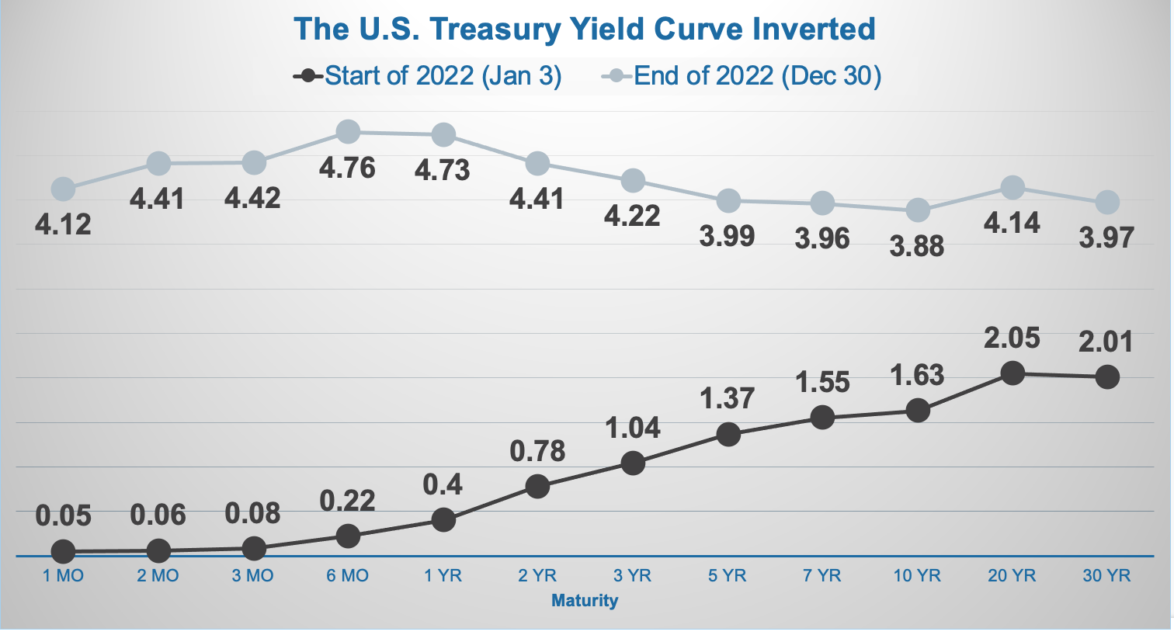
Source: U.S. Treasury
Notes:
Source: https://home.treasury.gov/resource-center/data-chart-center/interest-rates/TextView?type=daily_treasury_yield_curve&field_tdr_date_value=2022
https://www.newyorkfed.org/research/capital_markets/ycfaq#/interactive
https://www.bloomberg.com/news/newsletters/2022-11-23/bloomberg-evening-briefing-fed-sees-nearly-50-50-chance-of-us-recession
The U.S. Treasury yield curve inverted during 2022. The chart shows Treasury bond yields across maturities the start of 2022 and at the end of the year. Bond rates moved higher across maturities, but they rose most quickly for shorter maturities, causing the yield curve to invert. Shorter maturities yielded as much or more than longer maturities.

Slide 32
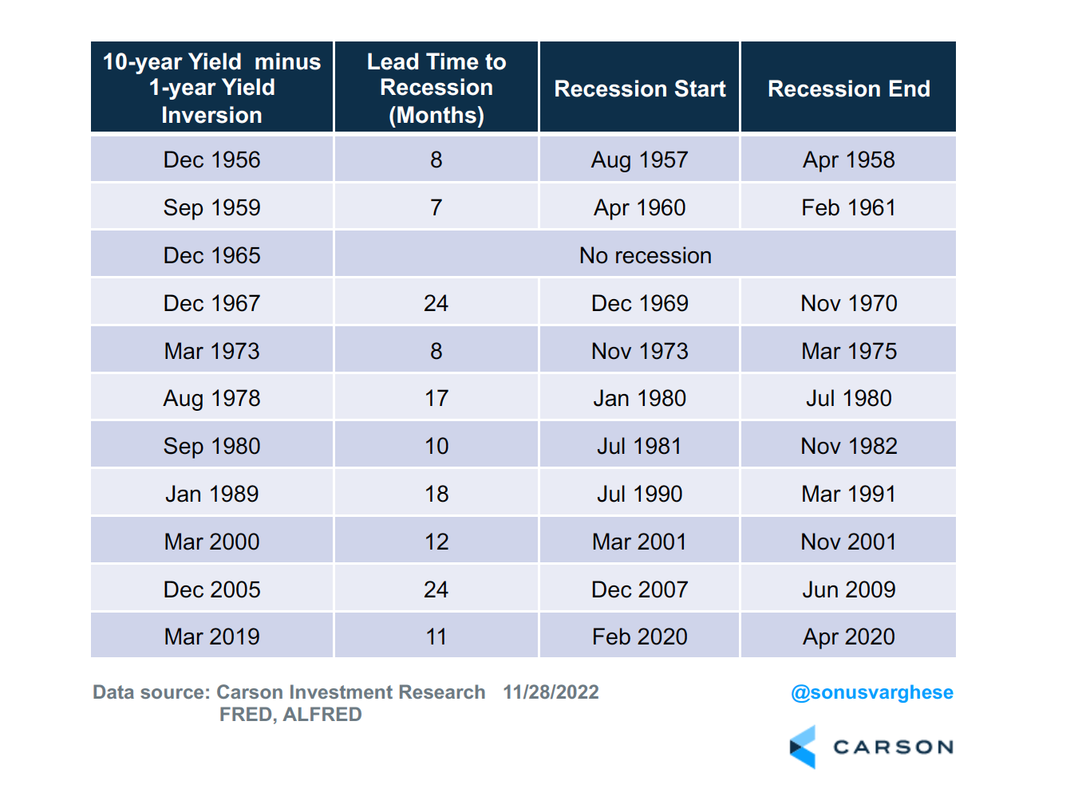
Notes:
Source: Carson Research
The Fed and many economists use the yield curve to gauge the potential for recession. Historically, inverted yield curves have occurred before recessions. [Review chart] At the end of 2022, Fed officials said the likelihood of recession in 2023 was about 50 percent.

Slide 33
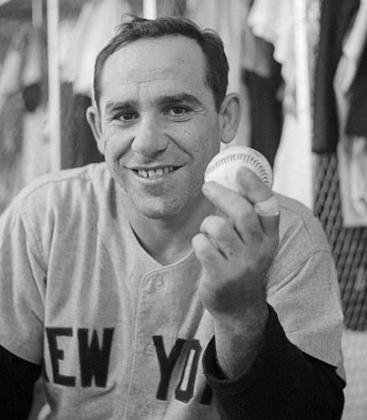
“It’s tough to make predictions, especially about the future.”
—Yogi Berra
Source: Goodreads
Notes:
Photo source: https://www.gettyimages.com/photos/yogi-berra
Source: https://www.goodreads.com/quotes/261863-it-s-tough-to-make-predictions-especially-about-the-future
As baseball great Yogi Berra used to say, “It’s tough to make predictions, especially about the future.”

Slide 34
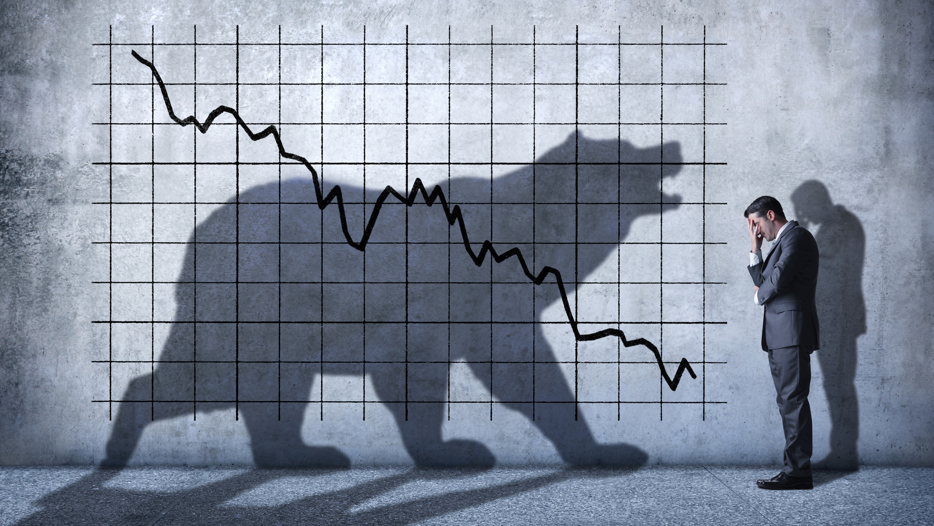
2022 in review: Financial markets
Notes:
Photo source: https://www.gettyimages.com/detail/photo/bear-market-royalty-free-image/1212035447?phrase=bear market&adppopup=true
There is no way to sugarcoat it. Last year was a tough year to be an investor. Soaring interest rates and rising inflation shocked financial markets. We had bear markets in stocks and bonds, and investors worried a lot.

Slide 35
University of Michigan Consumer Sentiment Survey
 | Dec 2021 | June 2022 | Dec 2022
Consumer sentiment | 70.6 | 50.0 | 59.7
Consumer inflation expectations, next year | 4.8% | 5.3% | 4.4%
Consumer inflation expectations, over 5 years | 2.9% | 3.1% | 2.9%
Source: University of Michigan Consumer Sentiment Survey
Notes:
Sources: http://www.sca.isr.umich.edu
http://www.sca.isr.umich.edu/files/tbcics.pdf
http://www.sca.isr.umich.edu/files/tbcpx1px5.pdf
Consumer sentiment declined to record lows last year, although it began to improve toward the end of year. The chart shows sentiment and inflation expectations through the third quarter of last year. Later in the year, the sentiment improved, particularly among higher-income families and people with larger stock holdings as financial markets headed higher. Short-term inflation expectations also improved, falling from 4.9 percent to 4.6 percent in December. That was the lowest reading in 15 months. Consumers expected inflation to average 3 percent over the longer term.

Slide 36
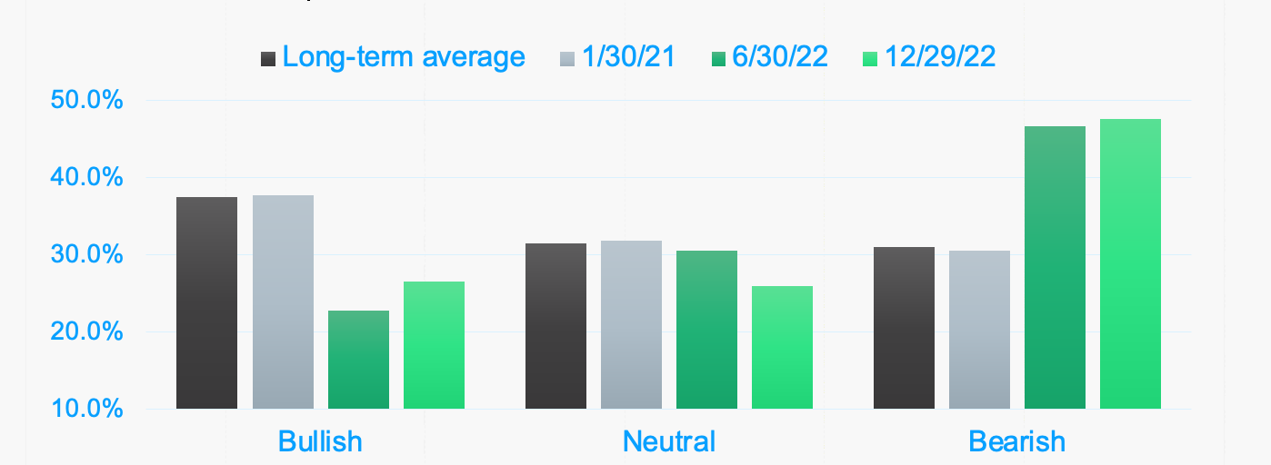
AAII Investor Sentiment Survey:
A contrarian indicator
Source: AAII Investor Sentiment Survey
Notes:
Source: https://www.aaii.com/sentimentsurvey (or go to https://resources.carsongroup.com/hubfs/Carson%20Coaching%20Online/Market%20Commentary/Presentations/2023/Forecast%202023%20Sources/Slide%2036_AAII%20Data.pdf)
Despite December’s optimism among consumers who held stock, many investors remained bearish. The AAII The Sentiment Survey is considered to be a contrarian indicator. So, when the level of optimism dips lower than usual, above-average market returns may follow. Similarly, when the level of optimism rises to unusually high levels, below-average market returns may follow. At the end of last year, investors were more bearish than usual.

Slide 37
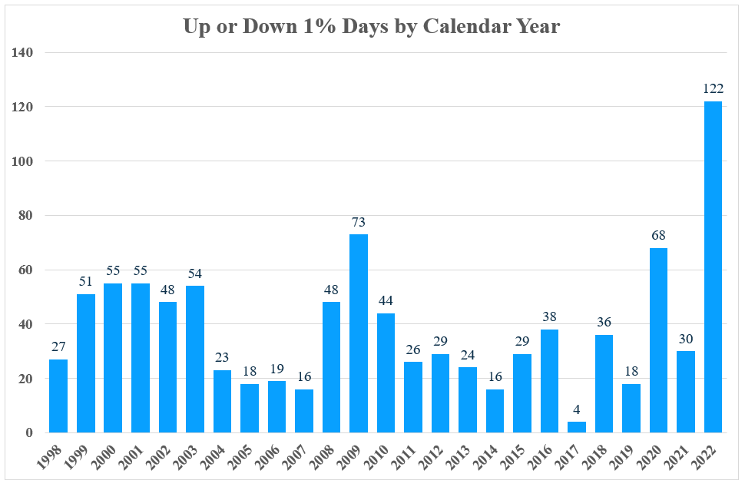
Standard & Poor’s 500 Index
Up or Down 1% Days through June by Calendar Year
Stock markets were turbulent
122 moves of 1%
46 moves of 2%
12 moves of 3%
Source: Morningstar Direct
Notes:
Source: Morningstar Direct
It was understandable. Volatility was one of the defining characteristics of U.S. stock markets during 2022. There were 122 moves of 1 percent, 46 moves of 2 percent, and 12 moves of 3 percent.

Slide 38
…the slump in markets around the world this year has been painful. MSCI’s broadest index of global equities is down by 18%, as is the S&P 500 index of big American firms. It is not just shares that have suffered...Supposedly safer assets have not escaped the rout, either.
—The Economist
December 8, 2022
Source:
Notes:
Source: https://www.economist.com/briefing/2022/12/08/rising-interest-rates-and-inflation-have-upended-investing
The Economist reported, “…the slump in markets around the world this year has been painful. MSCI’s broadest index of global equities is down by 18 percent, as is the S&P 500 index of big American firms. It is not just shares that have suffered...Supposedly safer assets have not escaped the rout, either.”

Slide 39
Performance
Index | Weekly Return | QTD Return | YTD Return
S&P 500 TR | -0.1% | 7.6% | -18.1%
MSCI ACWI TR | 0.0% | 9.8% | -18.4%
Bloomberg US Agg Bond TR | -0.7% | 1.9% | -13.0%
Russell 2000 TR | 0.1% | 6.2% | -20.4%
Top YTD Sector: Energy | 0.3% | 20.7% | 61.1%
Bottom YTD Sector: Communication Services | 0.0% | -1.9% | -40.7%
Top YTD Style Box (M*): Large Value | 0.2% | 15.6% | 0.3%
Bottom YTD Style Box (M*): Large Growth | -0.2% | 1.1% | -40.4%
Russell 1000 Value – Russell 1000 Growth (difference) | 0.5% | 10.2% | 21.6%
Source: Morningstar Direct
Notes:
Source: Morningstar Direct
Here you see how some major market indexes and sectors performed last year. [Review slide]

Slide 40

Some expect earnings to grow
“Despite concerns about a possible recession next year, analysts still expect the S&P 500 to report single-digit earnings growth in CY 2023. The estimated (year-over-year) earnings growth rate for CY 2023 is 5.5%... Analysts are expecting most of the earnings growth to occur in the second half of the 2023.”
  —John Butters, FactSet
  December 9, 2022
Source: FactSet
Notes:
Image: https://www.gettyimages.com/detail/photo/business-presentation-royalty-free-image/598260236?phrase=earnings&adppopup=true
Source: https://insight.factset.com/cy23-earnings-preview
Some analysts expect earnings to be positive in 2023. “Despite concerns about a possible recession next year, analysts still expect the S&P 500 to report single-digit earnings growth in CY 2023. The estimated (year-over-year) earnings growth rate for CY 2023 is 5.5%... Analysts are expecting most of the earnings growth to occur in the second half of the 2023.”
Some analysts think earnings forecasts are too optimistic.

Slide 41

Some expect an earnings recession
"I think there's a good chance the market is underpricing risk...If we achieve a soft landing, that's awesome and markets probably have bottomed...but the market hasn't really quite priced in the likelihood of a harder landing, the likelihood of an earnings recession..."
—Michael Zinn, Managing Director, UBS
December 22, 2022
Source: CNBC Squawk Box
Notes:
Photo: https://www.gettyimages.com/detail/photo/business-accounting-concept-business-man-using-royalty-free-image/1178916772?phrase=earnings financial &adppopup=true
Source: https://www.youtube.com/watch?v=QvJQCLow18g
For instance, Michael Zinn the Managing Director of UBS told CNBC's Squawk Box, "I think there's a good chance the market is underpricing risk... If we achieve a soft landing, that's awesome and markets probably have bottomed... but the market hasn't really quite priced in the likelihood of a harder landing, the likelihood of an earnings recession..." An earnings recession happens when earnings drop for two or more quarters.

Slide 42
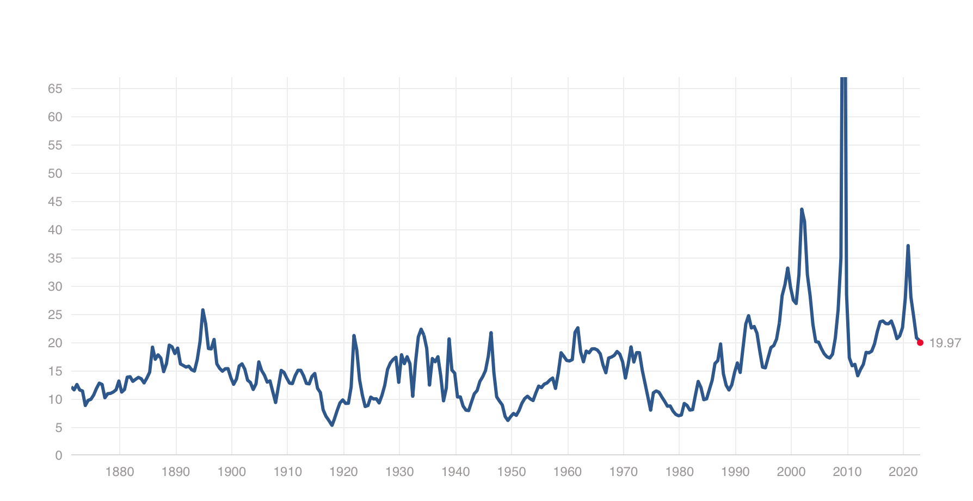
Price-to-earnings ratio of the S&P 500
(as of December 30, 2022)
19.97
Source: Multpl
Notes:
Source: https://www.multpl.com/s-p-500-pe-ratio
If earnings are lower than expected, share prices could move lower. Price-to-earnings ratios measure the price of a stock relative to its earnings. The PE of the S&P 500 was 19.97 at the end of December, which is above its long-term average of 14.91.

Slide 43
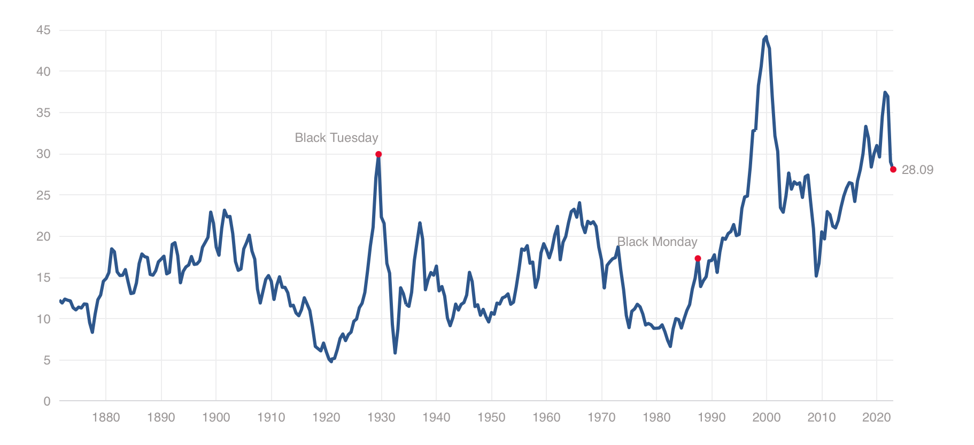
Shiller CAPE Ratio/S&P 500 Index
(as of December 12, 2022)
28.09
Source: Multpl
Notes:
Source: https://www.barrons.com/articles/is-us-in-recession-nber-official-definition-51654630634
The Shiller CAPE ratio measures the price of a stock relative to its earnings using average inflation-adjusted earnings from the previous 10 years. At the end of December, the CAPE PE was 28.09, well below recent highs but still above the long-term average of 16.99. These PE ratios suggest that S&P 500 stocks remain expensive.
In recent years, share valuations have been at exceptional levels for many reasons. One is that U.S. stocks have offered very attractive levels of income compared to bonds. Now that interest rates are increasing, bonds may become more competitive and offer investors opportunities to invest for income with less risk. As investors move assets from stocks to bonds, that could push share prices lower.

Slide 44
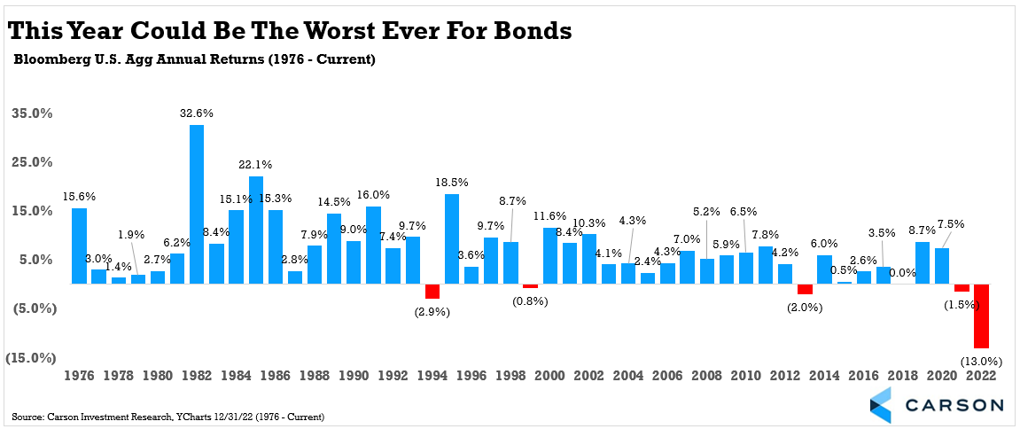
A bear market in bonds
Source: Carson Investment Research
Notes:
Source: Carson Investment Research
Bond yields soared last year on higher inflation expectations and a hawkish Federal Reserve. When bond yields rise, bond prices fall. As a result, bonds had a historically bad year. The Bloomberg U.S. Aggregate Bond Index was down 13 percent for the year. To put things in perspective, the Index had never been down two years a in row before, and the previous worse year ever was a 2.9 percent drop in 1994.

Slide 45
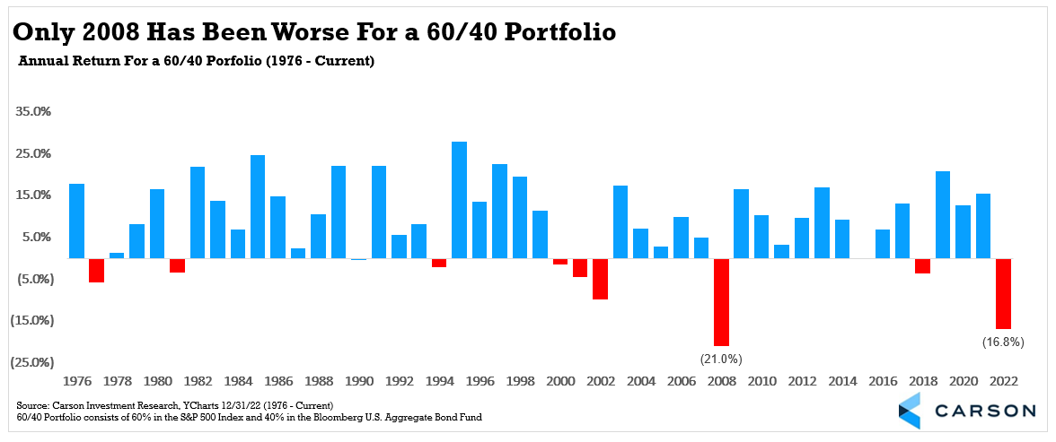
2022 was a tough year
Source: Carson Investment Research
Notes:
Sources: Carson Investment Research
https://www.marketwatch.com/investing/index/spx/charts
With stocks and bonds both heading lower, the traditional 60/40 portfolio, which holds 60 percent stocks and 40 percent bonds, had a very disappointing year. Investors hold 60/40 portfolios when they want to earn consistent returns while taking moderate risk.
The question on many people’s minds is how long will this last? And what comes next?

Slide 46

What may be ahead
Notes:
Photo source: https://www.gettyimages.com/detail/photo/commercial-jet-flying-over-clouds-royalty-free-image/155380716?phrase=Flight clear sky&adppopup=true
As much as we would like to say we see clear skies ahead, that’s probably not the case. A lot of uncertainty remains and, since markets hate uncertainty, we may experience some turbulence in 2023.

Slide 47
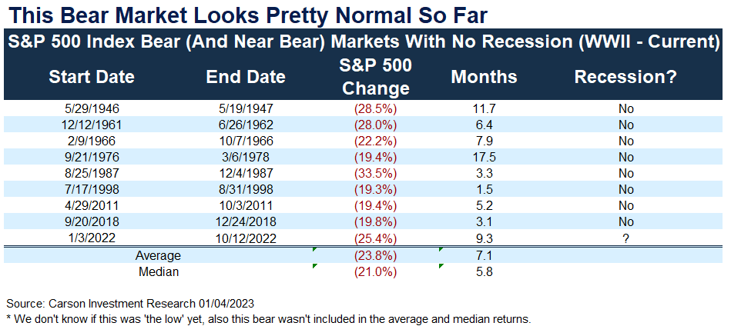
How long will this bear market last?
Source: Carson Investment Research, YCharts
Notes:
Source: Carson Investment Research
While no one can be sure how long a bear market will last, this one seems pretty normal. This data shows bear markets that took place without recessions. (We don’t think there was a recession in 2022. It shows that stocks fell about 24 percent on average. On one occasion, stocks fall more than 30 percent without an accompanying recession and that was the 1987 crash. It’s possible we’ll have a recession and markets will go lower. It’s also possible – just barely – that we won’t have a recession. The good news is that when markets decline, opportunities become available. A lot people miss out on the opportunities because stock market sales (aka bear markets) scare a lot of investors away.

Slide 48
What may happen after the bear market?
Source: Carson Investment Research, Ned Davis Research, FactSet
Notes:
Sources: Carson Investment Research, Ned Davis Research, FactSet
We don’t know when this bear market will end but, historically, markets have delivered attractive returns as they recover from bear market lows. It’s the light at the end of the tunnel of market downturns.

Slide 49
A top-down analysis of 17 Wall Street strategists' predictions shows the average S&P 500 price target for the end of 2023 is just 4,009, which represents potential upside of less than 1% from current levels.
—Matthew Fox, Business Insider
December 9, 2022
Source: Yahoo! Finance
Notes:
Source: https://finance.yahoo.com/news/recession-fears-paralyzed-wall-street-210149478.html
Matthew Fox reported, “A top-down analysis of 17 Wall Street strategists' predictions shows the average S&P 500 price target for the end of 2023 is just 4,009, which represents potential upside of less than 1% from current levels.” He suggested the negative outlook was the result of recession fears.

Slide 50
Some of the world’s biggest investors predict that stocks will see low double-digit gains next year, yet the path to a rebound won’t be a straight line. Amid recent optimism that inflation has peaked — and that the Federal Reserve could soon start to change its tone — 71% of respondents in a Bloomberg News survey expect equities to rise, versus 19% forecasting declines.
—Jan-Patrick Banert
Bloomberg, December 10, 2022
Source: Bloomberg
Notes:
Source: https://www.bloomberg.com/news/articles/2022-12-10/world-s-top-money-managers-see-global-stocks-recovering-in-2023?srnd=premium
Not everyone agreed. Estimates varied depending on whose estimates were included in the analysis. Jan-Patrick Banert of Bloomberg reported, “Some of the world’s biggest investors predict that stocks will see low double-digit gains next year, yet the path to a rebound won’t be a straight line. Amid recent optimism that inflation has peaked — and that the Federal Reserve could soon start to change its tone — 71 percent of respondents in a Bloomberg News survey expect equities to rise, versus 19% forecasting declines.”
There is one thing we can be certain about in 2023.

Slide 51
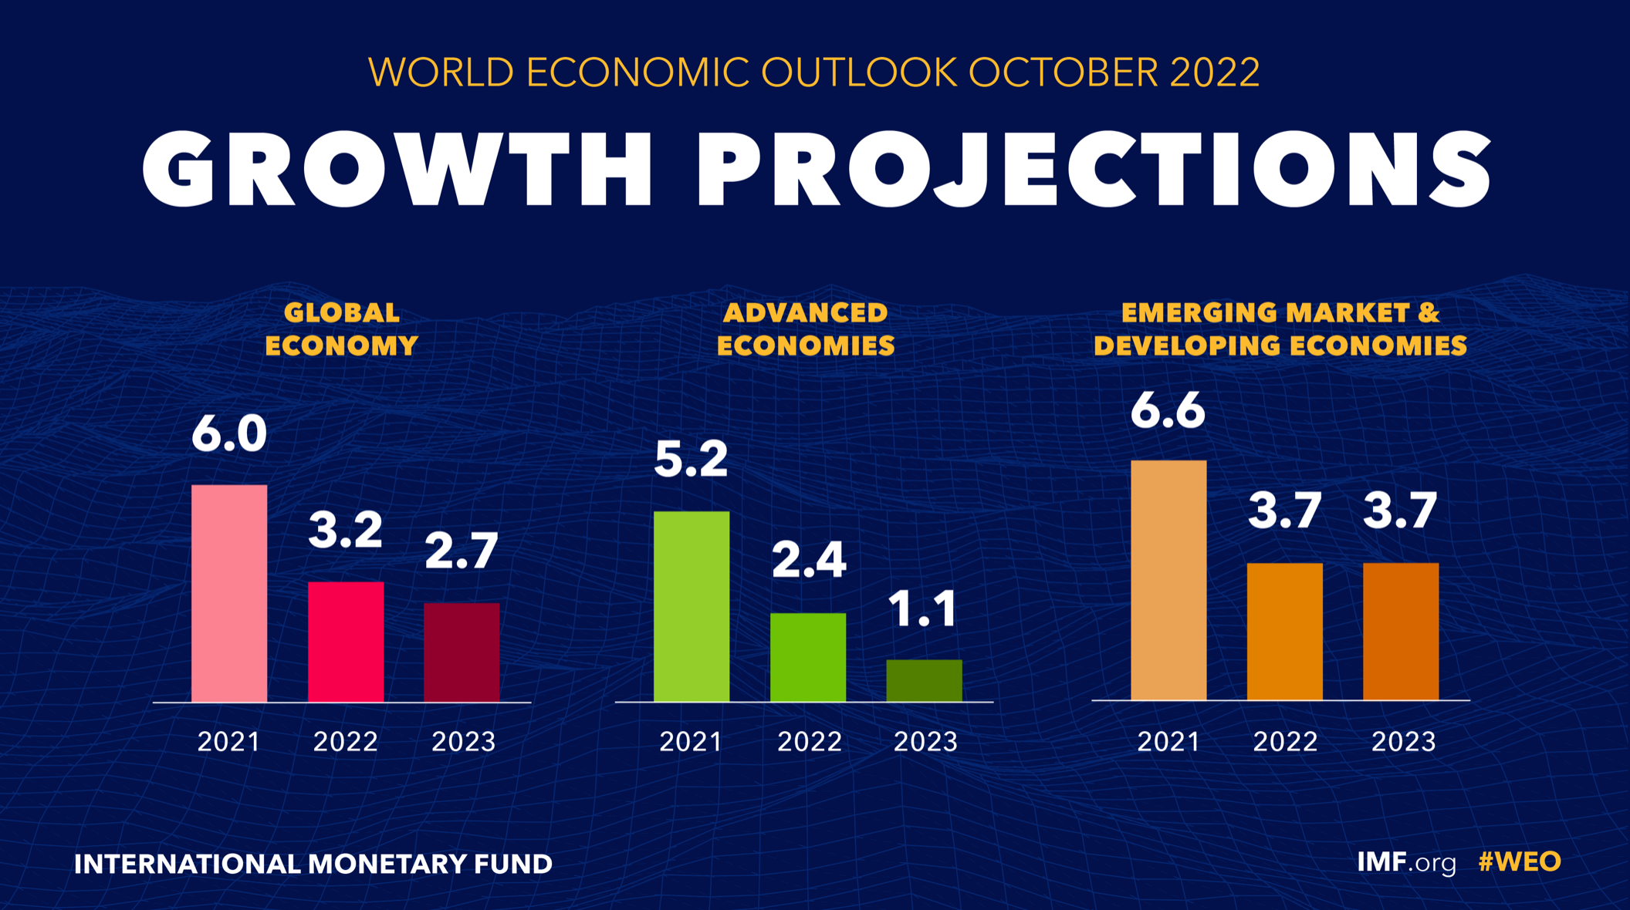
Notes:
Source: https://www.gettyimages.com/photos/buy-less?assettype=image&phrase=buy%20less&sort=mostpopular&license=rf%2Crm
The performance of financial markets is likely to be affected by economic growth. The International Monetary Fund anticipates that global economic growth will slow this year. Growth in emerging and developing nations is expected to be stronger than growth in advanced economies.

Slide 52
Global debt remained above pre-pandemic levels in 2021 even after posting the steepest decline in 70 years…Total public and private debt decreased in 2021 to the equivalent of 247 percent of global gross domestic product, falling by 10 percentage points from its peak level in 2020...Expressed in dollar terms, however, global debt continued to rise, although at a much slower rate, reaching a record $235 trillion last year.
—Vitor Gaspar, Paulo Medas, Roberto Perrelli, IMF blog December 12, 2022
Source: IMF
Notes:
Source: https://www.imf.org/external/terms.htm
One of the factors that will affect growth – apart from central bank tightening – is debt. The IMF blog reported, “Global debt remained above pre-pandemic levels in 2021 even after posting the steepest decline in 70 years…Total public and private debt decreased in 2021 to the equivalent of 247 percent of global gross domestic product, falling by 10 percentage points from its peak level in 2020…Expressed in dollar terms, however, global debt [reached] a record $235 trillion last year.”

Slide 53
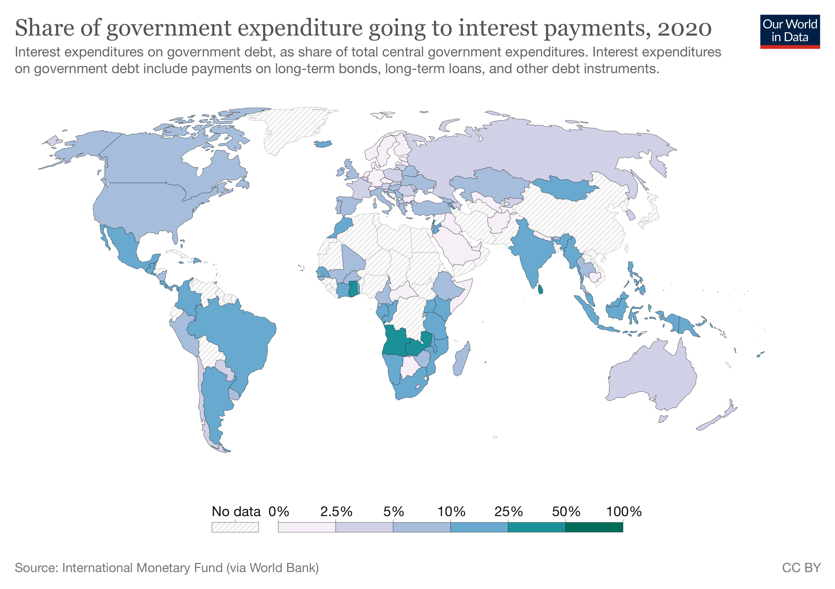
U.S. national debt
2022 debt metrics
$31.4 trillion
137% of GDP
Source: Our World in Data
Notes:
Sources: https://elibrary.worldbank.org/doi/abs/10.1596/1813-9450-5391
https://tradingeconomics.com/united-states/government-debt
https://ourworldindata.org/grapher/share-of-government-expenditure-going-to-interest-payments
In 2022, total debt reached $31.4 trillion, and 137% of GDP. A 2010 World Bank study found that when GDP surpasses 77 percent of gross domestic product (GDP), which is the value of all goods and services produced by a nation, economic growth slows. Another effect of high debt is paying the interest. As interest rates rise, the cost of our debt increases.

Slide 54
What people
are saying
Notes:
As you might imagine from what we’ve discussed so far, expert opinion about what the future may hold varies widely. Let’s take a look at what a few people think may happen this year.

Slide 55
…Fed Chair Jerome Powell and his colleagues have been quietly setting the stage for [a soft landing]. Their monetary tightening campaign is having a major impact in deflating asset bubbles that swelled during the first years of the pandemic…Investor-favored technology stocks have tumbled by more than 50%; Red-hot housing prices are falling for the first time in 10 years. And most importantly, all of this is occurring without upending the financial system.
- Rich Miller, Bloomberg
December 8, 2022
Source: Bloomberg
Notes:
Source: https://www.bloomberg.com/news/articles/2022-12-08/us-federal-reserve-s-inflation-fight-spurs-crypto-tech-housing-market-drops?cmpid=BBD120822_BIZ&utm_medium=email&utm_source=newsletter&utm_term=221208&utm_campaign=bloombergdaily
Journalist Rich Miller of Bloomberg reported, “…Fed Chair Jerome Powell and his colleagues have been quietly setting the stage for [a soft landing]. Their monetary tightening campaign is having a major impact in deflating asset bubbles that swelled during the first years of the pandemic…Investor-favored technology stocks have tumbled by more than 50%; Red-hot housing prices are falling for the first time in 10 years. And most importantly, all of this is occurring without upending the financial system.”

Slide 56
…the world may be experiencing major structural and secular changes that will outlast the current business cycle. Three new trends in particular hint at such a transformation and are likely to play an important role in shaping economic outcomes over the next few years: the shift from insufficient demand to insufficient supply as a major multi-year drag on growth, the end of boundless liquidity from central banks, and the increasing fragility of financial markets.
—Mohamed A. El-Erian, Foreign Affairs
November 22, 2022
Source: Foreign Affairs
Notes:
Source: https://www.foreignaffairs.com/world/not-just-another-recession-global-economy?check_logged_in=1&utm_medium=promo_email&utm_source=lo_flows&utm_campaign=registered_user_welcome&utm_term=email_1&utm_content=20221211 (or go to https://resources.carsongroup.com/hubfs/Carson%20Coaching%20Online/Market%20Commentary/Presentations/2023/Forecast%202023%20Sources/Slide%2057_Foreign%20Affairs_Not%20Just%20Another%20Recession.pdf)
Economist Mohamed El-Erian wrote, “…the world may be experiencing major structural and secular changes that will outlast the current business cycle. Three new trends in particular hint at such a transformation and are likely to play an important role in shaping economic outcomes over the next few years: the shift from insufficient demand to insufficient supply as a major multi-year drag on growth, the end of boundless liquidity from central banks, and the increasing fragility of financial markets.”

Slide 57
In 2023 the world will still be grappling with unstable oil and gas markets, but will also redouble its efforts to create an energy system that is cheaper, cleaner and more secure...In 2023 most countries will strike two new pacts with the devil. In the short term they will embrace investment in polluting fossil fuels in return for security. In the long term they will adopt state-led industrial policy in an attempt to accelerate a renewables build-out.
—Patrick Foulis, The Economist
November 18, 2022
Source: The Economist
Notes:
Source:
Patrick Foulis of The Economist forecasts, “In 2023 the world will still be grappling with unstable oil and gas markets, but will also redouble its efforts to create an energy system that is cheaper, cleaner and more secure...In 2023 most countries will strike two new pacts with the devil. In the short term they will embrace investment in polluting fossil fuels in return for security. In the long term they will adopt state-led industrial policy in an attempt to accelerate a renewables build-out.”

Slide 58
The Federal Reserve's ongoing commitment to raising interest rates to cool inflation is likely to lead to weak U.S. economic trends in early 2023. However, Fed policymakers have indicated they are looking to an eventual pause in rate hikes, possibly in early to mid-2023, and that it is likely the federal funds rate target will remain at its peak, or "terminal," rate for a while. In other words, there may be more choppiness, given that inflation is still a noticeable (although receding) problem, but the longer-term U.S. economic outlook has improved.
—Liz Ann Sonders, Managing Director, Schwab
December 12, 2022
Source: Charles Shwab
Notes:
Source: https://www.schwab.com/learn/story/outlook-overview
Liz Ann Sonders, who is the Managing Director and Chief Investment Strategist at Schwab turned her sights to the end of the Fed’s tightening cycle. “The Federal Reserve's ongoing commitment to raising interest rates to cool inflation is likely to lead to weak U.S. economic trends in early 2023. However, Fed policymakers have indicated they are looking to an eventual pause in rate hikes, possibly in early to mid-2023, and that it is likely the federal funds rate target will remain at its peak, or “terminal,” rate for a while. In other words, there may be more choppiness, given that inflation is still a noticeable (although receding) problem, but the longer-term U.S. economic outlook has improved.”

Slide 59
Now, we still probably have to work our way through a recession in 2023 but, looking back at how we came out of the 2001 recession, we saw economies recovering at different speeds. This made it interesting from an investment perspective and I certainly think this will be a great opportunity over the next couple of years. Already, it’s worth noting that emerging markets were far quicker to deal with inflation last year, so they’re getting very near to the end of their tightening cycle.
—Johanna Kyrklund, Co-Head of Investment, Shroders
December 7, 2022
Source: Shroders
Notes:
Source: https://www.schroders.com/en/us/professional-investor/insights/multi-asset/outlook-2023-cio-and-multi-asset-its-all-about-valuations/
Johanna Kyrkland, who is the co-head of investment at Shroder's wrote, "Now, we still probably have to work our way through a recession in 2023 but, looking back at how we came out of the 2001 recession, we saw economies recovering at different speeds. This made it interesting from an investment perspective and I certainly think this will be a great opportunity over the next couple of years. Already, it’s worth noting that emerging markets were far quicker to deal with inflation last year, so they’re getting very near to the end of their tightening cycle.”

Slide 60

Worry is normal
Avoid fear-based decisions
Stay the course
Keep your eyes on the end goal
Trust the plan
Be mindful in spending
Notes:
Photo: https://www.gettyimages.com/detail/photo/senior-couple-watching-digital-tablet-together-at-royalty-free-image/1219364296?phrase=older couple on ipad&adppopup=true
It can be really painful to go through market downturns and volatility like what we’re currently experiencing. If you’re feeling worried or anxious about your finances or feel a punch to your gut when you look at your account values – that’s normal. We’re human – we’re wired to avoid things that could cause us pain, even when we anticipate it will pay off in the future. That’s why we’re here – we help people make good decisions for their situation. While we can’t predict the future, we want to remind you of a few things that might help you sleep better at night:
Avoid fear-based decisions. Emotional decision-making can cause us to make irrational decisions that hurt us in the long term. We believe that this volatility is a short-term situation, yet your financial plan is built for the long term. As the markets rebound, making major adjustments to your plan could result in missing out on the next rise in the markets. As always, we need to rely on our process to make good decisions for you.
Stay the course. It can be difficult to see your account values drop significantly, and we understand. We’re here to help you through these challenging markets so you can stay on track.
Keep your eyes on the end goal. What’s important to most of our clients isn’t making the most money they possibly can – it’s achieving the goals that are important to you. Things may get bumpy along the way, but its important to stay focused on your destination.
Trust your plan. Your financial plan is built on diversification and longevity, both of which protect you from volatility. We can’t emphasize this enough: we stress test your plan, so volatility is already built in.
Be mindful in your spending. When costs for goods and services are high, it’s easy to overspend, and when we overspend, it can cause us to take on debt – which has high interest rates right now – or sell investments when their value is down.
In a turbulent market, a plan is essential. It’s also important to remember that, while turbulence can be unnerving and make a flight uncomfortable, it doesn’t usually prevent travelers from reaching their destinations.

Slide 61
Forecast 2023
The Standard & Poor’s 500 Index is a capitalization weighted index of 500 stocks designed to measure performance of the broad domestic economy through changes in the aggregate market value of 500 stocks representing all major industries.
The Consumer Price Index (CPI) is a measure of the average change over time in the prices paid by urban consumers for a market basket of consumer goods and services.
Personal Consumption Expenditures (PCE) is a measure of price changes in consumer goods and services, targeted towards goods and services consumed by individuals. PCE is released monthly by the Bureau of Economic Analysis (BEA).
The Price-to-Earning (P/E) ratio is a measure of the price paid for a share relative to the annual net income or profit earned by the firm per share. It is a financial ratio used for valuation: a higher P/E ratio means investors are paying more for each unit of net income, thus, the stock is more expensive compared to one with a lower P/E ratio.

