Slide 1
Notes to Advisors
Select a Presentation Title Page and End Page
Select the presentation cover from the three options that follow (slides 2-4).
Select the corresponding end page from the three options (slides 62-64).
Delete the other options.
Insert Your Logo into the Cover and Back Page
Delete the current text box with Insert Logo Here.
Select the Insert Tab > Picture > find the location on your computer and select Insert.
Resize logo by holding down the shift key and dragging one corner in (to make smaller) or out (to make larger).
Note: holding the shift key while dragging will proportionally change the size of your logo and not distort it.
Delete This Page
Delete this page from your presentation.

Slide 2
Half-Time 2022
From tailwinds to headwinds
{Insert Date | Insert Time} {Insert Location}
{Your Company Name or Logo Here}
Notes:
Getty Imagehttps://www.gettyimages.com/detail/photo/looking-with-binoculas-on-top-of-a-bouder-royalty-free-image/506237858?adppopup=true
Welcome to our Half-Time 2022 report. We're glad you're here!
A lot has happened in just six months. Tailwinds have become headwinds as factors that once supported economic recovery – like fiscal and monetary policy – changed direction and are now slowing economic growth. New headwinds, like the War in Ukraine and lockdowns in China, blew in. All of these have affected investors' outlook and financial market performance, as we'll discuss today. Before we get started, let me share some required information.

Slide 3
Half-Time 2022
From tailwinds to headwinds
{Insert Date | Insert Time} {Insert Location}
{Your Company Name or Logo Here}
Notes:
Getty Image: https://www.gettyimages.com/detail/photo/sunflowers-royalty-free-image/1264289908?adppopup=true
Welcome to our Half-Time 2022 report. We're glad you're here!
A lot has happened in just six months. Tailwinds have become headwinds as factors that once supported economic recovery – like fiscal and monetary policy – changed direction and are now slowing economic growth. New headwinds, like the War in Ukraine and lockdowns in China, blew in. All of these have affected investors' outlook and financial market performance, as we'll discuss today. Before we get started, let me share some required information.

Slide 4
Half-Time 2022
From tailwinds to headwinds
{Insert Date | Insert Time} {Insert Location}
{Your Company Name or Logo Here}
Notes:
Getty Image: https://www.gettyimages.com/detail/photo/mother-and-her-daughter-child-girl-playing-her-mom-royalty-free-image/1218429387?adppopup=true
Welcome to our Half-Time 2022 report. We're glad you're here!
A lot has happened in just six months. Tailwinds have become headwinds as factors that once supported economic recovery – like fiscal and monetary policy – changed direction and are now slowing economic growth. New headwinds, like the War in Ukraine and lockdowns in China, blew in. All of these have affected investors' outlook and financial market performance, as we'll discuss today. Before we get started, let me share some required information.

Slide 5
Half-Time 2022
The opinions voiced in this material are for general information only and are not intended to provide specific advice or recommendations for any individual. To determine which investment(s) may be appropriate for you, consult your financial professional prior to investing. All performance referenced is historical and is no guarantee of future results. All indices are unmanaged and cannot be invested into directly.
Risk Considerations: The economic forecasts set forth in this presentation may not develop as predicted and there can be no guarantee the strategies promoted will be successful. Stock investing involves risk including loss of principal. Bonds are subject to market and interest rate risk if sold prior to maturity. Bond values will decline as interest rates rise and bonds are subject to availability and change in price. International and emerging market investing involves special risks such as currency fluctuation and political instability and may not be suitable for all investors.
{Insert B/D Disclosure Here}
Notes:
The opinions voiced in this material are for general information only and are not intended to provide specific advice or recommendations for any individual. To determine which investment(s) may be appropriate for you, consult your financial professional prior to investing. All performance referenced is historical and is no guarantee of future results. All indices are unmanaged and cannot be invested into directly.
Risk Considerations: The economic forecasts set forth in this presentation may not develop as predicted and there can be no guarantee strategies promoted will be successful. Stock investing involves risk including loss of principal. Bonds are subject to market and interest rate risk if sold prior to maturity. Bond values will decline as interest rates rise and bonds are subject to availability and change in price. International and emerging market investing involves special risks such as currency fluctuation and political instability and may not be suitable for all investors.

Slide 6
Agenda
The economy
Financial markets
What may be ahead
Notes:
Today, we’re going to begin by talking about the crazy – and not so crazy – economic events that have shaped 2022 so far. Then, we'll focus on how these events have affected financial markets. Finally, we'll talk about what may be ahead in 2022. Before we get started, let’s get your brains warmed up with a brief quiz.

Slide 7
A Quiz:
Pop culture trends
Half-Time 2022 From tailwinds to headwinds
Notes:
Source:
Today’s quiz is about current trends.

Slide 8
It doesn't taste like chicken.
According to a popular organic market, in 2022, everything from soda to yogurt will be available in this trendy new flavor. What is it?
Basil
Cinnamon
Hibiscus
Rose Harissa
Notes:
Source: https://www.wholefoodsmarket.com/trends/top-food-trends-2022
Image: https://www.gettyimages.com/detail/photo/shopping-cart-view-in-supermarket-aisle-with-royalty-free-image/838816102?adppopup=true
Let's start with food trends. According to a popular organic market, everything from soda to yogurt will soon be available in this flavor. What flavor is it?
Basil
Cinnamon
Hibiscus
Rose Harissa

Slide 9
Hibiscus. It isn't just for tea, anymore.
Notes:
Image: https://www.gettyimages.com/detail/photo/colorful-hawaiian-hibiscus-in-the-garden-royalty-free-image/871942798?adppopup=true
The answer is hibiscus. Hibiscus tea has always been a good source of Vitamin C. Soon, you'll be seeing more hibiscus-flavored products.

Slide 10
What are they looking for in a partner?
The 10th most popular dating app reported that 91% of its singles would prefer to date someone who:
Knows where to find the best price on gasoline
Goes to therapy
Has a similar sense of humor
Would prioritize the search for loved ones in a zombie apocalypse
Notes:
Source: https://www.tomsguide.com/best-picks/best-dating-apps; https://www.globaldatinginsights.com/news/hinge-releases-2022-predictions-for-dating/
Image: https://www.gettyimages.com/detail/photo/close-up-woman-hand-hold-using-smart-phone-with-royalty-free-image/1340024049?adppopup=true
The 10th most popular dating app reported that 91% of its singles would prefer to date someone who:
Goes to therapy
Knows where to find the best price on gasoline
Has a similar sense of humor
Would search for their loved ones during a zombie apocalypse

Slide 11
Self-care is important.
91% would prefer to date someone who goes to therapy.
88% are more likely to go on a second date if their date mentions therapy on the first date.
Only 8% are willing to mention therapy on a first date.
Notes:
Image: https://www.gettyimages.com/detail/photo/empathetic-therapist-listens-to-female-client-royalty-free-image/1320392475?adppopup=true
They would prefer to date someone who goes to therapy — and they’re more likely to go on a second date if the person mentions going to therapy on the first date. However, very few respondents were willing to mention therapy on a first date!

Slide 12
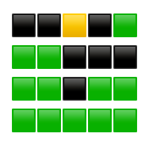
What is this?
And what is it telling us?
Notes:
Okay, what is this? (Bonus points if you know what it's telling us.)

Slide 13
It’s a Wordle score!
Notes:
Sources: https://twitter.com/jonnysun/status/1479178534585180163?lang=en; https://twitter.com/wordleinpaint?lang=en
That's right. It's a Wordle score. Wordle is a daily word game has become wildly popular. People often send their score boxes to each other or post them on social media. The score boxes have inspired a new art form: Wordle in paint.

Slide 14
It's the next big thing for your home!
There's a new trend in interior design this year. It's been written up in Country Living and House Beautiful, and it will soon have a streaming show. What is the trend called?
Cloffice (Closet + office)
Mauve revival (Everything pinkish)
Cinderella (Glass blocks and clear furniture)
Barkitecture (Pet buildings and rooms)
Notes:
Sources: https://www.housebeautiful.com/lifestyle/a29355111/barkitecture-quibi-dog-houses-luxury-building-series/; https://www.countryliving.com/uk/homes-interiors/interiors/a38665585/barkitecture/
Image: https://www.gettyimages.com/detail/photo/woman-picking-out-swatches-from-desk-royalty-free-image/171363704?adppopup=true

Slide 15
Barkitecture
Notes:
Images:
https://www.gettyimages.com/detail/photo/cat-in-cat-cafe-in-taipei-taiwan-royalty-free-image/1053633356?adppopup=true
https://www.gettyimages.com/detail/photo/dog-royalty-free-image/483719633?adppopup=true
https://www.gettyimages.com/detail/photo/black-and-white-cat-lies-on-a-special-scratching-royalty-free-image/1182666515?adppopup=true
https://www.gettyimages.com/detail/photo/stylish-interior-design-of-living-room-with-modern-royalty-free-image/1219892918?adppopup=true
The answer is Barkitecture. Demand for dog—and pet – friendly interiors is on the rise. There are solar-powered, sustainable dog houses and luxury dog and cat dens with pet-friendly built-ins.
Our pets have it pretty good.

Slide 16
The Economy
Half-Time 2022 From tailwinds to headwinds
Notes:
If you're feeling warmed up, let's talk about the economy.

Slide 17
Tailwinds supported rapid economic recovery in the United States
Fiscal stimulus
(Congress: $5.7 trillion)
Monetary policy
(Fed: Money supply +40%
COVID-19 cases slowed
Geopolitical stability
Notes:
Photo sources: : https://www.gettyimages.com/photos/federal-reserve-governors?assettype=image&family=editorial&phrase=federal%20reserve%20governors&sort=mostpopular; https://www.gettyimages.com/photos/us-government?assettype=image&family=editorial&phrase=US%20government&sort=mostpopular; https://www.gettyimages.com/photos/world-cooperation?assettype=image&license=rf&alloweduse=availableforalluses&family=creative&phrase=world%20cooperation&sort=mostpopular; https://www.gettyimages.com/photos/supply-chain?assettype=image&license=rf&alloweduse=availableforalluses&family=creative&phrase=supply%20chain&sort=mostpopular
https://www.gettyimages.com/photos/pandemic-map?assettype=image&phrase=pandemic%20map&sort=mostpopular&license=rf%2Crm
Sources: https://www.nytimes.com/interactive/2022/03/11/us/how-covid-stimulus-money-was-spent.html
https://www.washingtonpost.com/business/2022/02/06/federal-reserve-inflation-money-supply/
At the start of the year, the U.S. economy was firing on all cylinders. Our country had recovered from the pandemic downturn faster than anyone expected because it was supported by strong tailwinds. The first tailwind was fiscal stimulus. The Trump and Biden administrations spent more than $5 trillion during the pandemic. The money went to individuals and households ($1.8T), businesses ($1.7T), airlines ($80B), healthcare (~$500B), state and local governments ($745B), schools and other institutions that were affected by Covid-19. Fiscal stimulus kept people who were in trouble afloat. It also put money in the pockets of people whose finances remained stable during the pandemic. The second tailwind was monetary policy. The Federal Reserve kept interest rates near zero and started buying bonds – a policy that’s called quantitative easing. The Fed increased the nation’s money supply by 40 percent as it tried to support the economy through the pandemic. A third tailwind was the development of vaccines and treatments that helped slow the spread of Covid-19 and reopen the economy. The final tailwind was geopolitical stability. U.S.-China trade tensions were creating some rough waters and Russia was massing troops near Ukraine, but everyone was recovering from the pandemic and there was hope that trade issues would be resolved and Russia would back off. Together, these forces helped lift the economy out of recession in record time.

Slide 18
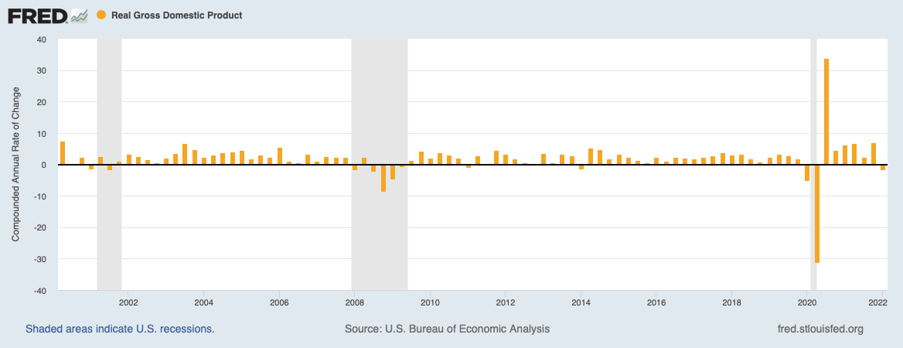
Real economic growth in the United States
Notes:
Sources: https://www.bea.gov/sites/default/files/2022-06/gdp1q22_3rd.pdf
U.S. Bureau of Economic Analysis, Gross Domestic Product [GDP], retrieved from FRED, Federal Reserve Bank of St. Louis; https://fred.stlouisfed.org/series/GDP, June 2, 2022.; U.S. Bureau of Economic Analysis, Real Gross Domestic Product [GDPC1], retrieved from FRED, Federal Reserve Bank of St. Louis; https://fred.stlouisfed.org/series/GDPC1, June 2, 2022.
https://www.barrons.com/articles/us-gdp-first-quarter-51651096830
https://www.grantthornton.com/library/articles/advisory/2022/Economic-Analysis/Real-Time-Analysis/gdp-042822.aspx
Last year, the U.S. economy grew by 6.3% – after inflation. During the first quarter of this year, much to the consternation of analysts and economists, the economy contracted by 1.6 percent. It was an unwelcome surprise that forced people to consider whether the country was in a recession. A recession is often defined as two consecutive quarters of negative economic growth. It was difficult to believe the United States was in a recession because a lot of economic data indicated the economy was productive.

Slide 19
Economic data told a different story
ISM Purchasing Manager's Index was above 50
Jobs growth was strong
Unemployment rate was low, at 3.6%
Labor force participation was up
Consumer spending was rising
Institute for Supply Management, U.S. Department of Labor
Notes:
Photo source: https://www.gettyimages.com/detail/photo/financial-and-technical-data-analysis-graph-showing-royalty-free-image/917844420?adppopup=true
Sources: https://www.prnewswire.com/news-releases/manufacturing-pmi-at-57-1-march-2022-manufacturing-ism-report-on-business-301515115.html
https://blog.dol.gov/2022/04/01/march-2022-jobs-report-america-is-back-to-work
For example, the ISM composite Purchasing Managers Index, which measures how well manufacturers are doing, was above 50. Any reading above means the economy is growing. Jobs growth was strong and the service industry was bouncing back. Unemployment was low at 3.6%. Labor force participation was up. And consumer spending was increasing. Since consumer spending accounts for almost three-quarters of economic growth, the contraction during first quarter was a bit of a mystery.

Slide 20
Components of gross domestic product (GDP)
Consumer Spending
+1.24
Business
Investment
+0.93
Q1 2022
Government Spending
-0.51
Net Exports
-3.23
U.S. Bureau of Economic Analysis
Notes:
Source: https://www.bea.gov/sites/default/files/2022-06/gdp1q22_3rd.pdf
Analysts dug deeper into the data to figure out what had happened. The first thing they did was see how the four components of economic growth affected gross domestic product or GDP. GDP reflects all of the goods and services a country produces in a specific period of time. It measures four components: consumer spending, business investment, government spending, and net exports. In the first quarter, consumer spending increased and so did business investment. Government spending dropped but not enough to offset the strength of consumer and business spending. The main reason the economy shrank during the quarter was because our economy recovered faster than other economies around the world. As a result, the U.S. purchased more goods from overseas than other nations purchased from us and that caused the economy to shrink in the first quarter.

Slide 21
The story is fairly straight-forward. The Omicron wave, the war in Ukraine and new lockdowns in China took a greater toll on growth abroad than at home.
—Diane Swonk, Chief Economist, Grant Thornton,
April 28, 2022
Notes:
https://www.grantthornton.com/library/articles/advisory/2022/Economic-Analysis/Real-Time-Analysis/gdp-042822.aspx
"The story is fairly straight-forward. The Omicron wave, the war in Ukraine and new lockdowns in China took a greater toll on growth abroad than at home,” explained Diane Swonk, the chief economist of Grant Thornton.
The question on many people’s minds was this: Would it happen again in the second quarter? It’s a difficult question to answer because economic data remained strong, but the tailwinds that supported economic recovery had shifted and become headwinds.

Slide 22
Tailwinds became headwinds
Geopolitical instability
China
lockdowns
Fiscal stimulus ends
Fed tightens
Notes:
Photo sources: : https://www.gettyimages.com/photos/federal-reserve-governors?assettype=image&family=editorial&phrase=federal%20reserve%20governors&sort=mostpopular; https://www.gettyimages.com/photos/us-government?assettype=image&family=editorial&phrase=US%20government&sort=mostpopular; https://www.gettyimages.com/photos/inflation?assettype=image&license=rf&alloweduse=availableforalluses&family=creative&phrase=inflation&sort=mostpopular; https://www.gettyimages.com/photos/russia-ukraine-war?assettype=image&license=rf&alloweduse=availableforalluses&family=creative&phrase=Russia%20Ukraine%20war&sort=mostpopular; https://www.gettyimages.com/photos/covid-19-china--lock-down?assettype=image&license=rf&alloweduse=availableforalluses&family=creative&phrase=covid-19%20China%20%20lock%20down&sort=mostpopular&suppressfamilycorrection=true&clarifications=lock%20down%3A91419
Sources: https://thedocs.worldbank.org/en/doc/18ad707266f7740bced755498ae0307a-0350012022/related/Global-Economic-Prospects-June-2022-Topical-Issue-2.pdf
https://www.bloomberg.com/news/articles/2022-05-20/us-growth-seen-outpacing-china-s-for-first-time-since-1976#xj4y7vzkg
https://www.npr.org/2022/04/19/1093620434/45-cities-in-china-are-in-some-sort-of-covid-lockdown-heres-the-toll-thats-takin
We no longer have geopolitical stability. Russia’s invasion of Ukraine disrupted global food and energy markets, damaging the world economy, and sanctions imposed by other nations created additional distress. China's zero-COVID policy led to lock downs of 45 cities – more than 400 million people. In some cases the cities were locked down for months. That meant supply chains were disrupted again, and supplies of many goods were cut off again. The lockdowns hurt China's economy and the global economy. China, like the United States, is one of the world's main economic engines. This year, the U.S. is expected to grow faster than China for the first time since 1976. Fiscal stimulus and monetary policy also became headwinds. Fiscal stimulus ended, although it had put additional money in the pockets of people who were eager to spend it. As a result, we saw high demand for goods at a time when supply was low and prices rose. To tame inflation, the Federal Reserve began to tighten monetary policy.

Slide 23
Inflation
Inflation 2022, year-over-year | PCE Price Index | Core PCE (Excludes energy and food)
January | 6.0% | 5.1%
February | 6.3% | 5.3%
March | 6.6% | 5.2%
April | 6.3% | 4.9%
May | 6.3% | 4.7%
An increase in the average price of goods and services
A function of supply and demand, as well as money supply
PCE is a broader index than CPI
U.S. Bureau of Economic Analysis
Notes:
Sources: https://www.bls.gov/news.release/cpi.nr0.htm
https://www.bls.gov/bls/news-release/cpi.htm#2022
Inflation – the average price we pay for goods or services – has been a thorn in the paw of U.S. consumers since last year. Inflation is affected by supply and demand, as well as the money supply. It has been increasing because of fiscal and monetary stimulus. American households and businesses were flush with cash and credit was readily available. Also, demand for goods was booming but there weren’t enough goods available because of supply chain issues. High demand and low supply caused prices to rise. This year, inflation intensified after Russia invaded Ukraine, and China began locking cities down.
The table shows changes in the Personal Consumption Expenditures (PCE) Price Index. This is the Fed's preferred inflation measure because it offers a broader and more timely measure of consumer behavior than the Consumer Price Index, which only reflects price increases in cities. This chart also shows changes in core PCE, which excludes food and energy prices. The core PCE is important because food and energy prices are volatile and often change swiftly. As a result, they can distort long-term pricing trends. The PCE was 6.3 percent in May, while the Core PCE was 4.7 percent. The Fed's goal is to keep inflation around 2 percent. It considers many inflation measures and emphasizes core PCE.
Rising prices have hurt consumer sentiment.

Slide 24
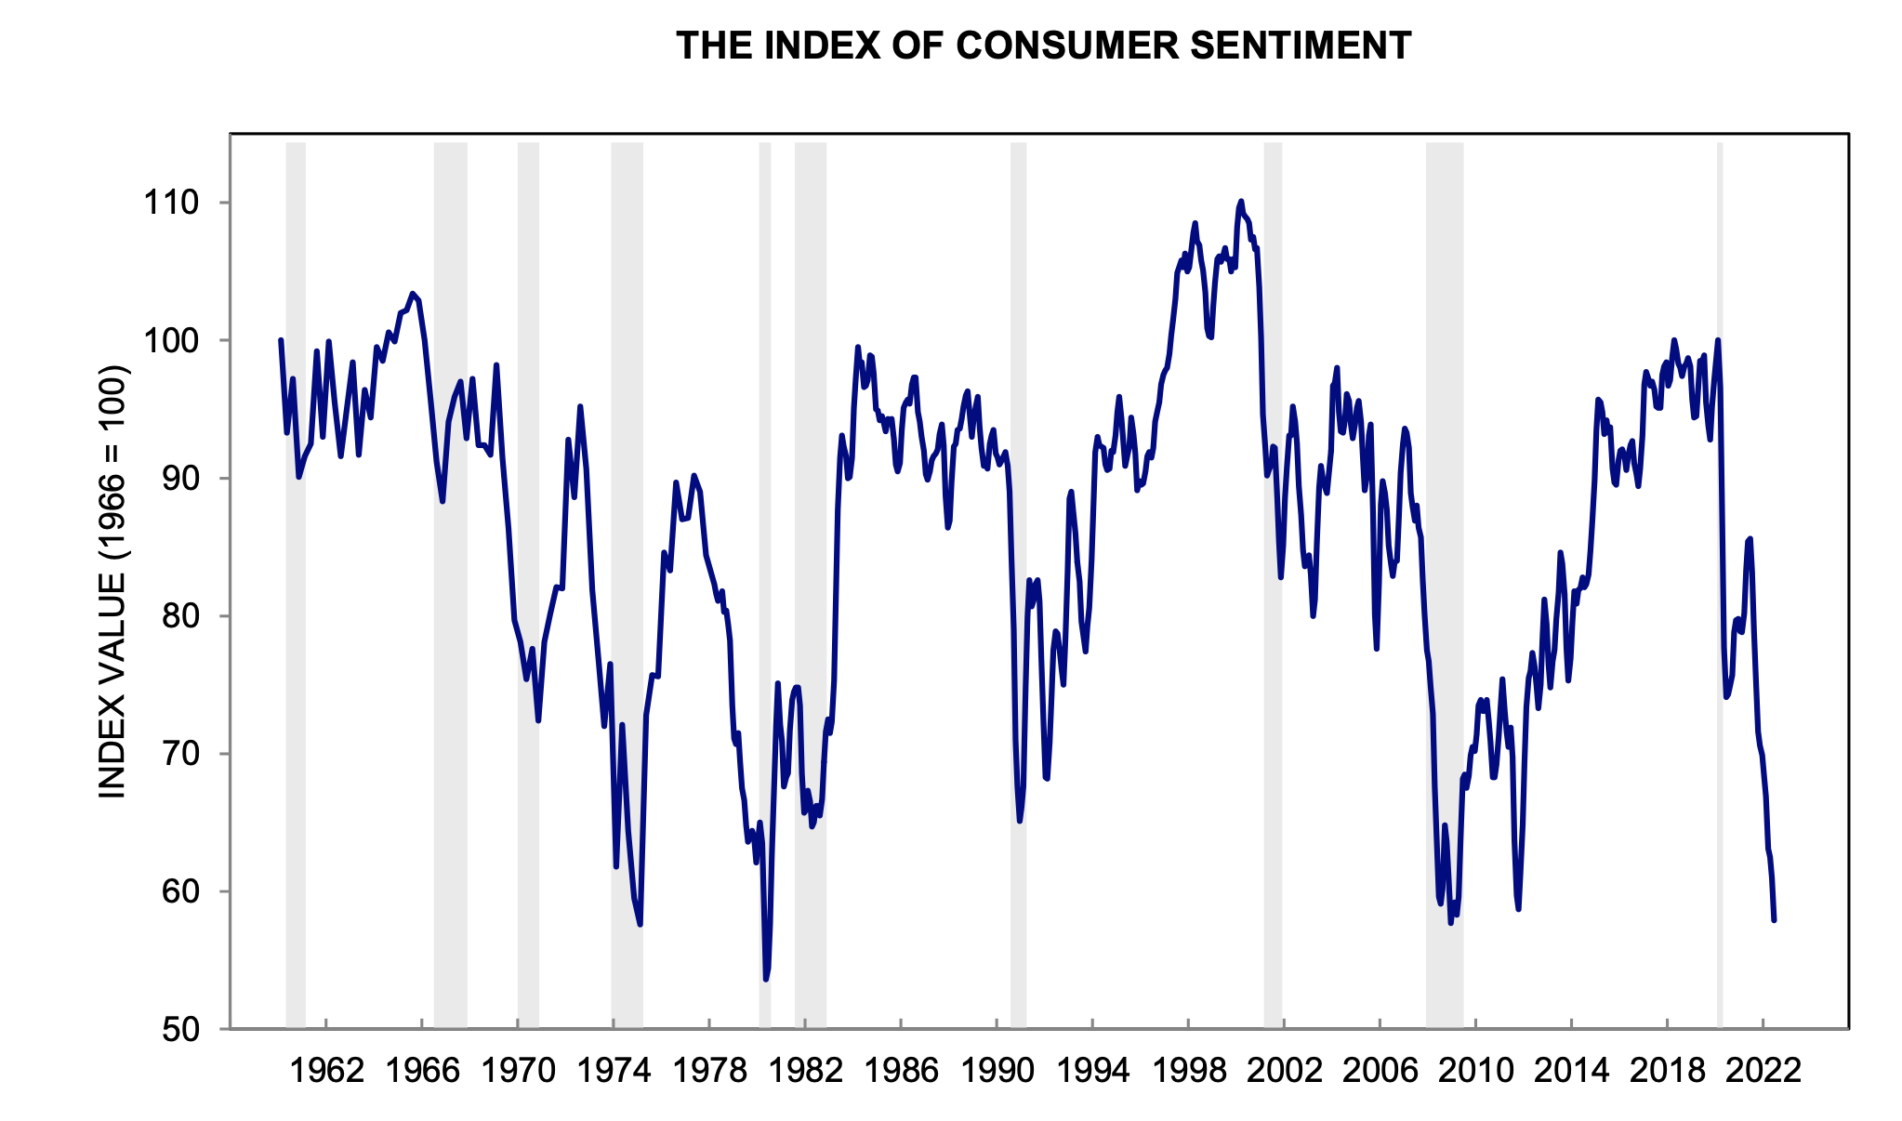
Consumer Sentiment: People are feeling more pessimistic
University of Michigan Consumer Sentiment Survey
Notes:
Photo source: https://www.gettyimages.com/photos/unhappy-shopper?assettype=image&phrase=unhappy%20shopper&sort=mostpopular&license=rf%2Crm
Source: http://www.sca.isr.umich.edu
https://data.sca.isr.umich.edu/fetchdoc.php?docid=70017
http://www.sca.isr.umich.edu/files/chicsh.pdf
In June, the University of Michigan’s Consumer Sentiment Survey showed that consumer sentiment had reached a record low. The most common reason for consumer pessimism was that inflation was making it difficult to maintain their standard of living.

Slide 25
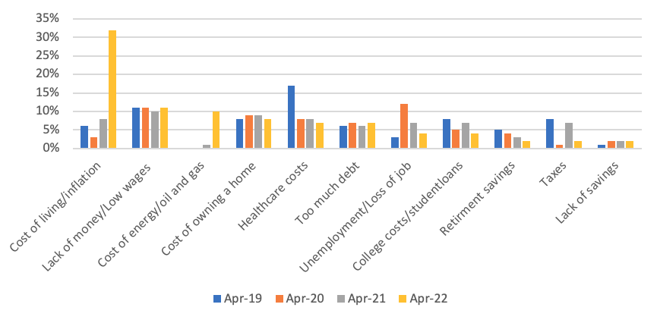
What is the most important financial problem facing your family today?
Source: Gallup
Notes:
Source: https://news.gallup.com/poll/392162/personal-finance-ratings-slide-amid-rising-prices.aspx
To get to the data in the pdf from the website, click on 'View complete question responses and trends (PDF download).’

Slide 26
Inflation affects the way people think and spend
Source: April 21-May 12, 2022, Washington Post-Schar School poll
of 1,055 U.S. adults with an error margin of +/- 4 percentage points.
Notes:
Source: https://www.washingtonpost.com/business/2022/06/09/inflation-worse-poll-americans/
Inflation changes the way people think and spend. A recent poll conducted in April and May by The Washington Post and George Mason University’s Schar School of Policy and Government found that:
87 percent of those surveyed were making a bigger effort to find the cheapest products
74 percent were delaying planned purchases
59 percent were saving less
59 percent were driving less
52 percent were buying products in anticipation of prices going higher.
That last one may be the most important. It suggests that inflation psychology is beginning to take hold.

Slide 27
This situation has been termed ‘inflationary psychology.’ Consumers purposely advance their purchases in order to beat anticipated future price increases. Firms readily pass along higher costs to consumers, including the future cost increases that they anticipate…Expected inflation [becomes] a self-fulfilling prophecy.
—Richard Curtin, Chief economist University of Michigan Surveys of Consumers, Barron’s, April 7, 2022
Notes:
Source: https://www.barrons.com/articles/inflation-consumer-prices-sentiment-51649268928?mod=Searchresults
In an op-ed for Barron’s, Richard Curtin, Chief economist University of Michigan Surveys of Consumers explained, “This situation has been termed “inflationary psychology.” Consumers purposely advance their purchases in order to beat anticipated future price increases. Firms readily pass along higher costs to consumers, including the future cost increases that they anticipate…Expected inflation becomes a self-fulfilling prophecy.”

Slide 28
The Fed is tightening monetary policy
No more bond buying (quantitative easing)
Beginning to shrink its balance sheet (quantitative tightening)
Raising the federal funds rate
Federal Reserve Bank, CME Group
Notes:
Sources: https://www.federalreserve.gov/monetarypolicy/fomccalendars.htm
https://www.cmegroup.com/trading/interest-rates/countdown-to-fomc.html
The Federal Reserve was late to act on inflation and now it is responding aggressively. The Fed stopped buying bonds, began to shrink its balance sheet. It also began increasing the federal funds target rate, which influences interest rates. Last December, the fed funds rate was near zero. In March, the Fed raised it to 0.25 to 0.50 percent. In May, it lifted the rate by half a point to 0.75 to 1.0 percent. And, in June, the Fed increased the fed funds rate again. This time by three quarters of a point, bringing it to 1.50 to 1.75 percent. By the end of this year investors anticipate the fed funds target rate will be 3.25 to 3.50 percent. That’s a significant increase for a single year. But it isn’t even close to the highest fed funds rate ever. That happened in 1980 when inflation was at 13.5 percent. The Fed raised the federal funds rate from 14 percent to 20 percent – a 6 percent bump – in a single year.

Slide 29
The economic outlook
Soft landing
Stagflation
Recession
Economy slows
Inflation falls
No recession
Economy slows or contracts
Inflation persists
Economy contracts
Inflation slows
Notes:
Source: https://www.barrons.com/articles/fed-economy-soft-landing-stagflation-crash-51653086991
Right now, there is a lot of uncertainty about and second-guessing of the Fed's monetary policy. Federal Reserve tightening could result in:
A soft landing is the Goldilocks ideal. If everything goes “just right,” the Fed will slow economic growth and contain inflation without leading the country into a recession.
Stagflation is another possibility. Stagflation is a combination of stagnant and inflation. It occurs when a country has slow economic growth and high inflation.
The Fed’s action could trigger a recession, which is often defined as two or more quarters of economic contraction. Recessions cool off the economy, lower demand for goods, and slow inflation. They also create financial challenges for many people.

Slide 30
So, is the economy in a recession? No. People are unhappy with inflation, which...has recently been running its highest since 1982. But inflation isn’t recession, which is defined as a significant decline in economic activity. Economic activity is not falling.
Quite the contrary: It is booming.
—Jeffrey Frankel, Professor of Capital Formation and Growth at Harvard University in Barron’s, June 13, 2022
Notes:
Source: https://barrons-nj.newsmemory.com
So, no one is sure what may be ahead, but Jeffrey Frankel, who was once a member of the NBER Business Cycle Dating Committee and is now a professor at Harvard, has a strong opinion about where we are now. In June, he wrote:
“So, is the economy in a recession? No. People are unhappy with inflation, which at 8.6% has recently been running its highest since 1982. But inflation isn’t recession, which is defined as a significant decline in economic activity. Economic activity is not falling. Quite the contrary: It is booming."
He pointed out that inflation and recession are, usually, opposing conditions. In this case, the factors that were responsible for the strong economic recovery from the COVID-19 recession also pushed inflation higher. Inflation can result in a recession because the Fed usually will raise rates to lower demand and slow price hikes.

Slide 31
Peak
Recession
Trough
Expansion
The Economic Cycle
Notes:
Source: https://www.investopedia.com/terms/e/economic-cycle.asp
No matter what happens, it’s important to remember that it’s not permanent. Economies typically cycle through four phases – expansion, peak, recession, and trough.
Now, let’s take a look at how financial markets feel about all of this.

Slide 32
Financial markets
Half-Time 2022 From tailwinds to headwinds
Notes:
As you know, financial markets hate uncertainty – and this year has been full of uncertainty. That’s one reason the bull market in stocks ended.

Slide 33
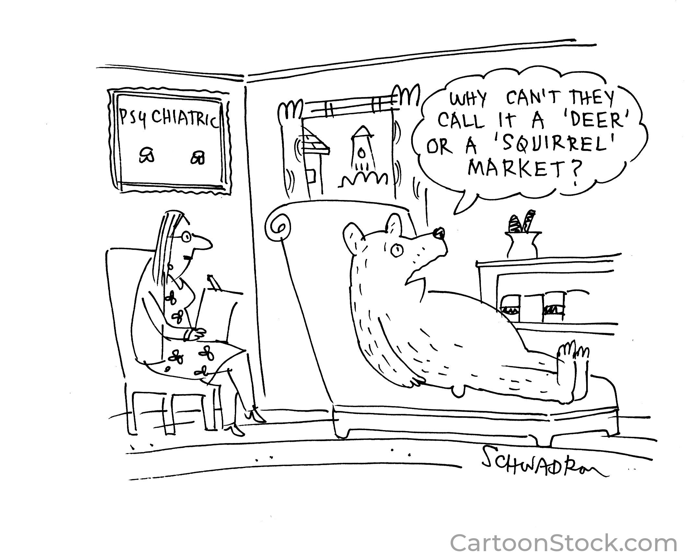
Notes:
Source: https://www.cartoonstock.com/search?type=images&keyword=bear+market&page=1&expanded=CS476458
We’re in a bear market. Although bears may prefer that the market be called something else.

Slide 34
Worst first half for stocks in 50 years
The Standard & Poor’s 500, Nasdaq Composite, and Dow Jones Industrials Indices
As of July 1, 2022
Notes:
Source: S&P Dow Jones Indices LLC, S&P 500 [SP500], retrieved from FRED, Federal Reserve Bank of St. Louis; https://fred.stlouisfed.org/series/SP500, July 1, 2022.
NASDAQ OMX Group, NASDAQ Composite Index [NASDAQCOM], retrieved from FRED, Federal Reserve Bank of St. Louis; https://fred.stlouisfed.org/series/NASDAQCOM, July 1, 2022.
S&P Dow Jones Indices LLC, Dow Jones Industrial Average [DJIA], retrieved from FRED, Federal Reserve Bank of St. Louis; https://fred.stlouisfed.org/series/DJIA, July 1, 2022.
https://www.cnbc.com/2022/07/01/sp-500-had-worst-half-in-50-years-but-the-60/40-portfolio-isnt-dead.html
We just lived through the worst first half of a year in 50 years. The S&P 500, Nasdaq Composite, and Dow Jones Industrials all experienced significant losses.

Slide 35
Performance by Index, June 30, 2022 | Q2 Return | YTD Return
S&P 500 TR | -16.1% | -20.0%
MSCI ACWI TR | -15.8% | -20.2%
Bloomberg US Agg Bond TR | -4.7% | -10.3%
Russell 2000 TR | -17.2% | -22.5%
Top YTD Sector: Energy | -6.5% | 29.6%
Bottom YTD Sector: Comm. Services | -26.3% | -33.8%
Top YTD Style Box (M*): Mid Value | -8.2% | -6.7%
Bottom YTD Style Box (M*): Large Growth | -29.8% | -39.3%
Russell 1000 Value – Russell 1000 Growth (difference) | 8.7% | 15.2%
Source: Morningstar Direct
Notes:
Source: Scott Kubie
It is always difficult to be an investor during a bear market. [Review the slide]

Slide 36
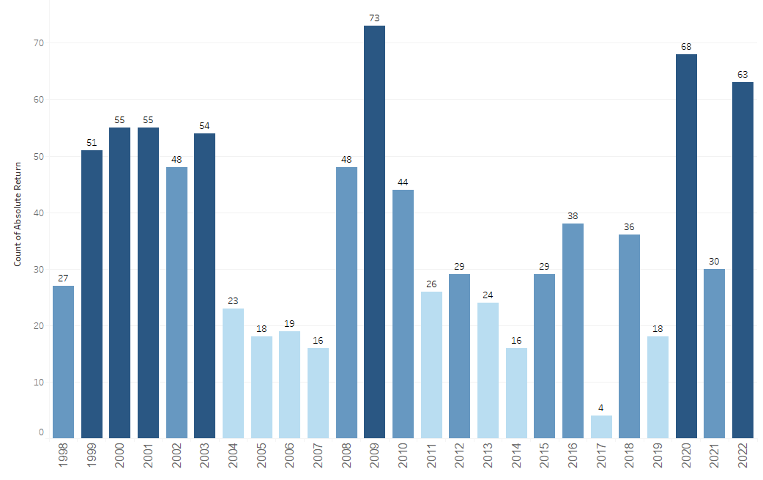
Stock markets have been volatile
Standard & Poor’s 500 Index
Up or Down 1% Days through June by Calendar Year
63 moves of 1%
26 moves of 2%
7 moves of 3%
Source: Morningstar Direct, 2022 includes date through May 22
Notes:
Source: Scott Kubie
In addition to watching the value of savings and investments decline, heightened market volatility can be unnerving – and volatility has been one of the defining characteristics of U.S. stock markets during 2022. There were 63 moves of 1 percent, 26 moves of 2 percent, and 7 moves of 3 percent.

Slide 37
Sector performance
(year-over-year as of June 30, 2022)
Source: Fidelity Research
Notes:
Source: https://eresearch.fidelity.com/eresearch/markets_sectors/sectors/sectors_in_market.jhtml
Even though we’re experiencing a bear market, not all sectors of the market have declined in value. [Review slide]

Slide 38
Company earnings expectations remain strong
S&P 500 BLENDED EARNINGS GROWTH
1Q 2022 + 9.2%
2Q 2022 (est.) + 4.1%
3Q 2022 (est.) +10.5%
4Q 2022 (est.) + 9.7%
CY 2022 (est.) +10.2%
Source: FactSet
Notes:
Image: https://www.gettyimages.com/detail/photo/black-pen-with-financial-figures-and-calculator-royalty-free-image/93054723?adppopup=true
Source: https://advantage.factset.com/hubfs/Website/Resources%20Section/Research%20Desk/Earnings%20Insight/EarningsInsight_070122.pdf
Company earnings are lower than they were during the pandemic recovery, but they remained strong during the first half of the year and expectations remain strong. During the first quarter, the year-over-year blended earnings growth for the S&P 500 Index was 9.2 percent, meaning profits were up. Earnings growth slowed during the second quarter, but is expected to increase every quarter and finish with profits up 10.2 percent for the year. Some expect earnings growth expectations to be revised lower as interest rates rise.

Slide 39
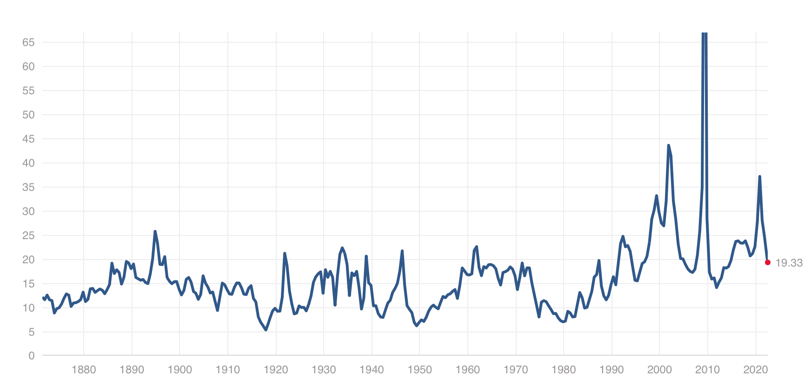
Price-to-earnings (PE) ratios have fallen
S&P 500 PE Ratio
Historic average: 15.97
June 30, 2021: 26.56
June 30, 2022: 19.33
S&P 500 PE Ratio. as of 6/30/22
19.33
Source: Multpl
Notes:
Source: https://www.multpl.com/s-p-500-pe-ratio
https://www.multpl.com/s-p-500-pe-ratio/table/by-month
Earnings are one the factors that help analysts evaluate whether a company’s stock is underpriced, fairly priced, or overpriced. The price-to-earnings or PE ratio is another. It compares a company’s share price to its earnings per share. Historically, the PE ratio for the S&P 500 Index has averaged 15.97. One year ago, the S&P 500’s PE was 26.56, which suggests investors were willing to pay relatively high prices for shares of the index. (You cannot invest directly in an index.) By the end of the second quarter, the S&P 500’s PE had fallen to 19.33.
Interest rates also play a role in PE ratios. When rates move higher, earnings/profits may be lower in the future. That makes investors reassess what a fair company share price really is. If investors want to pay less, then the PE ratio will fall.
PE ratios have dropped, meaning investors are worried about what may be ahead.

Slide 40
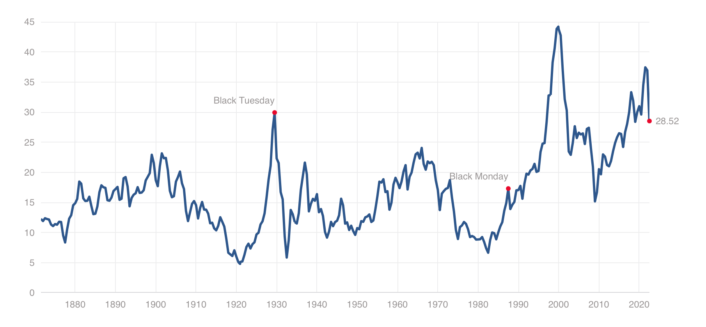
Shiller CAPE Ratio/S&P 500 Index
(as of 6/30/22)
29.55
Source: Multpl
Notes:
Source: https://www.barrons.com/articles/is-us-in-recession-nber-official-definition-51654630634
This chart shows the CAPE ratio, which measures the price of a stock relative to its earnings using average inflation-adjusted earnings from the previous 10 years. As you can see, the CAPE ratio suggests that S&P 500 stocks remain quite expensive.
Share valuations have been at exceptional levels for many reasons. One is that U.S. stocks have offered very attractive levels of income compared to bonds. Now that interest rates are increasing, bonds may become more competitive and offer investors opportunities to invest for income with less risk. If investors begin to move assets from stocks to bonds, that could push share prices lower.

Slide 41
The stock market has predicted nine out of the last five recessions.
—Paul Samuelson Nobel Prize-winning economist Newsweek, 1966
Notes:
Source: https://stockinvesting.today/ma1607/article/the-1966-bear-market?
https://www.cnbc.com/2016/02/04/can-the-markets-predict-recessions-what-we-found-out.html
The stock market downturn suggests that many investors expect a recession. They may be right, but they could be wrong.
Back in 1966, following two decades of nearly uninterrupted economic growth and stock market gains, a bear market arrived. The S&P 500 Index dropped 24% over eight months before a bull market began. The market downturn was unnerving but there was no recession. That year, economist Paul Samuelson, who was the first person to win a Nobel prize in economics, quipped in a Newsweek interview, “ The stock market has predicted nine out of the last five recessions.”

Slide 42
Factcheck: Paul Samuelson was right
1966
9 bear markets/
5 recessions
= 55%
2016
13 bear markets/
7 recessions
= 53%
Notes:
Source: https://www.cnbc.com/2016/02/04/can-the-markets-predict-recessions-what-we-found-out.html
In 2016, CNBC decided to factcheck Paul Samuelson. They looked at the13 bear markets that have occurred in the postwar era. During each of those downturns, stocks fell by 20 percent or more and stayed down for more than a month. CNBC reported that 7 of the bear markets preceded recessions. So, Samuelson was right. About half of the time, bear markets lead to recessions.
We just don’t know yet where this one will lead.

Slide 43
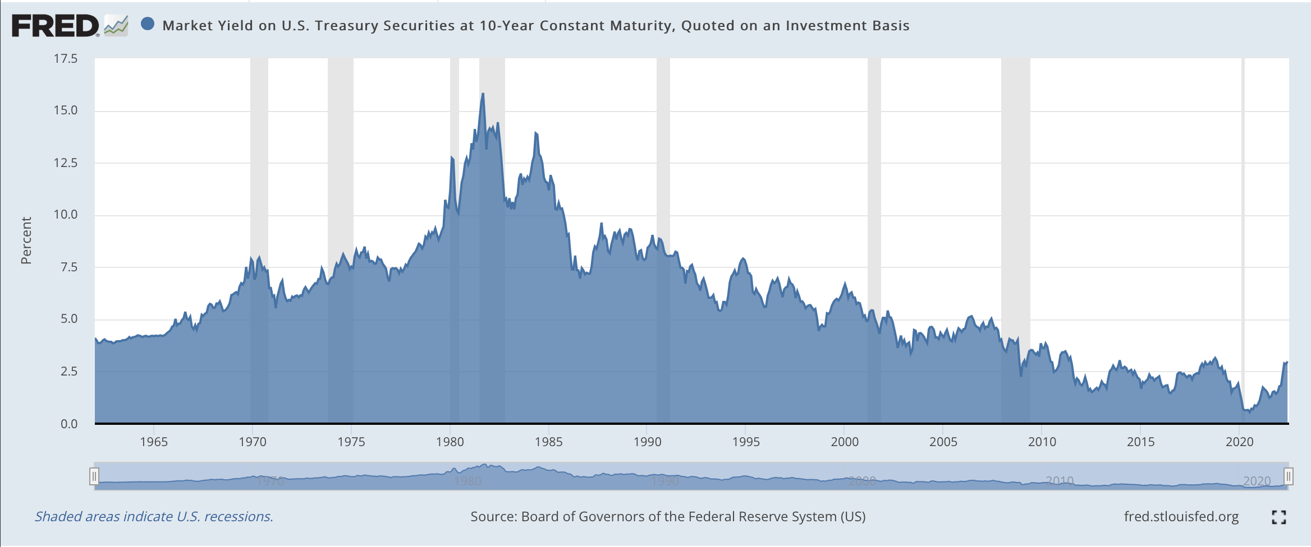
Will be updated (content)
We’re in a bear market for bonds
As of July 1, 2022
Notes:
Source: Board of Governors of the Federal Reserve System (US), Market Yield on U.S. Treasury Securities at 10-Year Constant Maturity, Quoted on an Investment Basis [DGS10], retrieved from FRED, Federal Reserve Bank of St. Louis; https://fred.stlouisfed.org/series/DGS10, July 1, 2022.
We’re in a bear market for bonds, too. The driver behind the bear market is inflation which caused the Fed to raise rates. Bond rates followed.

Slide 44
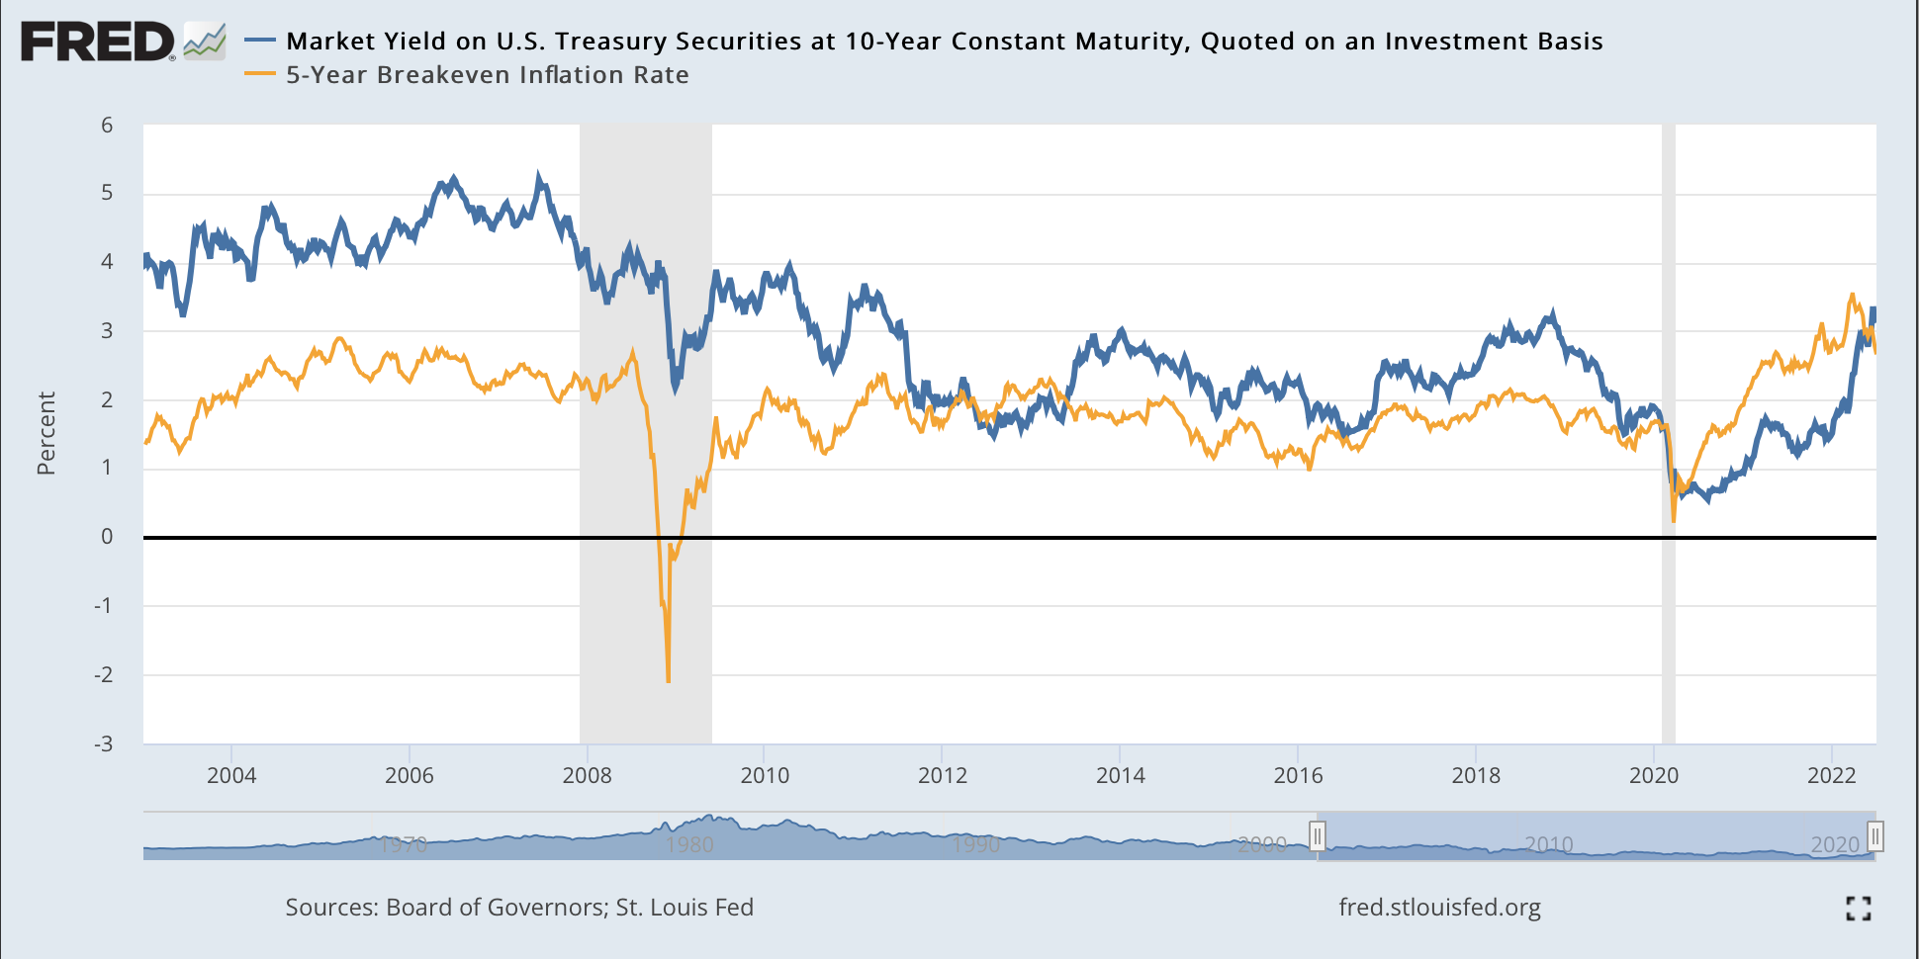
Bond markets offer inflation information
As of July 1, 2022
Notes:
Sources: https://home.treasury.gov/resource-center/data-chart-center/interest-rates/TextView?type=daily_treasury_yield_curve&field_tdr_date_value=2022
Board of Governors of the Federal Reserve System (US), Market Yield on U.S. Treasury Securities at 10-Year Constant Maturity, Quoted on an Investment Basis [DGS10], retrieved from FRED, Federal Reserve Bank of St. Louis; https://fred.stlouisfed.org/series/DGS10, July 1, 2022.
Federal Reserve Bank of St. Louis, 5-Year Breakeven Inflation Rate [T5YIE], retrieved from FRED, Federal Reserve Bank of St. Louis; https://fred.stlouisfed.org/series/T5YIE, July 1, 2022.
Here we see the yield on the benchmark 10-year Treasury note over the past 5 years (blue line). At the start of this year, the yield was about 1.63 percent. By the end of June, it was at 2.98 percent. The orange line is the breakeven inflation rate. It tells us what the bond market thinks inflation will be, on average, over the next 5 years. At the end of June, the breakeven rate was 2.58 percent.

Slide 45
The US yield curve in particular — thanks to the central position of the dollar in the global financial system — acts as a kind of barometer of investors’ collective wisdom about the future path of the world’s largest economy, and has a strong record in signaling downturns before they arrive.
—Chelsea Bruce-Lockhart, Emma Lewis and Tommy Stubbington, Financial Times, April 6, 2022
Notes:
Source: https://ig.ft.com/the-yield-curve-explained/
The U.S. Treasury bond yield curve is a well-respected recession indicator. The Financial Times explained why. "The US yield curve in particular — thanks to the central position of the dollar in the global financial system — acts as a kind of barometer of investors’ collective wisdom about the future path of the world’s largest economy, and has a strong record in signaling downturns before they arrive."

Slide 46
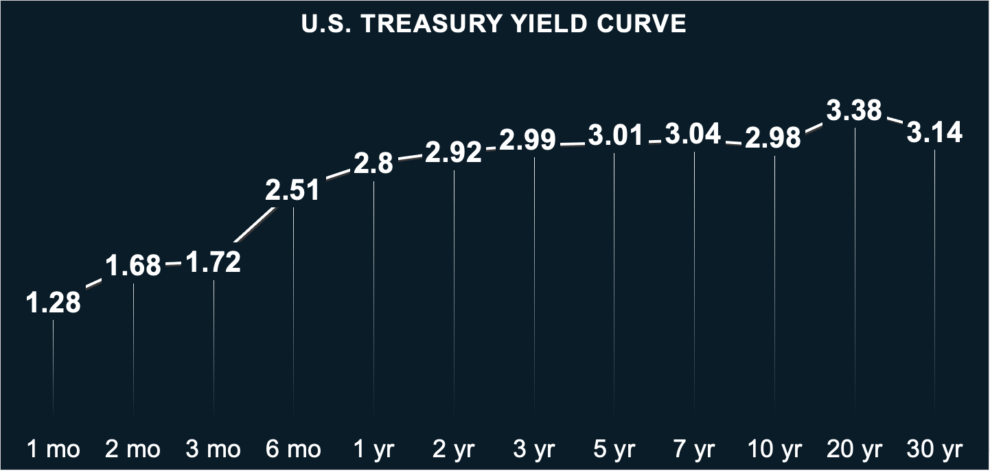
Treasury yield curve
As of July 1, 2022
Source: U.S. Treasury
Notes:
Sources: https://www.investopedia.com/terms/i/invertedyieldcurve.asp
https://home.treasury.gov/resource-center/data-chart-center/interest-rates/TextView?type=daily_treasury_yield_curve&field_tdr_date_value_month=202206
https://www.barrons.com/articles/inverted-yield-curve-recession-wall-street-51649170366?tesla=y
https://www.newyorkfed.org/research/current_issues/ci2-7.html
In normal circumstances, yields on Treasuries rise as maturities get longer. So, a 2-year Treasury bill will normally yield less than a 10-year Treasury note. On occasion, shorter-maturity Treasuries yield more than longer-maturity Treasuries. This is unusual because investors normally want to earn higher interest when they lend money for a longer period of time.
When a 2-year treasury yields more than a 10-year Treasury, it can be a signal that a recession may occur 12 to 24 months in the future. The most accurate indicator, though, is the spread between interest rates on the 3-month Treasury bill and the 10-year Treasury note. At the end of June, the 3-month Treasury bill was at 1.72 percent, the 2-year Treasury was yielding 2.92 percent, and 10-year Treasuries were yielding 2.98 percent.

Slide 47
Investors have been feeling bearish
INVESTOR SENTIMENT
Consensus Index | May 30 | June 6 | June 13 | June 20 | June 27
Bullish | 39% | 41% | 45% | 38% | 35%
Source: Barron's
Notes:
Source: https://barrons-nj.newsmemory.com
As investors have become more concerned about Fed policy, rising interest rates, and the possibility of recession, they've become less bullish and more bearish. [Review slide]

Slide 48
Bear markets don’t last forever
Notes:
Source: https://www.cnbc.com/2020/03/14/a-look-at-bear-and-bull-markets-through-history.html
When the value of your portfolio declines and everyone around you is bearish, it can be difficult to remember that bear markets don’t last forever. The S&P 500 Index has experienced 7 bear markets over the last 50 years and, while past performance does not guarantee future results, the market recovered from all of them. [Review slide]
Historically, bull markets have usually lasted longer than bear markets. Often, bear markets provide buying opportunities for long-term investors. Just make sure your portfolio remains well diversified. Diversification won’t help you avoid losses in a bear market, but it can help minimize them. Also, please remember that we are here. We are available to discuss your concerns, review your portfolio, and help you decide on a course of action that suits you.

Slide 49
What may be ahead
Half-Time 2022 From tailwinds to headwinds
Notes:
Source:

Slide 50
Global economic growth (after inflation)
Source: World Bank, June 2022
Notes:
Sources: https://thedocs.worldbank.org/en/doc/18ad707266f7740bced755498ae0307a-0350012022/related/Global-Economic-Prospects-June-2022-Chapter-1-Highlights.pdf
Economies around the world did pretty well, overall, last year. The United States recovered faster than expected – thanks to abundant monetary and fiscal stimulus – and grew by 5.7% last year, after inflation. This year, economic growth in the United States and most other parts of the world has slowed. The outlook for next year is mixed – and subject to change because the world is facing some significant risks.

Slide 51
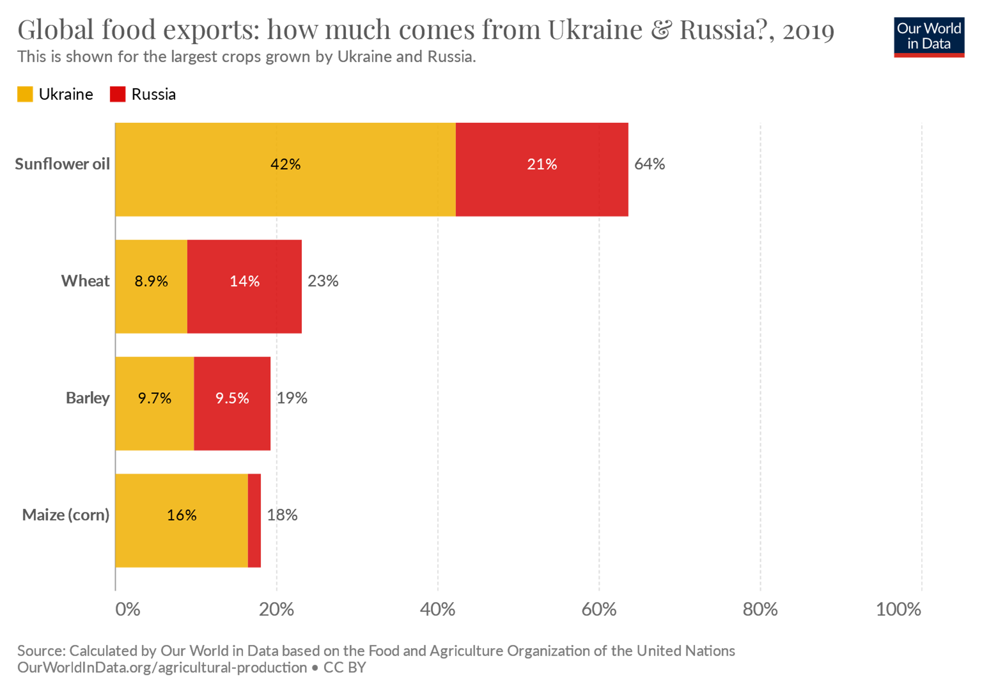
War in Ukraine
Food shortages
Energy shortages
Higher food and energy prices
Notes:
Source: https://ourworldindata.org/ukraine-russia-food
The War in Ukraine is one of those risks. We don’t know when it will end. We don’t know whether Putin will expand the war. However, we do know that Putin’s decision to invade Ukraine, and the sanctions that followed, have affected food and energy supplies across the world. Shortages have exacerbated inflation, pushing food and energy prices higher.

Slide 52
…spillovers from the Russian Federation’s invasion of Ukraine are set to sharply hasten the deceleration of global economic activity…The war in Ukraine is leading to high commodity prices, adding to supply disruptions, increasing food insecurity and poverty, exacerbating inflation, contributing to tighter financial conditions, magnifying financial vulnerability, and heightening policy uncertainty.
—The World Bank, Global Growth Prospects, June 2022
Notes:
Source: https://openknowledge.worldbank.org/bitstream/handle/10986/37224/Global-Economic-Prospects-June-2022-Global-Outlook.pdf
The World Bank lowered its economic growth forecast for 2022 and attributed much of the adjustment to the war. The organization’s Global Growth Report said, “…spillovers from the Russian Federation’s invasion of Ukraine are set to sharply hasten the deceleration of global economic activity…The war in Ukraine is leading to high commodity prices, adding to supply disruptions, increasing food insecurity and poverty, exacerbating inflation, contributing to tighter financial conditions, magnifying financial vulnerability, and heightening policy uncertainty."

Slide 53
COVID lockdowns in China
Notes:
Source: https://www.ft.com/content/564be705-2de0-4837-acc6-fe87c3e61aec
https://www.washingtonpost.com/world/2022/06/13/china-covid-testing-companies/
China’s Zero-COVID Policy is another factor that is having an outsized impact on global economic growth. Residents of China’s largest cities must be tested every three days and carry evidence of their COVID status on their cell phones. If a person has not been tested in the last three days, they can be refused access to stores, parks, and other public spaces. There is no home testing so the cost of constant testing is weighing on cities and towns. Small outbreaks can lead to lockdowns that bring everything to a standstill. People cannot work or earn money. Shops cannot sell goods. Factories cannot produce goods. And nothing gets transported from the region that has been locked down. That affects the U.S. because lockdowns cause breakdowns in supply chains.

Slide 54
Possibility of a Federal Reserve Policy mistake
Fed raises rates too much: recession
Fed raises rates too slowly: persistent inflation
Notes:
Photo source: https://www.gettyimages.com/photos/federal-reserve-board?assettype=image&family=editorial&phrase=federal%20reserve%20board&sort=mostpopular
We're also facing the risk that the Federal Reserve could make a policy mistake. If it raises rates too much, we could experience a recession. If the Fed raises rates too slowly, inflation may persist.

Slide 55
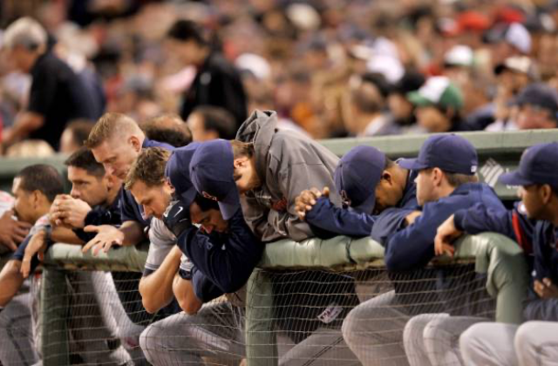
Investor behavior
Notes:
Photo source: https://www.gettyimages.com/photos/baseball-team-unhappy?assettype=image&family=editorial&phrase=baseball%20team%20unhappy&sort=mostpopular&page=2
One of the biggest risks during a bear market is investor behavior. Investing during a bear market can be a lot like playing baseball for a team that’s in a slump. Your teammates are worried, hecklers in the bleachers make distracting comments, and the team’s record of wins and losses moves in the wrong direction. You may even find yourself beginning to question whether playing baseball is right for you. Before you decide to exit the game, talk with us.

Slide 56
Bear markets test investors
Sell
Stay invested
Look for opportunities
Notes:
Photo source: https://www.gettyimages.com/photos/investing-sell?family=creative&assettype=image&phrase=investing%20sell
While it is never comfortable to watch the value of savings and investments drop, as they do during a bear market, it’s important to remember that the decisions you make today can have a significant effect on the value of your portfolio over the long-term. During bear markets, investors may choose to:
Sell. The thinking behind selling is usually something like this: If I sell, I will cut my losses and preserve what I have. These investors are willing accept a loss of principal, which may hurt their ability to reach long-term financial goals.
Stay invested. Investors who remain invested recognize that a market decline is not the same as a loss of principal. By remaining invested, they create an opportunity to regain lost value should the market change direction.
Look for opportunities. Some investors recognize that bear markets often create buying opportunities. These investors work with their financial professionals to identify ways to position for gains should the market recover. The goal of investing, after all, is to buy low and sell high.

Slide 57
There may never have been a more important time to work with a financial professional
Notes:
Image: https://www.gettyimages.com/detail/photo/insurance-agent-lawyer-financial-advisor-broker-royalty-free-image/1328352067?adppopup=true
These are difficult times – and there may bever have been a more important time to work with a financial professional.

Slide 58
What the experts say
Half-Time 2022 From tailwinds to headwinds
Notes:
In the home stretch of this presentation, let's see what the experts have to say.

Slide 59
The first half of the year was terrible. Worst in decades for stocks…Arguably the biggest single cause of the misery was the spike in oil prices. Russia’s invasion of Ukraine accelerated a rise that was already building as the world emerged from the pandemic…To be sure, a lot of damage has already been done by high energy prices. But if they fall back soon, as history suggests they should, the second half of 2022 could be much better than most people currently expect.
—Brian Swint, Acting Deputy Bureau Chief Barron's, July 1, 2022
Notes:
Source: https://www.barrons.com/articles/things-to-know-today-51656671121
Brian Swint is the Acting Deputy Bureau Chief of Barron's. On July 1, he wrote,
"The first half of the year was terrible. Worst in decades for stocks…Arguably the biggest single cause of the misery was the spike in oil prices. Russia’s invasion of Ukraine accelerated a rise that was already building as the world emerged from the pandemic…To be sure, a lot of damage has already been done by high energy prices. But if they fall back soon, as history suggests they should, the second half of 2022 could be much better than most people currently expect."

Slide 60
...It is very difficult to resist the temptation to draw parallels with the 1970s…But consider the following: in 1970, anyone 40 or older had already seen three episodes of inflation comparable to that of the present day. Today’s 40-year-olds have seen nothing comparable, and in fact are more familiar with deflationary trends than inflationary ones. In 1970, the thought must have been, 'Here we go again,' whereas today the question is, 'What is next?'
———Seth Carpenter, Global Chief Economist at Morgan Stanley, Financial Times, July 1, 2022
Notes:
Source: https://www.ft.com/content/314c4eb3-dc48-4c53-b818-220e71631d9b
Seth Carpenter who is the global chief economist at Morgan Stanley wrote an article for the Financial Time sin which he opined that the current situation is not like the 1970s. He wrote,
"the 1970s…But consider the following: in 1970, anyone 40 or older had already seen three episodes of inflation comparable to that of the present day. Today’s 40-year-olds have seen nothing comparable, and in fact are more familiar with deflationary trends than inflationary ones. In 1970, the thought must have been, “Here we go again”, whereas today the question is, “What is next?”"

Slide 61
We can certainly hope for a 'soft landing' this time around, but in my 35 years in this business, hope is rarely an effective investment strategy. The backdrop is one of a peak in the liquidity and economic cycle, and what follows is the natural expunging of the excesses (meme stocks, cryptocurrencies, speculative Nasdaq 100, even residential real estate, which is in a huge price bubble of its own) and then…the rebirth.
—David Rosenberg, President of Rosenberg Research Associates Barron’s, May 13, 2022
Notes:
Source: https://acyhk.com/en/market-news/market-analysis/downhill-protect-just-beginning-084249
David Rosenberg is President, Chief Economist, and Strategist at Rosenberg Research which is an economic consulting firm. In Barron's he wrote,
"We can certainly hope for a “soft landing” this time around, but in my 35 years in this business, hope is rarely an effective investment strategy. The backdrop is one of a peak in the liquidity and economic cycle, and what follows is the natural expunging of the excesses (meme stocks, cryptocurrencies, speculative Nasdaq 100, even residential real estate, which is in a huge price bubble of its own) and then…the rebirth."

Slide 62
Most important, the opportunity for innovation remains vast. The potential market for technology products has expanded hugely, beyond the bastions of business and consumer computing, to affect all parts of the business world, from biotech to supply-chain monitoring. What emerges from the chaos will be a leaner and more efficient industry—and one that will remain a powerful force.
—The Economist, June 30, 2022
Notes:
Source: https://www.economist.com/finance-and-economics/2022/06/01/what-americas-next-recession-will-look-like
The Economist encouraged investors to remember that downturns can obscure opportunity. "Most important, the opportunity for innovation remains vast. The potential market for technology products has expanded hugely, beyond the bastions of business and consumer computing, to affect all parts of the business world, from biotech to supply-chain monitoring. What emerges from the chaos will be a leaner and more efficient industry—and one that will remain a powerful force."

Slide 63
Serving
You
Notes:
Images:
https://www.gettyimages.com/detail/photo/carefree-senior-couple-dancing-in-the-living-room-royalty-free-image/1301266358?adppopup=true
https://www.gettyimages.com/detail/photo/this-is-our-time-royalty-free-image/1215073717?adppopup=true
https://www.gettyimages.com/detail/photo/small-business-owner-at-entrance-looking-at-camera-royalty-free-image/1180926063?adppopup=true
https://www.gettyimages.com/detail/photo/latin-senior-man-serving-the-food-to-his-family-at-royalty-free-image/1167975422?adppopup=true

Slide 64
Half-Time 2022
The Standard & Poor’s 500 Index is a capitalization weighted index of 500 stocks designed to measure performance of the broad domestic economy through changes in the aggregate market value of 500 stocks representing all major industries.
The Consumer Price Index (CPI) is a measure of the average change over time in the prices paid by urban consumers for a market basket of consumer goods and services.
Personal Consumption Expenditures (PCE) is a measure of price changes in consumer goods and services, targeted towards goods and services consumed by individuals. PCE is released monthly by the Bureau of Economic Analysis (BEA).
The Price-to-Earning (P/E) ratio is a measure of the price paid for a share relative to the annual net income or profit earned by the firm per share. It is a financial ratio used for valuation: a higher P/E ratio means investors are paying more for each unit of net income, thus, the stock is more expensive compared to one with a lower P/E ratio.
The MSCI World Index is a broad global equity index that represents large and mid-cap equity performance across all 23 developed markets countries. It covers approximately 85% of the free float-adjusted market capitalization in each country.
The MSCI European Union (EU) Index captures large and mid cap representation across the 13 Developed Markets (DM) countries and 4 Emerging Markets (EM) countries in Europe*. With 321 constituents, the index covers approximately 85% of the free float- adjusted market capitalization in the European equity universe.
The MSCI USA Index represents 63% of the MSCI World Index1. It is designed to measure the performance of the large and mid-cap segments and aims to represent ~85% of the US market.
The MSCI United Kingdom Index represents 5% of the MSCI World Index1. It is designed to measure the performance of the large and mid-cap segments and aims to represent ~85% of the United Kingdom market.
The MSCI China Index covers 85% of the free float market cap of the China Equity Universe across H-shares, A-shares, B-shares, Red-chips, P‐chips and foreign listed shares.
The MSCI Emerging Markets Index includes large and mid-cap companies in 26 Emerging Markets (EM) countries. It covers approximately 85% of the free float-adjusted market capitalization in each country.
The MSCI Frontier Markets Index captures large and mid cap representation across 27 Frontier Markets (FM) countries*. The index includes 81 constituents, covering about 85% of the free float-adjusted market capitalization in each country.

