Slide 1
Notes to Advisors
Select a Presentation Title Page and End Page
Select the presentation cover from the three options that follow (slides 2-4).
Select the corresponding end page from the three options (slides 62-64).
Delete the other options.
Insert Your Logo into the Cover and Back Page
Delete the current text box with Insert Logo Here.
Select the Insert Tab > Picture > find the location on your computer and select Insert.
Resize logo by holding down the shift key and dragging one corner in (to make smaller) or out (to make larger).
Note: holding the shift key while dragging will proportionally change the size of your logo and not distort it.
Delete This Page
Delete this page from your presentation.

Slide 2
Insert Logo
Forecast
2022
Notes:
Getty Image: https://www.gettyimages.com/detail/photo/close-up-woman-walk-in-to-the-wild-with-sunset-and-royalty-free-image/1173136352?adppopup=true
Welcome to Forecast 2021: On the road to a new normal. We’re glad to see you.

Slide 3
Insert Logo
Forecast
2022
Notes:
Getty Image: https://www.gettyimages.com/detail/photo/life-work-balance-and-city-living-lifestyle-concept-royalty-free-image/1183657530?adppopup=true
Welcome to Forecast 2021: On the road to a new normal. We’re glad to see you.

Slide 4
Insert Logo
Forecast
2022
Notes:
Getty Image: https://www.gettyimages.com/detail/photo/african-american-son-and-father-rests-on-grass-at-royalty-free-image/1221265584?adppopup=true
Welcome to Forecast 2021: On the road to a new normal. We’re glad to see you.

Slide 5
Forecast 2022
The opinions voiced in this material are for general information only and are not intended to provide specific advice or recommendations for any individual. To determine which investment(s) may be appropriate for you, consult your financial advisor prior to investing. All performance referenced is historical and is no guarantee of future results. All indices are unmanaged and cannot be invested into directly.
Risk Considerations: The economic forecasts set forth in this presentation may not develop as predicted and there can be no guarantee strategies promoted will be successful. Stock investing involves risk including loss of principal. Bonds are subject to market and interest rate risk if sold prior to maturity. Bond values will decline as interest rates rise and bonds are subject to availability and change in price. International and emerging market investing involves special risks such as currency fluctuation and political instability and may not be suitable for all investors.
Notes:
The opinions voiced in this material are for general information only and are not intended to provide specific advice or recommendations for any individual. To determine which investment(s) may be appropriate for you, consult your financial advisor prior to investing. All performance referenced is historical and is no guarantee of future results. All indices are unmanaged and cannot be invested into directly.
Risk Considerations: The economic forecasts set forth in this presentation may not develop as predicted and there can be no guarantee strategies promoted will be successful. Stock investing involves risk including loss of principal. Bonds are subject to market and interest rate risk if sold prior to maturity. Bond values will decline as interest rates rise and bonds are subject to availability and change in price. International and emerging market investing involves special risks such as currency fluctuation and political instability and may not be suitable for all investors.

Slide 6
Agenda
The economy
Financial markets
What may be ahead
Notes:
Today, we’re going talk about what may come next, but first, we're going to take a look back at the economy and financial market performance during 2021. Before we get started, let’s get your brains warmed up.

Slide 7
A Quiz
Forecast 2022 The Pandemic Recovery
Notes:
Source: https://www.mckinsey.com/industries/technology-media-and-telecommunications/our-insights/ordering-in-the-rapid-evolution-of-food-delivery
As you may already know, a lot of people had their food and groceries delivered last year. That was a boon for the food delivery industry where business doubled, according to reports from McKinsey & Company. One food delivery company examined the data it collected delivering food over the year and published a report about it. So, today's quiz is about American's pandemic eating habits.

Slide 8
A customer in North Carolina liked a certain type of cuisine so much, they ordered from the same restaurant 904 times – that's 2.5 orders each day – in 2021. What type of cuisine was it?
Italian
American
Indian
Mexican
Source: 2021 Uber Eats Cravings Report
Notes:
Images: https://www.gettyimages.com/detail/photo/fresh-tasty-burger-royalty-free-image/807031028?adppopup=true
https://www.gettyimages.com/detail/photo/pasta-with-meatballs-and-parsley-royalty-free-image/160231786?adppopup=true
https://www.gettyimages.com/detail/photo/soft-beef-tacos-with-fries-royalty-free-image/614313140?adppopup=true
https://www.gettyimages.com/detail/photo/authentic-indian-food-royalty-free-image/639389404?adppopup=true
Source: https://www.uber.com/newsroom/the-2021-uber-eats-cravings-report/
Here's our first question:
A customer in North Carolina liked a certain type of cuisine so much, they ordered from the same restaurant 904 times – that's 2 to 3 orders each day -- in 2021. What type of cuisine was it?
What do you think? Italian? American? Indian? Or Mexican?

Slide 9
Indian Food
Notes:
And the answer is... Indian food.

Slide 10
Customers sometimes had odd requests. Which of the following food combinations was not actually requested during 2021?
Watermelon and yellow mustard
Ice cream and hot sauce
Pizza and sauerkraut
French fries and hot fudge
Source: 2021 Uber Eats Cravings Report
Notes:
Image: https://www.gettyimages.com/detail/photo/man-searches-refrigerator-for-food-royalty-free-image/1286291282?adppopup=true
According to the 2021 Cravings Report, customers sometimes had odd requests. Which of the following food combinations was not actually requested during 2021?
Watermelon and yellow mustard
Ice cream and hot sauce
Pizza and sauerkraut
French fries and hot fudge
What do you think. Has anyone here ever tried one of these combos?
Which one do you think was not ordered – or maybe just was not considered an odd request?

Slide 11
French fries and hot fudge
Notes:
Images:
https://www.gettyimages.com/detail/photo/cajun-seasoned-french-fries-royalty-free-image/511621559?adppopup=true
https://www.gettyimages.com/detail/photo/melted-chocolate-being-poured-royalty-free-image/182730724?adppopup=true
The answer is that French fries and hot fudge did not make the list of odd orders.

Slide 12
Which cities ordered the most alcoholic beverages?
Sacramento, Palm Springs and Tampa Bay
Fargo, Green Bay and Las Vegas
San Francisco, New York and Chicago
Seattle, Philadelphia and Denver
Source: 2021 Uber Eats Cravings Report
Notes:
Image: https://www.gettyimages.com/detail/photo/cocktails-royalty-free-image/504754220?adppopup=true
Which cities had the most deliveries of alcoholic beverages?
Sacramento, Palm Springs and Tampa Bay
Fargo, Green Bay, and Las Vegas
San Francisco, New York, and Chicago
Seattle, Philadelphia, and Denver
What do you think?

Slide 13
Sacramento, Palm Springs and Tampa Bay
Notes:
Images:
https://www.gettyimages.com/detail/photo/sacramento-river-bridge-and-buildings-royalty-free-image/1276892992?adppopup=true
https://www.gettyimages.com/detail/photo/golf-course-in-palm-springs-california-royalty-free-image/163641603?adppopup=true
https://www.gettyimages.com/detail/photo/tampa-florida-skyline-royalty-free-image/599138130?adppopup=true
The answer is Sacramento, Palm Springs and Tampa Bay

Slide 14
Where did people order the healthiest foods?
Los Angeles, California
Miami, Florida
Milwaukee, Wisconsin
Portland, Oregon
Source: 2021 Uber Eats Cravings Report
Notes:
Image: https://www.gettyimages.com/detail/photo/grilled-chicken-meat-and-fresh-vegetable-salad-of-royalty-free-image/1295633127?adppopup=true
Where did people order the healthiest foods?
Los Angeles, California
Miami, Florida
Milwaukee, Wisconsin
Portland, Oregon
What do you think?

Slide 15
Miami, Florida
Notes:
Image: https://www.gettyimages.com/detail/photo/palm-trees-and-skyscrapers-in-miami-riverwalk-royalty-free-image/1307254132?adppopup=true
The answer is Miami, Florida.
And now for a bonus question that has nothing to do with American food delivery.

Slide 16
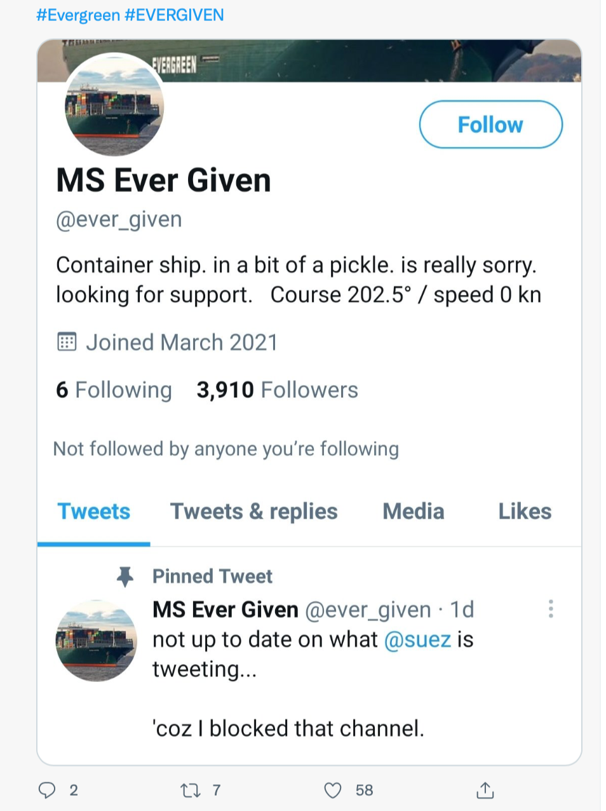
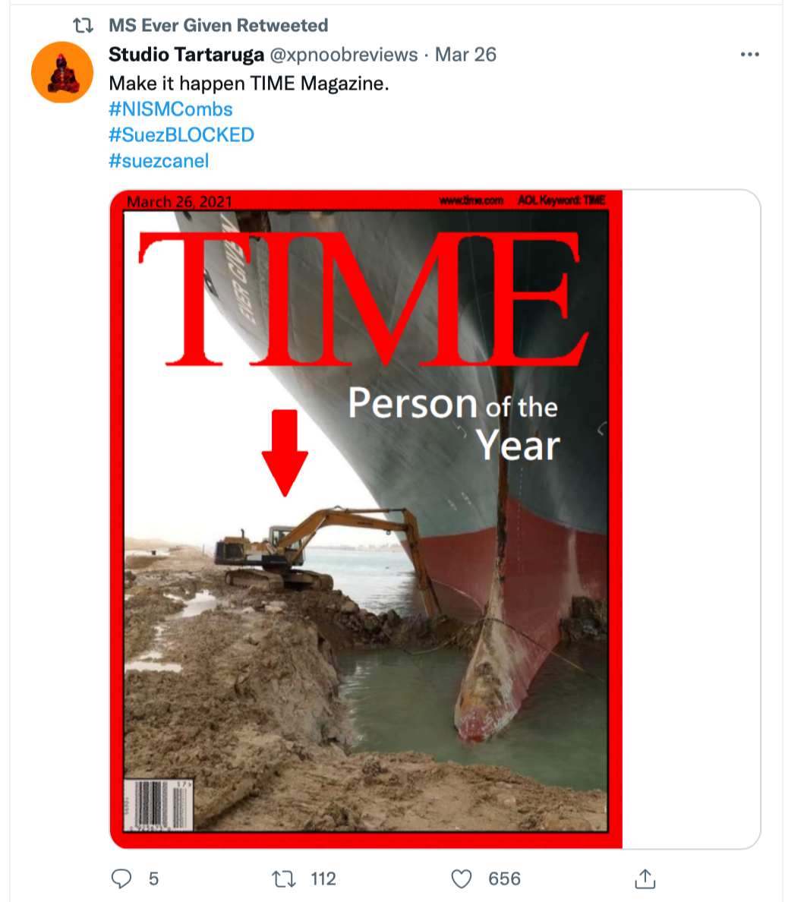
What was the name of the canal where a ship blocked global trade last March?
Source: Twitter
Notes:
Source: https://twitter.com/ever_given
https://twitter.com/KarlreMarks/status/1375138808954503169?ref_src=twsrc%5Etfw
On a Tuesday evening, last March, a container ship the length of four soccer fields was caught by gust of wind. The ship became wedged across a canal, blocking global trade. The event launched a thousand memes. What was the name of the canal?

Slide 17
Suez Canal
Notes:
Image: https://www.gettyimages.com/detail/photo/suez-canal-royalty-free-image/93173830?adppopup=true
It was the Suez Canal.

Slide 18
The Economy
Forecast 2022 The Pandemic Recovery
Notes:
Let’s begin by talking about the economy.

Slide 19
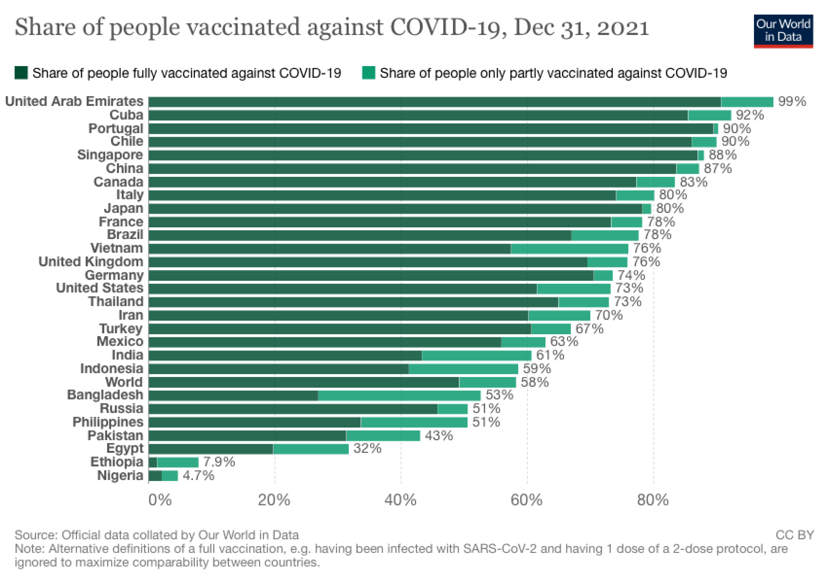
Source: Our World in Data
Notes:
Source: https://ourworldindata.org/covid-vaccinations
One of the keys to robust economic recovery was the development and rollout of effective vaccines. By the end of last year, slightly more than 73 percent of Americans had received at least one dose of vaccine.

Slide 20
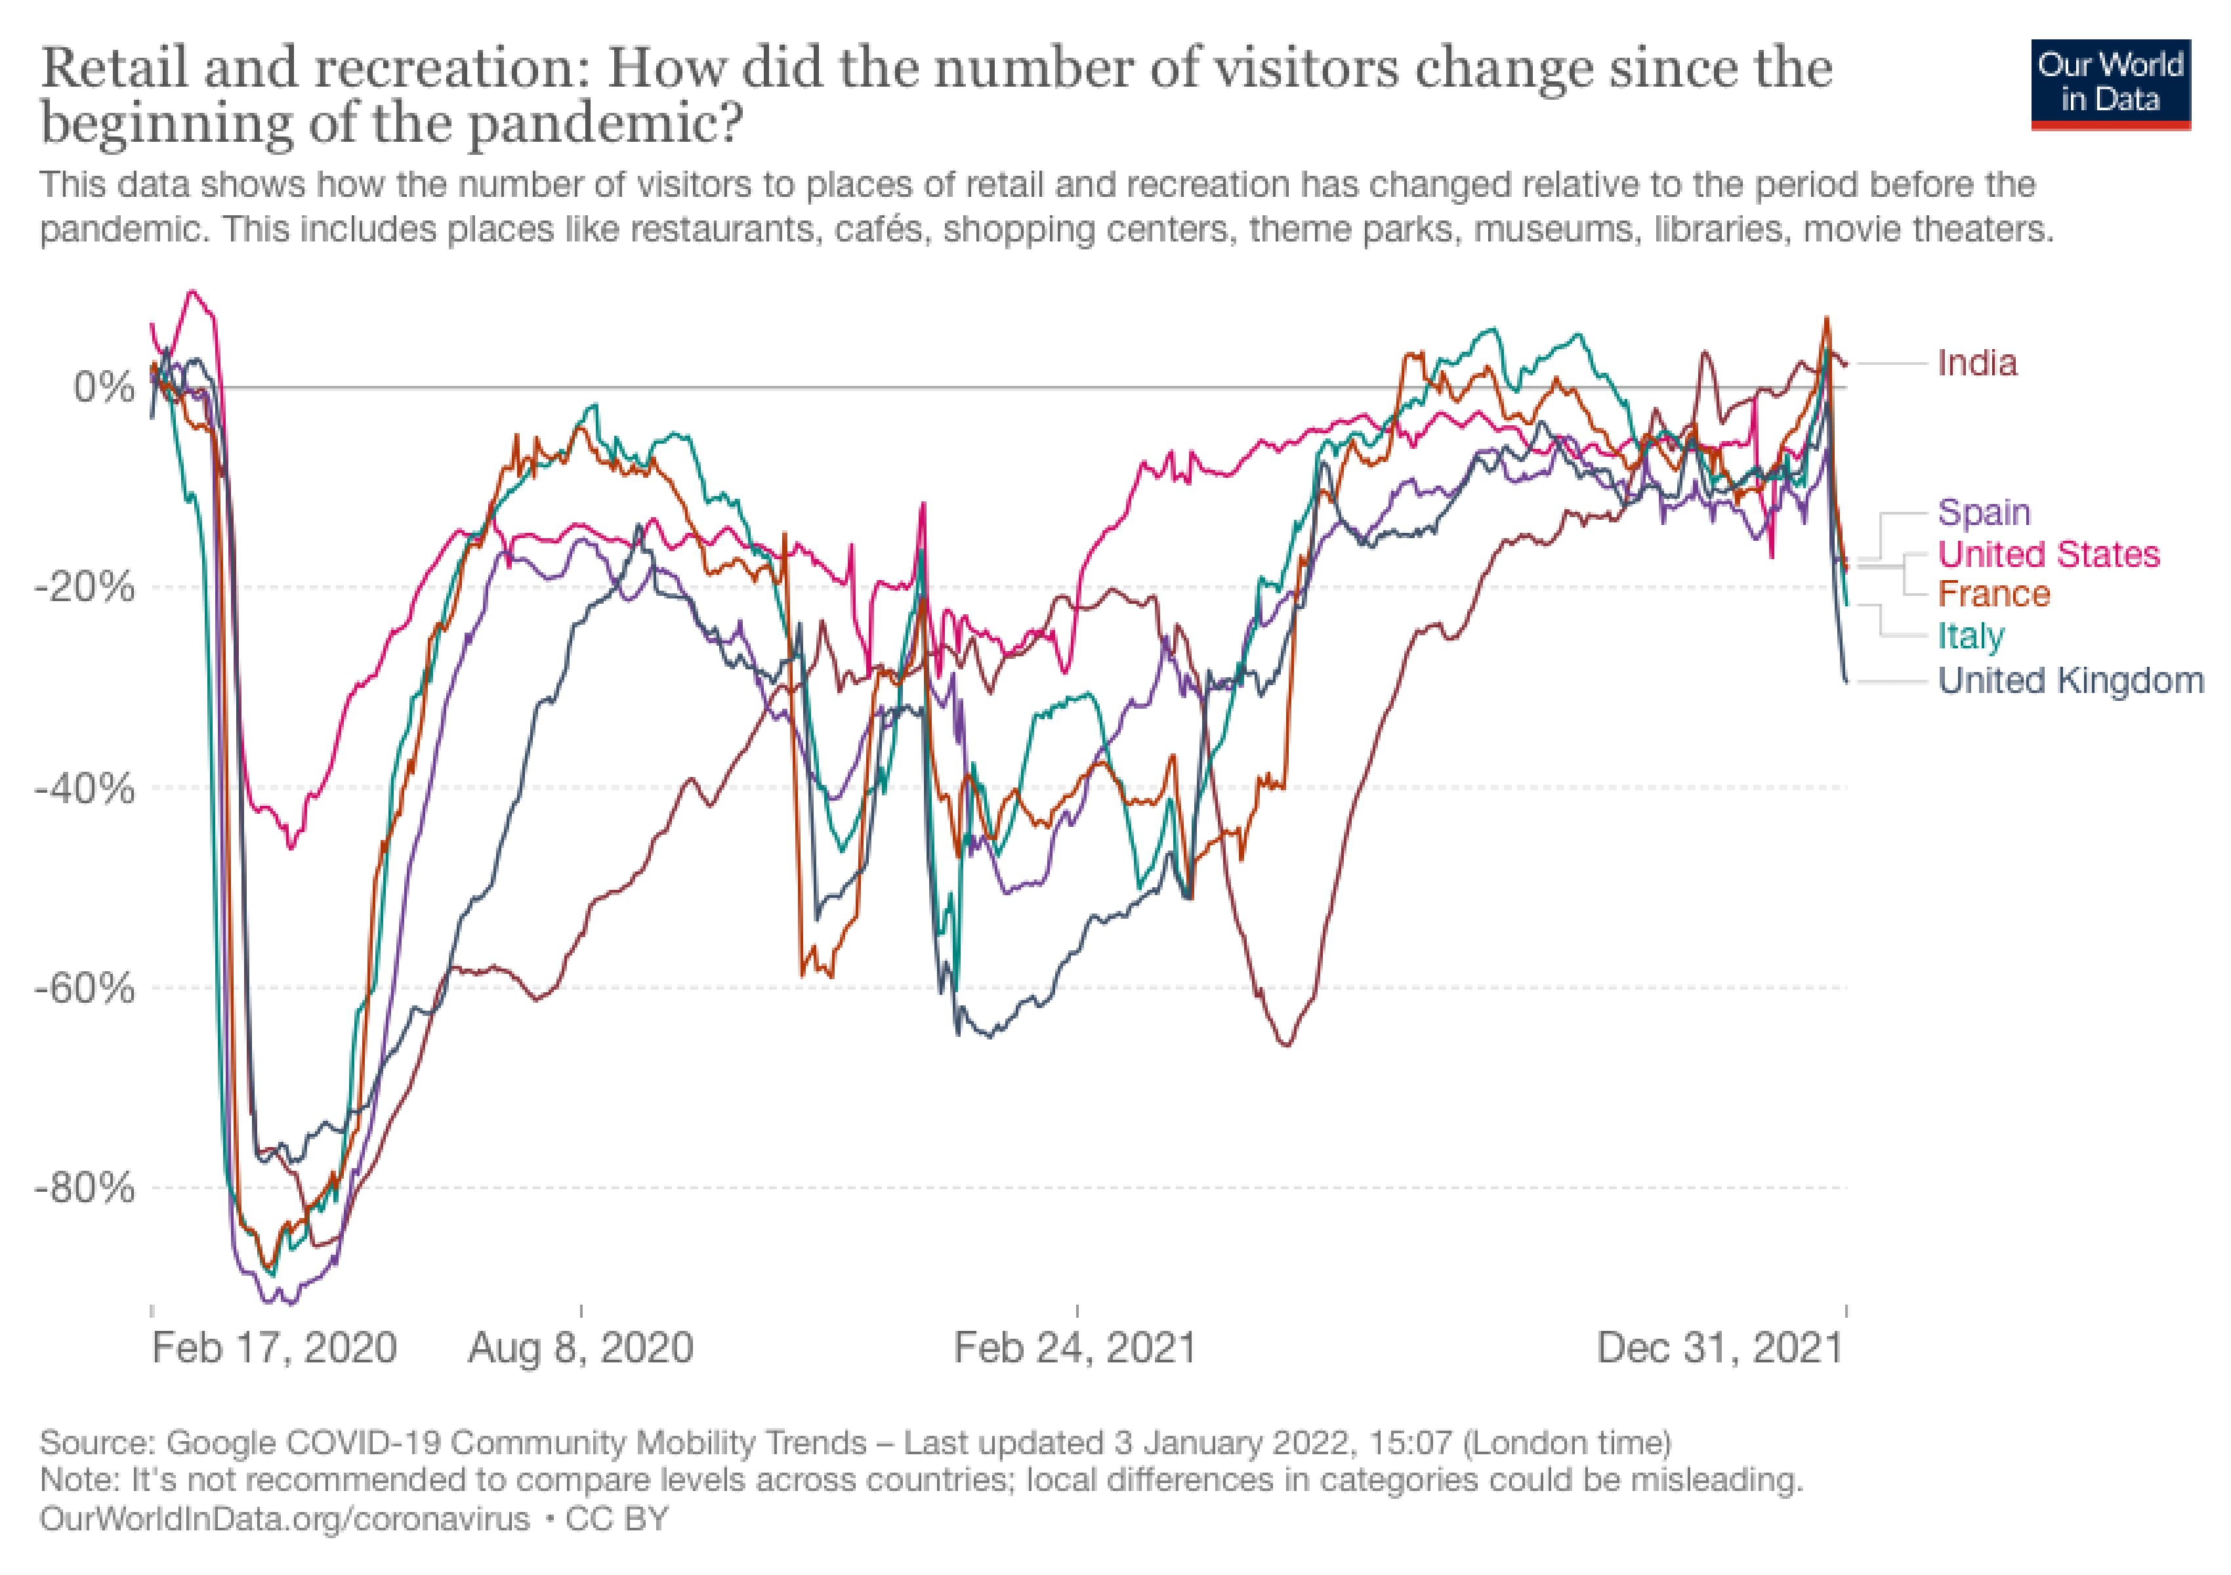
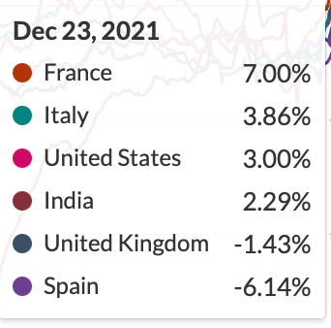
Activity was almost back to normal
People were returning to restaurants, cafés, shopping centers, theme parks, museums, libraries, movie theaters...and then the omicron variant spread
Source: Our World in Data
Notes:
Source: https://ourworldindata.org/covid-google-mobility-trends
https://www.npr.org/sections/health-shots/2021/11/30/1059926089/new-antiviral-drugs-are-coming-for-covid-heres-what-you-need-to-know
Vaccines helped people around the world feel more comfortable about returning to work, sending their children to school, going to restaurants, attending shows, and interacting with other people. In the United States and other nations, the level of retail and recreational activity had nearly returned to risen above pre-Covid levels. Then, as the omicron variant of Covid-19 spread, activity levels dropped lower again.
NOTE:
December 23:
France +7.0 percent
Italy +3.86 percent
U.S. +3.0 percent
India: +2.29
U.K. -1.43 percent
Spain -6.14 percent
December 31:
France -18.0 percent
Italy -21.17 percent
U.S. -17.86 percent
India: +2.43
U.K. -29.43 percent
Spain -17.14 percent

Slide 21
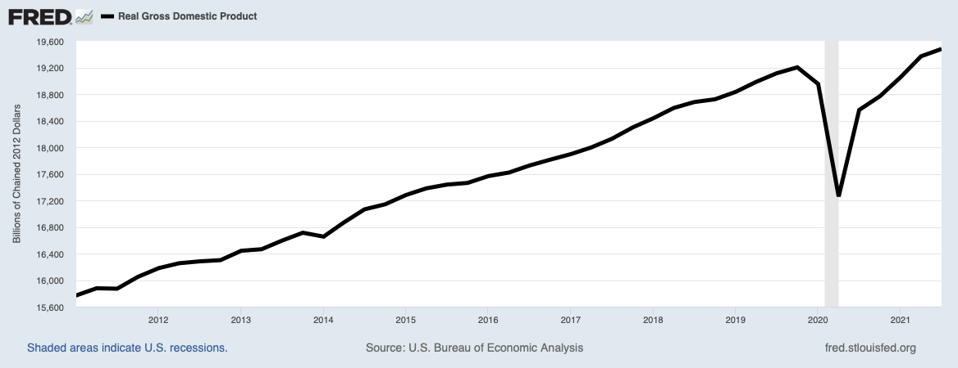
U.S. economic growth
U.S. economic growth
(Real GDP, % change annualized)
1Q 2021: 6.4%
2Q 2021: 6.7%
3Q 2021: 2.3%
4Q 2021: 6.1% (est.)
Source: U.S. Bureau of Economic Analysis, Real Gross Domestic Product [GDPC1], retrieved from FRED, Federal Reserve Bank of St. Louis; https://fred.stlouisfed.org/series/GDPC1, January 2, 2022; https://www.conference-board.org/research/us-forecast
Notes:
Source: https://www.bea.gov/news/2021/gross-domestic-product-3rd-quarter-2021-advance-estimate
U.S. Bureau of Economic Analysis, Real Gross Domestic Product [GDPC1], retrieved from FRED, Federal Reserve Bank of St. Louis; https://fred.stlouisfed.org/series/GDPC1, January 2, 2022.
Thanks to vaccinations, the United States economy recovered a lot faster than most people expected. The black line shows real gross domestic product, which is the value of all goods and services produced in the United States, has surpassed pre-Covid levels. Real GDP is adjusted for inflation. During 2021, the economy grew by 6.4 percent, annualized, in the first quarter and 6.7 percent in the second quarter before slowing in the third quarter. The Conference Board estimated that economic growth for the fourth quarter of 2021 was 6.1 percent.
Does anyone know why economic growth slowed during the third quarter?

Slide 22
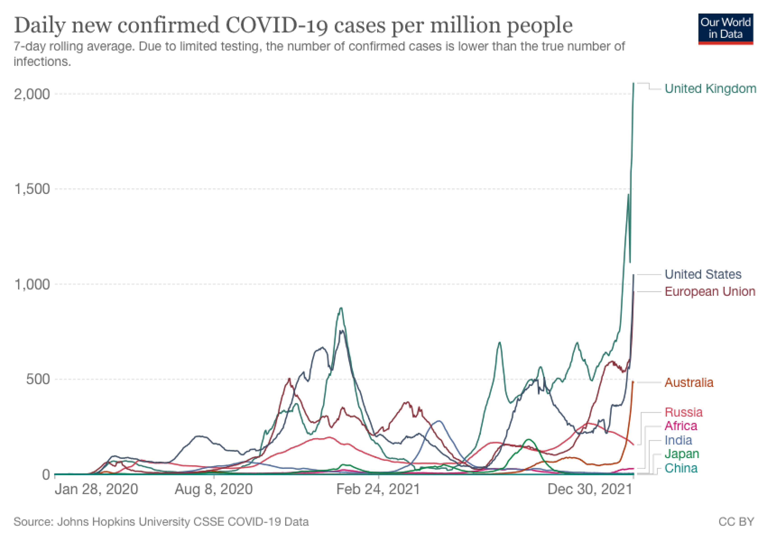
The Delta variant slowed progress
Omicron
Delta
Source: Our World in Data
Notes:
Source: https://ourworldindata.org/coronavirus/country/united-states
https://www.bea.gov/news/2021/gross-domestic-product-3rd-quarter-2021-advance-estimate; https://www.opentable.com/state-of-industry; https://www.bts.gov/newsroom/us-airlines-carry-584-million-passengers-september-2021-preliminary-still-down-20-pre; https://money.com/pandemic-shortages-us/
Growth slowed because of the delta variant of Covid-19. It spread rapidly in the United States over the summer. More Americans stayed home. Many spent less money causing economic growth to slow, but the economy kept growing. Spending at hotels and restaurants continued to increase but at a slower pace. Airlines were not so lucky, as the number of passengers flying declined again.
Then the Omicron variant emerged. This chart shows the rapid spread of omicron during the last days of 2021. It's possible the surge could have a detrimental effect on economic growth in 2021.

Slide 23
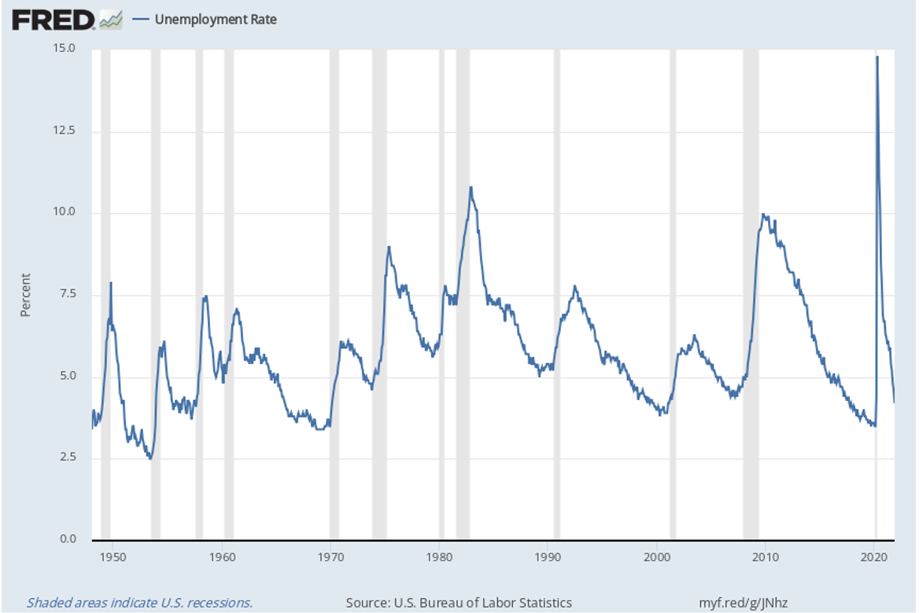
Employment made steady gains in 2021
Overall | 4.2%
Men | 4.2%
Women | 4.2%
Whites | 3.7 %
Blacks | 6.7%
Hispanics | 5.2%
Asians | 3.8%
Teens | 11.2%
Source: U.S. Bureau of Labor Statistics
Notes:
Source: https://finance.yahoo.com/news/next-recession-everything-bubble-burst-120100109.html
U.S. Bureau of Labor Statistics, Unemployment Rate [UNRATE], retrieved from FRED, Federal Reserve Bank of St. Louis; https://fred.stlouisfed.org/series/UNRATE, December 10, 2021.
https://www.bls.gov/news.release/empsit.t01.htm
https://www.bls.gov/news.release/pdf/empsit.pdf
Despite the emergence of Covid variants, employment steadily improved throughout 2021. In November, unemployment dropped to 4.2 percent overall, a level the country wasn't expected to reach until 2024. Despite progress, unemployment gains varied by demographic group. As you can see, unemployment rates were higher for Black and Hispanic Americans.

Slide 24
By the numbers Unemployment, Nov. 2021
23% of the group looking for work for 52 weeks or more was Black
61.8% labor force participation
3.6 million Americans not working due to COVID-19
Source: U.S. Bureau of Labor Statistics
Notes:
Image: https://www.gettyimages.com/detail/photo/female-apprentice-using-yoke-machine-in-factory-royalty-free-image/1149239358?adppopup=true
Sources: https://www.bls.gov/news.release/pdf/empsit.pdf
https://blog.dol.gov/2021/12/03/5-numbers-from-the-november-jobs-report
Long-term unemployment continues to be an issue for many workers of color. Black people account for 13% of the U.S. population, but make up 23% of workers who have been unemployed for 52 weeks or longer. The labor force participation rate, which measures the share of people who are working or actively looking for work, edged higher. But there were still 3.6 million people who reported that they couldn’t work, or worked fewer hours, due to COVID-19. Among the reasons given were early retirement, childcare obligations, shifting career priorities and the desire for better working conditions.
Covid issues have exacerbated a problem the job market was experiencing before the pandemic arrived – a lack of skilled labor.

Slide 25
Even before the pandemic, we faced an endemic shortage of workers to fill in-demand ‘middle skill’ jobs (which require some education after high school, but not a college degree) that make up the lion’s share of the labor market. Although such jobs, like electricians and plumbers, account for 52% of the U.S. labor market, just 43% of the nation’s workers are presently trained to do them.
– Maria Flynn, CEO of Jobs for the Future, Barron’s
November 30, 2021
Notes:
Source: https://www.barrons.com/articles/infrastructure-bill-labor-crisis-51638211859
The CEO of Jobs for the Future Maria Flynn reported in Barron’s that, “Even before the pandemic, we faced an endemic shortage of workers to fill in-demand ‘middle skill’ jobs (which" require some education after high school, but not a college degree) that make up the lion’s share of the labor market. Although such jobs, like electricians and plumbers, account for 52% of the U.S. labor market, just 43% of the nation’s workers are presently trained to do them."

Slide 26
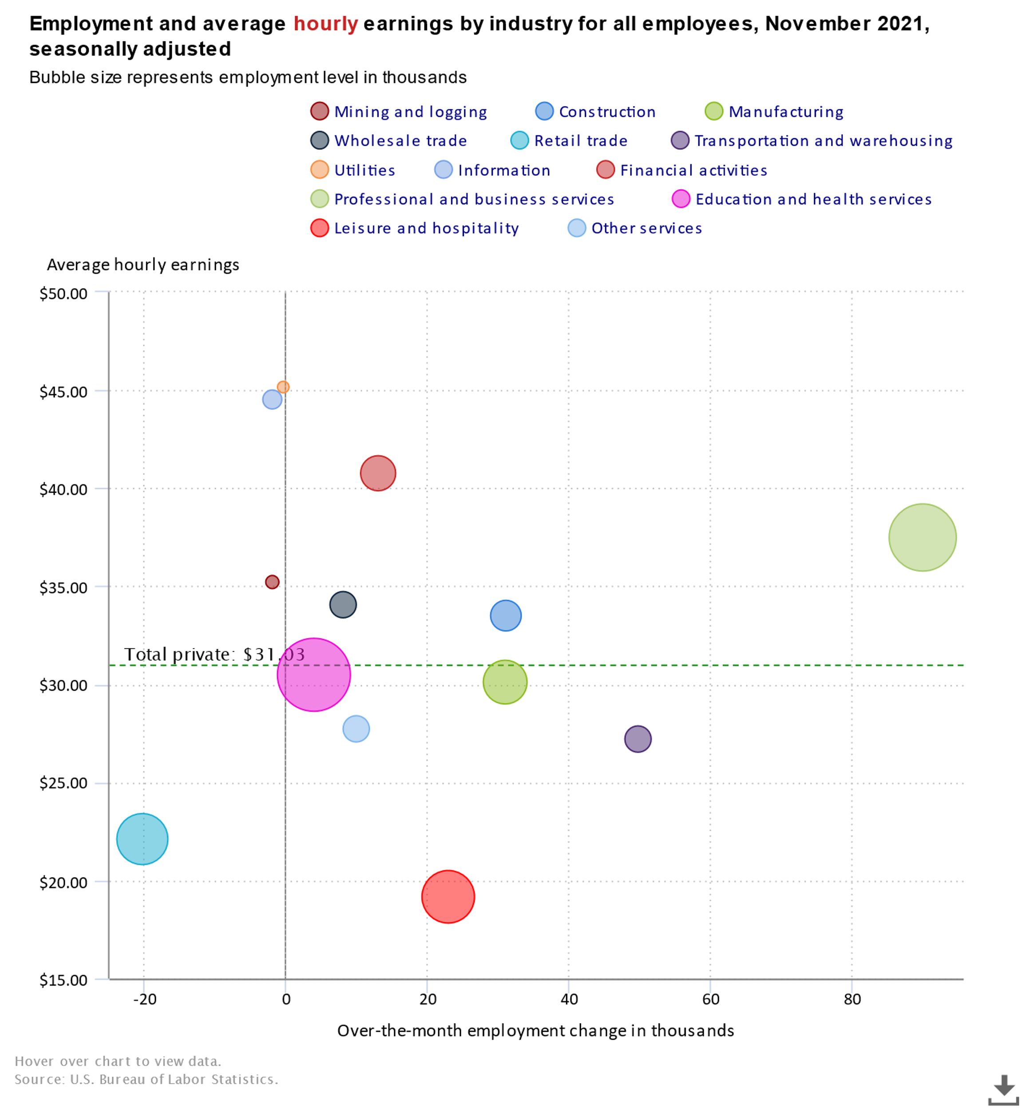
The labor shortage pushed wages higher
Average hourly earnings: $31.03
Source: U.S. Bureau of Labor Statistics
Notes:
Source: https://www.bls.gov/charts/employment-situation/employment-and-average-hourly-earnings-by-industry-bubble.htm
The shortage of workers pushed wages higher. Last November, the average hourly earnings across industries was $31.03. The bubbles represent different industries. The bottom axis shows changes in employment – whether a company gained or lost workers – and the left axis shows wages. The pink bubble is Education and Health services. The industry gained 4,000 workers in November and paid $30.49 an hour. The green bubble to the right of the pink is Manufacturing. Jobs there paid $30.15 an hour and the industry added more than 12,000 workers to payrolls. The blue bubble in the bottom left is Retail where workers average hourly earnings were $22.08 an hour. The industry lost more than 15,000 workers last November.

Slide 27
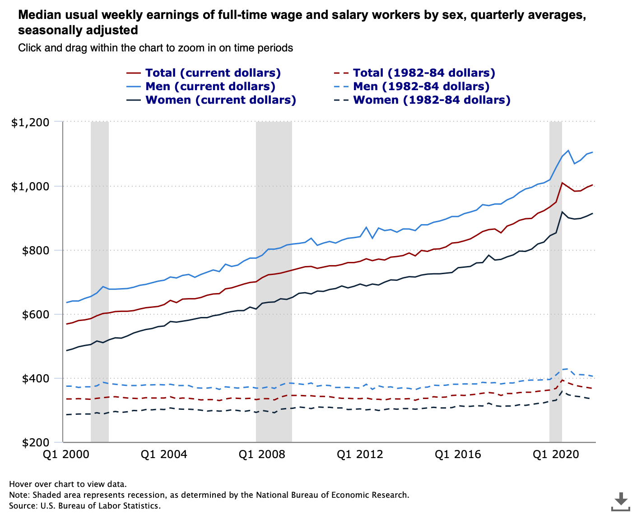
Higher earnings have been affected by inflation
Source: U.S. Bureau of Labor Statistics
Notes:
Source: https://www.bls.gov/charts/usual-weekly-earnings/usual-weekly-earnings-over-time-total-men-women.htm#
https://www.pewresearch.org/fact-tank/2021/09/07/despite-the-pandemic-wage-growth-held-firm-for-most-u-s-workers-with-little-effect-on-inequality/
https://www.census.gov/topics/income-poverty/income/guidance/current-vs-constant-dollars.html
https://www.conference-board.org/blog/labor-markets/2022-salary-increase-budgets
Median inflation-adjusted earnings rose early in the pandemic, not because employers were paying more, but because lower-wage workers lost jobs at a faster pace than more highly-paid workers, which pushed the average up. When lower-paid workers returned to work, average weekly earnings bumped lower but remained at a higher level than they were prior to the pandemic.

Slide 28
Supply Chain Issues
Notes:
Image:
Sources: https://money.com/pandemic-shortages-us/; https://www.popsci.com/technology/global-chip-shortage/;
Snarled supply chains contributed to rising inflation. They made everything from cars to furniture to golf and tennis balls more scarce and more costly. Toward the end of 2021, supply chains appeared to be resolving and productivity indexes moved higher.

Slide 29
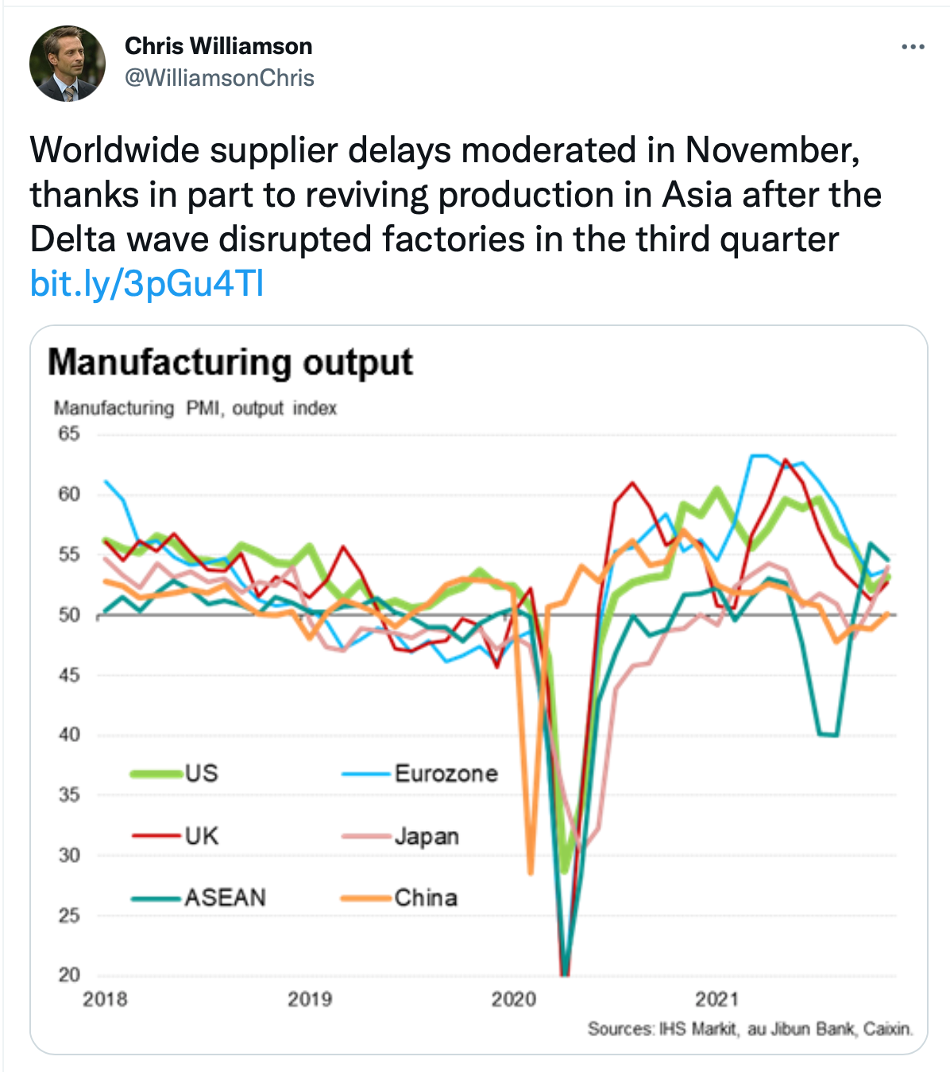
If we cannot use the tweets, I can use a FRED chart showing production and new orders]
Supplier delays eased toward year end
Worldwide supplier delays moderated in November, thanks in part to reviving production in Asia after the Delta wave disrupted factories in the third quarter.
– Chris Williamson, IHS Markit December 9, 2021
Source: Twitter
Notes:
Sources:
https://twitter.com/WilliamsonChris, December 9, 2021
https://www.drewry.co.uk/supply-chain-advisors/supply-chain-expertise/world-container-index-assessed-by-drewry
https://www.bloomberg.com/opinion/articles/2021-11-18/the-u-s-supply-chain-crisis-is-already-easing
Late in 2021, it appeared that supply issues were easing. Container shipping rates began to decline during the fourth quarter, as did the number of days containers remained in the Port of Los Angeles.
Perhaps most importantly, U.S. manufacturing output improved. "Chris Williamson of IHS Markit, which tracks manufacturing and productivity, tweeted in December that, "Worldwide supplier delays moderated in November, thanks in part to reviving production in Asia after the Delta wave disrupted factories in the third quarter."
While these are positive developments, inflation has been a serious concern .

Slide 30
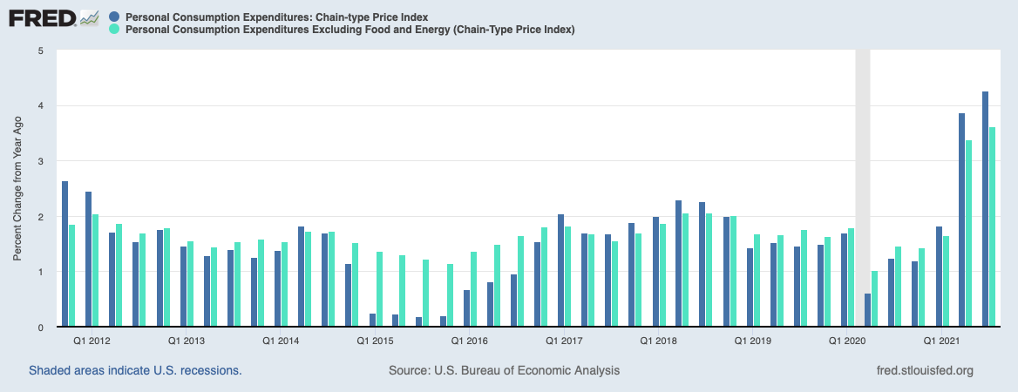
Inflation
Notes:
Sources: https://www.economist.com/briefing/2021/07/10/surprising-levels-of-inflation-are-increasingly-being-driven-by-wages-not-goods; https://www.stlouisfed.org/on-the-economy/2021/july/inflation-expectations-fed-new-monetary-framework
As 2021 drew to a close, one of the biggest concerns for most Americans was inflation. During the year, prices rose at a pace that was well above the Federal Reserve’s 2 percent target. Here you see Personal Consumption Expenditures, or PCE, in dark blue. It shows the increase in prices paid for goods and services in the United States. The core PCE, which is the Federal Reserve’s preferred measure of inflation, is the lighter turquoise bar. It excludes food and energy prices because they tend to be volatile. As you can see here, inflation moved significantly higher during 2021.
The Federal Reserve’s job is to provide a safe and stable monetary and financial system. Its policies are supposed to promote full employment and stable prices. When prices rise too high or employment falls to low, it takes steps to remedy the situation. For many years, inflation remained low and central banks around the world have had difficulty pushing it higher. So, the Fed adopted a new policy – Flexible Average Inflation Targeting -- that allows inflation to remain above 2 percent for an unspecified period of time. When the Fed determines inflation needs to be tamed, it will tighten monetary policy and raise interest rates.
There are significant differences in opinion about the Fed's new policy.

Slide 31
Although [inflationary] pressures are unlikely to subside quickly, I remain confident in the basic view that both headline and core inflation will fall significantly next year.
– Jan Hatzius, Chief Economist, Goldman Sachs November 17, 2021
Notes:
Source: https://www.goldmansachs.com/insights/pages/gs-research/inflation-here-today-gone-tomorrow/inflation-here-today-gone-tomorrow.pdf; https://www.economist.com/finance-and-economics/a-three-decade-high-in-inflation-sows-concerns-about-americas-recovery/21806221
Jan Hatzius, who is Head of Global Investment Research and Chief Economist at Goldman Sachs, said, “Although [inflationary] pressures are unlikely to subside quickly, I remain confident in the basic view that both headline and core inflation will fall significantly next year.”
If he’s right and inflation is short-lived, the Federal Reserve should look past it and continue to tighten gradually, according to The Economist.

Slide 32
“The Fed’s delayed and slow reaction to inflationary pressures has unfortunately increased the probability that it will have to slam on the brakes by raising rates very quickly after tapering and at a more aggressive pace than it would have if it started to tighten policy earlier.”
– Mohamed A. El-Erian, President of Queen’s College, Cambridge University, November 17, 2021
Notes:
Source: https://www.goldmansachs.com/insights/pages/gs-research/inflation-here-today-gone-tomorrow/inflation-here-today-gone-tomorrow.pdf; https://www.economist.com/finance-and-economics/a-three-decade-high-in-inflation-sows-concerns-about-americas-recovery/21806221
Mohamed A. El-Erian, who is the President of Queen’s College at Cambridge University at Chief Economic Advisor at Allianz, believes inflation will not subside without central bank action. He wrote, “The Fed’s delayed and slow reaction to inflationary pressures has unfortunately increased the probability that it will have to slam on the brakes by raising rates very quickly after tapering and at a more aggressive pace than it would have if it started to tighten policy earlier.”
If his opinion is correct, then the Federal Reserve should be tightening rapidly to tame inflation – and that could slow economic growth.

Slide 33
Will Fed policy be “just right”?
Too Slow =
Inflation could rise higher than desired.
Too Fast =
Economic growth could slow or stall.
Notes:
Source: https://www.federalreserve.gov/faqs/about_12594.htm
Many people, on both sides of the debate, are worried the Fed will make a policy mistake. If the U.S. central bank raises rates too slowly, inflation could rise more quickly than anyone would like it to. On the other hand, if the Fed raises rates too quickly, economic growth could slow or stall.
In November, Federal Reserve policy appeared to take a hawkish turn, removing the term "Transitory" from its inflation discussion.

Slide 34
Consumer sentiment
 | Dec. 2021 | Nov. 2021 | Month to month | Year to year
Index of Consumer Sentiment | 70.6 | 67.4 | +4.7 | -12.5
Index of current conditions | 74.2 | 73.6 | +0.8 | -17.6
Index of future conditions | 68.3 | 63.5 | +7.6 | -8.4
Source: University of Michigan, Surveys of Consumers
Notes:
Source: http://www.sca.isr.umich.edu
Inflation had a significant effect on consumer optimism. This chart reflects the findings of the University of Michigan's Consumer Sentiment Survey. Sentiment improved in December, primarily among households with incomes in the bottom third of the distribution. They were more optimistic because of expectations that incomes will increase during 2022.
While expectations for the future improved markedly, optimism about current conditions rose less, largely due to inflation. In December, after the Federal Reserve removed the word "transitory" from its assessment of inflation and appeared ready to take more decisive action to tame inflation, consumers became more optimistic.
Let's take a look at how the rapid economic rebound affected financial markets.

Slide 35
Financial Markets
Forecast 2022 The Pandemic Recovery
Notes:
Sources: https://www.cnn.com/2021/11/23/energy/asia-uk-strategic-oil-reserves/index.html
As I mentioned, supply shortages pushed inflation higher and that hurt consumers around the globe. The United States, China, Japan, India, South Korea and the United Kingdom released strategic oil reserves.

Slide 36
The Quebec Maple Syrup Producers (QMSP) – the so-called OPEC of maple syrup – has released about 22m kg from its emergency larder, nearly half the total in reserve.
– BBC News, December 6, 2021
Notes:
Image: https://www.gettyimages.com/detail/photo/maple-syrup-royalty-free-image/671889382?adppopup=true
Source: https://www.bbc.com/news/world-us-canada-59555141
And Canada, for the first time in three years, tapped into its strategic maple syrup reserves. The BBC News reported, "The Quebec Maple Syrup Producers (QMSP) - the so-called Opec of maple syrup - has released about 22m kg from its emergency larder, nearly half the total in reserve." High demand and low supply, due to a limited harvest, had constrained supplies.
We're not sure how that will affect share prices of syrup producers.

Slide 37
Stock markets delivered strong returns
 | 2021 return
S&P 500 Index | 28.7%
MSCWI ACWI Index | 18.5%
Bloomberg US Aggregate Bond Index | -1.5%
Russell 2000 | 14.8%
S&P 500 Growth Index | 32.0%
S&P 500 Value Index | 24.9%
Bloomberg Commodity Index | 27.1%
Source: Carson Group, Morningstar Direct
Notes:
Sources: Scott Kubie quarterly presentation
https://www.schwab.com/resource-center/insights/content/2022-schwab-market-outlook-ebb-tide
https://www.spglobal.com/spdji/en/indices/equity/sp-500-value/#overview
https://www.spglobal.com/spdji/en/indices/equity/sp-500-growth/#overview
https://www.marketwatch.com/investing/index/bcom/historical?countrycode=xx
We are sure that stocks delivered a strong performance in 2021. As the U.S. economy strengthened and employment and productivity made great strides, financial markets reflected the improvement.
The Standard & Poor’s 500 Index, which reflects the performance of the U.S. stock market, finished 2021 up 28.7 percent, which is well above its long-term average annual return. Returns above 20% are remarkable, but it's important to recognize that more than 90% of the stocks in the S&P 500 experienced corrections in 2021, meaning they fell more than 10% from a peak price.
The Morgan Stanley All-Country World Index finished up 18.5 percent.
The Bloomberg Barclays Aggregate Bond Index was down 1.5 percent.
The Russell 2000, which is a proxy for small company stock performance, was up 14.8 percent.
It looked like value stocks were making comeback early in 2021, but growth rotated back into favor when the Delta variant arrived. The S&P 500 Growth Index returned 32 percent for the year, while the Value index returned 24.9 percent.
As the global economic recovered last year, we saw a surge in demand for energy and materials that could not be met because of pandemic disruptions. As a result, commodities prices moved higher. The Bloomberg Commodity Index was up 27.1 percent in 2021.

Slide 38
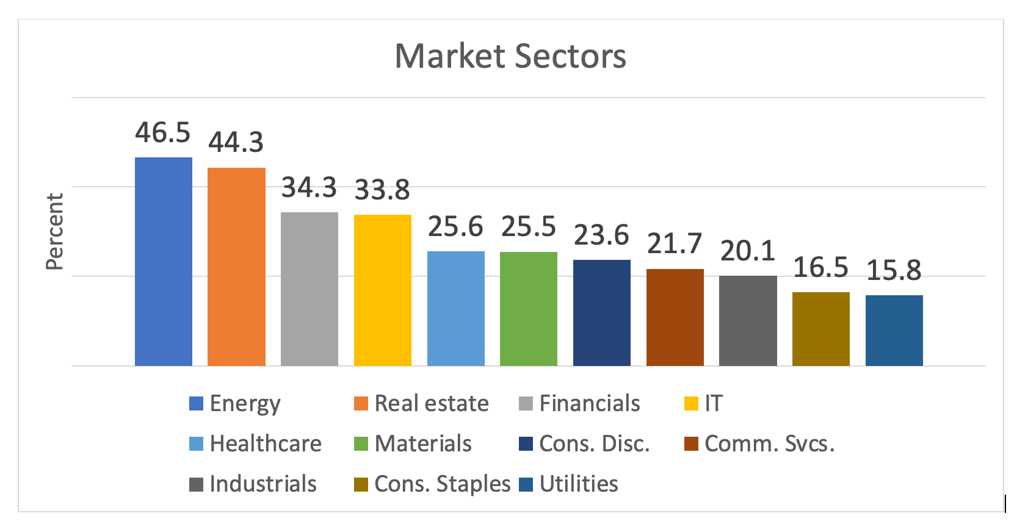
Energy was the top performer
Source: Fidelity
Notes:
Source: https://eresearch.fidelity.com/eresearch/markets_sectors/sectors/sectors_in_market.jhtml
The top performing sector was Energy. As you may remember, demand for energy dropped sharply when the pandemic arrived, so energy providers cut back on production. When the American economy rebounded so quickly, it caught energy providers by surprise. Demand increased faster than they could bring supplies online and that pushed prices higher.
Utilities was the worst performing sector. Utilities is a defensive sector. It tends to perform best when people are concerned about economic growth slowing down. Typically, utilities companies provide steady revenue because people always need water, gas and electricity.

Slide 39
S&P 500 companies were profitable in 2021
+45.1%
(Year-over-year estimate, 2021)
Source: FactSet
Notes:
Image: https://www.gettyimages.com/detail/photo/workers-working-late-tall-building-reflected-royalty-free-image/1173173561?adppopup=true
Source: https://insight.factset.com/sp-500-earnings-season-update-october-29-2021
https://insight.factset.com/earnings-insight-q3-21-by-the-numbers-infographic
Despite supply chain issues, labor shortages, wage increases, and inflation, U.S. corporate earnings were exceptional. Earnings are a measure of company profitability. Companies in the Standard & Poor’s 500 Index saw earnings increase by 38 percent during the third quarter of 2021. That’s the highest earnings growth since 2010. , were up 45.1 percent year-over-year.
Analysts expect earnings growth for 2021 to increase by about 45 percent. That’s well above the trailing 10-year average annual earnings growth rate of 5.0 percent. As fourth quarter earnings come in, we'll find out if they're right.
Analysts have high expectations for 2022, too. Earnings are projected to grow 9.6% next year.

Slide 40
Investors have not needed to care about bloated companies until now...Indeed the median S&P 500 company earned $1 in sales for every $1 it held in assets in the early 2000s. It now earns just 60 cents. In 2022, the focus on asset efficiency is set to return as the two other sources of returns on equity – profit margins and leverage – are coming under significant pressure.
– Luke Templeman, Deutsche Bank December 2021
Notes:
Source: https://www.dbresearch.com/PROD/RPS_EN-PROD/Deutsche_Bank_Research__economic_cyclegrowth_trends_economic_policy/RPSHOME.alias (Top 10 themes, page 7)
One of the things investors may be looking for as we find a post-pandemic normal is asset efficiency. Luke Templeman of Deutche Bank explained, "Investors have not needed to care about bloated companies until now...Indeed the median S&P 500 company earned $1 in sales for every $1 it held in assets in the early 2000s. It now earns just 60 cents. In 2022, the focus on asset efficiency is set to return as the two other sources of returns on equity – profit margins and leverage – are coming under significant pressure."

Slide 41
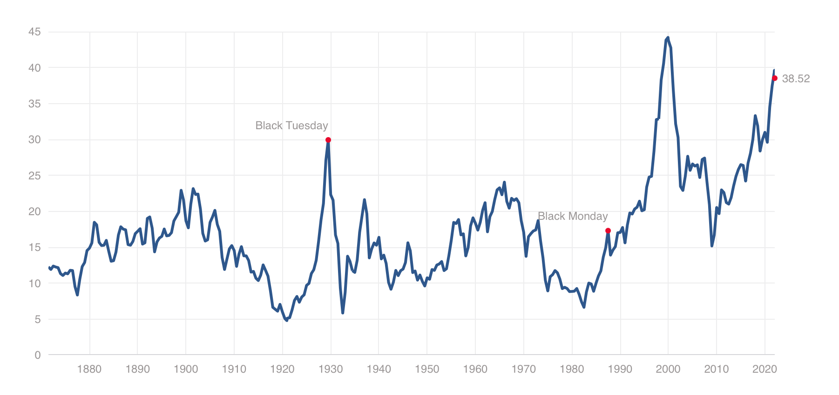
Shiller CAPE Ratio/S&P 500 Index
December 31, 2021
38.68
Source: Multipl, January 14, 2022
Notes:
Source: https://www.multpl.com/shiller-pe; https://www.nytimes.com/2021/03/05/business/stock-market-prices-bubble.html
When a company's earnings go up, often the value of its stock does, too.
Fair valuation will also get attention. One measure of whether a stock is fairly valued is the price-to-earnings or PE ratio. The Shiller CAPE Ratio measures the price of a stock relative to its earnings using average inflation-adjusted earnings from the previous 10 years. In other words, it factors in inflation and considers company earnings over a long period of time.
The ratio indicates whether shares are underpriced, fairly priced, or overpriced. As you can see, the CAPE ratio suggests that S&P 500 stocks are quite expensive right now. And yet, Robert Shiller -- the Nobel-prize-winning economist who helped develop the CAPE ratio, thinks they may not be as expensive as they look. He explained in a New York Times article.

Slide 42
Examined on their own, stock valuations are at giddy levels, yet they are far more attractive when viewed side by side with bonds. That’s why it is so hard to determine whether the stock market is dangerously high or a relative bargain.
– Economist Robert Shiller, The New York Times March 5, 2021
Notes:
Source: https://www.nytimes.com/2021/03/05/business/stock-market-prices-bubble.html
“Examined on their own, stock valuations are at giddy levels, yet they are far more attractive when viewed side by side with bonds. That’s why it is so hard to determine whether the stock market is dangerously high or a relative bargain.”
The question is: Is there a better and safer place to earn money if you sell stocks?
So far, U.S. equities appear to offer better potential for positive real returns than long-term U.S. bonds. They may even be more attractive than relative opportunities in other countries' stock markets.
One region where investors are becoming more cautious is China.

Slide 43
China turmoil
Slowing economic growth (Est. 3.8% in 2022)
Regulatory enforcement
Education and tutoring
Technology
Real estate
Chinese companies delisting
Real estate market issues
Source: The Economist, The Economist, Barron's, Reuters
Notes:
Image: https://www.gettyimages.com/detail/photo/dollar-and-yuan-chinese-banknote-royalty-free-image/1139133621?adppopup=true
Source: https://www.economist.com/finance-and-economics/chinas-economy-looks-especially-vulnerable-to-the-spread-of-omicron/21806564
https://www.economist.com/the-world-ahead/2021/11/08/xi-jinpings-crackdown-on-chinese-tech-firms-will-continue
https://www.barrons.com/articles/us-listed-chinese-stock-selloff-didi-alibaba-nio-51638574341
https://www.reuters.com/world/china/developer-china-evergrandes-shares-set-rise-66-restructuring-looms-2021-12-07/
For decades, China has delivered strong economic growth that supported attractive market returns, making it very attractive to investors around the world. Now, China's economic growth is slowing. Oxford Economics thinks China’s economic growth could slow to 3.8 percent in 2022 and could be even lower if the housing market loses value.
But slower economic growth isn’t the only concern for investors. China's President, Xi Jinping, is tightening control in a variety of ways. During 2021, he initiated a regulatory crackdown that erased more than a trillion from the market capitalization of some of the world’s leading internet companies. Online education and tutoring companies, ride sharing and delivery companies, social media and real estate companies, have all come under regulatory scrutiny and been required to make changes that destroyed share value and made companies less attractive to investors.
In addition, Chinese firms have begun to delist from U.S. exchanges with the intention of listing on the China-controlled Hong Kong exchange. The U.S. Securities & Exchange Commission finalized new transparency requirements that would require Chinese companies to provide U.S. regulators with the documents from financial audits completed in China.
Finally, as China's growth has slowed, it's real estate market has come under pressure. During 2021, some large Chinese property developers made news when they ran short of cash, raising concerns that defaults might be ahead. China's top property developer is pursuing debt restructuring.
While many hope the furor will die down, The Economist explained that it may not.

Slide 44
Some $1.5trn of Chinese company shares trade in New York. Those listings have already been threatened by American regulations that require all listed companies to provide access to internal auditing documents or face eventual delisting. Chinese officials have refused to allow access, often deeming this material 'state secrets'...Until now no Chinese enforcement body has sought to control Chinese listings in foreign markets.
– The Economist December 8, 2021
Notes:
Source: https://www.economist.com/business/2021/12/03/didis-delisting-sounds-the-death-knell-for-chinese-ipos-in-america
"Some $1.5trn of Chinese company shares trade in New York. Those listings have already been threatened by American regulations that require all listed companies to provide access to internal auditing documents or face eventual delisting. Chinese officials have refused to allow access, often deeming this material 'state secrets'...China’s growing regulatory reach should also raise alarms for global investors. Until now no Chinese enforcement body has sought to control Chinese listings in foreign markets."
It may be a while before tensions between the U.S. and China settle.

Slide 45
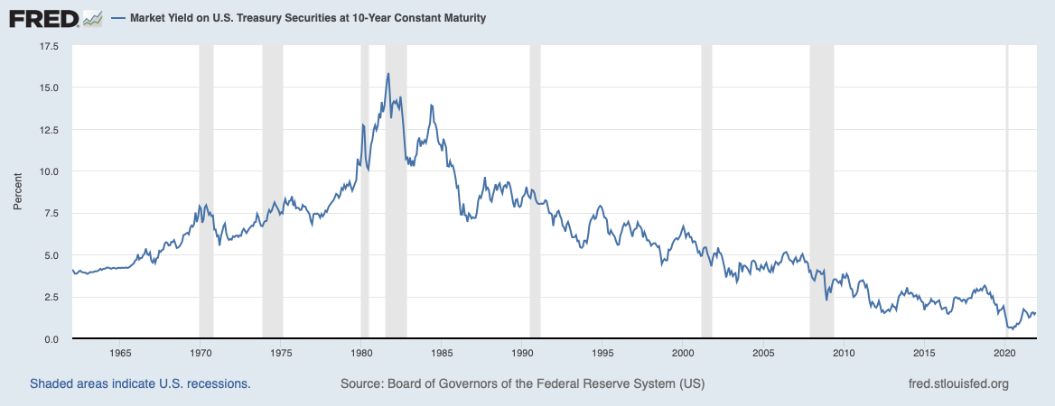
Bond yields rose and fell
Notes:
Source: https://www.schwab.com/resource-center/insights/content/2022-schwab-market-outlook-ebb-tide
Board of Governors of the Federal Reserve System (US), Market Yield on U.S. Treasury Securities at 10-Year Constant Maturity [DGS10], retrieved from FRED, Federal Reserve Bank of St. Louis; https://fred.stlouisfed.org/series/DGS10, January 2, 2022.
The U.S. bond market also was in turmoil this year.
During 2021, bond yields rose early on as the economy recovered faster than expected. Then, yields fell as the Delta variant slowed economic growth. Yields rose again in anticipation of the Fed tightening sooner than expected to fight inflation. Overall, though, Treasury yields trended higher. If the Federal Reserve begins to raise rates in 2022, as expected, then interest rates should rise over during 2022.

Slide 46
Finding income in a low- or rising-rate environment
Preferred stock
Real estate
Core plus
Other options
Source: Morningstar, Investopedia
Notes:
Source: https://www.morningstar.com/articles/1028709/3-income-alternatives-to-consider
https://www.investopedia.com/articles/investing/040315/reits-versus-real-estate-mutual-funds.asp
Image: https://www.gettyimages.com/detail/photo/investment-direction-royalty-free-image/183036424?adppopup=true
We often think of bonds as "safe" investments, but in a low or rising rate environment, bonds may not do what many people have become accustomed to them doing, which is being the portfolio Zamboni and smoothing volatility. In the current environment, it may make sense to consider other income options, a swell. These could include:
Preferred stocks, which are another type of stock investment. They typically offer regular income payments like bonds, but they have less standing than bonds if a company runs into trouble. Real estate investments can help deepen diversification, they may boost overall portfolio returns, and real estate can be a hedge against inflation. Core plus options offer widely diversified bond holdings, although they also have higher credit risk than a government or investment grade portfolio.

Slide 47
Divergent sentiment
Zero
Bearish
45.3
More bearish than two weeks prior (46.7)
100
Bullish
TIM Market Sentiment Survey (As of Dec. 27, 2021)
AAII Investor Sentiment Survey (As of Dec. 29, 2021)
30.5% Bearish
37.7% Bullish
31.8% Neutral
Source: Barron's, American Association of Individual Investors
Notes:
Sources: https://www.aaii.com/sentimentsurvey
https://www.aaii.com/journal/sentimentsurveyarticle
https://sts3.wsj.net/barrons/static_files/newsletterPreviews/marketLab.html
https://www.barrons.com/market-data/market-lab?mod=md_subnav
As 2021 came to a close, there was a divergence in outlook between individual investors and professional investors. AAII Investor Sentiment Survey showed that bullishness moved sharply higher at the end of the year (37.7 percent on December 29 compared to 29.6 percent the previous week). A large, but declining percentage of investors were feeling bearish (30.5 percent compared to 33.9 the week before). Almost 32 percent of those surveyed were neutral, meaning they were uncertain whether the stock market would move higher or lower over the next six months. These numbers are very close to the long-term historic averages for the survey (bearish 30.5 percent; bullish, 38 percent; and neutral, 31.5 percent)
Some say this survey is a strong contrarian indicator, meaning the stock market may do the opposite of what survey respondents think will happen. In other words, if respondents were strongly bullish, the market might be expected to move lower over the next six months, and vice versa.9 The strong neutral reading indicates investors don’t know what to expect.
TIM Group Market Sentiment Survey reflects the real-time advice that investment bankers, corporate financial advisors, and other sell-side firms are providing to clients.10 Last week, survey respondents took a turn to the bearish. The survey’s sentiment reading was 45.3 during the last week of the year, down from 46.7 in mid-December. (A reading of zero is completely bearish and a reading of 100 is completely bullish.)
Let's take a look at Where We May Be Going.

Slide 48
Where We May Be Going
Forecast 2022 The Pandemic Recovery
Notes:
There is a lot of uncertainty in the world today. Like individual and professional investors, people often have different opinions about the same situation. But that doesn’t stop people from engaging in random acts of kindness.

Slide 49
Engaging in random acts of kindness
“When I was a kid, I used to always twist the quarter machines on the way into stores just in case. Got lucky a couple of times and a few free toys. Now that I’m grown, if I'm leaving a store [that has them], I like to drop change into them if I have it and leave them half twisted.”
“Sometimes I walk the longer way home from the supermarket in the hopes of seeing that cat that likes me to give it tummy rubs.”
Source: Buzzfeed
Notes:
Images: https://www.gettyimages.com/detail/photo/candy-machine-royalty-free-image/172194106?adppopup=true
Source: https://www.buzzfeed.com/jasminevaughnhall/wholesome-secrets-reddit
Recently, a social media site asked people to share their wholesome secrets – and they did. One person wrote, “When I was a kid, I used to always twist the quarter machines on the way into stores just in case. Got lucky a couple of times and a few free toys. Now that I'm grown, if I'm leaving a store [that has them], I like to drop change into them if I have it and leave them half twisted.”
Whoever they are, they're making children happy – perhaps, their parents less so.

Slide 50
Engaging in random acts of kindness
“I put change in people’s parking meters, so they don’t run out of time.”
Source: Buzzfeed
Notes:
Images: https://www.gettyimages.com/detail/photo/close-up-of-hand-putting-coin-in-parking-meter-royalty-free-image/866817006?adppopup=true
Source: https://www.buzzfeed.com/jasminevaughnhall/wholesome-secrets-reddit
One secret sharer said, "I put change in people's parking meters, so they don't run out of time.”

Slide 51
Engaging in random acts of kindness
“I know a little boy in my child’s class that lives a hard life. Whenever there is a raffle for any goodies, I buy a bunch of tickets and put his name on them. He’s won a pizza party and an ice cream party.”
Source: Buzzfeed
Notes:
Image: https://www.gettyimages.com/detail/photo/children-eating-pizza-outdoors-royalty-free-image/85632699?adppopup=true
Another keeps their kind acts closer to home. "I know a little boy in my child's class that lives a hard life. Whenever there is a raffle for any goodies, I buy a bunch of tickets and put his name on them. He's won a pizza party and an ice cream party."
It’s not surprising that people do kind things. Happiness research has shown that the joy that accompanies making someone else happy – even if they don’t know you’ve done it – is powerful. We know we’re having an impact.

Slide 52
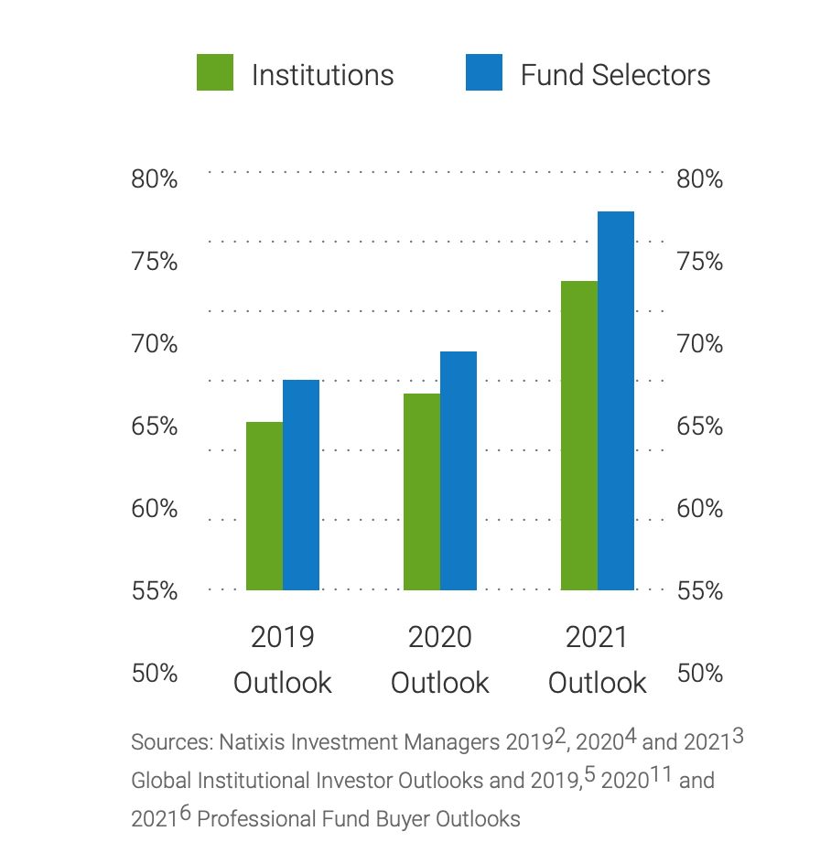
Wider adoption of ESG criteria
Environmental, Social, and Governance investing
Responsible investing
Sustainable investing
Socially responsible investing
Impact Investing
Source: Natixis, The GIIN
Notes:
Source: https://www.im.natixis.com/us/research/esg-investing-survey-insight-report
https://thegiin.org/impact-investing/need-to-know/
https://www.globenewswire.com/en/news-release/2021/11/16/2335435/0/en/92-of-S-P-500-Companies-and-70-of-Russell-1000-Companies-Published-Sustainability-Reports-in-2020-G-A-Institute-Research-Shows.html
Impact is becoming powerful in investing, too. People use a variety of names to describe it: Environmental, Social, and Governance (ESG) investing, responsible investing, sustainable investing, socially responsible investing. In the long run, its investing with the intention to generate positive and measurable social and environmental impact alongside a financial return. You can see that interest in impact investing has grown among institutions and investment professionals.
The idea of putting capital to work to encourage change isn’t new. However, it has evolved over time from screening for specific negative characteristics to a set of wide-ranging strategies developed to deliver results. Growth is not driven only by investment objectives. Asset owners and asset managers are also being scrutinized by regulators and investors who want impactful and sustainable investments. In 2020, 92% of S&P 500 companies and 70% of Russell 1000 companies published Sustainability Reports.

Slide 53
Why ESG investing?
57% To align investment strategies with organizational values
35% To influence corporate behavior
34% To minimize headline risk (the chance that a news story will hurt the value of an investment)
29% To generate higher risk-adjusted returns over the long-term
26% To make a better world
Source: Natixis Global
Notes:
Source: https://www.im.natixis.com/us/research/esg-investing-survey-insight-report
The Natixis 2021 ESG Investor Insight Report shared the reasons that institutions and individuals gave for pursuing impact investing. They included:
57% To align investment strategies with organizational values
35% To influence corporate behavior
34% To minimize headline risk
29% To generate higher risk-adjusted returns over the long-term
26% To make a better world
Of course, no matter what investment strategy you adopt, the performance of the economy will have an impact on your investments.

Slide 54
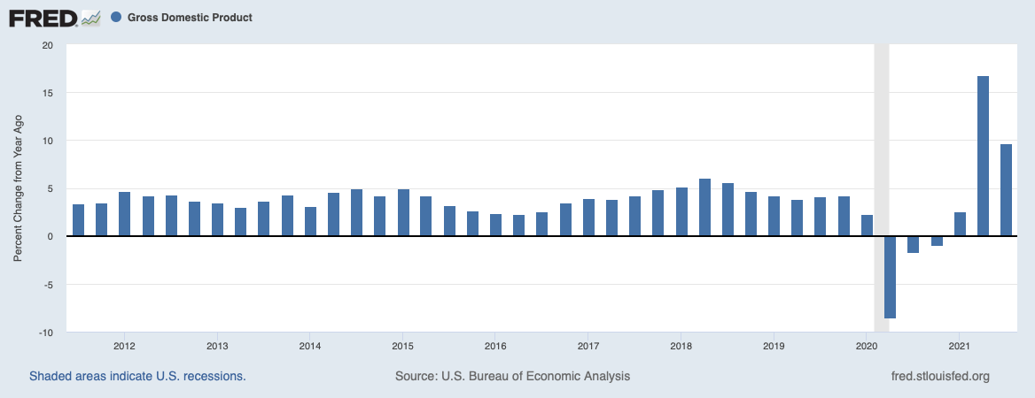
U.S. economic growth
The Business Roundtable survey found CEOs expect to the economy to grow by 3.9%, year-over-year, in 2022.
Notes:
Source: U.S. Bureau of Economic Analysis, Gross Domestic Product [GDP], retrieved from FRED, Federal Reserve Bank of St. Louis; https://fred.stlouisfed.org/series/GDP, January 2, 2022.
https://www.businessroundtable.org/media/ceo-economic-outlook-index/ceo-economic-outlook-index-q4-2021
Economic growth was robust in 2021. Despite Delta variant setbacks, U.S. gross domestic product, which is the value of all goods and services produced in the country, was up almost 9.7 percent in the third quarter of 2021. The Business Roundtable survey found that CEOs expect 3.9% economic growth, year-over-year, in 2022. Historically, that's pretty healthy. When you look back at economic growth since the turn of the century, 3.9 percent is the black line.

Slide 55
U.S. Business leaders are optimistic
Hire more
employees
+13 points
Increase capital investment
+7 points
Grow sales
+9 points
Benefit from the Infrastructure Investment & Jobs Act
Source: Business Roundtable CEO Economic Outlook Survey, November 2021
Notes:
Source: https://www.businessroundtable.org/media/ceo-economic-outlook-index/ceo-economic-outlook-index-q4-2021
The Business Roundtable, which is an association of chief executive officers of America’s leading companies, CEO Economic Outlook Index was at its highest level in its 20-year history late in 2021. They expect to hire more employees, increase capital investment and sales, and benefit from the bi-partisan Infrastructure Investment & Jobs Act.

Slide 56
There are risks and challenges
Covid -19
Labor costs
Supply
chain issues
Tax increases
Source: Business Roundtable CEO Economic Outlook Survey, November 2021
Notes:
Source: https://www.businessroundtable.org/media/ceo-economic-outlook-index/ceo-economic-outlook-index-q4-2021
CEOs don’t expect smooth sailing, though. The economy and businesses face a variety of risks and pressures including: a resurgence of coronavirus, rising labor costs, supply chain issues, and he possibility of higher corporate taxes.

Slide 57
Geopolitics could disrupt growth
GLOBAL TECHNOLOGY DECOUPLING between the U.S. and China accelerates
MAJOR CYBERATTACK(S) cause sustained disruption in the operation of key digital or physical infrastructure
STRATEGIC COMPETITION
China attempts to force reunification with Taiwan or assert dominance in South China Sea
Russia invades Ukraine
BlackRock Geopolitical Risk Indicator
Notes:
Source: https://www.blackrock.com/corporate/insights/blackrock-investment-institute/interactive-charts/geopolitical-risk-dashboard#risk-summary
Companies and financial markets also will face geopolitical risks. Each year, the BlackRock Geopolitical Risk Indicator (BGRI) identifies and ranks risks. [Review slide]
Global technology decoupling between the U.S. and China accelerates. (High)
Major cyberattack(s) cause sustained disruption in the operation of key digital or physical infrastructure. (High)
Strategic competition between the U.S. and China if China attempts to force reunification with Taiwan or assert dominance in South China Sea. (Medium).
We have included the possibility of Russia invading Ukraine. Also, Covid resurgence also was considered a high risk.
In recent years, many Americans have been focused on domestic issues and geopolitical risks have not been top-of-mind.

Slide 58
Overall, our global BGRI shows a significant reduction in concern about geopolitical risk since the change in U.S. administration. The gauge has been hovering in negative territory this year, as the chart shows, meaning investor attention to geopolitical risks is below the average of the past four years. See our methodology section for details. As a result, geopolitical shocks could catch investors more off guard than usual.
– BlackRock Geopolitical Dashboard December 2021
Notes:
Source: https://www.blackrock.com/corporate/insights/blackrock-investment-institute/interactive-charts/geopolitical-risk-dashboard#risk-summary
BlackRock reported, “Overall, our global [BlackRock Geopolitical Risk Indicator] shows a significant reduction in concern about geopolitical risk since the change in U.S. administration. The gauge has been hovering in negative territory this year, as the chart shows, meaning investor attention to geopolitical risks is below the average of the past four years…As a result, geopolitical shocks could catch investors more off guard than usual.”

Slide 59
Climate-related risks
Average number of events with losses of $1 billion or more:
1980 – 2016
2017 – 2020
Jan - Oct 2021
7 events/year
16 events/year
18 events YTD
Source: National Oceanic & Atmospheric Administration
Notes:
Images:
https://www.gettyimages.com/detail/photo/night-long-exposure-photograph-of-the-santa-clarita-royalty-free-image/587794546?adppopup=true
https://www.gettyimages.com/detail/photo/flood-protection-sandbags-with-flooded-homes-in-the-royalty-free-image/840710978?adppopup=true
https://www.gettyimages.com/detail/photo/hurricane-season-royalty-free-image/1062305448?adppopup=true
Source: https://www.ncdc.noaa.gov/billions/
We may also need to be more aware of risks associated with severe weather and natural disasters, which are becoming more frequent. From 1980 to 2020, the United States averaged about 7 events a year with losses exceeding $1 billion. From 2016 through 2020, the average was about 16 events. Through October 2021, the U.S. had 18 weather/climate disaster events with losses greater than $1 billion.

Slide 60
Risk brings innovation
“[The] physical effects of climate change – as well as many, varied government policies trying to mitigate its effects – are also inspiring technological innovations that will give rise to new products, services and business models in the coming years. How can investors effectively price these risks and opportunities?”
– Danielle Kost, Harvard Business School Working Knowledge April 22, 2020
Notes:
Source:
There are a lot of different types of risks -- business, geopolitical, climate or other types – and there are a lot of people trying to find ways to mitigate these risks. Covid-19 led to the fastest vaccine development in history. Danielle Kost wrote about climate risk and innovation. She said,
“[The] physical effects of climate change -- as well as many, varied government policies trying to mitigate its effects -- are also inspiring technological innovations that will give rise to new products, services, and business models in the coming years. How can investors effectively price these risks and opportunities?”
It's an important question that deserves more thought than we have time left in this presentation. So, let's use the time to talk about some of the innovations that may be ahead in 2022, although not all of these are climate related.

Slide 61
Container ships with sails
Container ships produce 3% of greenhouse-gas emissions, and they burn maritime bunker fuel, which contributes to acid rain. One solution is high-tech sails, which could cut costs and emissions.
Source: The Economist
Notes:
Source: https://www.economist.com/the-world-ahead/2021/11/08/what-next-22-emerging-technologies-to-watch-in-2022
The shortage of container ships contributed to supply shortages during 2021. New container ships may have sails. Container ships produce 3% of greenhouse-gas emissions, and they burn maritime bunker fuel, which contributes to acid rain. One solution is high-tech sails, which could cut costs and emissions.

Slide 62
3D bone implants
Researchers have been developing techniques that allow artificial organs to be created with 3D printing and biological materials. Two companies plan to have 3D-printed bones available to implant in humans in 2022.
Source: The Economist
Notes:
Source: https://www.economist.com/the-world-ahead/2021/11/08/what-next-22-emerging-technologies-to-watch-in-2022
There are plenty of trends that may create opportunities for investors in 2022 and beyond. These include 3D bone implants. Researchers have been developing techniques that allow artificial organs to be created with 3D printing and biological materials. Two companies plan to have 3D-printed bones available to implant in humans in 2022.

Slide 63
Virtual reality workouts
VR workouts gained popularity during the pandemic after lockdowns closed gyms. New VR headsets with fitness features and apps are coming in 2022.
Source: The Economist
Notes:
Source: https://www.economist.com/the-world-ahead/2021/11/08/what-next-22-emerging-technologies-to-watch-in-2022
VR workouts gained popularity during the pandemic after lockdowns closed gyms. New VR headsets with fitness features and new apps are coming in 2022.

Slide 64
Virtual influencers
Virtual influencers are more reliable and ask for fewer perks than real influencers do – and they’re already plugging products on social media. One is an interstellar traveler who is scheduled to arrive on Earth in 2022. She already has a song out on a popular video platform.
Source: The Economist
Notes:
Source: https://www.economist.com/the-world-ahead/2021/11/08/what-next-22-emerging-technologies-to-watch-in-2022
Virtual influencers are more reliable and ask for fewer perks than real influencers do – and they’re already plugging products on social media. One is an interstellar traveler who is scheduled to arrive on Earth in 2022. She already has a song out on a popular video platform.

Slide 65
What The Professionals Say
Notes:
Of course, not everyone agrees about ESG, the economy, geopolitical risks, and other matters. Here's a cross section of expert opinion about what may happen in the coming year.

Slide 66
But in U.S. history, I would say there is a bigger buy-in this time to the idea that prices never decline, that all you have to do is buy them [stocks], than there has ever been, which suggests that when the decline comes, it will be perhaps bigger and better than anything previously in U.S. history.
– Jeremy Grantham, Co-founder GMO, Bloomberg Television November 12, 2021
Notes:
Source: https://www.youtube.com/watch?v=Zf0iken0_9E (4:49)
But in U.S. history, I would say there is a bigger buy-in this time to the idea that prices never decline, that all you have to do is buy them [stocks], than there has ever been, which suggests that when the decline comes, it will be perhaps bigger and better than anything previously in U.S. history.

Slide 67
Yields will likely move higher for all maturities [of bonds] with more volatility as the support from easy monetary policy ebbs. The yield curve could go through bouts of steepening from time to time, but the long-term trend is likely to be a “bear flattener,” where yields rise but the difference between short- and long-term yields narrows.
Kathy Jones, Managing Director, Chief Fixed Income Strategist, Schwab Center for Financial Research
November 17, 2021
Notes:
Source: https://www.schwab.com/resource-center/insights/author/kathy-jones
"Yields will likely move higher for all maturities [of bonds] with more volatility as the support from easy monetary policy ebbs. The yield curve could go through bouts of steepening from time to time, but the long-term trend is likely to be a “bear flattener,” where yields rise but the difference between short- and long-term yields narrows." Kathy Jones, Managing Director and Chief Fixed Income Specialist, Charles Schwab.

Slide 68
Although the fastest pace of recovery now lies behind us, we expect strong global growth in coming quarters, thanks to continued medical improvements, a consumption boost from pent-up saving, and inventory rebuilding. For 2022 as a whole, global GDP is likely to rise 4 ½ %...
Jan Hatzius et al, GS Macro Outlook 2022, November 8, 2021
Notes:
Source: https://www.goldmansachs.com/insights/pages/gs-research/gs-macro-outlook-2022/gs-macro-outlook-2022-the-long-road-to-higher-rates.pdf
"Although the fastest pace of recovery now lies behind us, we expect strong global growth in coming quarters, thanks to continued medical improvements, a consumption boost from pent-up saving, and inventory rebuilding. For 2022 as a whole, global GDP is likely to rise 4½%…" said Jan Hatzius of Goldman Sachs.

Slide 69
While we expect wage growth to slow a little in 2022, in the coming decade a tight labor market that drives wage pressures will be the norm. This will largely be due to the sizable generation of Baby Boomers continuing to retire, without enough people to replace them to meet the growing demand for workers.
Gad Levanon, Head of The Conference Board Labor Market Institute, September 14, 2021
Notes:
Source: https://www.conference-board.org/press/why-wages-are-growing-rapidly
"While we expect wage growth to slow a little in 2022, in the coming decade a tight labor market that drives wage pressures will be the norm. This will largely be due to the sizable generation of Baby Boomers continuing to retire, without enough people to replace them to meet the growing demand for workers." Gad Levanon of The Conference Board Labor Market Institute

Slide 70
Macroeconomic backdrops that include slower growth and tightening monetary policy tend to usher in higher intra-market correlations—that is, the potential for securities to rise and fall in tandem...However, we’re in no way suggesting that investors should 'get out' of the stock market. Neither getting in nor getting out is an investing strategy; they simply represent gambling on moments in time, whereas investing should always be a disciplined process over time.
– Schwab Center for Financial Research
Notes:
Source: https://www.schwab.com/resource-center/insights/content/2022-schwab-market-outlook-ebb-tide
"Macroeconomic backdrops that include slower growth and tightening monetary policy tend to usher in higher intra-market correlations—that is, the potential for securities to rise and fall in tandem" And went on to say, "However, we’re in no way suggesting that investors should “get out” of the stock market. Neither getting in nor getting out is an investing strategy; they simply represent gambling on moments in time, whereas investing should always be a disciplined process over time."

Slide 71
Serving
You
Notes:
Images:
https://www.gettyimages.com/detail/photo/carefree-senior-couple-dancing-in-the-living-room-royalty-free-image/1301266358?adppopup=true
https://www.gettyimages.com/detail/photo/this-is-our-time-royalty-free-image/1215073717?adppopup=true
https://www.gettyimages.com/detail/photo/small-business-owner-at-entrance-looking-at-camera-royalty-free-image/1180926063?adppopup=true
https://www.gettyimages.com/detail/photo/latin-senior-man-serving-the-food-to-his-family-at-royalty-free-image/1167975422?adppopup=true

Slide 72
Forecast 2022
The Standard & Poor’s 500 Index is a capitalization weighted index of 500 stocks designed to measure performance of the broad domestic economy through changes in the aggregate market value of 500 stocks representing all major industries.
The Consumer Price Index (CPI) is a measure of the average change over time in the prices paid by urban consumers for a market basket of consumer goods and services.
Personal Consumption Expenditures (PCE) is a measure of price changes in consumer goods and services, targeted towards goods and services consumed by individuals. PCE is released monthly by the Bureau of Economic Analysis (BEA).
The Price-to-Earning (P/E) ratio is a measure of the price paid for a share relative to the annual net income or profit earned by the firm per share. It is a financial ratio used for valuation: a higher P/E ratio means investors are paying more for each unit of net income, thus, the stock is more expensive compared to one with a lower P/E ratio.
The MSCI World Index is a broad global equity index that represents large and mid-cap equity performance across all 23 developed markets countries. It covers approximately 85% of the free float-adjusted market capitalization in each country.
The MSCI European Union (EU) Index captures large and mid cap representation across the 13 Developed Markets (DM) countries and 4 Emerging Markets (EM) countries in Europe*. With 321 constituents, the index covers approximately 85% of the free float- adjusted market capitalization in the European equity universe.
The MSCI USA Index represents 63% of the MSCI World Index1. It is designed to measure the performance of the large and mid-cap segments and aims to represent ~85% of the US market.
The MSCI United Kingdom Index represents 5% of the MSCI World Index1. It is designed to measure the performance of the large and mid-cap segments and aims to represent ~85% of the United Kingdom market.
The MSCI China Index covers 85% of the free float market cap of the China Equity Universe across H-shares, A-shares, B-shares, Red-chips, P‐chips and foreign listed shares.
The MSCI Emerging Markets Index includes large and mid-cap companies in 26 Emerging Markets (EM) countries. It covers approximately 85% of the free float-adjusted market capitalization in each country.
The MSCI Frontier Markets Index captures large and mid cap representation across 27 Frontier Markets (FM) countries*. The index includes 81 constituents, covering about 85% of the free float-adjusted market capitalization in each country.

