Slide 1
`

Slide 2
The Bad News
THERE HAS BEEN AN ALARMING INCREASE IN THE NUMBER OF THINGS YOU KNOW NOTHING ABOUT

Slide 4
We’ve Passed The Point of No Return
200 Pound Baby
Lots of Power
Totally Immature
We are Most Afraid of Things (like Technology) that We Depend on, But which We Cannot Entirely Control

Slide 5
WE ARE STUCK WITH TECHNOLOGY WHEN WHAT WE REALLY WANT IS JUST STUFF THAT WORKS.

Slide 6
CHANGE ISN’T HARD
“Nobody likes Change except Babies with Wet Diapers.”

Slide 7
People Don’t Change When They See the Light,
They Change When They Feel the Heat

Slide 8
CHANGE ISN’T HARD
“Nobody likes Change except Babies with Wet Diapers.”
CHANGE HAPPENS IN AN INSTANT
WHAT’S HARD IS OVERCOMING THE RELUCTANCE TO LEAVE BEHIND WHAT HAS WORKED WELL FOR YOU IN THE PAST

Slide 9
CHANGE INITIALLY ALWAYS CREATES DISCOMFORT AND INCOMPETENCE
IT IS FAR BETTER TO BE UNEASY THAN TO BECOME EXTINCT
The One Certainty for Anyone in the Path of an Avalanche is that Standing Still is not an Option.

Slide 10
APPLE BLACKBERRY
2007 $70 BILLION $70 BILLION
2017 $825 BILLION $5 BILLION

Slide 11
SPEED IS THE NAME OF THE GAME
IT TOOK RIM/BLACKBERRY TWO YEARS TO LAUNCH AN APP STORE
IN THAT PERIOD, 1 BILLION APPS WERE DOWNLOADED FROM THE APPLE STORE

Slide 13
MISSED THE WEB, MISSED SEARCH, MISSED MOBILE

Slide 14
TRUST
TRUMPS
TECHNOLOGY

Slide 16
PARADIGMS ARE CHANGING CONSTANTLY AND – ONCE CHANGED – YOU CAN NEVER GO BACK

Slide 18
Duck or Rabbit?
ENTREPRENEURS LOOK AT WHAT EVERYONE ELSE HAS AND SEE SOMETHING NEW AND DIFFERENT

Slide 19
BUSINESS MODELS ARE CONSTANTLY MORPHING BEFORE OUR EYES

Slide 20
70 MILLION PLUS RIDES A MONTH

Slide 23
CARE BY VOLVO
FLAT MONTHLY FEE
INSURANCE
FINANCING
MAINTENANCE
DETAILING
FIXED PRICE
ALL AGES
20% of Volume in 5 Years

Slide 24
MIGRATION FROM MANUFACTURING TO MOBILITY

Slide 28
No Racks – No Problem
OFO/MOBIKE = 100 MILLION USERS
Mobike 5 Million Bikes – 25 Million Rides a Day

Slide 29
Dockless Already Here as Well – Washington, DC
LimeBike in 35 Markets Already in U.S.

Slide 30
AIRBNB

Slide 31
EVEN THE BEST HOTELS DON’T WANT EMPTY ROOMS

Slide 32
Any Revenue is Better than An Empty Seat

Slide 33
Market Caps - Headcounts
MARRIOTT 34 BILLION
AIRBNB 31 BILLION
HILTON 20 BILLION
226,500 EEs
3500 EEs
169,000 EEs

Slide 34
THE FUTURE IS HERE NOW
The One Thing You Learn Very Early in Racing is that They Don’t Wait for You

Slide 39
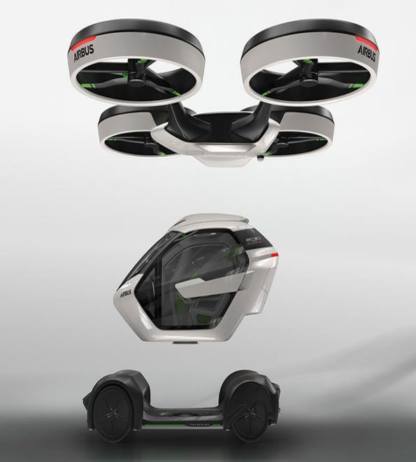

Slide 40
Star Wars Cantina

Slide 42
CLEAR TSA ACCESS IN TWO SECONDS

Slide 43
Pixar’s WALL-E

Slide 44
GITA – Personal Cargo Robot

Slide 45
Domino’s Pizza Delivery Robot

Slide 46
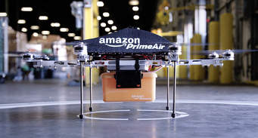
Drone Delivery is Real – If Stupid

Slide 47
Drone Emergency is Real & Smart
In Manhattan, during UN Week, driving in traffic from Plaza Hotel to the Midtown Tunnel — roughly a mile — takes longer than flying from New York’s LaGuardia to Boston.

Slide 48
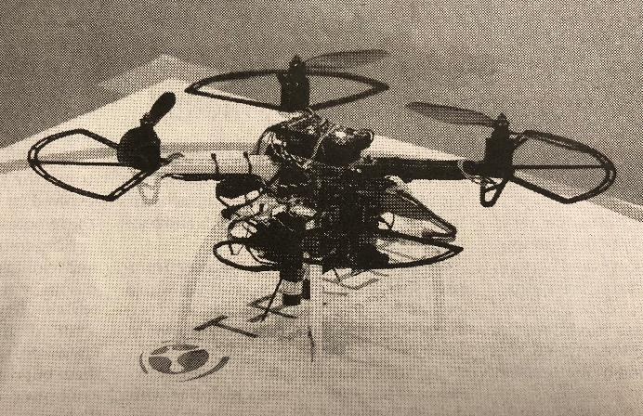
“Go Home” Drones in Japan Offices

Slide 49
A Bit of Bad News
THE FUTURE
WON’T
BE
INCREMENTAL
What You’re Doing Today May Be Valueless and Meaningless Tomorrow
These are Times of Disruptive Change and Radical Obsolescence
Think Revolutionary, Not Evolutionary Development

Slide 50
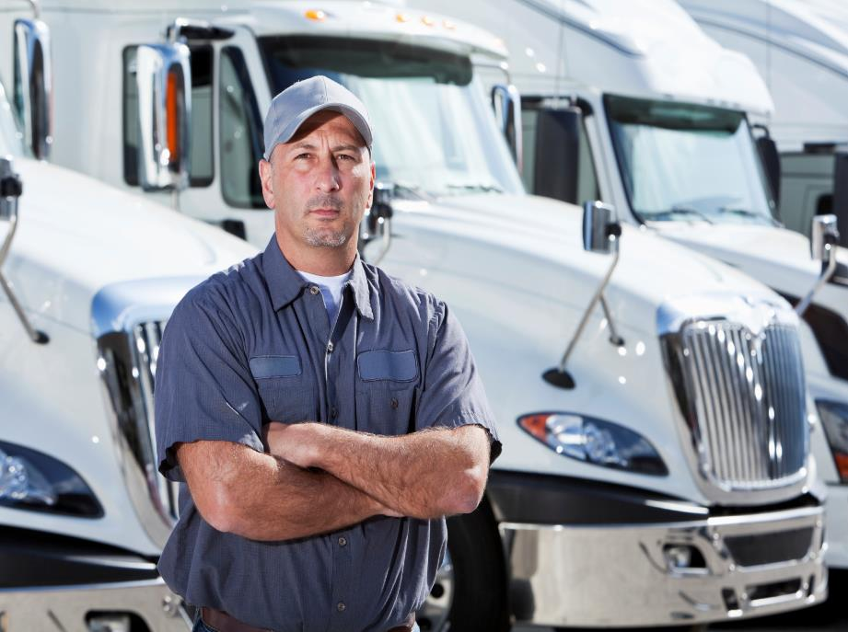

Slide 51
UBER Freight is Here

Slide 52
TESLA SEMI - 500 Mile Range
WALMART and J.B.Hunt Have Already Announced Road Tests & Pilots

Slide 53
THERE ARE 11 MILLION CASHIERS IN THE U.S. MORE THAN THE NUMBER OF TEACHERS

Slide 54
The Rise of BOTS
OPERATOR
ASSIST
SMOOCH
ICON8BOT
EXPERT SHOPPERS
FIND SERVICES
CUSTOMER LOVE
ARTSY SELFIES

Slide 55
JP MORGAN BOTS
IT BOTS WILL HANDLE APPROXIMATELY 1.7 MILLION ACCESS REQUESTS THIS YEAR
DOING THE WORK OF 140 PEOPLE

Slide 57
Sorting 1 Million Images into 1000 Categories More Accurately than Human

Slide 58
Which is the Chihuahua and Which is the Muffin?

Slide 59
Mechanical – vs - Creative Jobs
If I Can Reduce Your Job to a Set of Rules and Instructions, You Won’t Have a Job Much Longer
If the Root of Your Responsibilities is to Flawlessly Repeat a Process or a Procedure,
A Machine Will Soon Do It Better, Faster, Cheaper and More Reliably than You

Slide 60
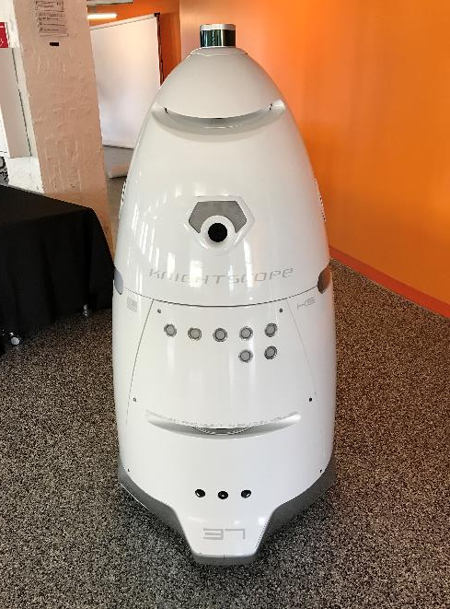

Slide 61
SUPERMARKET INVENTORY/PRICING ROBOT

Slide 62
AMAZON WAREHOUSE ROBOTS

Slide 63
Percent of Time Spent that can be Automated
Least Risk Less Risk High Risk
78
Managing Others
Applying Expertise
Stakeholder Interactions
Unpredictable Physical Work
69
64
25
20
Data Collection
Data Processing
Predictable Physical Work
18
9

Slide 64
Not So Fast, Sherlock

Slide 65
IT’S ALL ABOUT SPEED

Slide 66
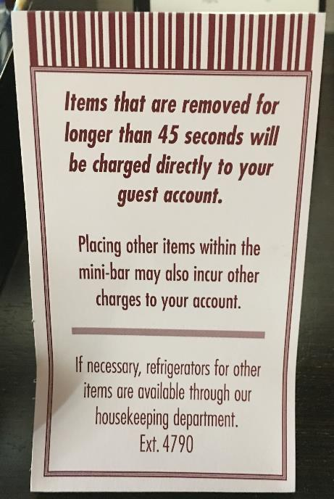

Slide 67
MANAGING THE RATE OF CHANGE
AUTOCATALYTIC
Each Change Accelerates the Rate of the Next Change
SPEED (VELOCITY) = How Fast You’re Going?
vs
ACCELERATION = How Fast Are You Getting
Faster?

Slide 68
IF THE RATE OF CHANGE ON THE OUTSIDE EXCEEDS THE RATE OF CHANGE ON THE INSIDE, THE END IS NEAR
THE RATE OF CHANGE WILL NEVER AGAIN BE AS SLOW AS IT IS TODAY

Slide 69
THE NEW WAY TO THINK ABOUT TECH
DON’T SIMPLY ASK HOW NEW TECHNOLOGY CAN HELP YOU DO WHAT YOU DO BETTER
ASK WHAT TECHNOLOGY LETS YOU DO TODAY THAT YOU COULD NEVER DO BEFORE

Slide 70
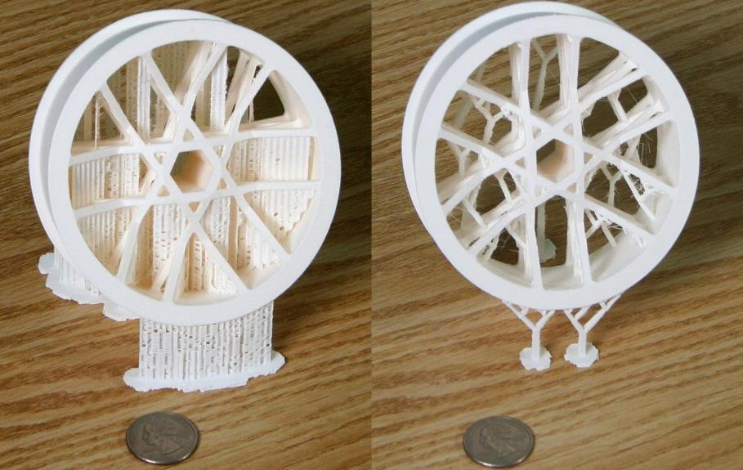
Stronger than Steel - Lighter than Aluminum
3D PRINTING TO DATE

Slide 72
SOURCES and VECTORS OF DISRUPTION

Slide 73
WHERE TO LOOK FOR BIG TROUBLE
NOT IN YOUR CORE BUSINESS WHERE YOU AND YOUR COMPETITORS KNOW EVERYTHING
LOOK AT THE EDGES AND THE EXTREMES AND IN ADJACENT MARKETS – THIS IS WHERE DISRUPTION STARTS

Slide 74
SERVICES ARE MORE IMPORTANT THAN OBJECTS
NOT A BETTER TAXI COMPANY
A WHOLE NEW PLATFORM
NOT A CAR WITH CHIPS
A COMPUTER WITH WHEELS

Slide 75
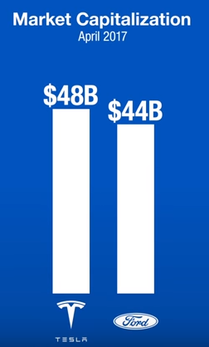

Slide 76
Opportunities and Exposures
WHO WHAT WHERE/WHEN HOW
CUSTOMERS
INTERACTION
IMMERSIVE
EXPERIENCES
NEEDS
(BEHAVIOR DRVRS)
PRODUCT MIX
EXTENSIONS
NEW
APPLICATIONS
NEW ACCESS
METHODS
EVERYWHERE
ANYWHERE
NEW
NETWORKS &
CHANNELS
ANY TIME
PROCESS CHANGE
ORGANIZATIONAL
CHANGE
VENDOR CHANGE
TECH CHANGE
(AR/MR/VR)
What are Your Unfair Competitive Advantages?

Slide 77
What are Your Competitive Advantages?
Customers
Distribution
Size and Scale
Domain Expertise and Intelligence
Platform
Exposure, PR and Networking
DIVERSIFICATION NEGLECTS COMPARATIVE ADVANTAGE
DO IT
BEFORE SOMEONE
DOES IT TO YOU

Slide 78
“If we don’t create the thing that kills Facebook, someone else will.”

Slide 79
10
DRIVERS

Slide 80
1.
TIME IS THE SCARCEST RESOURCE OF ALL
You Can Do Anything You Want,
But You Can’t Do Everything

Slide 82
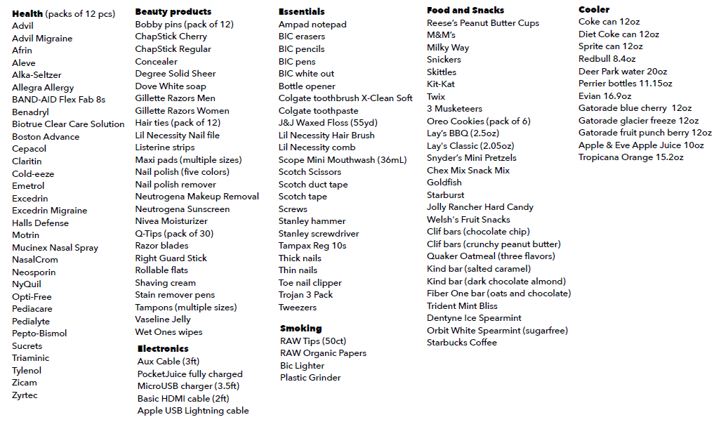

Slide 83
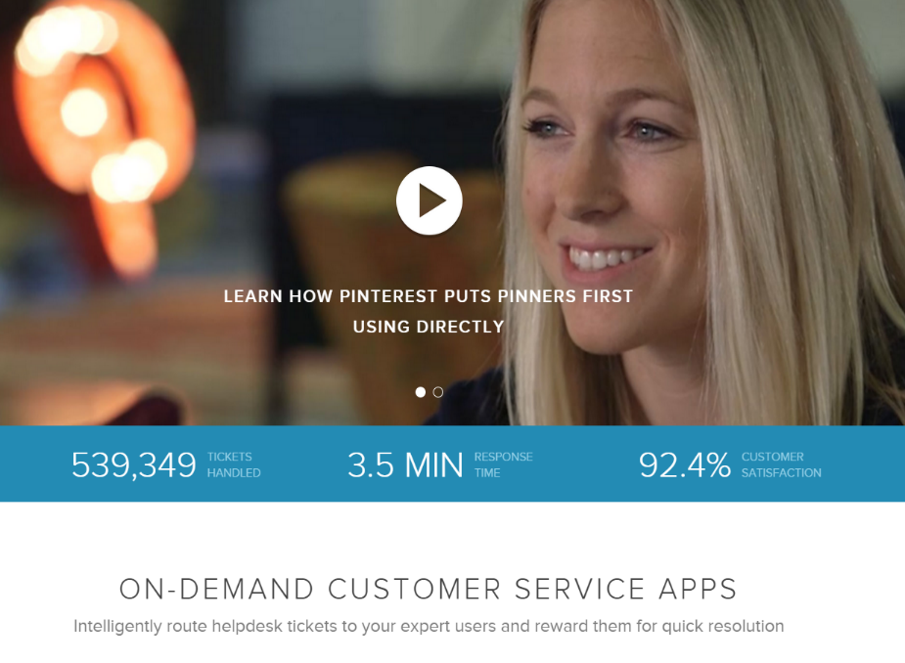

Slide 84
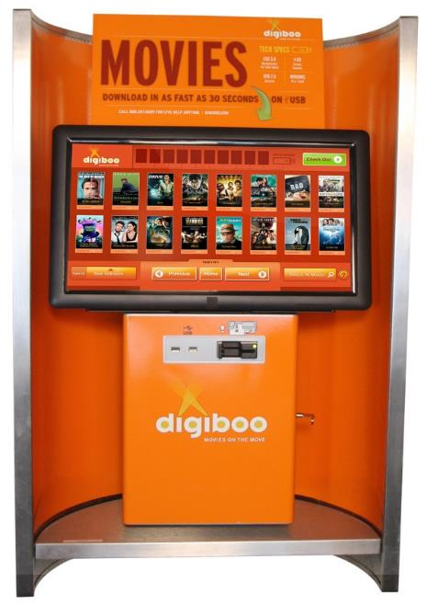
1 to 3 Minutes to Download a Feature-Length Film

Slide 85
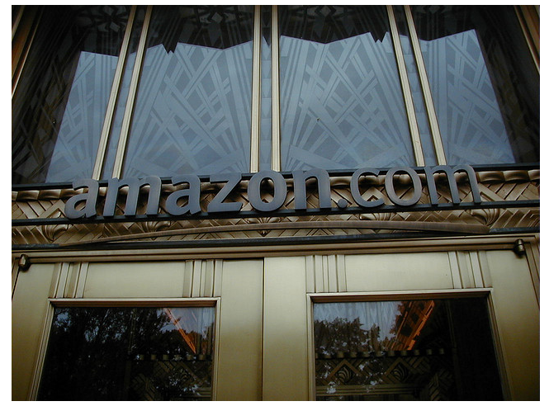
Amazon – Anticipatory Shipping
Previous Orders Shopping-Cart Contents
Product Searches Wish Lists
Product Returns Cursor Hover Times
DIGITAL “DROOLING”

Slide 87
2.
THE
“RIGHT NOW”
ECONOMY

Slide 88
THE “RIGHT NOW” ECONOMY
32.1% - EXPECT RESPONSE WITHIN 60 MNUTES
26.5% - EXPECT RESPONSE WITHIN 30 MINUTES
19.5% - EXPECT RESPONSE WITHIN 10 MINUTES
78%

Slide 89
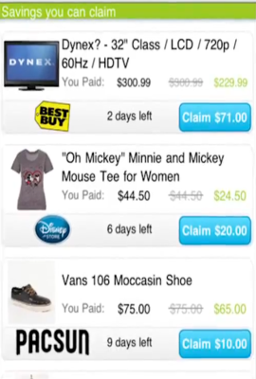
“SNACK/NUDGE”
COMMERCE
Personalization
Proximity
Price
PLACECAST – Location Services Platform

Slide 90
CONTEXTUAL COMMERCE

Slide 91
Proximity-Driven & Commerce Enabled

Slide 94
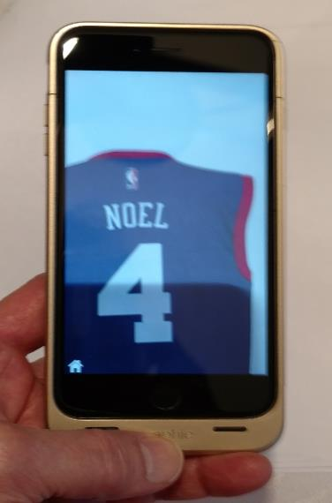
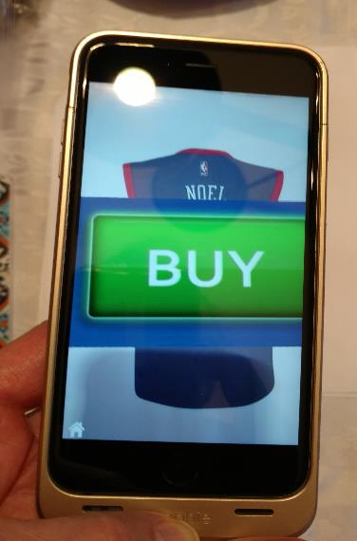
PHILADELPHIA 76ers

Slide 95
YOU’VE GOT TO BE THERE WHEN THE BUYER IS READY TO BUY

Slide 96
IT’S NOT YOUR FRONT DOOR ANYMORE

Slide 97
NEED TO OPEN APIs TO OTHERS
IF THE CUSTOMER LIVES WITHIN FACEBOOK OR INSTAGRAM, THEN YOU NEED TO PROVIDE ACCESS TO YOUR OFFERINGS WITHIN THAT ENVIRONMENT
SOMEONE ELSE WILL OFTEN BE PROVIDING THE PRIMARY CUSTOMER EXPERIENCE
THE CUSTOMER NO LONGER COMES TO YOU

Slide 98
YESTERDAY’S MIRACLES ARE TOMORROW’S “SO-WHATS”
CUSTOMER EXPECTATIONS ARE PERPETUALLY PROGRESSIVE

Slide 99
“OUR COMPETITION IS THE LAST GREAT EXPERIENCE THAT THE CUSTOMER HAD.”
WHO AND WHERE DOESN’T MATTER

Slide 100
3.
NO ONE WANTS TO WAIT FOR ANYTHING

Slide 101
PERCENTAGE OF U.S. E-COMMERCE REVENUE
VIA CLICK & COLLECT
ACE HARDWARE
65%
WALMART
50%
45%
BEST BUY
REI
35%
COMP USA
35%

Slide 104
AT YOUR SERVICE

Slide 105
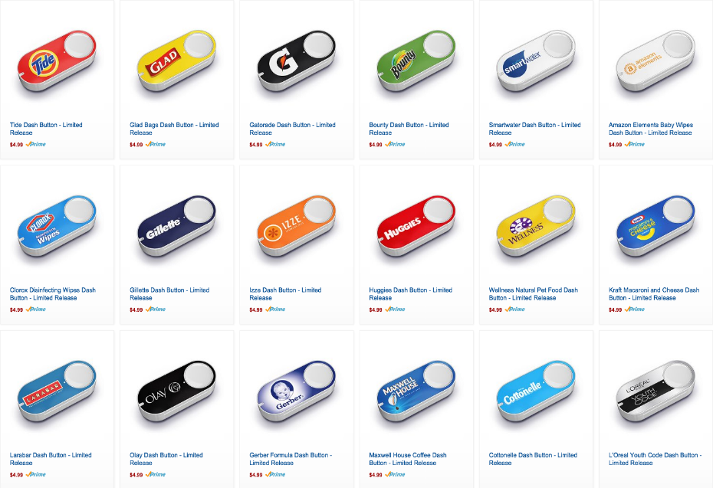
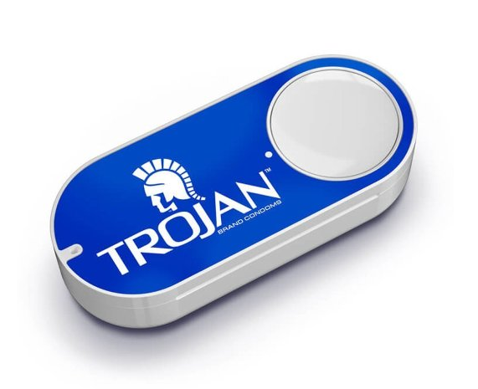

Slide 106
Speed, Convenience & Ease of Access
TRUMPS
CHOICE
(HUGE PROBLEM FOR BRANDS)
TASTE
COST

Slide 107
The MAIN Metric that Matters
CUSTOMER EFFORT SCORE

Slide 108
The $64,000 Question
HOW EASY IS IT
TO DO BUSINESS WITH YOUR BUSINESS?
REPRESENTATIVE METRICS
Number of People Talked to…
Number of Transfers…
Time to Resolution…
1st Call Resolution…
1st Contact Resolution…

Slide 109
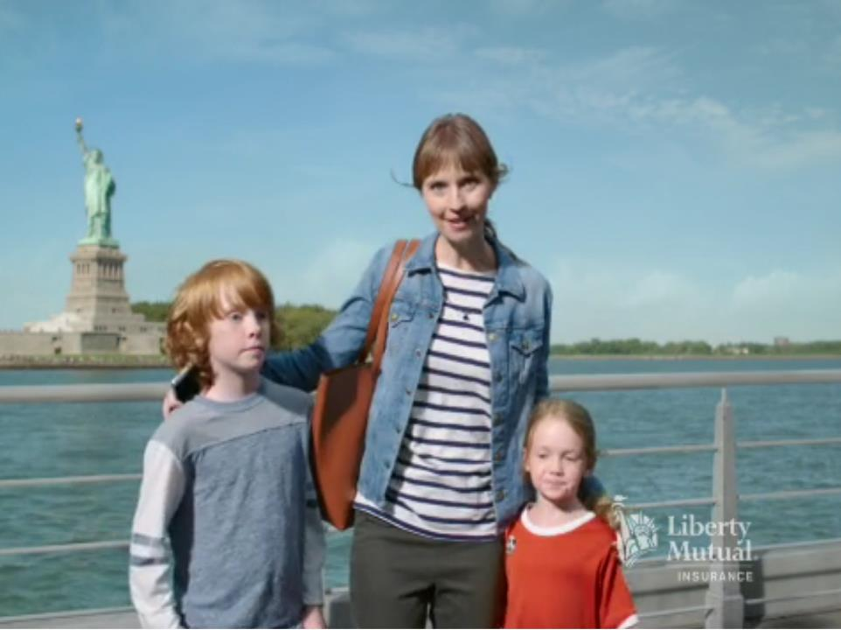
CAN YOU BE FRICTION–FREE?

Slide 110
4.
I WANT IT
MY WAY !

Slide 111
The Consumer Wants to Drive

Slide 112
I WANT WHAT I WANT
WHEN & WHERE I WANT IT

Slide 113
COMMITMENT
SUBSCRIPTIONS
APPOINTMENTS

Slide 114
HOW CAN YOU SUCCESSFULLY BE ALL THINGS TO EACH CLIENT OR CUSTOMER?

Slide 115
MASS CUSTOMIZATION
SCALE AND PRECISE TARGETING USED TO BE MUTUALLY EXCLUSIVE
TODAY – IT’S NO LONGER AN “EITHER/OR” DEAL

Slide 117
FAILURES TO DATE

Slide 118
STITCH FIX
“AUGMENTED” INTELLIGENCE
(PEOPLE POWERED BY TECHNOLOGY)

Slide 119
5.
DATA IS THE OIL OF THE DIGITAL AGE

Slide 120
THE NEW FEEDBACK LOOP
ADVERTISING
TIGHT & REAL-TIME
FEEDBACK LOOP
COMMERCE

Slide 121
GOOGLE CONNECTS ONLINE ADS TO OFFLINE PURCHASES
70% of ALL Credit and Debit Card Transactions will now be Linked to Online Consumer Behavior
Connecting online ad exposure to bricks-and-mortar sales

Slide 122
MOVING FROM DIAGNOSTICS TO PROGNOSTICS
WHERE THE PUCK IS HEADED, NOT WHERE IT’S BEEN

Slide 123
The Future of Prediction
JOINT TRACKING STUDY BY PROFESSORS AT WHARTON AND M.I.T.
Frequency of GOOGLE Searches for Real Estate Purchase Related Terms (Agent, House Pxs, Mortgages) Predicted Improvements in National Housing Market
24 % MORE ACCURATE THAN EXPERT FORECASTS FROM THE NATIONAL ASSOCIATION OF REALTORS

Slide 124
“Marriage on the Rocks”
Credit Card Companies Can Now Accurately Predict the Incidence of “Early” Divorces from Activity:
Same City Hotel Charges
Flowers Sent to Addresses Other Than Home
Increased Charges for Self-Improvement
Increased Spending in Bars Focused on Singles
WHY?
DIVORCING COUPLES PRESENT A MUCH MORE SUBSTANTIAL RISK OF DEFAULTING ON THEIR CREDIT CARD OBLIGATIONS

Slide 125
WASTELESS

Slide 126
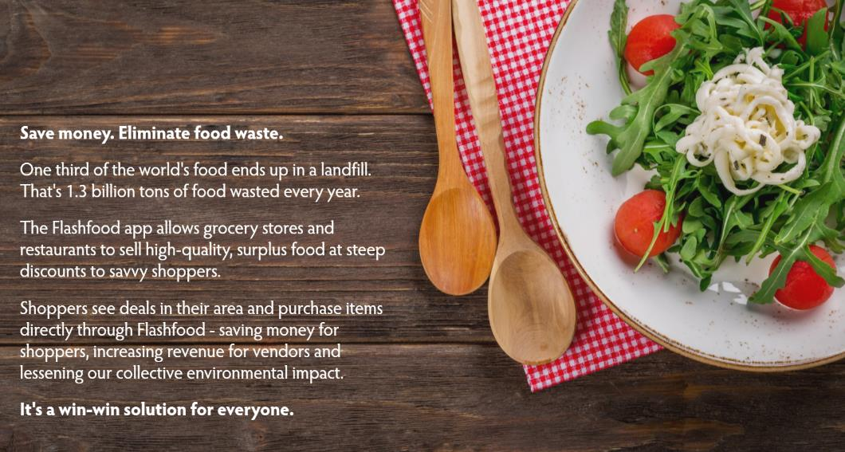
FLASHFOOD

Slide 128
Algorithmic Real Time Pricing
“THIS IS NOT ABOUT STEALING MORE MONEY FROM YOUR CUSTOMER.
IT’S ABOUT MAKING MARGIN ON PEOPLE WHO DON’T CARE AND GIVING AWAY MARGIN TO PEOPLE WHO DO CARE.”
Don’t You Wish You Could Do That?

Slide 130
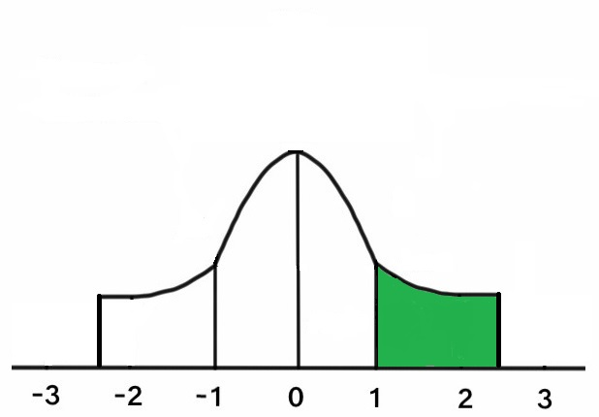
Exceptional People Deserve Special Concessions
TRAFFIC
AUDIENCE
HIGH-VALUE, CONNECTED AND ENGAGED CUSTOMERS
INDIFFERENT
HOSTILE

Slide 131
SERIOUS AND CONNECTED AND ENGAGED USERS ARE INCREASINGLY WILLING TO PAY FOR QUALITY

Slide 132
6.
ATTENTION IS THE NEW CURRENCY

Slide 133
We “Make” Time for What We are Interested In
EVERY STATUS UPDATE YOU READ ON FACEBOOK, EVERY PHOTO YOU TAG ON INSTAGRAM, EVERY TWEET OR TEXT MESSAGE YOU GET FROM YOUR FRIENDS ARE ALL INTERRUPTIVE AND COMPETING FOR RESOURCES IN YOUR BRAIN WITH MORE IMPORTANT THINGS

Slide 134
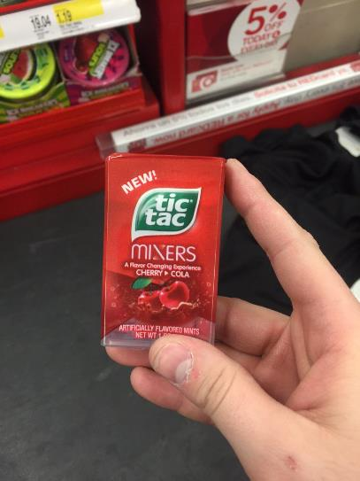
These Folks Have the Attention Span of a Flea
CHERRY
PEACH
LEMON
COLA

Slide 135
Attention Spans
13 Seconds
13 Seconds
13 Seconds
10 Seconds

Slide 136
Adult Digital Media Consumption
Grew Last Year By One Full Hour
10 HOURS
&
39 MINUTES
Video 5:05 hrs
Other Media 2:27 hrs
Audio 2:09 hrs
Gaming 1:17 hrs
Social Media 1:06 hrs

Slide 137
Bursts and Micro-Moments
WE ARE SPENDING MORE AND MORE TIME ONLINE, BUT…EACH AND EVERY SESSION IS SHORTER.
REAL TIME ACTIONS SEEKING IMMEDIATE RESULTS
NO SURFING – NO EXPLORING – INTENT-DRIVEN INQUIRIES
BE THERE – BE USEFUL – BE QUICK – BE EASY

Slide 138
ATTENTION MUST BE PAID…FOR

Slide 140
VALUE-BASED TRANSACTIONS
Save Me Time
Save Me Money
Increase My Productivity
Help Me Make Better Choices
Change/Improve My Status

Slide 141
IN TWO WORDS,
IT’S ALL ABOUT TRANSPARENCY
and
EFFICACY
The Most Critical Attribute of the Internet is NOT Its Immediacy or Its Low Cost;
It is the Heightened Direct Access to Individuals, the Ability to Accurately Measure Their Engagement, and the Accountability that It Enables.

Slide 142
UNLIMITED

Slide 143
LOYALTY TODAY IS NOTHING MORE THAN THE ABSENCE OF SOMETHING BETTER
YET !

Slide 144
NOBODY OWNS THE CUSTOMER, BUT SOMEONE ALWAYS OWNS THE MOMENT

Slide 145
Survey of 500 Physicians & 1000 Patients
Key Physician Selection Criteria
Physicians’ Criteria Patients’ Criteria
Specialty Location
Board Certified Office Hours
Technical Skills Parking
Referrals – WoM Insurance Plans
Insurance Plans Staff Courtesy
OFFICE VISITS TO PRIMARY CARE DOCTORS FELL 18% BETWEEN 2012 AND 2016

Slide 146
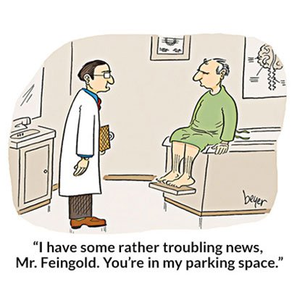

Slide 147
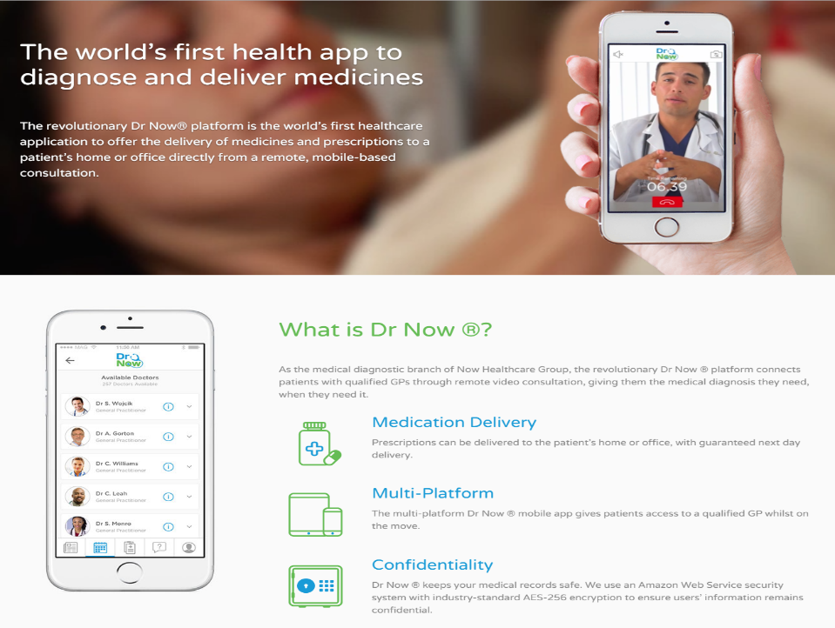

Slide 148
Doctor On Demand

Slide 149
Why Bother?

Slide 150
Newest Survey Results
2 out of 3 Consumers Who Were Asked Prefer a Digital Medical App to a Doctor’s Visit
80% Said They Would Be Willing to Wear a Digital Device to Help Manage Their Health

Slide 151
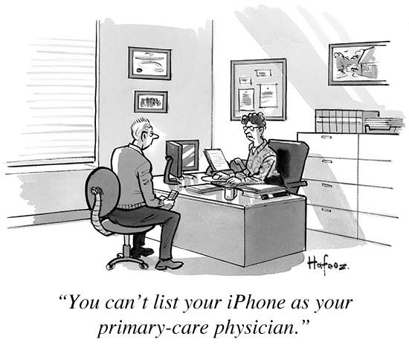

Slide 152
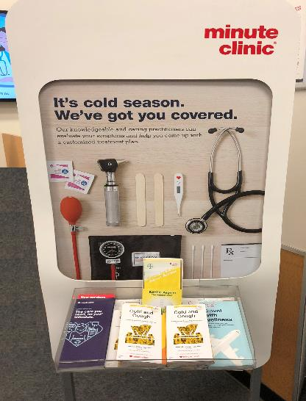
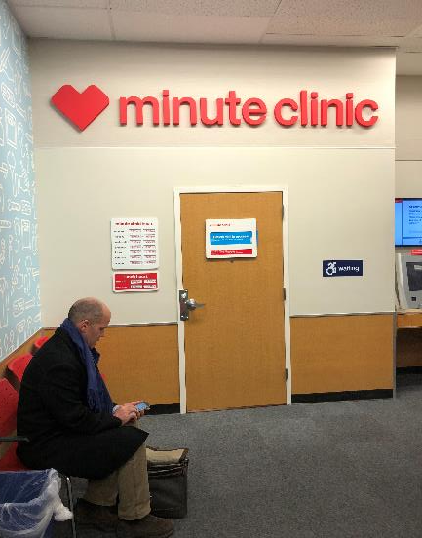
Always At Your Service

Slide 153
7.
ENGAGEMENT
NOT
EYEBALLS

Slide 154
CONTEXT IS MORE IMPORTANT THAN CONTENT

Slide 155
“IF I’M NOT LISTENING, IT DOESN’T MUCH MATTER WHAT YOU’RE SAYING”

Slide 156
REACH
(Did You Hear Me?)
RESONANCE
(Changes in Attitudes)
REACTION
(Changes in Behaviors)

Slide 157
“SMART REACH”
IF YOU’RE NOT WHERE YOUR CUSTOMERS ARE, YOU’RE NOWHERE
WHAT WE NEED
(Outsourced Memory – Device Recall – The Ending of Forgetting)
WHEN WE NEED IT
(Instant Discovery – Peer Input – Competitive & Comparative)
WHEREVER WE ARE
(Site Sensitive – Location Aware – Context & Content)
WITHOUT ASKING
(Passive & Constant Presence – Automated Decisions)
ENGAGING, RELEVANT, CUSTOMIZED CONTENT AT THE RIGHT TIME IN THE RIGHT PLACES

Slide 158
MARKETING IS LIKE SEX …. ONLY LOSERS PAY FOR IT
ADVERTISING IS THE COST OF BEING BORING
ENGAGE ME DON’T ENRAGE ME

Slide 159
8.
ATTENTION
IS AN ARMS RACE

Slide 160
TV CAN NO LONGER COMPETE

Slide 161
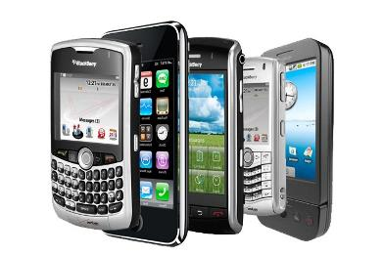
OLD WORLD NEW WORLD
TELEVISION – ONE TO MANY MOBILE – MANY TO MANY
SARNOFF’S LAW – AUDIENCE SIZE METCALFE’S LAW – NETWORK SIZE
22 MILLION NIGHTLY
VIEWERS
2
BILLION DAILY USERS

Slide 164
Some Hard Numbers
73% of Millennials Currently Using Some Form of Streaming Service
47% of Millennials and Gen Xers Watch NO Traditional TV at all

Slide 166
SEEING IS BELIEVING
IT’S ALL ABOUT STREAMING MEDIA NOW
U.S. Users of Streaming Media
YouTube 180,000,000
Netflix 120,000,000
Amazon 76,000,000
Hulu 30,000,000
AMAZINGLY, APPLE AND FACEBOOK AREN’T EVEN IN THE GAME YET
NETFLIX NOW HAS MORE SUBSCRIBERS (50 MILLION) THAN CABLE DOES (48 MILLION)

Slide 168
9.
A WORLD OF CONSTANT CONNECTIVITY

Slide 169
KIDS TODAY ARE SYNCHRONOUS
12%
DAILY
56%
92%
SEVERAL TIMES A DAY
13 - 17
YEAR OLDS
24%
CONSTANT

Slide 171
Average Person in U.S. Today
163
Daily
Interactions with Their Phone

Slide 172
AVERAGE U.S. CONSUMER TODAY SPENDS 3 HOURS AND 40 MINUTES A DAY ON MOBILE

Slide 173
The Connected Car

Slide 174
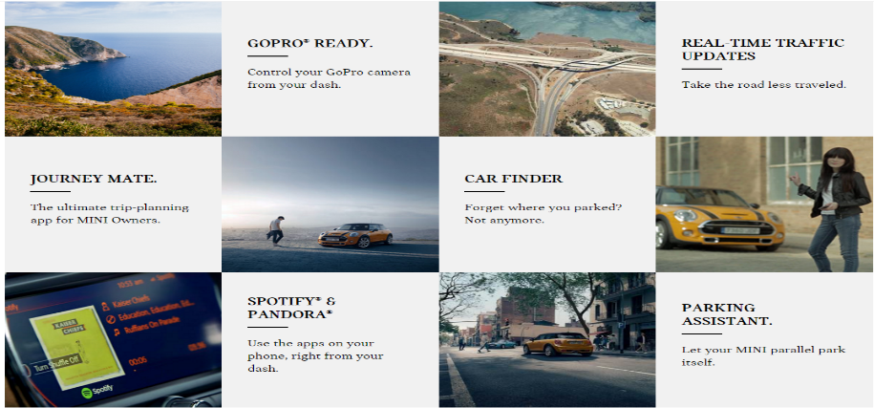

Slide 175
Volkswagen – Bird Connected Doorbell

Slide 178
In-Store Mobile Tracking – Retail Next

Slide 179
Heat Mapping in Retail

Slide 180
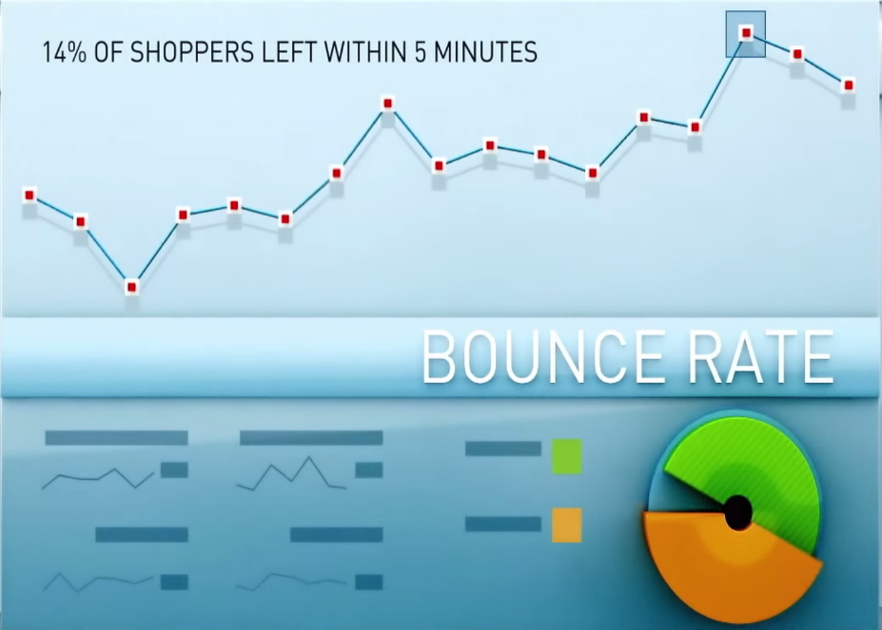

Slide 181
10.
THE INTERNET OF
THINGS
EVERYTHING

Slide 182
THE SMART HOME IS HERE

Slide 183
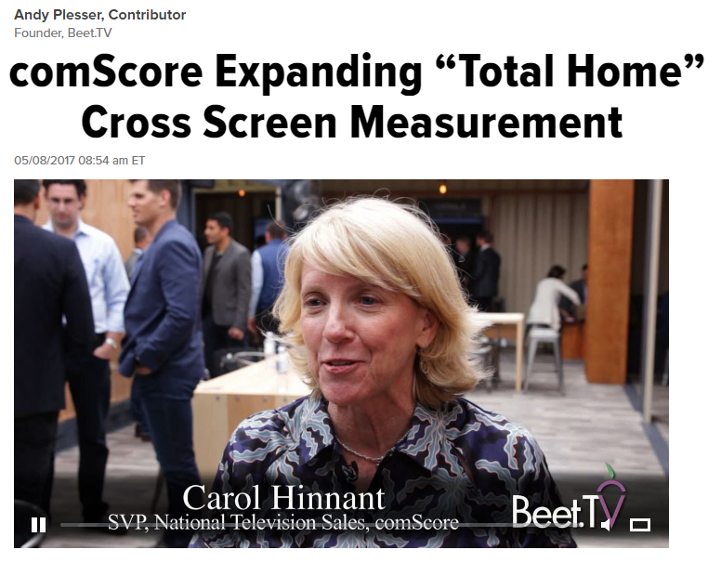
The Average
Connected Home Has
8.5
Internet-Connected
Devices

Slide 184
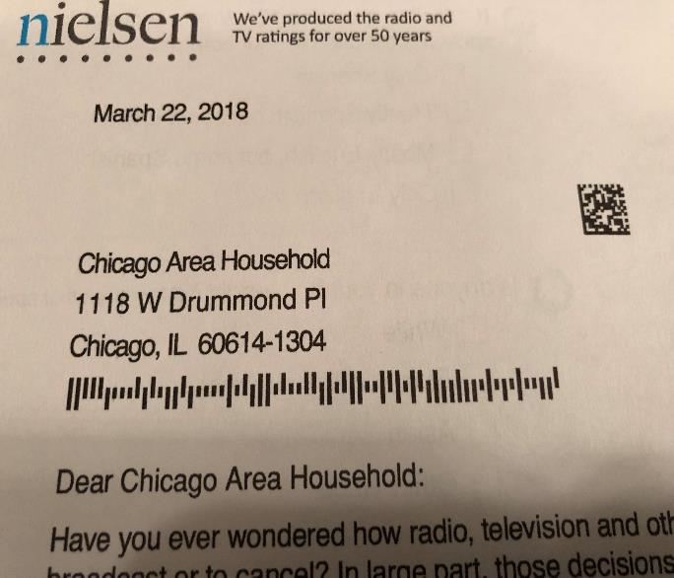
Nielsen – Still in the Dark Ages

Slide 185
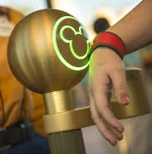
Disney Magic Bands
Park Entry
Hotel Room Key
Payment for Food and Merchandise
Fast Pass Access

Slide 186
1. Personalized Experiences – Goofy
2. Immersive Experiences - Attractions
3. Special Access & Perks – Sooner

Slide 187
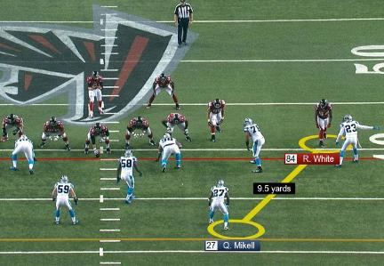
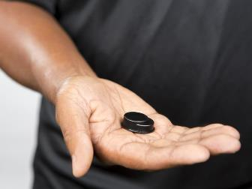
People Trackers as Well as Place Markers

Slide 188
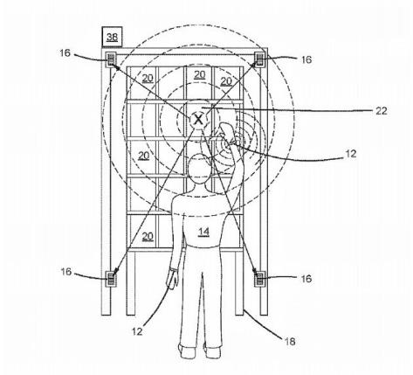

Slide 189
Stealing Bases on Syndergaard

Slide 190
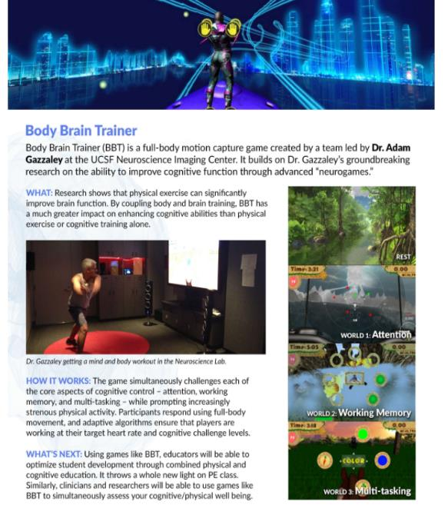

Slide 191
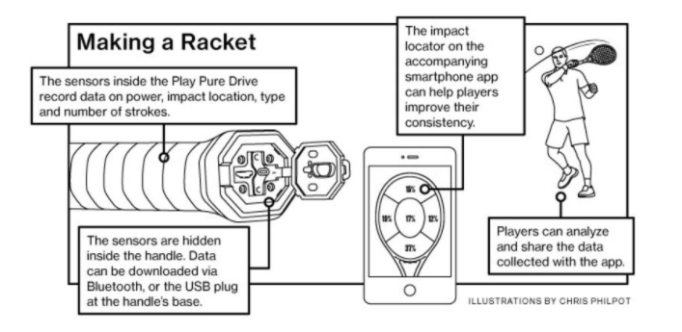

Slide 193
Wearable Trackers

Slide 194
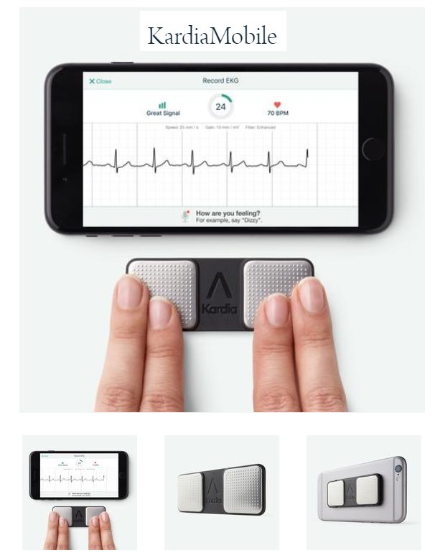
$99

Slide 195
Helping the Blind to See

Slide 197
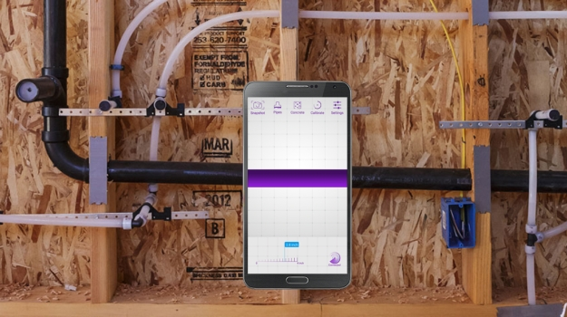
Walabot RF Radar Imaging

Slide 198
GM – DRIVER EYETRACKING

Slide 199
Haptic Fork

Slide 201
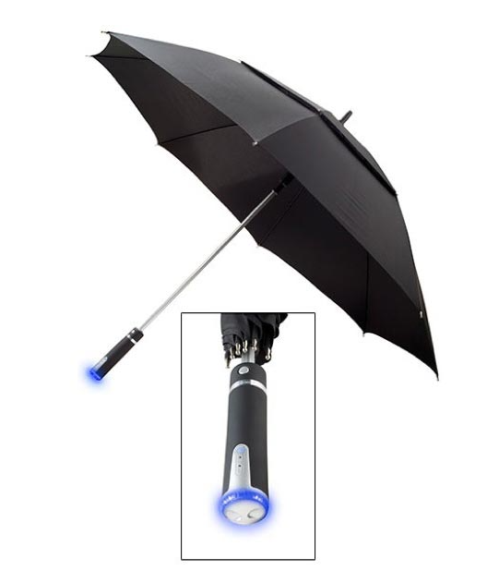

Slide 202
TALKING CONNECTED PILL BOTTLE

Slide 203
Ingestible – Colon Camera

Slide 204
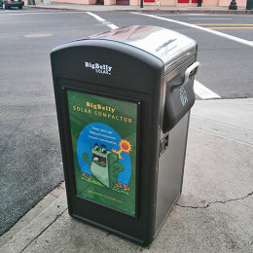
BIG BELLY SOLAR TRASH CAN

Slide 205
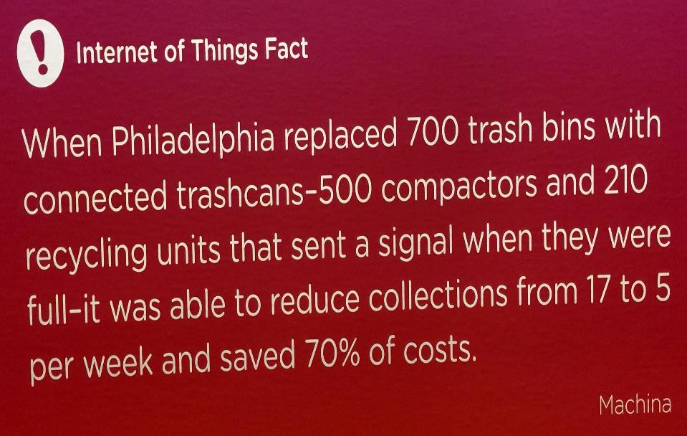

Slide 206
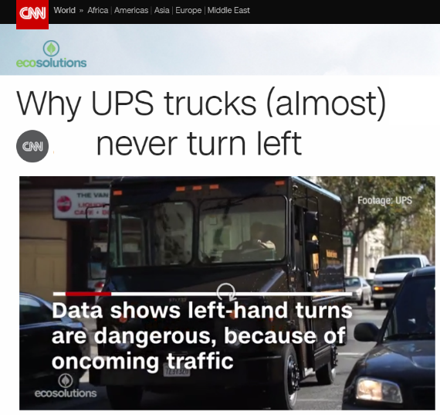

Slide 207
Haptic WALLET – B of A
AS THE MONTH GOES BY AND YOU BEGIN TO REACH YOUR BUDGET LIMITS, THE WALLET GETS PROGRESSIVELY HARDER TO OPEN

Slide 208
LOTS - vs - LITTLE
MAKE IT EASY FOR ME – OR –
I WILL GO ELSEWHERE
Content Time
Activity Attention
Eyeballs Engagement
Data Information
Demands Patience

Slide 213
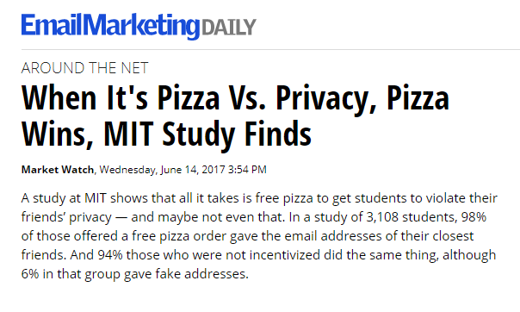
Privacy versus Pizza

Slide 214
Privacy versus Proper Care

Slide 215
5-31-18
Notes:
1

