Slide 1
Fresh Out of College to Forbes Top 50 Next Gen Advisor
How a New Advisor Built at $100M Business in 3 Years
#Excell2018

Slide 2
Speakers
Ron CARSON
Zac Richey
Founder and CEO Carson Group
Wealth Advisor
Carson wealth
#Excell2018
#Excell2018

Slide 3
EXCELL | SPRING 2014
#Excell2018

Slide 4
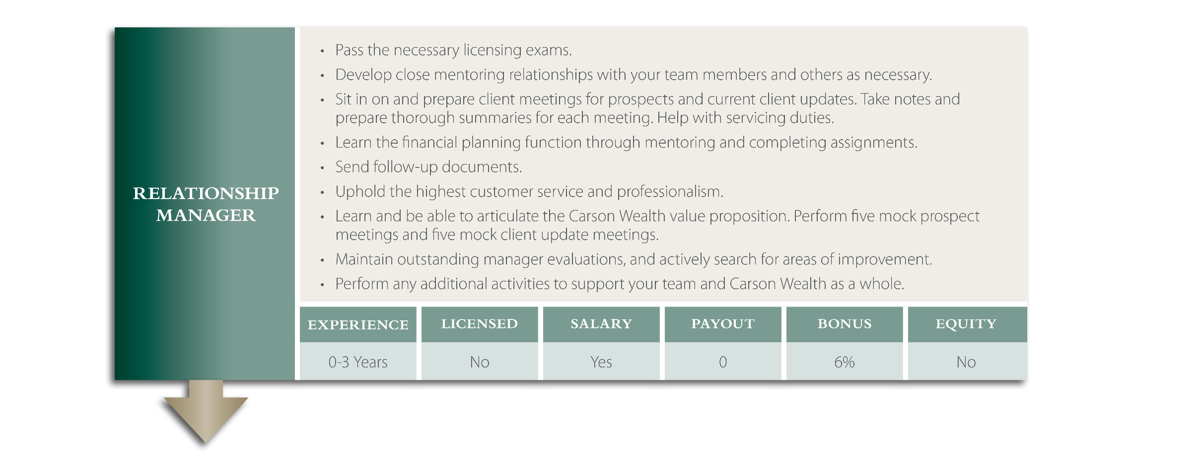
Advisor Growth Path
#Excell2018

Slide 5
Advisor Growth Path
#Excell2018

Slide 6
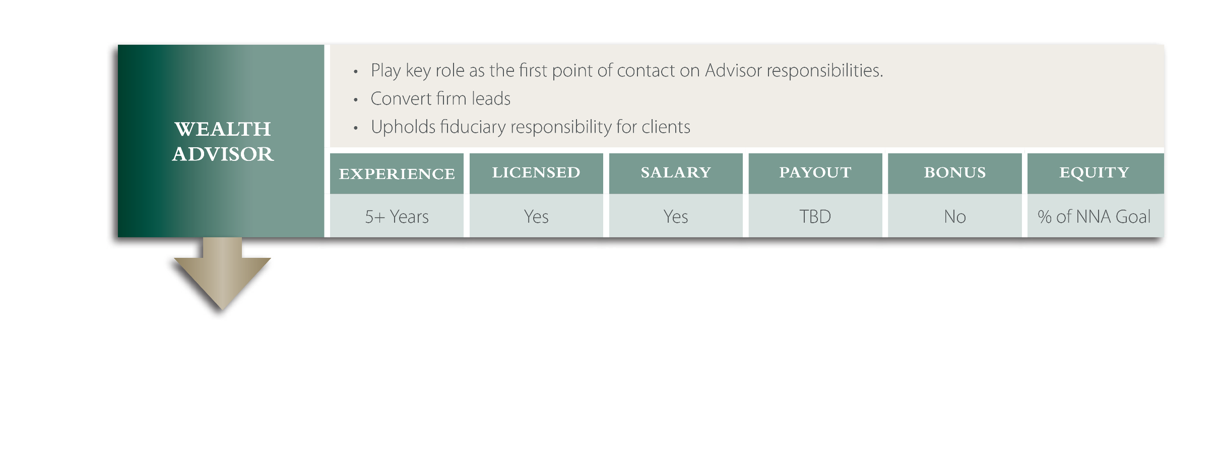
Advisor Growth Path
#Excell2018

Slide 7
Advisor Growth Path
#Excell2018

Slide 8
Do’s and don’ts of Career Path
Do this
empower
Train Well
Let observe
Give Keys
#Excell2018

Slide 9
Do’s and don’ts of Career Path
Don’t do that
Let sink/swim
Over Promote
Over Promise
#Excell2018

Slide 10
Fresh Out of College to Forbes Top 50 Next Gen Advisor
How a New Advisor Built at $100M Business in 3 Years
#Excell2018

