Slide 1
Blockchain
Notes:
Starting the discussion about third gen web
Jeff Spring - Chief Innovation Officer at Carson Group
Product design for complex software systems - from startups to broker dealers

Slide 2
What is it?
Size of the World Wide Web
Meta-technology
Internet of Value
Distributed Ledger
Underpinning of cryptocurrency
Physical assets can have a digital proxy tracked on a blockchain
Computer language for money
Notes:
Tech shift
Technology that changes other technologies
Assets can be owned digitally

Slide 3
A SSETS
T RUST
O WNERSHIP
M ONEY
I DENTITY
C ONTRACTS
Notes:
What does blockchain apply to?

Slide 4
Every blockchain
has these properties
SIMULTANIOUSLY
Cryptocurrency
Financial Services Marketplace
Computing Infrastructure
Transaction Platform
Decentralized Database
Distributed Accounting Ledger
Development Platform
Open Source Software
Peer-to-Peer Network
Trust services layer

Slide 5
Blockchain is 3 combined sciences
Computer Science & Software Engineering
Cryptographic Science
Game Theory
Notes:
Many things combined. Not one upgrade.

Slide 6
Cryptographic science
HASHING Involves the use of a unique fingerprint that verifies that a piece of information has not been altered without the need to see it KEYS Public visibility / private inspection - much like your house DIGITAL SIGNATURES Mathematical computation used to prove the authenticity of a digital message

Slide 7
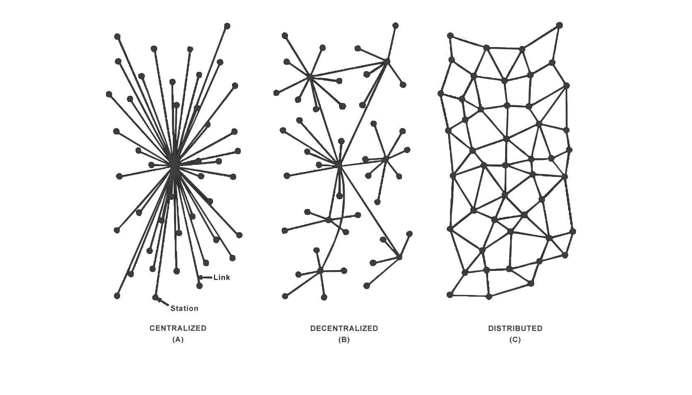
Blockchains rely on distributed networks
Transactions occur between nodes
Every node performs validation
Nodes are paid in the currency to operate
No central choke-point

Slide 8
Blockchains use the internet but not the web
Internet (TCP-IP)
Web
Blockchains
bypass the web

Slide 9
Single Ledger

Slide 10
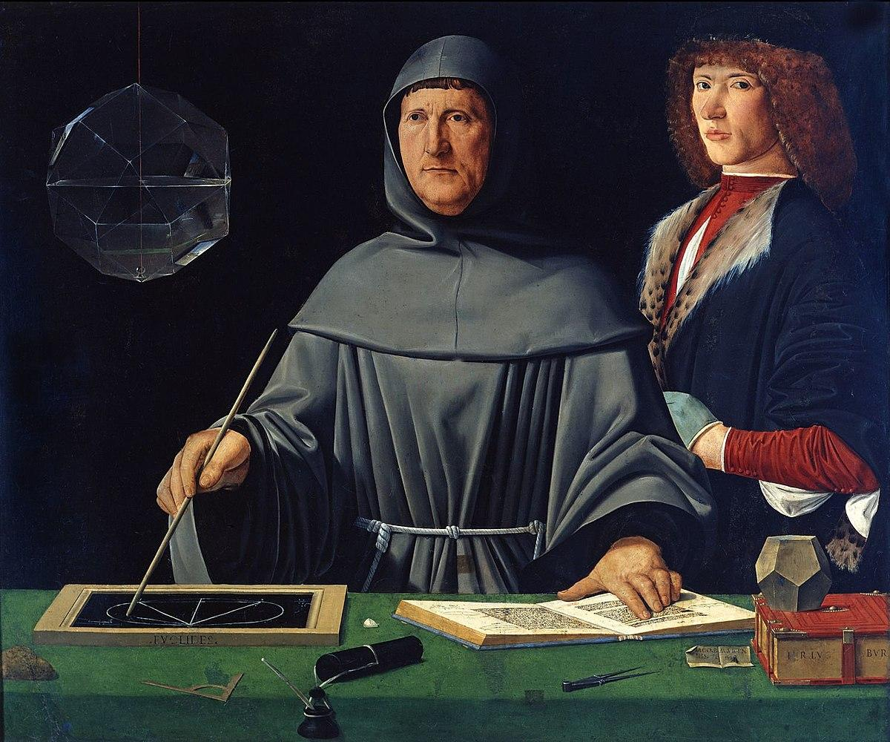
Financial
Nirvana
Dual Ledger
Accounting
Invented in 1494
by
Luca Pacioli
...and presumably, that other guy ?

Slide 11
Dual-Ledger Accounting
$200
$200
Notes:
If the grey line represents a transaction

Slide 12
Single-Ledger Accounting
$200
$200
Notes:
Invented 2008 by Satoshi Nakamoto

Slide 13
Cryptography ensures validation
This transaction + last hash = new hash
4v34k4v56...
r569230mdf91338n482mb48283bm382
This transaction + last hash = new hash
8738v9823...
4v34k4v56q233134b5143b46134h414
This transaction + last hash = new hash
n53n70385...
8738v98238jr983380hh12b4928b3982
Notes:
Transactions in the ledger are linked together like a chain

Slide 14
Cryptography exposes bad actors
This transaction + last hash = new hash
4v34k4v56...
2b4928b3982ja4kj3s38jr983380hh1
This transaction + last hash = new hash
fja4kj3s38j...
4v34k4v56q233134b5143b46134h414
This transaction + last hash = new hash
n53n70385...
fja4kj3s38jr983380hh12b4928b3982

Slide 15
Transactions
Transaction finality happens by consensus
Participants don’t need to know each other
Intermediaries are not required to verify a person’s reputation
Source of consensus doesn’t matter

Slide 16
Transactions
The consensus ledger is distributed across multiple nodes
All nodes independently and immediately verify all transactions
Byzantine fault tolerance prevents bad actors from altering data in transit

Slide 17
Value & Crypto
All blockchains represent a different center of value
Every blockchain can be completely different
There will be an infinite number of currencies
They will shapeshift and have entirely different purposes
Some will remain private or even local
Notes:
Not based on the price to earnings ratio - this is based on utility of the token

Slide 18
The race is on
Financial
Societal
Legal
Governance
Business
Notes:
Race to give power to the edge of the networks
Estonia - model for crypto governance and identification

Slide 19
Bitcoin & Ethereum

Slide 20
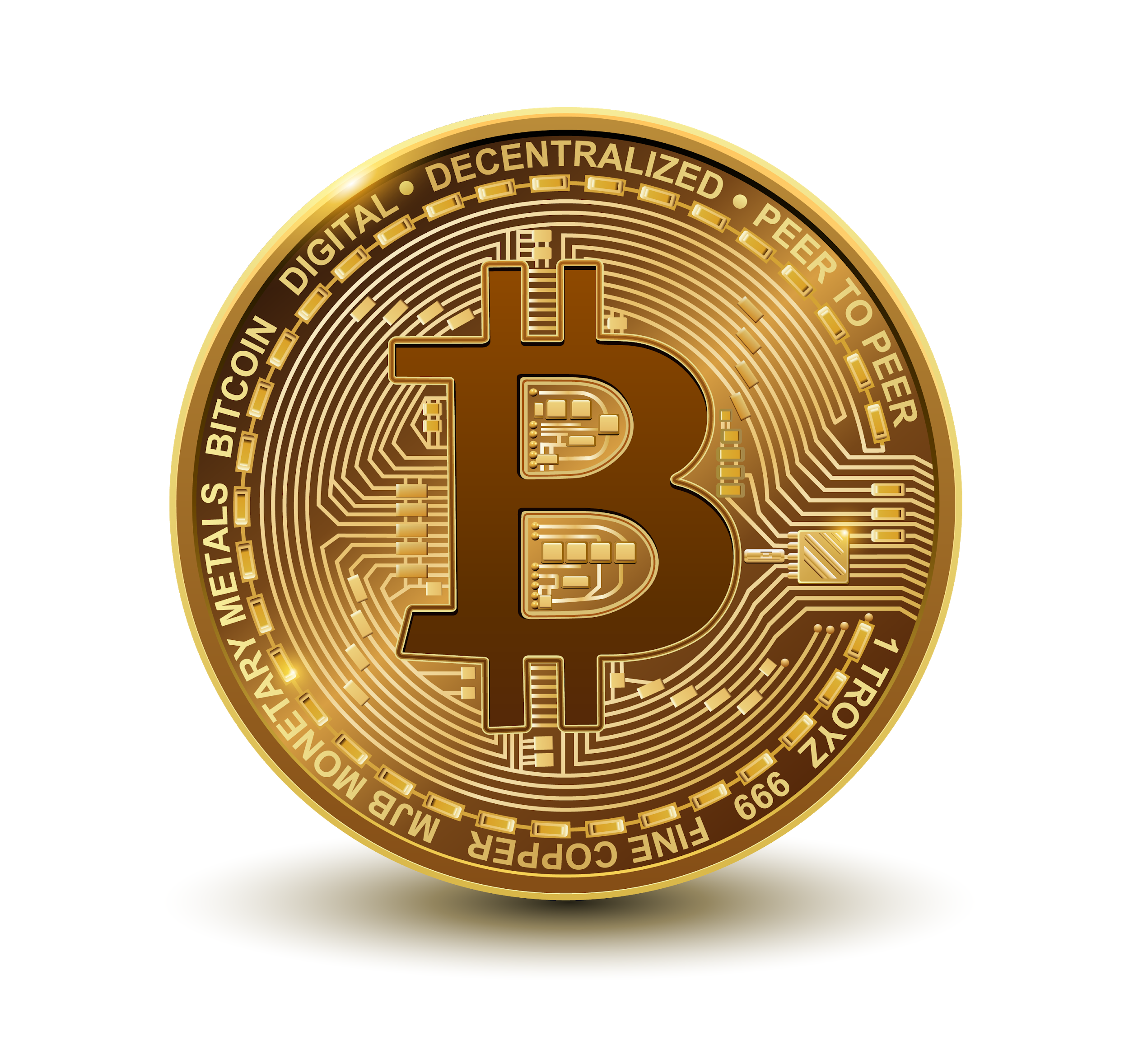
The base use case digital value with the properties of currency
First-Best-To-Market (FBTM) founded on Satoshi papers
Market darling the “Brand” of the revolution
Notes:
What makes it significant? Transparent & open.

Slide 21
Bitcoin = Cash?
Gold standard. Store of value
21 million bitcoins by 2140 - supply limited
Litecoin = moment-to-moment transactions
Speed and liquidity technology is often tested on “side-chains” and folded into Bitcoin
Notes:
Bitcoin has a speed problem
Litecoin is the silver to bitcoin’s gold

Slide 22
Volatility
PRESS Bad actors and speculation
ADOPTION CURVE Emotionally and politically driven

Slide 23
Privacy
Identities can be completely protected
Zero-knowledge proof schemes
Paradise papers
Source and destination anonymity
Hidden chains

Slide 24
Application layer / Protocol coin
Blockchain’s second “killer app” concept
Virtual Machines enable blockchain dApps
dApps are required to pay Ether for every operation
Ether is the reward for contributing resources to the network… aka “hash power”
Notes:
Like JAVA on the blockchain
Developers do not have to be aware of the underlying computer architecture

Slide 25
Smart Contracts
DEFINITION Business logic implemented in a program whos result is recorded on the blockchain for others to use
SOME RAMIFICATIONS
Built-in Anti Money Laundering & KYC attestations with their proofs automated
Transaction terms are stored on the blockchain within a smart contract
Business logic simultaneously stores the associated regulatory agreement and collateral
Notes:
Definition - other users or other smart contracts
Ramifications - Imagine

Slide 26
The new DAO
Ethereum brings the world the Distributed Autonomous Organization

Slide 27
Components of a DAO
Ownership stake earned actively or passively
Units of internal value - utility, currency, etc
Transparency in governance
Appreciation of organization value
Smart programs as transaction engines
APIs to integrate with partners & oracles

Slide 28
Motivation
Central banks as currency manipulators
Libertarian attitudes
Mishandling of tax proceeds
Politicization of financial markets
High fees for intermediaries that provide little value

Slide 29
Near future
What part of my portfolio is in crypto?
HEAD-FAKE Traditional portfolio + humanless automated management
REAL FUTURE A blended portfolio of traditional and digital assets
Notes:
Monumental shift translates to HUGE human value

Slide 30
Déjà vu
Unthinkable market penetration
Barriers to entry were knocked down
Legal & regulatory issues were addressed
Rewards were higher for early participants
It completely shifted society

Slide 31
Market Challenges
Where are we at today?

Slide 32
Underdeveloped Infrastructure
Lack of mature applications. No Amazon
Each blockchain needs its own infrastructure and a network of people participating
Connectivity & interoperability protocols are nascent
Without adoption there is little impact
Notes:
The orchestra is missing some key instruments

Slide 33
Legal & Regulatory Barriers
Do nothing and let the market mature and evolve
Control the choke points
Insert automatic regulation at the point of transaction or on it’s journey
Lack of clarity causes confusion and uncertainty

Slide 34
Fundamental paradigm shift
for regulators
Decentralized Trust
Trust is now decentralized
Centralized banks are not needed to prove that we have assets or credit, nor to prove identity
Regulators are used to regulating the trust providers
Innovation in regulation is needed
Regs will come that are not thought of yet
Notes:
Will they adapt to things that don’t fit the model of central choke-point regulation?
Consumer protection standards
Heavy handed actions by China and governments could stifle innovation

Slide 35
Behavioral &
Educational
Challenges
Lack of understanding of potential value
Takes time to wrap your mind around
Some will see what they want to see.
Fear of dealing with the potential disruption
Fear means dialing down your vision to fit your own reality
Notes:
Need a concerted effort to become educated

Slide 36
Changing our trust networks
We already have institutions that provide trust functions, don’t we?
Use the web as a guide… remember…
Banks didn’t trust web payments
That created online payment gateways
Then CC usage on the web became accepted and trusted
Our fears about trust networks will be soon taken for granted like payments on the web are today
Notes:
Why put trust into a network and reduce it to mathematical computations?

Slide 37
Compliance
Accepting cryptocurrency backed tokens as real value
Recognizing the finality of transactions made on the blockchain
Allowing the necessary legal linkages to smart contracts
Accepting peer-to-peer counterparty validation via the blockchain as truth

Slide 38
Financial Services
The worst place to create a new business model is from within your existing business model
Notes:
The challenge ahead for financial services

Slide 39
Break the business model
DEFAULT POSITION Only slightly open the door. Let as many benefits seep in with the least amount of opening.
RISK External innovation could surpass the ability to absorb or usurp it. Startups will kick the door open, throwing incumbents off balance.
GOAL Match the right tech and business approaches to the right projects and initiatives

Slide 40
Innovator’s Dilemma
Difficult to innovate within your business model
Tie everything back to what exists
Short-sighted and limited view of what is possible
Especially true if business has a trust related function… such as a clearing firm
Notes:
Blockchain hits at the core of their value proposition.
They will need to dare disrupt themselves and develop new value propositions… or they will lose. Who will win?

Slide 41
The “Being Regulated” Dilemma
FUNDAMENTAL TRUTH It’s easier to innovate outside the regulatory box
Hard to extricate the business from the regulations it operates under
Risk out-doing yourself only to be penalized

Slide 42
Disrupting
FinTech
Web offered alternative point of entry for any financial service
Banks believed they could not be disintermediated
Banks adopted web at their own pace, now they can’t resist the onslaught
PayPal was the ultimate disrupter to-date but was never truly global
Crypto is global FinTech disruption
Notes:
Crypto is advancing because banking lacks innovation

Slide 43
“Startup mentality” means huge
disruption potential
Startups don’t attack huge players head on
Startups are in adjacent, uncontested, or underserved territory until they are significant and unstoppable
Notes:
Ripple has swallowed the international payment scene in only several years. Automation trend proves that a new form of product can be created without legacy baggage

Slide 44
Crude Metaphor
It’s better to shoot yourself in the foot than for someone else shoot you in the head

Slide 45
Take action
Get your hands dirty. Make a trade
Get your minds dirty vetting and testing wild concepts that risk failure
Acquire experience through experimentation
Uncover our own perspective
Incubate ideas throughout education

Slide 46
Skepticism
Notes:
Dinosaurs don’t talk about spaceships… they talk about other dinosaurs.

