Slide 1
SECURE Act and Stretch IRA Planning
Notes:
How many think we face a retirement crisis?

Slide 2
Speaker Name
Title(s)
Registered Branch Address
Registered Branch Phone Number
Add partner logo if needed

Slide 3
Speaker
Jamie Hopkins, Esq.
MBA, CFP®, LLM, CLU®, ChFC®, RICP®
Director, Retirement Research
Finance Professor of Practice, Heider School of Business at Creighton University
American Bar Foundation Fellow
American Bar Association Top 40 Young Attorney
InvestmentNews Top 40 Under 40 Financial Services
Trusts & Estates Distinguished Author
Notes:
[Jamie will introduce himself in webinar recording]

Slide 4
Overview
SECURE Act Overview
Impact of 10-Year IRA Payout
Planning Opportunities for “Stretch” Mimic
Roth Planning Opportunities
Opportunities for Carson
Notes:
We will go through six major sections today, talking through each major provision and spending a bit more time on the elimination of the stretch IRA. Then, we’ll talk about options on how to help adjust financial plans to these rules.

Slide 5
SECURE Act
Overview

Slide 6
SECURE Act – 2019
SECURE Act – Setting Every Community Up For Retirement Enhancement Act (2019)
Passed House 417-3 in June 2019
Got derailed for months
Attached to Appropriations Bill in December 2019 – Passed House on Tuesday, December 17
Notes:
Here’s a look at how this all led up to today.
Mention this is biggest piece of financial planning legislation since 2006.
Mention it was looking grim on this passing until December. Now we are all left to adjust in very little time.

Slide 7
SECURE Act – Major Provisions
29 separate provisions
Appropriations bill has some additional tax implications
3 main goals of SECURE
Encourage small employers (MEPs, tax credits, simplified safe harbor provisions)
Increased lifetime income options (portability of annuities, simplification for qualification of annuities in plans, exemptions for annuities from RMD changes, calculation of lifetime income)
Major RMD changes (10-year stretch, age 72, IRA after 70.5)
Notes:
Let’s look at this from three angles:
Small employers and the additional benefits they receive
The insurance side of this – Increased lifetime income options, including annuities
Major RMD changes (10-year stretch, age 72, IRA after 70.5)

Slide 8
SECURE Act – Other Major Provisions
Increase access for small employers to multi-employer plans
Increase annuity options inside retirement plans
Increase RMD ages
Removal of age limitation for IRA contributions
Tax credit for businesses using automatic enrollment
Penalty-free distributions for birth of child or adoption
Lifetime income disclosure for DC plans
Removal of stretch IRA for beneficiaries
Notes:
Here are all the major provisions we will cover.
[Just highlight on this slide, then move to deeper look at each section in next slides.]

Slide 9
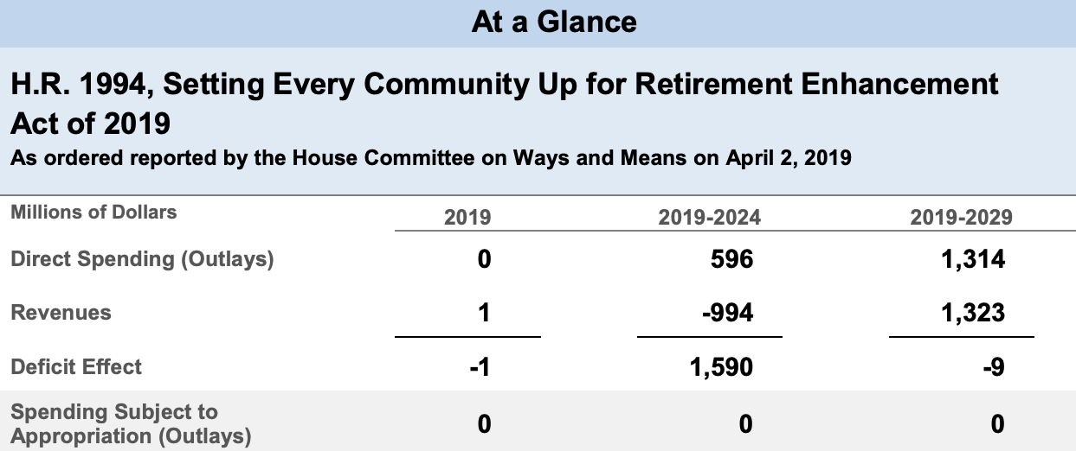
Revenue Impact
https://www.cbo.gov/system/files/2019-04/hr1994.pdf
Notes:
Unfortunately, grandchildren don’t seem to be exempt.

Slide 10
What Is Next?
Stickiness of SECURE Act: Likely most provisions stay in effect; don’t expect bill to be overturned in whole; a lot of commonsense changes; broad bi-partisan support
Biggest issues: Bill doesn’t really address major issues on income
Social Security: Social Security 2100 Act
Medicare Issues Remain
Medicaid: Long-Term Care
Tax Bill 2.0 by end of 2025
Notes:
Unfortunately, grandchildren don’t seem to be exempt.

Slide 11
Framing The Issue

Slide 12
Financial Concerns
Do I have enough saved?
Rising healthcare costs
Will money last a lifetime?
Burden on family members
Market uncertainty
The “what ifs”
Notes:
This is what a lot of you probably feel like, maybe not every day but from time to time, wondering about what the future holds. That's uncertain. We don't know what the future holds and we don't know what's going to happen with the stock market next. We don't know what's going to happen with healthcare law next. So, there's a lot of uncertainty percolating around people's minds, especially as they start entering the stage of life when they start nearing retirement.

Slide 13
Finances are a Means to an End
Remember finances are not the end
Finances are a means to an end
Our goals are what should drive our finances, not the other way around
So take control of your outcomes!
Notes:
[These points will not discuss any particular funds or investment options. Just an overarching view of options available.]

Slide 14
Planning for the Now and Later
How do we balance today’s needs with our future needs?
Reward Yourself
Planning and Process
Consumption Smoothing
Notes:
[These points will not discuss any particular funds or investment options. Just an overarching view of options available.]

Slide 15
Consumption Smoothing
$
Income Curve
Save
Consumption
Spend
Early Career
Retirement
0
20
40
65
Lifetime

Slide 16
Human Capital
$
Human Capital (HC) is an individual’s ability to earn and save money, which diminishes over time.
HC + FC = Total Economic Wealth
$
Financial Capital (FC) is an individual’s total saved assets.
Retirement
Age 25
45
65
85
100
Notes:
10,000 baby boomers a day reach 65 (3.65 million a year).
Heavy reliance on Social Security (for 1/3 of this group, it is the only source of income).
Only 44% of retirees have a professional to help them.

Slide 17
“Retirement income planning can be like hitting a moving target in the wind.”

Slide 18
What is Retirement Income Planning?
Goal-Based Planning
Meet your financial goals
Income needs
Contingent expenses
Legacy goals
Address retirement risks
Longevity
Inflation
Healthcare
Long-term care
Sequence of withdrawal risk
Public policy risk
= Secure Retirement Income Plan that Lasts a Lifetime

Slide 19
Retirement Plan Impact

Slide 20
Retirement Plan Changes
Development of Open Multiple Employer Plans (MEP)
Increased savings options for part-time employees
Increased tax credits for starting plans
Notes:
Source: https://www.groom.com/resources/house-passes-bipartisan-retirement-reform-legislation/
Unless you are age 70.5 by the end of the year, you’re affected.
Roth conversions will give people a book boost in the SECURE Act era.

Slide 21
Open v. Closed MEP
Closed MEP (Pre-SECURE)
Closed MEPs were run by a sponsor that was a bona fide group, association, or organization
Members shared a common nexus or interest
Only members of the group could participate
Open MEP (After-SECURE)
SECURE Act opened this up
Allows a single retirement plan for all members
Members need no business connection or nexus between each other
Effective Date: 2021
Notes:
Source: https://www.groom.com/resources/house-passes-bipartisan-retirement-reform-legislation/
Unless you are age 70.5 by the end of the year, you’re affected.
Roth conversions will give people a book boost in the SECURE Act era.

Slide 22
What are MEPs?
A retirement plan adopted by two or more unrelated employers from an income tax perspective
Each MEP is run by an MEP sponsor who performs administrative duties and typically fiduciary liability for the plan
Companies that participate or adopt the plan are considered “adopting employers”
Goal is to reduce costs and complexity for small employers and remove obstacles in prior law
Adoption has been lower than desired in small employer space
Notes:
Source: https://www.groom.com/resources/house-passes-bipartisan-retirement-reform-legislation/
Unless you are age 70.5 by the end of the year, you’re affected.
Roth conversions will give people a book boost in the SECURE Act era.

Slide 23
MEP SECURE Act Impact
401k MEP
Employers
Notes:
Source: https://www.groom.com/resources/house-passes-bipartisan-retirement-reform-legislation/
Unless you are age 70.5 by the end of the year, you’re affected.
Roth conversions will give people a book boost in the SECURE Act era.

Slide 24
Other SECURE Act Small Business Beneﬁts
MEP alternative in SECURE – filing a combined 5500 form for a group of plans with a common administrator
Increase in the business tax credit, for retirement plan startup costs, from current cap of $500 up to $5,000
Encourage small-business automatic enrollment by allowing an additional $500 tax credit for three years for plans that add automatic enrollment
Raised default savings cap for automatic enrollment safe harbor plans from 10% to 15% of employee paycheck (can still opt out)
Notes:
This change removes a notable savings limitation, particularly for those who continue to work later in life.

Slide 25
Part-Time Workers
SECURE Act requires employers to include long-term, part-time workers as participants in DC plans except in collectively bargained agreements
Previously, you could exclude anyone who reached 1,000 hours in 12-month period
Now, anyone age 21 with at least 500 hours in last three consecutive years need to be counted
Might just modify plans to let anyone in with 500 hours instead of testing for past three years (could be administrative burden)
Starts in 2021 (first year would be 2024 since it takes three years)
Notes:
This change removes a notable savings limitation, particularly for those who continue to work later in life.

Slide 26
Impact of 401(k) Changes
Goal is to increase usage of retirement plans by small employers
Lowers cost and liability for joining a multi-employer plan
Small business owners look out for MEPs in 2021 as offering!
Tax credit for starting a retirement plan and automatic enrollment can also help offset the costs
Notes:
The idea is to boost plan offerings for small employers who don’t use these plans because they think they’re too complex.
Previous attempts to fix this issue haven’t always worked. We’ll see.

Slide 27
Lifetime Income Option Changes
SECURE Act

Slide 28
Lifetime Income Option Provisions
In-Plan Annuity Safe Harbor Provision
Increased Portability of Annuities Provision
Lifetime Income Calculation Provision
Notes:
This change removes a notable savings limitation, particularly for those who continue to work later in life.

Slide 29
In-Plan Annuities Safe Harbor
Can have in-plan annuities today
Most 401(k)s don’t offer (SHRM Survey showed 7-8% of plans)
One hurdle has been employer fiduciary liability of the insurance company providing the annuity
If the company failed on promise, fiduciary could have liability
Annuities can be used in plans both as a distribution option and as an investment (accumulation vehicle)
Notes:
This change removes a notable savings limitation, particularly for those who continue to work later in life.

Slide 30
Annuity Safe Harbor Provision
Employers protected from liability of insurance company failure if:
Annuity provider, for the past seven years, has been licensed by the state insurance commissioner to provide such contracts, filed all required financial audit statements, maintains proper reserves for all states in which it does business, and notifies company of any changes to these
Must also review the financial capability of the insurer to meet obligations at the time of selection
No requirement to pick the cheapest provider (just reasonable)
Likely won’t see a huge change in 2020 but, in 2021, expect more insurance in plans
Notes:
This change removes a notable savings limitation, particularly for those who continue to work later in life.

Slide 31
Annuity Portability
Portability of annuities was also increased by letting employees roll annuities from 401(k)s to IRAs or other plans with more ease
In the past, if you left the plan and went to another 401(k), etc., you might have to liquidate the annuity inside the plan to roll out value
Now, if annuity option becomes unavailable in the plan, the participant can be allowed an in-kind distribution of the qualified annuity contract if it is made within 90 days of the date the investment is no longer authorized to be held as an investment option under the plan
Allows for participant to not suffer from surrender charges and fees if an annuity becomes deselected as an investment option inside the plan
Should allow for companies to make better decisions around adding or removing annuities
Notes:
The stretch strategy has been on its way out – there’s too much revenue on the table.
This means there are fewer tax-deferred savings opportunities.

Slide 32
Annual Disclosure of Lifetime Income
Discussed for years
DOL now required to build the model and rules
Basic – show the income from a set amount of savings
Example: 4% rule
$1,000,000 in savings – creates $40,000 a year in income
Most plans offer something today but it isn’t very accurate and oftentimes doesn’t help do what we want to achieve in making people think about income, not just savings
Will require a disclosure of lifetime income each 12-month period
2021 likely rule is done by DOL
2022 likely first time we see this enacted
Notes:
The stretch strategy has been on its way out – there’s too much revenue on the table.
This means there are fewer tax-deferred savings opportunities.

Slide 33
Lifetime Income Changes Impact
Understand the annuities in your plan before investing or buying
Increased access to annuities likely and easier to transfer from one account to another
Focus on income and not just savings amount
Notes:
Source: https://www.groom.com/resources/house-passes-bipartisan-retirement-reform-legislation/
This was a big win for insurance companies because each annuity no longer has to be vetted – only the insurance company.
This might not change behavior because the default 401(k) distribution will still be a lump sum.

Slide 34
BIG IRA and RMD Changes

Slide 35
RMD and IRA Changes
RMD age to 72
Save in plans after 70.5
No more stretch IRA
Notes:
Source: https://www.groom.com/resources/house-passes-bipartisan-retirement-reform-legislation/
Unless you are 70.5 by the end of the year, you’re affected.
Roth conversions will give people a book boost in the SECURE Act era.

Slide 36
Increase RMD Age
RMD age would be increase to 72, effective in 2020
If you turned 70.5 by end of 2019, still subject to old rules
Not a huge change: pushes RMD for one year or two
So, one or two more years of tax deferral but would have higher RMDs
More room for Roth conversions!
Notes:
Source: https://www.groom.com/resources/house-passes-bipartisan-retirement-reform-legislation/
Unless you are 70.5 by the end of the year, you’re affected.
Roth conversions will give people a book boost in the SECURE Act era.

Slide 37
Age 72 Impact
More room for Roth conversions!
More time for money to grow
Higher distributions after 72
IRS expected to roll out new lifetime tables in 2020, effective in 2021, that would lower the RMDs
Did not change age you can do QCD (still 70.5)
Notes:
Source: https://www.groom.com/resources/house-passes-bipartisan-retirement-reform-legislation/
Unless you are 70.5 by the end of the year, you’re affected.
Roth conversions will give people a book boost in the SECURE Act era.

Slide 38
Removal of Age Limit
Terrible rule – good it is gone
At 70.5, you could not continue to save in an IRA
But you could in a Roth or qualified plan
Now people working in retirement can keep saving, get tax deduction
Good planning option – but does not change need for RMDs
Notes:
This change removes a notable savings limitation, particularly for those who continue to work later in life.

Slide 39
Removal of Age Limit
You can save in a Roth or traditional IRA after 70.5
Can do spousal contribution also even if only one spouse working
$7,000 into an IRA (2020) for those over age 70.5 ($14,000 for couple)
Coordination with QCD offset provision
Notes:
This change removes a notable savings limitation, particularly for those who continue to work later in life.

Slide 40
Stretch IRA Going Away
Stretch IRA for non-spouse beneficiaries is going away
Has been on chopping block for years
Huge tax revenue: $15.7 billion through 2029, estimates Joint Committee on Taxation
Would require account to be distributed within 10 years
As opposed to old rule where you could stretch out over life expectancy of the beneficiary in most cases
This generally means higher RMDs for beneficiary and less tax-deferred savings opportunities
Not effective until December 31, 2021 for government plans
Source: https://www.jct.gov/publications.html?func=download&id=5189&chk=5189&no_html=1
Notes:
The stretch strategy has been on its way out – there’s too much revenue on the table.
This means there are fewer tax-deferred savings opportunities.

Slide 41
10-Year Stretch Impact
Review trust language
Review beneficiary language
Review tax impact on estate and beneficiaries
Roth conversions, life insurance, and charitable remainder trusts can all be helpful for planning now
Notes:
This change removes a notable savings limitation, particularly for those who continue to work later in life.

Slide 42
Childbirth and Student Loan Provisions

Slide 43
Penalty-Free Childbirth and Adoption
A feel-good, smart public policy rule
Supports adoption and childbirth
Can take a $5,000 withdrawal per person ($10,000 a couple) from 401(k) or IRA, etc., for childcare costs up to one year after date of birth or legal adoption
Added provision: you can repay this back to plan over time as a “rollover”
Don’t need to track expenses
Notes:
You can take a $5,000 withdrawal per person from 401(k) or IRA, etc. for childcare costs – a really interesting and welcome addition to the bill.

Slide 44
529 Plan and Student Loans
Can repay up to $10,000 of student loans (lifetime)
Treated as a qualified distribution now
Cannot also deduct interest paid (would be a double count)
Can be used to support beneficiary or beneficiary’s siblings
Remember, beneficiary can be changed at no cost
Notes:
You can take a $5,000 withdrawal per person from 401(k) or IRA, etc. for childcare costs – a really interesting and welcome addition to the bill.

Slide 45
Basic Tax Issues of 10-Year Payout v. Stretch

Slide 46
What Does Stretch Change Mean?
Increased taxes
Decreased tax-deferral benefits
Increase in value of Roth conversions
More planning needed around beneficiaries
Trust language reviews
Possible benefits of charitable giving with IRAs to CRATs and CRUTs
Notes:
In the coming slides, we’ll go over the impact of the SECURE Act on stretch strategies.

Slide 47
Some Big Exceptions Still
The 10-year distribution requirement generally does not apply if the designated beneficiary is an eligible beneficiary.
Eligible beneficiary is defined as any beneficiary who, as of the date of death, is a surviving spouse, disabled, or chronically ill, or is an individual who is not more than 10 years younger than the employee (or IRA owner), or is a child of the employee (or IRA owner) who has not reached the age of majority.
Effective for those who die after December 31, 2019 and December 31, 2021 for government plans
Notes:
There are exceptions to the 10-year distribution requirement.

Slide 48
Who isn’t exempt?
Grandchildren don’t appear to be exempt
That means a 10-year-old grandchild would have 10 years to deplete the account
That is not a good outcome!
Notes:
Unfortunately, grandchildren don’t seem to be exempt.

Slide 49
Stretch v. 10-Year Example
75-year-old parent passes away
Leaves IRA to 45-year-old child – 38.8 years for life factor
IRA worth $1,000,0000
RMD year one – $100,000 after SECURE v. $25,773 under Stretch
Notes:
So, in this example, you can see Year 1 alone is about a $74,000 difference. That can alter an individual's tax situation pretty rapidly.

Slide 50
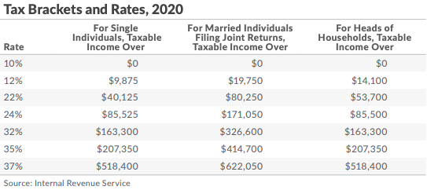
Your 2020 Individual Tax Bracket
https://taxfoundation.org/2019-tax-brackets/
Notes:
[Visual aid outlining income tax brackets[

Slide 51
Stretch – Keep It Kathy
$1 Million IRA inherited under stretch rules
45-year-old Kathy with income of $130,000 a year
She’s in the 24% tax bracket marginal
With $25,773 of extra income, goes to $155,773 and stays in 24%
Effective rate in 18% range
Total income taxes at state level (PA assumption at 3%) roughly $43,000
Notes:
You can see in this example how the change can push people into higher tax brackets.

Slide 52
10-Year Payout – Pay Out Penny
$1 Million IRA inherited under 10-year rule
45-year-old Penny with income of $130,000 a year
She’s in the 24% tax bracket marginal
With $100,000 of extra income, goes to $230,000, goes to 35% Marginal Rate up from 24%
Effective rate 22.3% up from 18%
Total income taxes at state level (PA assumption at 3%) roughly $70,000 up from $43,000 = $27,000 more in taxes
Notes:
You can see in this example how the change can push people into higher tax brackets.

Slide 53
Bonus Tax Issue
Net Investment Income:
Gains from the sale of stocks, bonds, and mutual funds.
Capital gain distributions from mutual funds.
Gains from the sale of investment real estate, including gains from the sale of a second home that is not a primary residence.
Gains from the sale of interests in partnerships and S corporations, to the extent the partner or shareholder was a passive owner. See section 1.1411-7 of the 2013 proposed regulations.
Net Investment Income Tax
Filing Status | Threshold Amount
Married filing jointly | $250,000
Married filing separately | $125,000
Single | $200,000
Head of household (with qualifying person) | $200,000
Qualifying widow(er) with dependent child | $250,000
Notes:
Outline of net investment income and threshold amount.

Slide 54
NIIT Bonus Tax Issue Example
Taxable distributions from IRA are not subject to 3.8% tax but do impact income threshold amounts
This could subject other investment income to 3.8% tax
Tax applies to the lesser of one’s net investment income or the amount over the threshold
In this situation, she was over threshold by $30,000 (so a max of $30,000 could be subject to taxation if she has $30,000 or more of NIT)
Notes:
We’ll discuss what is and isn’t subject to the 3.8% tax.

Slide 55
Pay Out Penny Return
$1 Million IRA inherited under 10-Year Rule
45-year-old Penny with income of $130,000 a year
With $100,000 of extra income, goes to $230,000
Let’s assume she had $30,000 of net investment income
Under old rules, didn’t pass over $200k in MAGI, but now she does
At $230,000 of income, her entire $30,000 is subject to the 3.8% income
Over 10 years, 3.8% on $30,000 is $11,400 in additional taxes!
Notes:
You can see in this example how the change can push people into higher tax brackets.

Slide 56
What End of Stretch IRA Means
End of Stretch IRA means three basics things:
Higher taxes for many people
Less tax-deferred growth of account
Higher MAGI and taxable income can cause loss of benefits or higher taxes in other areas
Notes:
There are two major but straight-forward hurdles that come with the end of the stretch IRA.

Slide 57
Medicare Surcharge Tax Planning
Notes:
Medicare premiums can also be impacted by income. So while not a tax, it does feel like a tax.

Slide 58
$1 Can Mean Thousands of Dollars
$1 over IRMAA Brackets means you pay the new Medicare premiums
Notes:
Source: https://www.financial-planning.com/news/ira-strategies-to-cut-medicare-costs-for-wealthy-clients
Perhaps the most important thing to know about Medicare premiums is $1 over IRMAA Brackets means you pay the new Medicare premiums.

Slide 59
More Medicare Mary
65-year-old Mary, single, inherits $1,000,000 IRA
Subject to 10-year stretch
Has $70,000 of MAGI income before deduction
What happens to her Medicare premiums if she has $100,000 more of income?
Notes:
There are two major but straight-forward hurdles that come with the end of the stretch IRA.

Slide 60
Income Bracket Premium Example 2020
Medicare Premiums 2020 (Per Person)
MAGI Bracket
Single Taxpayer
Married Filing Jointly
Part B Monthly Premium
Part D Monthly Premium
2020 Annual Premiums
2018
2018
$144.60*
$47.59**
$2,306.28
1
≤$85,000
≤$170,000
$144.60
$47.59
$2,306.28
2
$85,001 - $107,000
$170,001 - $214,000
$202.40
$47.59 + $12.20
$3,146.28
3
$107,001 - $133,500
$214,001 - $267,000
$289.20
$47.59 + $31.50
$4,419.48
4
$133,501 - $160,000
$267,001 - $320,000
$376.00
$47.59 + $50.70
$5,691.48
5
$160,001 - $500,000
$320,001-$749,999
$462.70
$47.59 + $70.00
$6,963.48
6
$500,001+
$750,000+
$491.60
$47.59 + $76.40
$7,387.08
Single taxpayers (MAGI > $85,000) and married taxpayers (MAGI > $170,000) pay income related monthly adjustments (IRMA).
MAGI is simply adjusted gross income determined on the tax return (AGI) plus tax-exempt municipal bond interest.
* $134 is the base premium for those enrolling in Medicare in 2019. ** This number represents the 2019 national average premium for a stand-alone Medicare Part D plan as identified by the Kaiser Foundation. Part D participants pay the actual premium charged by the plan.
Notes:
Source: https://www.medicare.gov/your-medicare-costs/part-b-costs
So, let’s look at a projection of Medicare premiums and how the cost could be impact by an increase in income. As you can see, as income jumps over the ranges, the potential for premiums to jump a lot is pretty amazing.
$400k could be a breaking point for some.

Slide 61
More Medicare Mary
Mary’s Medicare premiums go roughly from:
$2,306 a year to $7,387 a year after the $100k distribution
This causes a $5,000 Medicare increase
Notes:
There are two major but straight-forward hurdles that come with the end of the stretch IRA.

Slide 62
The “Stretch” IRA Mimic Strategies

Slide 63
SECURE Act Change
All inherited accounts must be distributed within 10 years
Effective date: December 31, 2019
Exceptions:
Surviving Spouse
Children under the age of majority
Disabled
Chronically ill
Individuals who are not more than 10 years younger than employee
Notes:
The major change is the distribution time period – now 10 years.

Slide 64
Planning Strategies to Consider
Spousal rollovers
Annuity contracts
Roth planning
Multi-gen spray trusts
IRAs to CRTs
Life insurance max strategies
Charitable beneficiary
Notes:
A look at other strategies you can consider.

Slide 65
Today and Future
Two real types of IRAs
Spousal v. Inherited
Spouse has a lot of options (will stay same in future)
Can retitle in their own name, rollover, leave in ex-spouse’s name
Retitle and rollover allow spouse to follow their own RMD rules
A spouse who is significantly younger, or under 59.5, might want to leave IRA as inherited to get penalty-free access
Notes:
As you can see, a spouse has more flexibility, and that will continue going forward.

Slide 66
New Spousal Rollover Strategy
Old best practice: Leave entire IRA or 401(k) to surviving spouse, then to children
Maximized tax growth and tax deferral
Problem with strategy: Surviving spouse might now leave large IRA to children combined with the inherited, creating big tax burden over 10 years
Notes:
Leaving your entire retirement account to a spouse comes with problems, too. The kids could inherit a huge tax burden later.

Slide 67
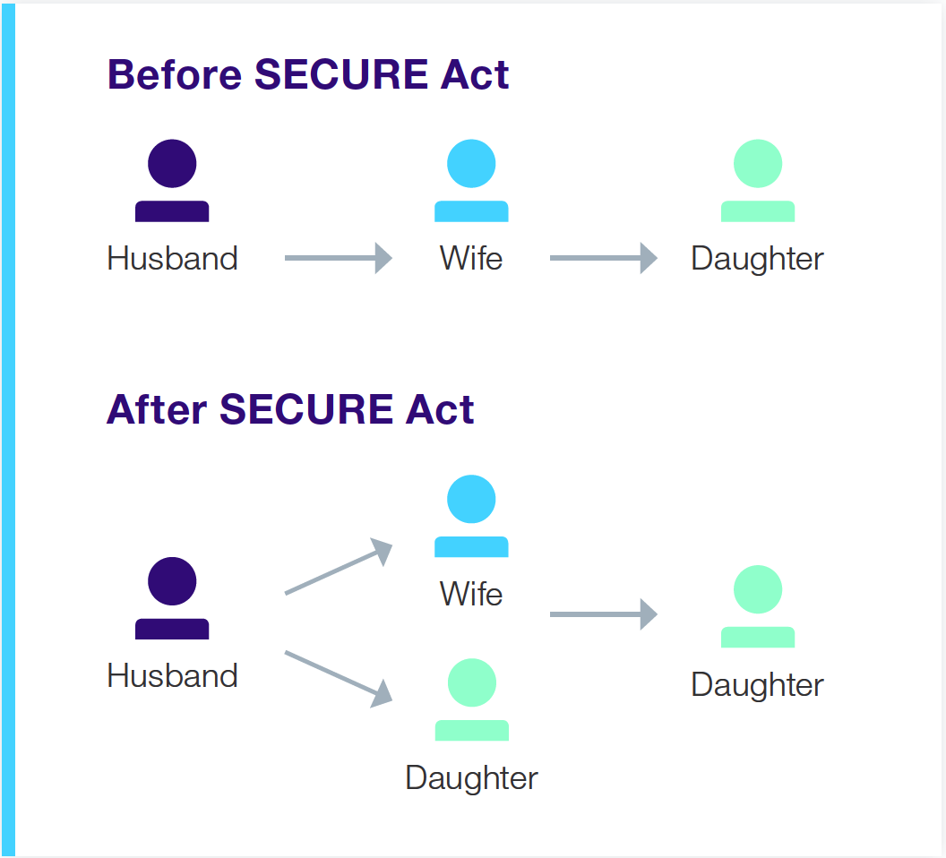
New Spousal Rollover Strategy
New best practice:
Leave portion to surviving spouse and portion to children
This allows children to take RMDs now for first IRA and allows surviving spouse to take their own RMDs
Death of second parent also allows another 10-year RMD timeframe
If surviving spouse lives five years, children have 15 years to take RMDs
Notes:
Consider leaving a portion to the surviving spouse and another portion to children.

Slide 68
Conduit Trust Planning
Previously used to pass through tax benefits
Worked well under the life expectancy rules
Added some beneficial creditor protections
Disastrous under new rules: 10 years or all payout at year 10. Huge tax burden and no real value added
Consider redoing existing conduit trusts and likely won’t use much moving forward
Notes:
You won’t be using conduit trusts going forward – it’s a huge tax burden under the new rules. Here’s why.

Slide 69
Huge Trust Issue
Conduit trust
“Beneficiaries will only have access to the RMDs of the IRA each year”
SECURE Act language – no RMD due until year 10
Access issue – money locked up for 10 years
Tax issue – all money distributed in one year
Notes:
Quick bullets on the issues with trusts.

Slide 70
Roth Conversions
Pay tax today on tax-deferred
Goal is to spread taxes over lower tax time periods to maximize growth
Pay ordinary income on tax-deferred IRA/401(k) assets
Roth gets tax-“free” growth if holding period and trigger events met
In simple terms, it is all about paying lower taxes today than in future
If you have same taxes forever, tax-deferred IRA and Roth generate similar outcomes
Notes:
Roth conversions require the account owners to plan in advance. If done correctly, they can cancel out the taxes that come with a shortened distribution period.

Slide 71
Roth v. Traditional Example
Traditional IRA: $1,000,000 grows to $2,000,000. Eventually pay $30% in taxes. End up with $1.4 million after taxes.
Roth Conversion: Take the $1,000,000 over time and convert to Roth, paying 30% taxes, so that $700,000 is in Roth. It doubles, end up with $1.4 million after taxes.
Notes:
As you can see in this example, both roads lead to $1.4 million.

Slide 72
Roth Planning Points
Outside funds used – like making a tax-advantaged contribution
Look for time period when you can convert at lower-than-normal tax rates
Roth doesn’t impact AGI in retirement or SS and Medicare
Roth not subject to RMDs in retirement for owner
Helps reduce taxable estate
Notes:
The Roth conversation strategy has a lot of value already and will become increasingly important under the SECURE Act. Paying attention to tax rates is key.

Slide 73
Why Roth Works with Death of Stretch
10-year period can cause higher distributions for heirs
Higher distributions means higher tax rates for heirs
Compare owners tax rates to potential heir tax rates
Could be better to pay today, rather than leave to heirs at higher tax rate
Notes:
Consider the account owner’s tax rate and compare it to the potential tax rate of their heirs down the road.

Slide 74
Multi-Generation Spray Trust
With 10-year rule, goal would be to spread taxes out over many beneficiaries to lower effective tax impact of distributions
General rule: Trusts have troublesome income tax rules
Income taxed at trust level – high taxes quickly
Income distributed from trust – taxed to beneficiary that receives income
Additional benefit: Clark v. Rameker says trust can help shield IRA assets and investments from bankruptcy to some degree. Inherited IRAs not protected assets in bankruptcy
Notes:
Outlines how the Multi-Generation Spray Trust works.

Slide 75
Spray Trust Benefits
Issue with multiple beneficiaries in past: you had to use age of oldest for stretch
Having multiple beneficiaries might not matter as much with 10-year
Instead, allows to spread over a bunch of beneficiaries to reduce taxes
Spray provision must be added for trustee
Still need to pay attention to pass-through rules on trusts (avoid 5-year RMDs)
Notes:
Pay attention to pass-through rules, but you can potentially reduce taxes using multiple beneficiaries.

Slide 76
ILIT Income Stream
Take distribution from IRA or ongoing distributions
Fund new life insurance policy in ILIT
Removes life insurance value from estate
Creates a tax-free build up inside ILIT in life insurance
Tax-free distributions to heirs can be spread over life as a lifetime distribution option from LI policy
Popular strategy for higher net worth that otherwise might be subject to federal estate tax
Notes:
ILIT income stream is a popular option when you’re dealing with higher net worth.

Slide 77
RMDs to LI to Tax-Free Income
IRA
LIFE INSURANCE
HEIRS
Notes:
ILIT income stream is a popular option when you’re dealing with higher net worth.

Slide 78
Non-Qualified Annuities
Non-qualified deferred annuity or SPIA could be purchased to mimic the tax deferral and income aspects of stretch IRA
Issue: Many beneficiaries might want more access/control of assets and not have them tied up in an income stream
Notes:
[Talk about the issue with annuities]

Slide 79
Using Charitable Remainder Trusts
NIMCRUT: fixed payment, but if trust earns less, then only pays what trust earns (5% minimum for fixed)
CRUT: variable payment to beneficiary and remainder to charity
CRAT: essentially a fixed payment to beneficiary and remainder to charity
Can fund with IRA at death of individual
Only would be taxed when assets leave CRT – can be lifetime
Still need to be charitably inclined
General idea: Gift to trust, charity is remainder beneficiary. Life income beneficiary gets payments for term or life; deduction in amount of remainder interest to charity (must be at least 10% value of current trust)
Notes:
Explanation on how Charitable Remainder Trusts work.

Slide 80
CRTs Visual
IRA
CRT named as the designated beneficiary
CRT
Payments over life or up to 20 years
Children
At the or at the end of the trust term, the charity receives the residual assets held in the trust
Charity
(Remainder Beneficiary)
IRC §§ 401(a)(9), 664

Slide 81
CRAT Example
Basic Assumptions*
$1,000,000 in a Traditional IRA at death
50-year old beneficiary
Pre-tax growth rate of 6%
Tax rate assumptions
37% income tax rate applies if the IRA is liquidated
32% income tax rate applies if the IRA is distributed over 5 years
24% income tax rate applies if the IRA is distributed over 10 years
22% income tax rate applies if the IRA is distributed over the lifetime of the beneficiary or passed to the beneficiary via a CRT
*CRAT Examples by Keebler

Slide 82
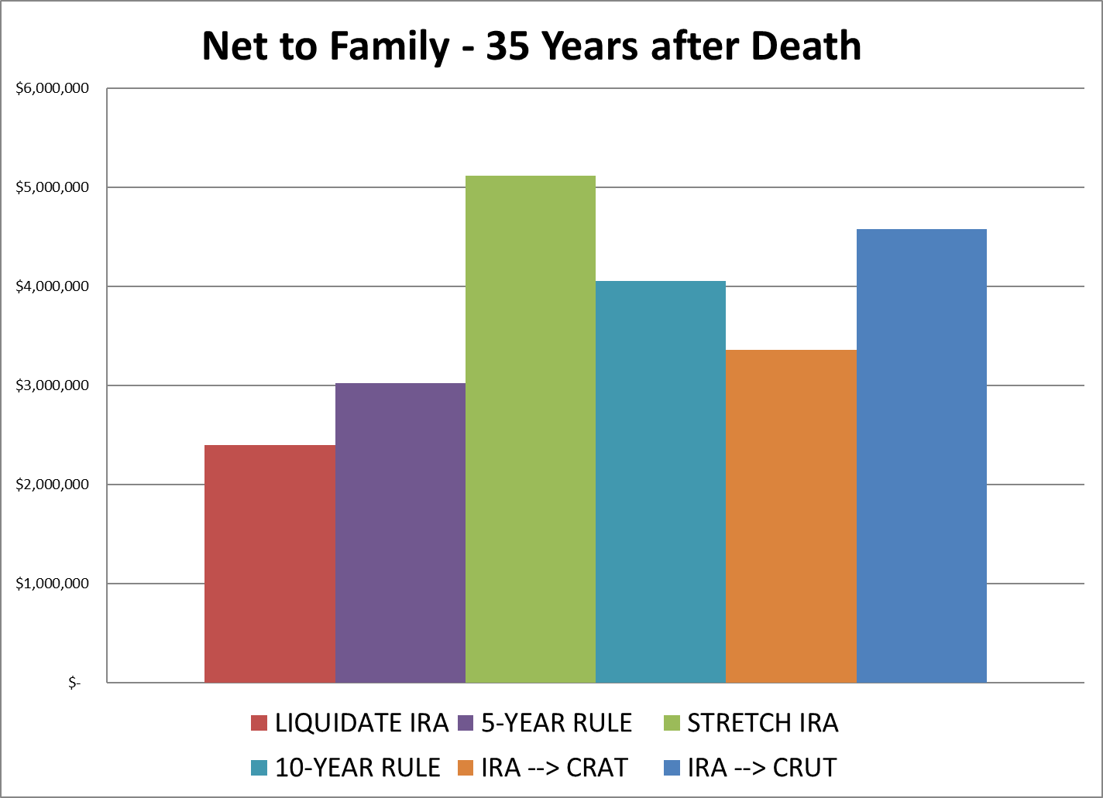
CRAT to Family Assets*
*Provided by Keebler Tax & Wealth Education

Slide 83
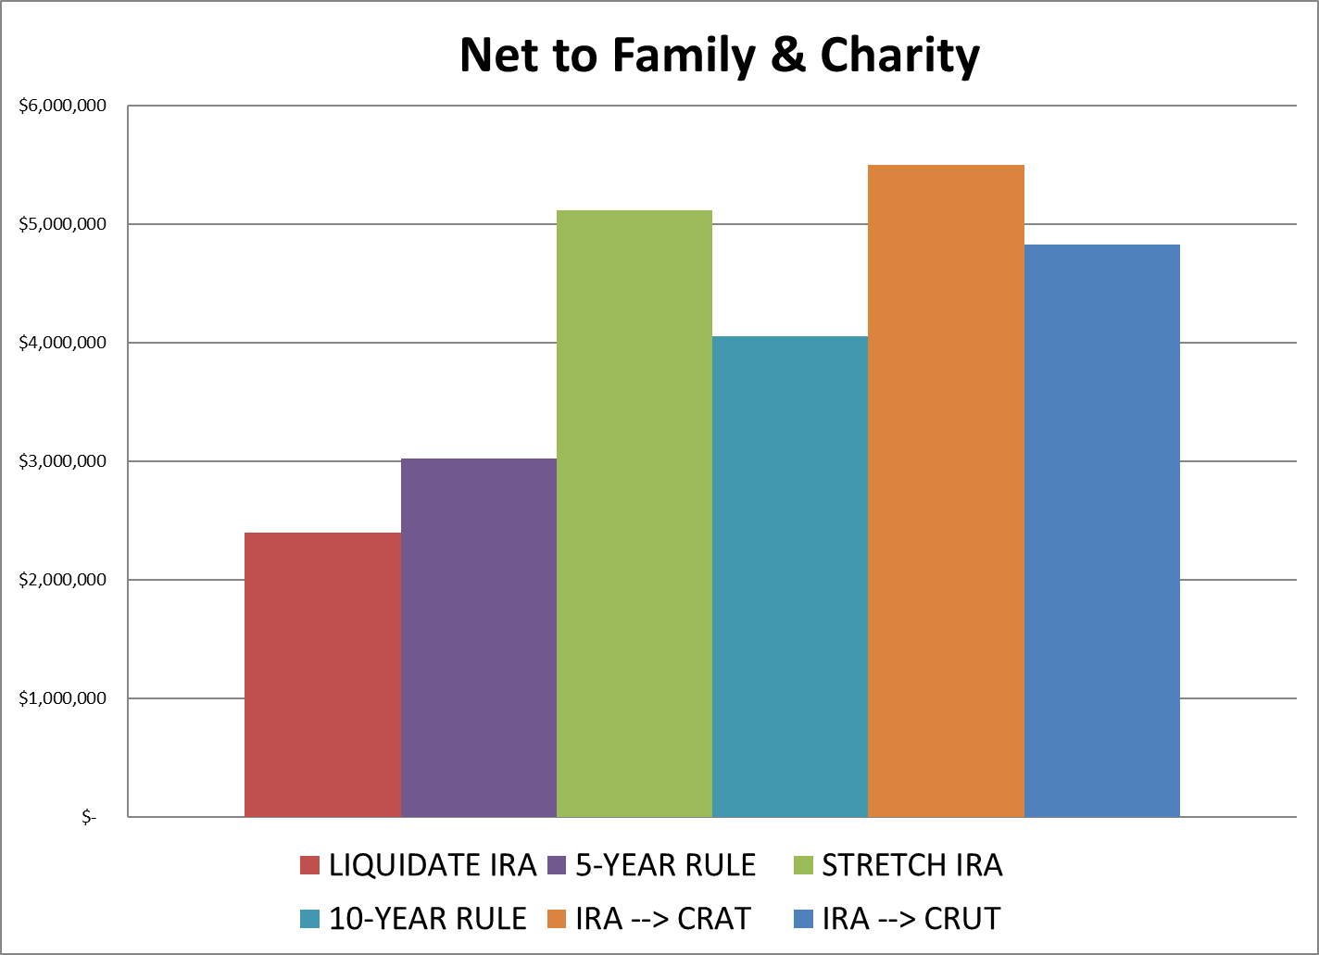
CRAT to Family and Charity*
*Provided by Keebler Tax & Wealth Education

Slide 84
QCD Issues

Slide 85
QCD Rules Still at 70.5
Qualified Charitable Distributions didn’t change
Allowed at 70.5
Still should be deductible at 70.5
Won’t offset any RMDs at 70.5 and 71
Issues with deductible contributions – offset provision
Remember no QCD to DAF!
Notes:
Qualified charitable distributions didn’t change.

Slide 86
Non-Deductible Benefit
QCDs are impacted by deductible after 70.5
Reduces QCD available
Could cost you in taxes to deduct contribution instead of offsetting the RMD
After-tax for those using QCDs are better in some situations
Notes:
Jamie will go over quick bullets on the back-door Roth

Slide 87
QCD Offset Provision Example
2023 – contribute $7,000 deductible to IRA at 70.5
2024 – additional $7,000 deductible to IRA at 71.5
Total of $14,000 deductible after 70.5
Does QCD in 2025 of $10,000
However, the $10,000 of QCD offset by the $14,000 deductible so none of the $10,000 will be deductible or offset RMDs
If itemizing, you can deduct as itemized contribution to charity
Do another $10,000 QCD in 2026, $4,000 offset by previous deduction, $6,000 still allowed as QCD

Slide 88
Action Items

Slide 89
SECURE Act Planning
Review beneficiaries
Consider life insurance needs
Review trust language
Understand children or spouses that have spending/bankruptcy risks
Charitable remainder trusts could have a bigger role
Roth planning is huge
Keep preparing for changes in income planning (The WIND)
Notes:
These are the seven things people need to consider under the SECURE Act.

Slide 90
Best Practices for Financial Planning
There isn’t always a “best”
There is, however, meaningful planning
Build a plan around your goals
Build flexibility in your plan for the future
Have someone looking out for the changes that are coming
Notes:
[Review slide]

Slide 91
Jamie Hopkins, Esq.
MBA, CFP®, LLM, CLU®, ChFC®, RICP®
To Contact for Speaking Requests:
jhopkins@carsongroup.com
WEBSITE
www.hopkinsretirement.com

Slide 92
Additional Disclosures
Securities offered through Cetera Advisor Networks LLC, Member FINRA/SIPC. Investment advisory services offered through CWM, LLC, an SEC Registered Investment Advisor. Cetera Advisor Networks LLC is under separate ownership from any other named entity. Carson Partners, a division of CWM, LLC, is a nationwide partnership of advisors.
Please note not all advisors affiliated or using the name of Carson Wealth offer securities through Cetera Advisor Networks LLC, Member FINRA/SIPC, or offers investment advisory services through CWM, LLC. Please visit your advisor’s website for information related to specific advisors for more disclosures related to which firms they offer securities business through, if any, or which firm they offer advisory services through.
Carson Wealth is the marketing name for investment advisory services offered through Spectrum Management Group, LLC, an SEC Registered Investment Advisor. Spectrum Management Group, LLC is affiliated with CWM, LLC, an SEC Registered Investment Advisor through common ownership by Carson Group Holdings, LLC.
This presentation is designed to provide accurate and authoritative information on the subjects covered. It is not, however, intended to provide specific legal, tax, or other professional advice. For specific professional assistance, the services of an appropriate professional should be sought.
Some IRA's have contribution limitations and tax consequences for early withdrawals. For complete details, consult your tax advisor or attorney. Distributions from traditional IRA's and employer sponsored retirement plans are taxed as ordinary income and, if taken prior to reaching age 59 ½, may be subject to an additional 10% IRS tax penalty. Converting from a traditional IRA to a Roth IRA is a taxable event. A Roth IRA offers tax free withdrawals on taxable contributions. To qualify for the tax-free and penalty-free withdrawal or earnings, a Roth IRA must be in place for at least five tax years, and the distribution must take place after age 59½ or due to death, disability, or a first time home purchase (up to a $10,000 lifetime maximum). Depending on state law, Roth IRA distributions may be subject to state taxes. If you are purchasing an annuity to fund any tax-qualified retirement plan (IRA), you should be aware that this tax-deferral feature is available with any investment vehicle and is not unique to an annuity. Carefully consider the features and benefits of the annuity before making the decision to purchase.
Converting from a traditional IRA to a Roth IRA is a taxable event.
The hypothetical investment results are for illustrative purposes only and should not be deemed a representations of past or future results. Actual investment results may be more or less than those shown. This doe snot represent any specific product [and/or service].
This event is purely educational. No products or services will be offered for sale and there is no obligation.
Notes:
For the RIA-only version of all presentations associated with case, the tax and legal disclosure which is already included will suffice.
For B/D-RIA versions of the all presentations associated with the case, please replace the existing tax and legal disclosure with the following disclosure:
For a comprehensive review of your personal situation, always consult with a tax or legal advisor. Neither Cetera Advisor Networks LLC nor any of its representatives may give legal or tax advice.

Slide 93
SECURE Act and Stretch IRA Planning

