Slide 1
RMD Planning in 2020 After the CARES & SECURE Acts
Address 1
Address 2
City, ST 00000
Replace With Logo
LPL Compliance Approval # 1-05023721
Notes:
Hello and welcome to this client update on RMD planning in 2020 after the CARES and SECURE Acts. We are thankful you could take the time to join us today.
Today we are going to go over the basics of the changes and why it is so important we engage in proactive planning in 2020.

Slide 2
Overview
RMD Overview
SECURE Act RMD Changes
2020 RMD Changes
2020 Planning Opportunities
Conclusion
Notes:
We will go through some baseline pieces of RMDs.
Then, we will go into the areas of changes with the SECURE Act RMD Changes. We’ll talk about options on how to help adjust financial plans to these new rules.

Slide 3
RMD Overview
Notes:
Let’s first dive into some RMD basics.

Slide 4
RMD Basics
RMD – Required Minimum Distributions or a.k.a. MRDs – Minimum Required Distributions
Govt gave tax benefits to tax-advantaged retirement accounts
But, wants its money at some point (TAXES)
RMDs either while alive or at death
Essentially just forced distributions
Complex rules
Notes:
RMD – Required Minimum Distributions or a.k.a. MRDs – Minimum Required Distributions. Throughout the presentation we will just refer to RMD.
What are RMDs?
Essentially your retirement accounts are required by law to have minimum distributions once you reach a certain age. In the past, the RMD age was 70.5, it has changed to 72.
When you put money into an IRA or 401(k), the government gives you a tax benefit: a tax-deductible contribution. You put money in, deduct it from income, and do not pay taxes until you take the money out. Because the government will need to collect the taxes at some point, they have required distributions.

Slide 5
When do RMDs start?
Age 70.5 or retired by end of 2019 (not 5% owner)
2020 and onward at age 72 or retired (not 5% owner)
After account owner dies
Notes:
When do RMDs start?
Your first RMD from an IRA or retirement plan is required when you reach 72 (age 70-1/2 if you reached this age before January 1, 2020). However, if you are still working, you can delay taking your RMD from your current plan until the year you retire (if allowed by your plan and you own less than 5% of the company).
Another time when the RMD would start is with the inherited retirement accounts which are more complex and the distribution rules change depending on situation.

Slide 6
Accounts Subject to RMDs
Retirement Accounts:
Traditional IRAs
SEP IRAs
SIMPLE IRAs
Inherited IRAs
401(k)s, 403(b)s, and 457(b)s
Inherited 401(k)s, 403(b)s, and 457(b)s
Federal Thrift Savings Program subject to RMDs but slightly different rules
HSAs/529s also subject to special at-death rules
Roth IRAs not subject to lifetime rules, just at-death RMDs
Roth Accounts are subject to RMD rules
Notes:
What accounts are subject to RMDs?
The usual traditional accounts, and then there are some accounts that have RMDs rules at the time of death. [Read retirement accounts from slide]
There are other types of plans that are subject to RMDs, but rules at time of death apply. [Read slide]
Roth accounts are subject to traditional RMD rules.

Slide 7
Simple Calculation for RMD
To calculate RMDs, use the following formula for each account:
Account Balance as of December 31 last year
÷
Life Expectancy Factor see the Uniform Lifetime Table for the age you turn this year
= Your RMD
Notes:
If you calculate one account at a time it makes it less complicated.
Account balance of previous year determines this year’s RMD, then you divide that by the Life Expectancy Factor table published by the IRS.

Slide 8
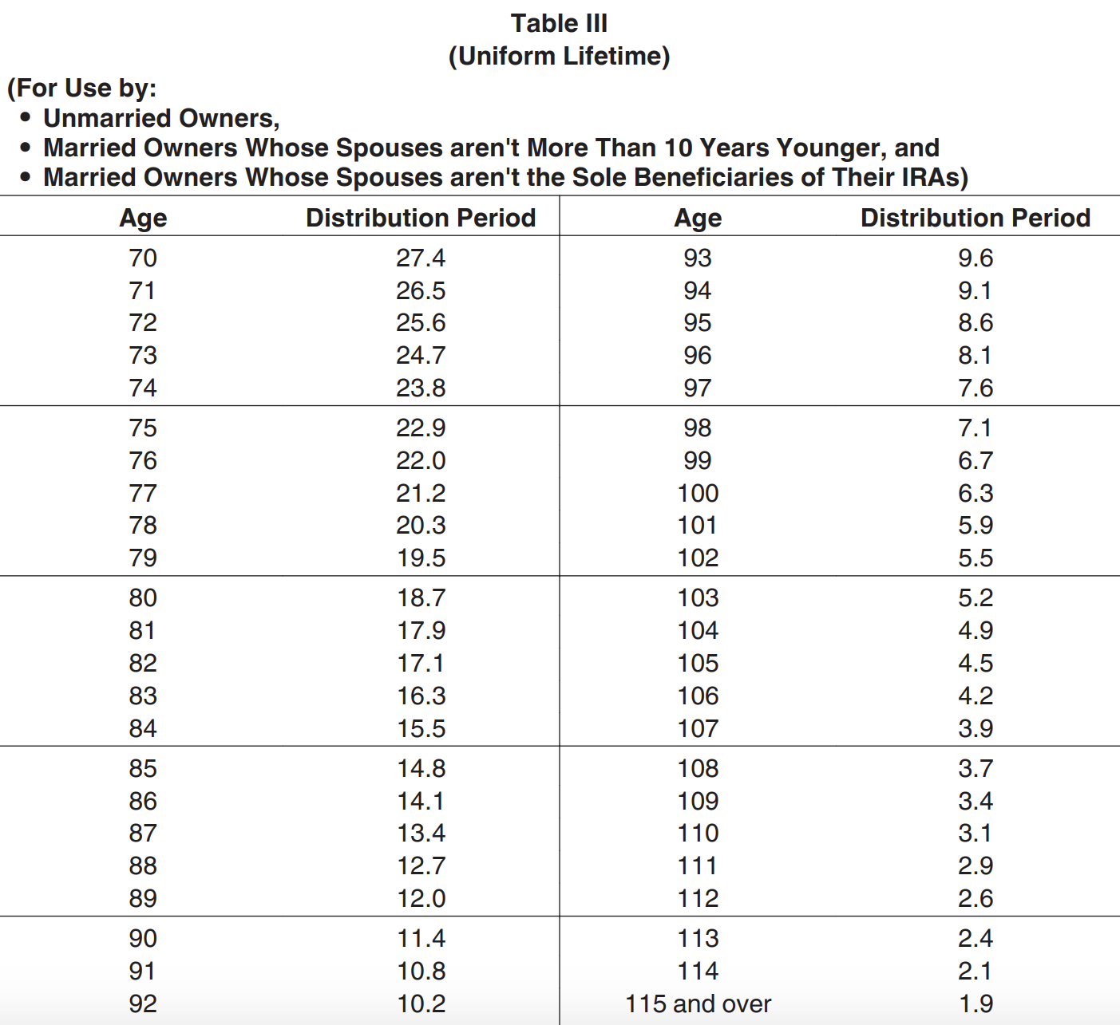
IRS Life Factor Tables
Notes:
Life Factor Table (Table 3), which helps to calculate RMD, is more often used. There are two other tables: one for inherited and the other if one of the spouses is 10 years younger or older than the other.

Slide 9
RMD Calculation Example
Age 72 (according to the table, use Distribution Period 25.6)
Account Balance as of December 31 last year was $500,000
$500,000 ÷ 25.6 = $19,531.25 (RMD due for this year)
This example is for illustrative purposes only.
Notes:
Let’s use age 72 as an example. We have used a round number for easier calculation purposes.
Take the account balance as of December 31 of last year, divide by 25.6, and this equals $19,531.25.
This is the required amount you need to take out for the year. If you miss taking out this distribution, there is a plenty tax of which we do not want to occur.

Slide 10
First RMD Due
April 1 in the year after you reach age 72
If you turn age 72 in 2021, your first RMD is due by April 1, 2022
This RMD is for year 2021, so calculate it on the ending balance as of December 31, 2020
Second RMD is still due by the end of 2022
Notes:
Let’s look at when the RMDs start.
If you turn 72 in 2021, the first RMD is due April 1, 2022 and it will be calculated based on the ending balance as of December 31, 2020.
While you can wait until 2022, note you will still owe another RMD for that following year.
It’s not always best to push the RMD out to the latest possible date.

Slide 11
Taxation of RMDs
Generally speaking, prorated taxation with basis
Most accounts are fully tax-deferred with IRAs and 401ks
This means, taxation of full distribution amount as ordinary income
Missed RMDs are subject to 50% penalty tax
Notes:
Most people have RMDs taxed as ordinary income.
Two RMDs in the same year can raise those taxes unnecessarily because it creates two ordinary income events in one year.
Additional 50% penalty tax is applied for a missed RMD. Penalty tax is severe, so you do not want to miss an RMD. There is a process to walk through to fix missed RMDs, if that is a situation you are in. So, be sure to reach out to us to see how we might be able to assist you.

Slide 12
SECURE Act
Impact on RMDs
Notes:
We now shift our focus to the SECURE Act and RMDs.
It is very important to be proactive, not reactive.

Slide 13
SECURE Act – 2019
SECURE Act – Setting Every Community Up For Retirement Enhancement Act (2019)
Passed House 417-3 in June 2019
Got derailed for months
Attached to Appropriations Bill in December 2019 – Passed House on Tuesday, December 17
Notes:
Here’s a look at how this all led up to today.
[Read slide]
This is biggest piece of financial planning legislation since 2006.
At the end of 2019 we had a new law and we were all left to adjust in very little time.

Slide 14
Two Major RMD Changes
Age 72 instead of age 70.5 (starting in 2020)
Removal of Stretch RMDs for many inherited retirement accounts
Notes:
The SECURE Act pushed back the RMD beginning dates.
Again, if you reached 70.5 in 2019, you are still under the old rules.
The next, and really the biggest, piece of the SECURE Act is the removal of “Stretch RMDs,” which were a common strategy for inherited retirement accounts. In the past if you left an IRA to your child, they could take distributions on their own life expectancy when they inherited the account, giving a 30-year-old 30-40 years to take distributions.

Slide 15
10-Year Provision
Most non-spouse designated beneficiaries must distribute the entire inherited IRA or DC account by the end of the 10th year following the year of death of the owner.
Notes:
[Read slide]
This part of the SECURE Act essentially generates tax revenue by eliminating the stretch provision and requiring the entire amount to be distributed in a shorter time frame.

Slide 16
IRA Beneficiaries After the SECURE Act
*Minor children are eligible to take distributions using the life expectancy rules until they reach the age of majority at which time the remaining balance must be distributed within the 10-year period.
Notes:
This is a nice graphic to show the changes from the SECURE Act:
The middle column covers most non-spouse beneficiaries.
The left column shows exceptions – note the spousal exception.
Minor children are excluded, but not minor grandchildren, nieces, and nephews, etc.
The right column designates other exceptions.

Slide 17
Some Big Exceptions Still
The 10-year distribution requirement generally does not apply if the designated beneficiary is an eligible beneficiary.
Eligible beneficiary is defined as any beneficiary who, as of the date of death, is a surviving spouse, disabled, or chronically ill, or is an individual who is not more than 10 years younger than the employee (or IRA owner), or is a child of the employee (or IRA owner) who has not reached the age of majority.
Effective for those who die after December 31, 2019 and December 31, 2021 for government plans.
Notes:
There are exceptions to the 10-year distribution requirement.
[Summarize slide]

Slide 18
Who Isn’t Exempt?
Grandchildren don’t appear to be exempt
This means a 10-year-old grandchild would have 10 years to deplete the account
This is not a good outcome!
Notes:
This is interesting. Unfortunately, grandchildren don’t seem to be exempt no matter their age.
[Read slide]

Slide 19
Stretch vs. 10-Year Example
75-year-old parent passes away
Leaves IRA to 45-year-old child – 38.8 years for life factor
IRA worth $1,000,0000
RMD Year 1 – $100,000 after SECURE Act vs. $25,773 under Stretch
Notes:
This is just an example. While it is accurate, we are making a lot of assumptions.
In this example, you can see that Year 1 alone is about a $74,000 difference with the changes and no annual RMDs are required as it is assuming $100,000 was chosen as the Year 1 distribution amount for the 10 years.
This can alter an individual's tax situation pretty rapidly.

Slide 20
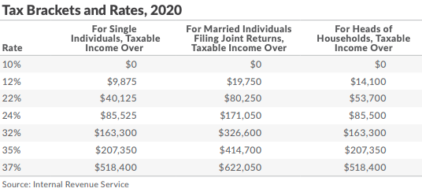
Your 2020 Individual Tax Brackets
https://taxfoundation.org/2019-tax-brackets/
Notes:
This is the 2020 individual tax bracket.
This visual aid outlines the income tax brackets and how the changes impact your tax bracket.

Slide 21
Stretch – Keep It Kathy
(Example Illustration)
Kathy inherits a $1 Million IRA under stretch rules
45 years old – income of $130,000 a year
24% tax bracket Marginal
With $25,773 of extra income, goes to $155,773, stays in 24%
Effective Rate in 18% range
Total income taxes at state level (PA assumption at 3%) roughly $43,000
PA = Pennsylvania is used in this example
Notes:
Let’s use an example to illustrate how this plays our with the stretch rules.
[Read slide]

Slide 22
10-Year Payout – Pay Out Penny
(Example Illustration)
Penny inherits a $1 Million IRA under 10-year rule
45 years old – income of $130,000 a year
24% tax bracket Marginal
With $100,000 of extra income, goes to $230,000, goes to 35% Marginal Rage up from 24%
Effective Rate 22.3% up from 18%
Total income taxes at state level (PA assumption at 3%) roughly $70,000 up from $43,000 = $27,000 more in taxes
PA = Pennsylvania is used in this example
Notes:
[Read slide]
In this example, Penny chose to take $100,000 as her first distribution for this year as she has the option to choose how much and when she takes a distribution within that 10-year period.
[Call-out the changes in taxes from Kathy to Penny’s example]
You can see in this example how the change can push people into higher tax brackets and end up costing the beneficiary a lot.
This is how the bill was designed to be a tax revenue generator.

Slide 23
What End of Stretch Means
End of Stretch IRA means three basics things:
Higher taxes for many people
Less tax-deferred growth of account
Higher MAGI and Taxable Income can cause loss of benefits or higher taxes in other areas
Notes:
There are major but straight-forward hurdles that come with the end of the Stretch IRA. You could lose Affordable Care Act subsidies or have higher Medicare premiums or other issues that arise from higher taxable income.

Slide 24
CARES Act Impact on RMDs
Notes:
Ensure you review your beneficiary designation and review how this changes the inheritance situation with your advisor.
Now, fast forward, we lost sight of planning because our world has abruptly changed. The government comes out with the CARES Act to put money back in the economy.

Slide 25
CARES Act – Two Main Impacts
New Distribution Option for 2020
No RMDs for 2020
Notes:
There is a new distribution option for 2020 called the Coronavirus-related distribution.
Now, the most important thing, in most situations the RMDs for 2020 have been waived.

Slide 26
Coronavirus-Related Distribution Exception
Notes:
Let’s shift focus a bit to some of the retirement related distribution changes in the CARES Act starting with the Coronavirus-Related Distribution (CRD) exception.

Slide 27
72(t) Penalty Tax
10% penalty
Pre-59.5 taxable distributions
Unless there is an exception
Notes:
[Read slide]
The 72(t) Penalty Tax is an early withdrawal penalty tax that is levied onto pre-59.5 distributions from retirement accounts unless you have another exception.

Slide 28
2020 Coronavirus-Related Distribution Exception
Exception of 10% penalty for certain distributions in 2020 for up to $100,000 of distributions in 2020
What plans get relief?
401(a) – defined contribution plans (401(k) included
403(b) plans
457(b) governmental plans
408 Individual Retirement Account or Annuity (IRA)
Notes:
A new exception was created by the CARES Act – the 2020 Coronavirus-Related Distribution exception applies to a number of retirement plans such as:
401(a) – defined contribution plans (401(k) included
403(b) plans
457(b) governmental plans
408 Individual Retirement Account or Annuity (IRA)

Slide 29
Individual Qualifications
Individual or spouse or dependent must be diagnosed with SARS-CoV-2 or COVID-19,
Or an individual must experience:
“…adverse financial consequences from being quarantined, furloughed, laid off, or having work hours reduced because of:
the virus or disease;
being unable to work because of a lack of childcare because of the virus or disease; or
closing or reducing hours of, because of the virus or disease, a business the person owned or operated; or
other factors set by the Secretary of the Treasury."
Plan administrator may rely upon claimant’s written statement that he or she qualifies
Notes:
To be eligible for the new exception, an Individual or spouse or dependent must be diagnosed with SARS-CoV-2 or COVID-19, or an individual must experience:
“…adverse financial consequences from being quarantined, furloughed, laid off, or having work hours reduced, because of the virus or disease; being unable to work because of a lack of childcare because of the virus or disease; or closing or reducing hours of, because of the virus or disease, a business the person owned or operated; or other factors set by the Secretary of the Treasury."

Slide 30
2020 Coronavirus-Related Distribution Exception
Coronavirus-related distribution can be an eligible rollover distribution
Plan is not required to give a rollover notice, need not provide for direct rollover, and need not withhold 20%
Taxation:
Income from distribution spread out over next three tax years (auto)
Can opt to have all tax treated in 2020
Notes:
Interestingly, the new CRD exception can be eligible for rollover, and the taxes can be spread out over three years or all included in 2020 taxes.

Slide 31
Can Be Repaid
From date of distribution and then three years after the date of distribution
Distribution can be repaid
Treated as if repaid within 60 days in 2020
If you repay in 2022, you’d likely have to amend 2020 tax return to get benefits back
Notes:
Additionally, the CARES Act allows for the CRD to be repaid from three years after the date of distribution.
If it is repaid, it is treated as if it were a 60-day rollover in 2020 so it would be as if there was no distribution at all.
If you wait a few years to repay, you would likely have to amend your 2020 tax returns to get the tax benefits back.

Slide 32
CRD Example
Take $90,000 out on May 15 of 2020
$30,000 taxable in 2020, $30,000 taxable in 2021, and $30,000 taxable in 2022
In 2022, you decide to repay all $90,000 on May 10, 2022 (have 3 years to repay)
File amended returns for 2020 and 2021 showing $30,000 less income each year (get taxes paid back)
Treated as a rollover – can also be repaid in multiple payments/years
Notes:
Here is an example of what the repayment might look like.
[Read slide]

Slide 33
2020 Distributions
Appears many 2020 distributions might fall into the relief
Expect the provision to be read broadly
But must still qualify – working individuals it is clearer; retirees might be harder to qualify
Many distributions can be repaid over the next 3 years
Notes:
Because this is a very board exception, it is likely many 2020 distributions would apply for the CRD exception and could be repaid.
This means this provision may have a lasting planning impact for anyone taking out money in 2020.
For retirees, it could be harder to qualify unless you are still working, cut from work, or get diagnosed with the COVID-19 virus.

Slide 34
2020 RMD Waiver
Notes:
Now let’s shift gears and look at the RMD changes in 2020.

Slide 35
Skip RMDs for 2020
RMDs essentially suspended for 2020
Applies to most plans
No need to make up in future year
Notes:
Simply put, RMDs for IRAs and 401(k)s were suspended in 2020, not a push off, just suspended.
Remember that defined benefit plans are still subject to RMDs in 2020.

Slide 36
RMD Waiver for 2020
Applies to most plans:
IRAs
Inherited retirement accounts
Defined contribution plans
Notes:
This is the most common question we are getting. What if I already took money out? It is possible a 2020 distribution can be repaid, if you meet the qualifications.
In addition to traditional accounts, the waiver also applied to inherited defined contribution plans and IRAs. But again, defined benefit plans are not exempt from RMDs in 2020.

Slide 37
RMD Already Out?
No direct relief to get RMDs already taken back into plan early in 2020
60-day rollover now applies
Why? Distributions are not RMDs in 2020 so they can be rolled over
Past 60 days – issues remain
Multiple accounts – only one 60-day rollover per 12 months
Consider Coronavirus-Related Distribution:
If you qualify – likely can rollover by paying back
Notes:
So, what do you do if you took an RMD already? There are a few strategies to consider.
First, stop automatic distributions from your accounts for 2020 if you don’t need the money.
Second, if within 60 days of the distribution, you can do a 60-day rollover and send it back. Now you only have one IRA-to-IRA 60-day rollover each year.
If you qualify for the CRD exception, it’s possible you could pay back in 2020 or up to three years from now.

Slide 38
April 9th Update on Rollovers
Extended time-based tax actions until July 15, looking 60 days before (February 1, 2020)
Tax Day – July 15, extensions staying at October 15
If you took a February 1, 2020 IRA distribution of $100,000, you could roll that over to an IRA without tax consequences until July 15, 2020.
IRS: https://www.irs.gov/pub/irs-drop/n-20-23.pdf
Final notice on April 9, 2020: https://www.irs.gov/newsroom/irs-extends-more-tax-deadlines-to-cover-individuals-trusts-estates-corporations-and-others
Notes:
On April 9, 2020, new guidance came out from the IRS allowing an extension of the 60-day rollover rules going back to February 1.
If you took a distribution February 1 to April or May, you can roll this over within the 60-day rules until July 15 – the new tax return due date.
However, extension to file still remains at October 15, 2020, which there was some confusion about before.

Slide 39
January 2020 Distributions
No longer RMDs
But, passed 60-day mark
New IRS ruling doesn’t help either
Only real option to payback and rollover would be the Coronavirus-Related Distribution
Notes:
Many people take their RMDs in January and that makes this strategy trickier.
[Read slide]
Talk with us to dive into this to see if the CRD is an option for you.

Slide 40
Final Thoughts and Planning Opportunities
Notes:
There are a lot of details here and the strategies have changed.
Because the CARES Act is essentially eliminating RMDs for 2020, if you had them set-up, contact us to inquire about stopping them.
For some people, they may need them, which is fine.
Ensure you do your research and talk with your advisor.

Slide 41
RMD Planning
Freeze distributions
“Undo RMDs” for 2020
Review beneficiaries
Consider life insurance needs
Review trust language
Understand children or spouses that have spending/bankruptcy risks
Charitable remainder trusts could have a bigger role
Roth planning is huge
Keep preparing for changes in income planning
Notes:
These are the many things people need to consider under the SECURE Act.
[Read slide]
Review beneficiaries and strategies, especially in light of these recent changes and quarantine conditions.

Slide 42
Best Practices for Financial Planning
There isn’t always a “best”
There is, however, meaningful planning
Build a plan around your goals
Build flexibility in your plan for the future
Have someone looking out for the changes that are coming
Notes:
[Read slide]

Slide 43
Additional Disclosures
This material was prepared by Carson Coaching. Carson Coaching is not affiliated with any broker/dealer or firm.
This presentation is designed to provide accurate and authoritative information on the subjects covered. It is not, however, intended to provide specific legal, tax, or other professional advice. For specific professional assistance, the services of an appropriate professional should be sought.
For a comprehensive review of your personal situation, always consult a tax or legal advisor.
Some IRAs have contribution limitations and tax consequences for early withdrawals. For complete details, consult your tax advisor or attorney. Distributions from traditional IRAs and employer-sponsored retirement plans are taxed as ordinary income and, if taken prior to reaching age 59½, may be subject to an additional 10% IRS tax penalty. Converting from a traditional IRA to a Roth IRA is a taxable event. A Roth IRA offers tax free withdrawals on taxable contributions. To qualify for the tax-free and penalty-free withdrawal or earnings, a Roth IRA must be in place for at least five tax years, and the distribution must take place after age 59½ or due to death, disability, or a first-time home purchase (up to a $10,000 lifetime maximum). Depending on state law, Roth IRA distributions may be subject to state taxes. If you are purchasing an annuity to fund any tax-qualified retirement plan (IRA), you should be aware this tax-deferral feature is available with any investment vehicle and is not unique to an annuity. Carefully consider the features and benefits of the annuity before making the decision to purchase.
The S&P 500 is a capitalization-weighted index of 500 stocks designed to measure performance of the broad domestic economy through changes in the aggregate market value of 500 stocks representing all major industries.
The hypothetical investment results in this presentation are for illustrative purposes only and should not be deemed a representation of past or future results. Actual investment results may be more or less than those shown.
This does not represent any specific product and/or service.

Slide 44
Advisor’s Name
Company Name
Company Address
EMAIL ADDRESS
WEBSITE URL
B/D Disclosure
Replace With Logo

Slide 45
Thank You For Joining Us!
Replace With Logo
Notes:
Thank you for joining us!

