Slide 1
RMD Planning In 2020 After The CARES & SECURE Acts
Address 1
Address 2
City, ST 00000
Replace With Logo
Notes:
Hello and welcome to this client update on RMD planning in 2020 after the CARES and SECURE Acts. We are thankful that you could take the time to join us today.
Today we are going to go over the basics of the changes and why it is so important that we engage in proactive planning in 2020.

Slide 2
Overview
RMD Overview
SECURE Act RMD Changes
2020 RMD Changes
2020 Planning Opportunities
Conclusion
Notes:
We will go through soe baseline pieces of RMDs.
Then we will go into the areas of changes with the SECURE Act RMD Changes. Then talk about options on how to help adjust financial plans to these rules.

Slide 3
Current Market Update
Notes:
Let’s start with what’s happening in the markets and the U.S. economy.

Slide 4
RMD Overview
Notes:
Lets first dive into some of RMD basics.

Slide 5
RMD Basics
RMD – Required Minimum Distributions or aka MRDs Minimum Required Distributions
Govt gave tax benefits to tax-advantaged retirement accounts
But, wants its money at some point (TAXES)
RMDs either while alive or at death
Essentially just forced distributions
Complex rules
Notes:
RMD – Required Minimum Distributions or aka MRDs Minimum Required Distributions. Throughout the presentation we will just refer to RMD.
What are RMDs?
Essentially they are your retirement accounts that are required by law to have minimum distributions, once you reach a certain age. In the past, the RMD age was 70.5, it is changing to 72
When you put money into an IRA or 401K the government gives you a tax benefit, a tax deductible contribution. You put money in, deduct it from income and do not pay taxes until you take the money out. Because the government will need to collect the taxes at some point they have required distributions.

Slide 6
When do RMDs start?
Age 70.5 or retired by end of 2019 (not 5% owner)
2020 and onward age 72 or retired (not 5% owner)
After account owner dies
Notes:
When do RMDs start?
The first age, which has been the age for decades up until the end of 2019 has been 70 and a half. If you are retired your RMDs would start, unless you are still working and not a 5% owner of the company. However, if you have an IRA outside of your work, that IRA will still be subject to RMDs if you are not retired.
A big change, due to the Secure Act is the phasing to 72 yo beginningg in 2020
Another time when the RMD would start is with the inherited retirement accounts are more complex and the distribution rules change depending on situation.

Slide 7
Accounts Subject to RMDs
Retirement Accounts:
Traditional IRAs
SEP IRAs
SIMPLE IRAs
Inherited IRAs
401(k)s, 403(b)s, and 457(b)s
Inherited 401(k)s, 403(b)s, and 457(b)s
Federal Thrift Savings Program subject to RMDs but slightly different rules
HSAs/529s also subject to special at death rules
Roth IRAs not subject to lifetime rules just at death RMDs
Roth Accounts are subject to RMD rules
Notes:
What accounts are subject to RMDs?
The usual traditional accounts, and then there are some accounts that have RMDs at death. (read retirement accounts from slide)
There are other types of plans that subject to RMDs, but at death (read slide).
Roth accounts, a 401K Roth is subject to traditional RMD rules.

Slide 8
Simple Calculation for RMD
To calculate RMDs, use the following formula for each account:
Account Balance as of December 31 last year
÷
Life Expectancy Factor see the Uniform Lifetime Table for age you turn this year
= Your RMD
Notes:
If you calculate one account at a time it makes it less complicated.
Account balance of previous year determines this year’s RMD, then you divide that by the Life Expectancy Factor table is published by IRS

Slide 9
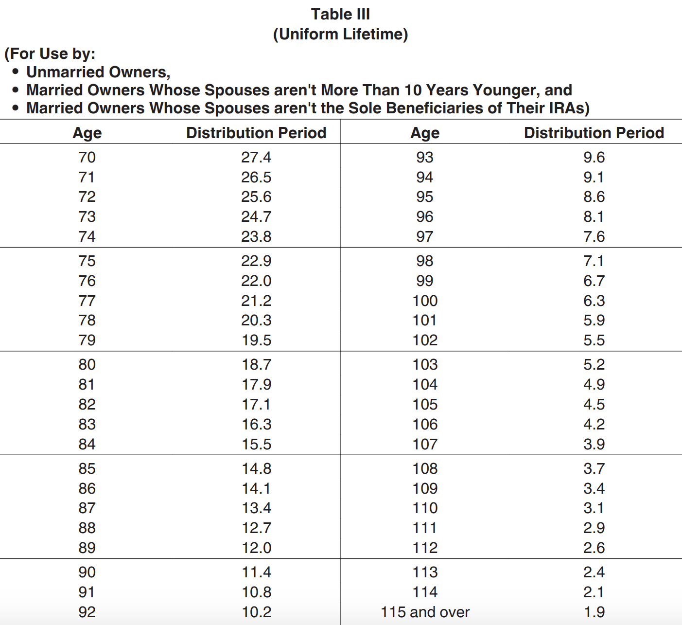
IRS Life Factor Tables
Notes:
Life Factor Table which helps to calculate RMD, this is table 3, which is more often used. There are two other tables, for inherited and if one of the spouses is 10 years younger or older than the other.

Slide 10
RMD Calculation Example
Age 72 – factor 25.6
Account Balance as of December 31 last year was $500,000
$500,000/25.6 = $19,531.25 is RMD due this year
Notes:
Let’s use age 72 as an example, we used a round number for calculation purposes. Take the account balance, divide by 25.6 and you get $19,531.25. That is the required to take out for the year. If you miss that there is a plenty tax, which we do not want to occur.

Slide 11
First RMD Due
April 1 year after you reach age (72)
Turn age 72 in 2021 – first RMD is due by April 1, 2022
This RMD is for year 2021, so calculate it on ending balance of Dec. 31, 2020
Second RMD still due by end of 2022
Notes:
Let’s look at when the RMDs start.
If you turn 72 in 2021, the first RMD is due April 1, 2011 and it will be calculated based on the ending balance of Dec 31, 2020.
While you can wait until 2022, note that you will still owe another RMD out for that following year.
It’s not always best to push that RMD out to the latest possible date

Slide 12
Taxation of RMDs
Generally speaking, prorated taxation with basis
Most accounts are fully tax-deferred with IRAs and 401ks
This means, taxation of full distribution amount as ordinary income
Missed RMDs are subject to 50% penalty tax
Notes:
Most people have them taxed as ordinary income
Two RMDs in the same year can raise those taxes unnecessarily because it creates two ordinary income events in one year.
Additional 50% penalty tax for a missed RMD. Penalty tax is severe, so you do not want to miss an RMD. There is a process to walk through to fix missed RMDs, if that is a situation you are in, be sure to reach out to me to see how we might be able to assist you.

Slide 13
SECURE Act
Impact on RMDs
Notes:
Summarize RMDs, shift focus to SECURE Act
It is very important to be proactive, not reactive.

Slide 14
SECURE Act – 2019
SECURE Act – Setting Every Community Up For Retirement Enhancement Act (2019)
Passed House 417-3 in June 2019
Got derailed for months
Attached to Appropriations Bill in December 2019 – Passed House on Tuesday, Dec. 17
Notes:
Here’s a look at how this all led up to today.
(read slide)
This is biggest piece of financial planning legislation since 2006.
At the end of the year we had a new bill and we were all left to adjust in very little time.

Slide 15
Two Major RMD Changes
Age 72 instead of age 70.5 (starting in 2020)
Removal of Stretch RMDs for many inherited retirement accounts
Notes:
- Push back of RMD beginning dates. Again, if you reached 70.5 in 2019, you are under the old rules.
- The next and really the biggest piece of the secure act is the removal of “stretch RMDs” which were a common strategy for inherited retirement accounts. In the past if you left an IRA to your child, they could take distrubitons on their own life expectancy when they inherited the account, giving a 30 year old 30-40 years to take distributions.

Slide 16
10 Year Stretch Provision
Designated beneficiaries must distribute the entire inherited IRA or DC account by the end of the 10th year following the year of death of the owner.
Notes:
Now…(read slide)
The SECURE is a tax revenue bill essentially, by reducing down the stretch provision and increasing the amount of RMDs that must come out of inherited retirement accounts.

Slide 17
IRA Beneficiaries After the SECURE Act
Notes:
This is a nice graphic to show the changes from the SECURE Act.
The middle column covers most people involved.
Lefthand column shows exceptions, note the spousal exception
Minor children are excluded, but not minor grandchildren, nieces and nephews, etc.
Righthand column designates other exceptions.

Slide 18
Some Big Exceptions Still
The 10-year distribution requirement generally does not apply if the designated beneficiary is an eligible beneficiary.
Eligible beneficiary is defined as any beneficiary who, as of the date of death, is a surviving spouse, disabled, or chronically ill, or is an individual who is not more than 10 years younger than the employee (or IRA owner), or is a child of the employee (or IRA owner) who has not reached the age of majority.
Effective for those who die after Dec 31, 2019 and Dec 31, 2021 for government plans
Notes:
There are exceptions to the 10-year distribution requirement.
(summarize slide)

Slide 19
Who isn’t exempt?
Grandchildren don’t appear to be exempt
That means a 10-year-old grandchild would have 10 years to deplete the account
That is not a good outcome!
Notes:
This is interesting.
Unfortunately, grandchildren don’t seem to be exempt no matter the age.
(read slide)

Slide 20
Stretch vs. 10-Year Example
75-year-old parent passes away
Leaves IRA to 45-year-old child – 38.8 years for life factor
IRA worth $1,000,0000
RMD year 1 – $100,000 after SECURE vs. $25,773 under Stretch
Notes:
This is just an example, while accurate we are making a lot of assumptions.
So in this example, you can see that Year 1 alone is about a $74,000 difference with the changes.
That can alter an individual's tax situation pretty rapidly.

Slide 21
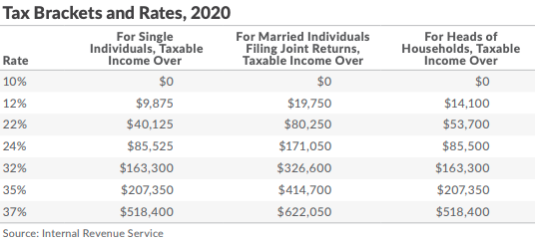
Your 2020 Individual Tax Brackets
https://taxfoundation.org/2019-tax-brackets/
Notes:
This is the 2020 individual tax bracket.
Visual aid outlining income tax brackets and how the changes impact your tax bracket.

Slide 22
Stretch – Keep It Kathy
$1 Million IRA inherited under stretch rules
45-year-old, Katherine – income of $130,000 a year
She’s in the 24% tax bracket Marginal
With $25,773 of extra income, goes to $155,773, stays in 24%
Effective Rate in 18% range
Total income taxes at state level (PA assumption at 3%) roughly $43,000
Notes:
Let’s use an example to illustrate how this plays our with the stretch rules.
(read slide)

Slide 23
10 Year Payout – Pay Out Penny
$1 Million IRA inherited under 10 year rule
45-year-old, Penny, – income of $130,000 a year
She’s in the 24% tax bracket Marginal
With $100,000 of extra income, goes to $230,000, goes to 35% Marginal Rage up from 24%
Effective Rate 22.3% up from 18%
Total income taxes at state level (PA assumption at 3%) roughly $70,000 up from $43,000 = $27,000 more in taxes
Notes:
(read slide)
(Callout the changes in taxes)
You can see in this example how the change can push people into higher tax brackets and end up costing the beneficiary a lot.
This is how the bill was designed to be a tax revenue generator.

Slide 24
What End of Stretch Means
End of Stretch IRA means three basics things:
Higher taxes for many people
Less tax-deferred growth of account
Higher MAGI and Taxable Income can cause loss of benefits or higher taxes in other areas
Notes:
There are major but straight-forward hurdles that come with the end of the stretch IRA. You could lose Affordable Care Act subsidies or have higher Medicare premiums or other issues that arise from higher taxable income.

Slide 25
CARES Act Impact on RMDs
Notes:
Make sure you review your beneficiary designation and review how this changes the inheritance situation with your advisor.
Now, fast forward, we lost sight of planning some because our world has abruptly changed. The government comes out with the CARES Act to put money back in the economy.

Slide 26
CARES Act Two Main Impacts
New Distribution Option for 2020
No RMDs for 2020
Notes:
There is a new distribution option for 2020 called the Corona Virus related distribution.
Now, the most important thing, in most situations the RMDs for 2020 have been waived.

Slide 27
Coronavirus Related Distribution Exception
Notes:
Now let’s shift focus a bit to some of the retirement related distribution changes in the CARES Act – starting with the coronavirus related distribution exception.

Slide 28
72(t) Penalty Tax
10% penalty
Pre-59.5 taxable distributions
Unless there is an exception
Notes:
(read slide)
The 72(t) Penalty Tax is an early withdrawal penalty tax that is levied onto pre-59.5 distributions from retirement accounts unless you have another exception.

Slide 29
2020 Coronavirus Related Distribution Exception
Exception of 10% penalty for certain distributions in 2020 for up to $100,000 of distributions in 2020
What plans get relief?
401(a) – defined contribution plans (401(k) included)
403(b) plans
457(b) governmental plans
408 Individual Retirement Account or Annuity (IRA)
Notes:
A new exception as created by the CARES Act – the 2020 coronavirus related distribution exception = this exception applies to a number of retirement plans such as
401(a) – defined contribution plans (401(k) included)
403(b) plans
457(b) governmental plans
408 Individual Retirement Account or Annuity (IRA)

Slide 30
Individual Qualifications
Individual or spouse or dependent must be diagnosed with SARS-CoV-2 or COVID-19
Or individual must experience
“adverse financial consequences from being quarantined, furloughed, laid off, or having work hours reduced, because of:
the virus or disease,
being unable to work because of a lack of childcare because of the virus or disease, or
closing or reducing hours of, because of the virus or disease, a business the person owned or operated; or
other factors set by the Secretary of the Treasury."
Plan administrator may rely upon claimant’s written statement that he or she qualifies
Notes:
To be eligible for the new exception an Individual or spouse or dependent must be diagnosed with SARS-CoV-2 or COVID-19
Or individual must experience
“adverse financial consequences from being quarantined, furloughed, laid off, or having work hours reduced, because of:
· the virus or disease,
· being unable to work because of a lack of childcare because of the virus or disease, or
· closing or reducing hours of, because of the virus or disease, a business the person owned or operated; or
· other factors set by the Secretary of the Treasury."

Slide 31
2020 Coronavirus Related Distribution Exception
Coronavirus related distribution can be an eligible rollover distribution
Plan not required to give a rollover notice, need not provide for direct rollover, and need not withhold 20%
Taxation:
Income from distribution spread out over next three tax years (auto)
Can opt to have all tax treated in 2020
Notes:
Interestingly, the new CRD can be eligible for rollover, the taxes can be spread out over three years or all included in 2020 taxes.

Slide 32
Can Be Repaid
From date of distribution and then three years
Distribution can be repaid
Treated as if repaid within 60 days in 2020
If you repay in 2022, you’d likely have to Amend 2020 tax return to get benefit back
Notes:
Additionally the CARES act allows for the CRD to be repaid from three years after the date of distribution – if it is repaid it is treated as if it were a 60-day rollover in 2020 so as if there was no distribution at all. If you wait a few years to repay you would likely have to amend your 2020 tax returns to get the tax benefits back.

Slide 33
CRD Example
Take $90,000 out on May 15th of 2020
$30,000 taxable in 2020, $30,000 taxable in 2021, and $30,000 taxable in 2022
In 2022, you decide to repay all $90,000 on May 10th, 2022 (have 3 years to repay)
File amended returns for 2020 and 2021 showing $30,000 less income each year (get taxes paid back)
Treated as a rollover – can also be repaid in multiple payments/years
Notes:
Here is an example of what this might look like
(read slide)

Slide 34
2020 Distributions
Appears that many 2020 distributions might fall into the relief
Expect the bill to be read broadly
But, must still qualify – working individuals it is clearer, retirees might be harder to qualify
Many distributions can be repaid over the next 3 years
Notes:
Because this is a very board exception its likely that many 2020 distributions would apply for the CRD exception and could be repaid. This means this provision of the bill will have a lasting planning impact for anyone taking out money in 2020. For retirees, it could be harder to qualify for unless you are still working, cut from work, or get diagnosed with the covid-19 virus.

Slide 35
2020 RMD Waiver
Notes:
Now let’s shift gears and look at the RMD changes in 2020.

Slide 36
Skip RMDs for 2020
RMDs essentially suspended for 2020
Applies to most plans
No need to make up in future year
Notes:
Simply put RMDs for IRAs and 401(k)s were suspended in 2020, no push off, just suspended. However, remember that defined benefit plans are still subject to RMDs in 2020.

Slide 37
RMD Waiver for 2020
Applies to most plans:
IRAs
Inherited retirement accounts
Defined contribution plans
Notes:
This is the most common question we are getting. What if I already took money out? It is possible that a 2020 distribution can be repaid, if you meet the qualifications.
IN addition to traditional accounts the waiver also applied to inherited DC and IRAs. But again, defined benefit plans are not exempt from RMDs in 2020.

Slide 38
RMD Already Out?
No direct relief to get RMDs already taken back into plan early in 2020
60-day rollover now applies
Why? Distributions are not RMDs in 2020 so can be rolled over
Past 60 days – issues remain
Multiple accounts – only one 60-day rollover per 12 months
Consider Coronavirus Related Distribution:
If you qualify – likely can rollover by paying back
Notes:
So what do you do if you took an RMD already? There are a few strategies to consider. First, stop automatic distributions from you accounts for 2020 if you don’t need the money. Second, if within 60 days of the distribution you can do a 60-day rollover and send it back. Now you only have one IRA to IRA 60-day rollover each year. If you qualify for the CRD exception its possible you could pay back in 2020 or up to three years from now.

Slide 39
April 9th Update on Rollovers
Extended time-based tax actions until July 15, looking 60 days before (February 1, 2020)
Tax Day – July 15, extensions staying at October 15
If you took a February 1, 2020 IRA distribution of $100,000 you could roll that over to an IRA without tax consequences until July 15, 2020.
IRS https://www.irs.gov/pub/irs-drop/n-20-23.pdf - final notice on April 9 - https://www.irs.gov/newsroom/irs-extends-more-tax-deadlines-to-cover-individuals-trusts-estates-corporations-and-others
Notes:
Just on April 9th new guidance came out from the IRS allowing an extension of the 60-day rollover rules going back to Feb 1. So if you took a distribution on Feb 1 to April or May you can roll this over within the 60 day rules out until July 15, the new tax return due date. However, extension to file still remains at October 15th now, which there was some confusion about before.

Slide 40
January 2020 Distributions
No longer RMDs
But passed 60-day mark
New IRS ruling doesn’t help either
Only real option to payback and rollover would be the Coronavirus Related Distribution
Notes:
Many people take their RMDs in January, and that makes this strategy trickier.
(read slide)
Talk with me to dive into this to see if the CRD is an option for you.

Slide 41
Final Thoughts and Planning Opportunities
Notes:
There are a lot of details here and the strategies have changed.
Because the CARES Act is essentially eliminating RMDs for 2020, if you had them setup contact us to inquire about stopping them, but some people may need them, which is fine.
Make sure you do your research and talk with your advisor.

Slide 42
RMD Planning
Freeze distributions
“Undo RMDs” for 2020
Review beneficiaries
Consider life insurance needs
Review trust language
Understand children or spouses that have spending/bankruptcy risks
Charitable remainder trusts could have a bigger role
Roth planning is huge
Keep preparing for changes in income planning
Notes:
These are the many things people need to consider under the SECURE Act.
(read slide)
Review beneficiaries and strategies, especially in light of these recent changes and quarantine conditions.

Slide 43
Best Practices for Financial Planning
There isn’t always a “best”
There is, however, meaningful planning
Build a plan around your goals
Build flexibility in your plan for the future
Have someone looking out for the changes that are coming
Notes:
(read slide)

Slide 44
Additional Disclosures
Investment advisory services offered through CWM, LLC, an SEC Registered Investment Advisor. Carson Partners, a division of CWM, LLC, is a nationwide partnership of advisors.
Please note not all advisors affiliated or using the name of Carson Wealth offer securities through Cetera Advisor Networks LLC, Member FINRA/SIPC, or offers investment advisory services through CWM, LLC. Please visit your advisor’s website for information related to specific advisors for more disclosures related to which firms they offer securities business through, if any, or which firm they offer advisory services through.
Carson Wealth is the marketing name for investment advisory services offered through Spectrum Management Group, LLC, an SEC Registered Investment Advisor. Spectrum Management Group, LLC is affiliated with CWM, LLC, an SEC Registered Investment Advisor through common ownership by Carson Group Holdings, LLC.
This presentation is designed to provide accurate and authoritative information on the subjects covered. It is not, however, intended to provide specific legal, tax, or other professional advice. For specific professional assistance, the services of an appropriate professional should be sought.
Some IRA's have contribution limitations and tax consequences for early withdrawals. For complete details, consult your tax advisor or attorney. Distributions from traditional IRA's and employer sponsored retirement plans are taxed as ordinary income and, if taken prior to reaching age 59 ½, may be subject to an additional 10% IRS tax penalty. Converting from a traditional IRA to a Roth IRA is a taxable event. A Roth IRA offers tax free withdrawals on taxable contributions. To qualify for the tax-free and penalty-free withdrawal or earnings, a Roth IRA must be in place for at least five tax years, and the distribution must take place after age 59 ½ or due to death, disability, or a first time home purchase (up to a $10,000 lifetime maximum). Depending on state law, Roth IRA distributions may be subject to state taxes. If you are purchasing an annuity to fund any tax-qualified retirement plan (IRA), you should be aware that this tax-deferral feature is available with any investment vehicle and is not unique to an annuity. Carefully consider the features and benefits of the annuity before making the decision to purchase.
The S&P 500 is a capitalization-weighted index of 500 stocks designed to measure performance of the broad domestic economy through changes in the aggregate market value of 500 stocks representing all major industries.
Converting from a traditional IRA to a Roth IRA is a taxable event.
The hypothetical investment results are for illustrative purposes only and should not be deemed a representations of past or future results. Actual investment results may be more or less than those shown. This doe snot represent any specific product [and/or service].
This event is purely educational. No products or services will be offered for sale and there is no obligation.
13321 California Street, #100, Omaha, Nebraska 68154
888.321.0808
Notes:
For the RIA only version of all presentations associated with case, the tax and legal disclosure which is already included will suffice.
For B//D-RIA versions of the all presentations associated with the case, please replace the existing tax and legal disclosure with the following disclosure:
For a comprehensive review of your personal situation, always consult with a tax or legal advisor. Neither Cetera Advisor Networks LLC nor any of its representatives may give legal or tax advice.

Slide 45
WEBSITE
To Contact for Speaking Requests:
Replace With Logo
Notes:
Reach out to Jamie or contact the Carson Group with questions.

Slide 46
Thank You For Joining Us!
Replace With Logo
Notes:
Thank you for joining us. Let’s continue to strategize – get in touch and stay safe and healthy.

