Slide 1
2020 Tax Preparation Planning
Address 1
Address 2
Address 3
Notes:
Welcome to our special client update. We’re glad you’ve been able to join us. We know there is a lot going on in our world that can cause a lot of fear and anxiety. It’s natural to feel that way – and we want you to know we’re here for you.

Slide 2
Overview
Where We Are Today
Tax Planning Process
8 Tax Tips For This Year and Next
Conclusion
Notes:
We will go through six major sections today, talking through each major provision and spending a bit more time on the elimination of the stretch IRA. Then talk about options on how to help adjust financial plans to these rules.

Slide 3
Where We Are Today
Notes:
A look at current circumstances.

Slide 4
2020 In Review
SECURE Act (End of 2019)
Coronavirus Impact
Extreme Market Volatility
Economic Uncertainty (job loss)
CARES Act (March 2020)
Notes:
Major movements in finance and that have affected finance in this last year. There were some retroactive changes at the end of 2019. The virus, of course, has a tremendous effect.

Slide 5
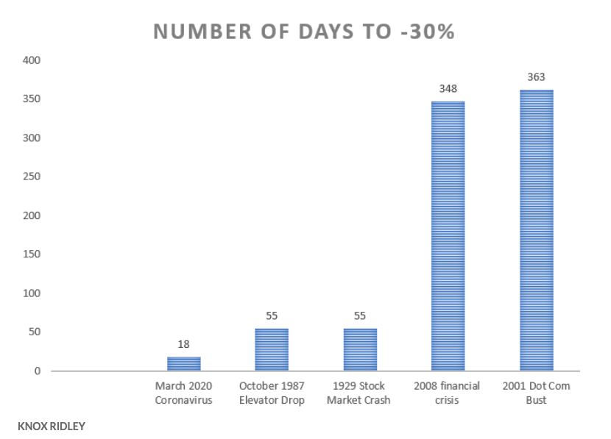
Fastest Drop in S&P
Source: https://www.marketwatch.com/story/algorithms-sped-up-selling-leading-to-the-fastest-bear-market-in-stock-market-history-2020-03-26#:~:text=March%202020%20holds%20the%20record,19.
Notes:
The fastest drop in the S&P 500 that we’ve ever seen, and that by a large margin. 18 days.

Slide 6
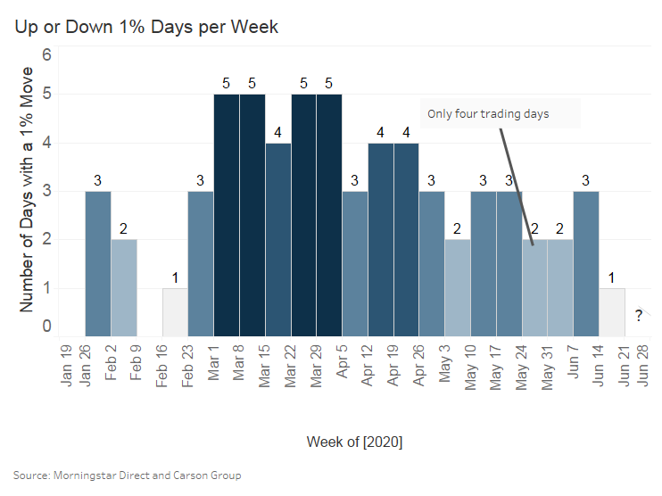
Markets
Volatility has been ratcheting lower in the face of increased uncertainty
Only one – 1% move day last week
Breaks a string of 16 straight weeks with multiple 1% moves
We see some disconnect between rising cases and falling volatility
Market is forward looking
Notes:
16 straight weeks with multiple 1% moves. Not just downward, upward as well. Causes a lot of confusion for clients especially.

Slide 7
Federal Tax Response
Treasury Department Announced an extension from April 15, 2020 to July 15, 2020 for tax filing
October 15, 2020 remains as extension date (Form 4868)
Interest and penalties start on July 16, 2020
CARES Act (2020) created a few retroactive tax changes as did the SECURE Act (end of 2019)
Notes:
Both payments and filings have been extended out this year. You have to file a Form 4868 to utilize the extension date of October 15.

Slide 8
Tips on Extension
To extend to October 15, you must file Form 4868
Must also estimate your tax liability by July 15
You must pay any tax liability by July 15
This is an extension to file, not to PAY!
If you are expecting a refund, won’t get until you file
Notes:
The October extension is to file, not to pay. Penalties and interest will start on 7/16.

Slide 9
Why to File Extension
Could allow you to take advantage of retroactive changes made after the deadline or after you file
Missing Information Needed To File (perhaps a 1099 form)
Travel/scheduling does not align
Complexity and extra time needed
Notes:
Plenty of life circumstances could make you want to file an extension. The option is there if you need it.

Slide 10
Why Not to File Extension
Inability To Pay
Many people file for this year
Bad reason to extend, because you are not getting an extension of paying, as such taxes and penalties start to accrue
Instead, look at a short extension to pay with IRS of 60 to 120 days
Notes:
If you can’t pay, this is not a reason to file an extension. The IRS has specific programs for that.

Slide 11
State Taxes 2020
Relief only applied to Federal Government Taxes
42 States plus DC require income tax filings
Most states pushed back dates to July 15
State extension rules vary – check with state website
https://www.investopedia.com/irs-tax-payments-delayed-until-july-15-2020-4800123
Notes:
Not all states have pushed back to 7/15. Most are.

Slide 12
Estimated Taxes For 2020
Estimated taxes due quarterly
Individuals, S proprietors, partners, etc.
Don’t need to be submitted to IRS until July 15
July 15 is due date for Q1 and Q2 in 2020
Pay online with Electronic Federal Tax Payment System (EFTPS)
https://turbotax.intuit.com/tax-tips/general/the-2020-tax-deadline-extension-everything-you-need-to-know/L8Ph4Vnci
Notes:
These are usually for non-corporate employees. Q1 and Q2 are due on the same day! Be aware of this.

Slide 13
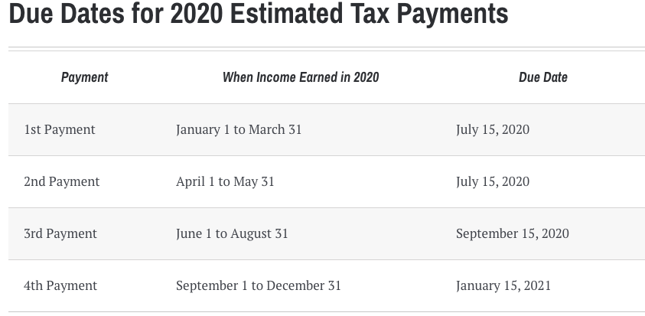
Estimated Taxes For 2020
Source: https://www.kiplinger.com/article/taxes/t056-c005-s001-when-are-2020-estimated-tax-payments-due.html#:~:text=If%20at%20least%20two%2Dthirds,make%20any%20estimated%20tax%20payments.
Notes:
Again, July 15 is an important date.

Slide 14
Estimated Tax Penalties
No penalty if you owe less than $1,000 in tax
No penalty if your 2020 withholdings and estimated payments total at least 90% of your 2020 tax liability
No penalty if your withholdings plus estimated payments total 100% of taxes on your 2019 return (110% if 2019 AGI was $150,000 or more)
Year in which you retire – might not owe estimated
Source: https://www.kiplinger.com/article/taxes/t056-c005-s001-when-are-2020-estimated-tax-payments-due.html#:~:text=If%20at%20least%20two%2Dthirds,make%20any%20estimated%20tax%20payments.
Notes:
Changes to Estimated Tax penalties are unique this year. Make sure you know what your options are.

Slide 15
Tax Planning Process
Notes:
Transition into tax planning process discussion.

Slide 16
Power of Process
Process is a blueprint for success!
Notes:
Here’s a look at how this all led up to day.
Mention that this is biggest piece of financial planning legislation since 2006.
Mention that it was looking grim on this passing until December. Now we are all left to adjust in very little time.

Slide 17
8 Step Tax Planning Process
Keep good records - track all of your taxable income
Track all business and personal expenses
Gather all the correct reporting forms (1099s etc)
Review last years return
Hire the right accountant and advisor
Claim all income that is reported to the IRS to avoid issues – 1099 MISC forms etc – even if its just a few dollars
Plan for tax payment or refund
Plan for the next tax year!
Notes:
Here’s your process to help you be tax successful. Setting out your process helps you know your bases are covered. Be strategic about payments and refunds.

Slide 18
Tax Planning v. Tax Filing
Most people engage in tax filing, not tax planning
Filing is reactive to past year, tax planning is proactive to next year
Start with goals
Do an initial tax review
Review existing law, business set up, and opportunities
Discuss possible scenarios
Implement Plan
Notes:
Almost all of us have to do tax-filing, not all of us do tax-planning, which is the wise, proactive move to pay the right amount of taxes.

Slide 19
8 Tax Planning Tips For This Year And Next
Notes:
Different tax planning opportunities that are out there right now.

Slide 20
8 Tax Tips for Tax Season
Until July 15, 2020
Fund IRA
Set Up Retirement Account
Fund HSA
NOLs
Next Year Tax Impact
Bunch Expenses
Defer Income
RMD Planning
Tax Loss Harvesting
Notes:
The 72t penalty tax is an early withdrawal penalty tax that is levied onto pre-59.5 distributions from retirement accounts unless you have another exception.

Slide 21
Fund IRA or Roth IRA for 2019
Can fund up until July 15, 2020
$6,000 ($7,000 if age 50+)
Remember, you can do a spousal IRA or Roth
Consider deductible v. non-deductible
Roth v. Traditional
Notes:
You can fund an IRA from last year and still generate a tax deduction. This is an important tax-smart strategy.

Slide 22
Set Up SEP Retirement Account
Can set up until July 15, 2020 (or Oct 15 if filed for extension)
Can fund out until July 15 or Oct 15 if extension
Up to 25% of employee compensation or $56,000 (2019 and $57,000 in 2020)
Notes:
Set up a SEP Retirement Account. You can do this if you are self-employed as well. This could create a large tax deduction for 2019.

Slide 23
Fund HSA for 2019
July 15, 2020
HSA is the triple tax play
Tax deductible contributions
Tax deferred growth
Tax free distributions if used for qualified expenses
Need to be in a high deductible plan and not on Medicare
Can put up to $3,500 for self, $7,000 for family, $1,000 catch up (55+)
Notes:
HSA is one of the best tax-strategies in the entire tax code.

Slide 24
Net Operating Losses (Retroactive)
CARES Act changed rules for a short time
2018, 2019, 2020, NOLs may be carried back to each of the five preceding tax years of such loss
NOLs before could not be carried back but only forward
TCJA limited NOL to 80% of taxable income, 2018, 2019, 2020 have no such restriction
Some corporate taxpayers are now eligible for NOLs in prior years and could receive tax refunds, would have to modify and amend filing
Notes:
A new exception as created by the CARES Act – the 2020 coronavirus related distribution exception = this exception applies to a number of retirement plans such as
401(a) – defined contribution plans (401(k) included)
403(b) plans
457(b) governmental plans
408 Individual Retirement Account or Annuity (IRA)

Slide 25
Bunch Expenses
Taxation:
Standard Deduction $12,200
Itemized
Charitable Planning:
DAF
Larger bunched gifts
Business Expenses:
Bunch expenses in high tax years
Roth Conversions:
Add income in years with larger than normal deductions or lower tax rates
Notes:
Interestingly the new CRD can be eligible for rollover, the taxes can be spread out over three years or all included in 2020 taxes. Bunch strategically to take advantage of certain deductions.

Slide 26
Defer Income
Easiest way – defer more salary to 401(k) or retirement plan
Non-qualified salary deferral – must do year ahead of time (lots of restrictions)
Can reduce short term income
Deferring salary means taxable income likely in the future
Balance need for cash flow, income, and taxes
Notes:
Additionally the CARES act allows for the CRD to be repaid from three years after the date of distribution – if it is repaid it is treated as if it were a 60-day rollover in 2020 so as if there was no distribution at all. If you wait a few years to repay you would likely have to amend your 2020 tax returns to get the tax benefits back.

Slide 27
RMD Planning
No RMDs in 2020
Consider your RMDs in future years (age 72)
Taxable distributions
Should you do Roth Conversions in 2020
QCD planning with charities
Tax impact on other benefits like Medicare and SS
Notes:
Because this is a very broad exception its likely that many 2020 distributions would apply for the CRD exception and could be repaid. This means this provision of the bill will have a lasting planning impact for anyone taking out money in 2020. For retirees, it could be harder to qualify for unless you are still working, cut from work, or get diagnosed with the covid-19 virus. There are no RMDs in 2020, so this should affect your strategy.

Slide 28
June 23rd Update on Rollovers
Rollovers allowed for 2020 distributions (otherwise an RMD)
August 31, 2020 deadline
Both owned accounts and inherited (although normally banned for rollovers)
Won’t impact 60-day rule and won’t count towards 1 per year IRA rule
IRS https://www.irs.gov/pub/irs-drop/n-20-51.pdf
Notes:
Just on April 9th new guidance came out from the IRS allowing an extension of the 60-day rollover rules going back to Feb 1. So if you took a distribution on Feb 1 to April or May you can roll this over within the 60-day rules out until July 15, the new tax return due date. However, extension to file still remains at October 15th now, which there was some confusion about before.

Slide 29
Tax Loss Harvesting
Should occur all year, not just end of year
Sell off stocks with gains, realizing those gains
Offset those gains by selling stocks with losses, realizing those losses
offset $3,000 in non-investment income from capital losses (carry forward other losses)
Focus on using short-term losses to offset short-term gains
Example:
Buy $2,000 of Stock X
Buy $2,000 of Stock Y
Stock X goes to $3,000
Stock Y goes to $1,000
Sell both: no taxable gain the $1,000 loss offsets the $1,000 gain
*Beware of 30-day Wash Sale rules on substantially identical securities
Notes:
You will usually see articles appear on this toward the end of the year, but it should be done all year. This is about being strategic about gains and offsetting them with losses.

Slide 30
Final Thoughts and Planning Opportunities
Notes:
– Tax-planning is very important, not just tax-filing
– Are you paying more taxes than your legally need to?
– Going to see legal changes throughout the year with tax-planning because of the response to the virus.

Slide 31
Tax Planning
Tax planning v. tax filing
Lots of opportunities
Get this year taxes done
Plan ahead for next year
Laws will keep changing
Keep long-term goals in sight
Notes:
These are the seven things people need to consider under the SECURE Act.

Slide 32
Additional Disclosures
{Insert Standard BD/RIA Disclosures}
This presentation is designed to provide accurate and authoritative information on the subjects covered. It is not, however, intended to provide specific legal, tax, or other professional advice. For specific professional assistance, the services of an appropriate professional should be sought.
Some IRA's have contribution limitations and tax consequences for early withdrawals. For complete details, consult your tax advisor or attorney. Distributions from traditional IRA's and employer sponsored retirement plans are taxed as ordinary income and, if taken prior to reaching age 59 ½, may be subject to an additional 10% IRS tax penalty. Converting from a traditional IRA to a Roth IRA is a taxable event. A Roth IRA offers tax free withdrawals on taxable contributions. To qualify for the tax-free and penalty-free withdrawal or earnings, a Roth IRA must be in place for at least five tax years, and the distribution must take place after age 59 ½ or due to death, disability, or a first time home purchase (up to a $10,000 lifetime maximum). Depending on state law, Roth IRA distributions may be subject to state taxes. If you are purchasing an annuity to fund any tax-qualified retirement plan (IRA), you should be aware that this tax-deferral feature is available with any investment vehicle and is not unique to an annuity. Carefully consider the features and benefits of the annuity before making the decision to purchase.
The Standard & Poor's 500 Index is a capitalization weighted index of 500 stocks designed to measure performance of the broad domestic economy through changes in the aggregate market value of 500 stocks representing all major industries.
Converting from a traditional IRA to a Roth IRA is a taxable event.
The hypothetical investment results are for illustrative purposes only and should not be deemed a representations of past or future results. Actual investment results may be more or less than those shown. This doe snot represent any specific product [and/or service].
This event is purely educational. No products or services will be offered for sale and there is no obligation.
Notes:
{Insert disclosure}

Slide 33
Questions?
Notes:
Any questions?

Slide 34
Thank you For Joining Us!
Phone: XXX-XX-XXXX

