Slide 1
Notes to Advisors
Insert Your Logo into the Cover and Back Page
Select the Insert Tab > Picture > find the location on your computer and select Insert.
Resize logo by holding down the shift key and dragging one corner in (to make smaller) or out (to make larger).
Note: holding the shift key while dragging will proportionally change the size of your logo and not skew it.
Delete This Page
Delete this page from your presentation.
Note: this presentation makes assumptions that:
Client portfolios are purposeful for their values and goals
You offer some level of goals-based financial planning for clients
This slide deck needs to be reviewed and approved by your compliance department before presenting to clients.

Slide 2
Client Update
2022 Bear Market
Replace With Logo
Notes:
Welcome to our special client update. We’re glad you’ve been able to join us. We know there is a lot going on in our world and the markets that can cause a lot of fear and anxiety. It’s natural to feel that way – and we want you to know we’re here for you.

Slide 3
Client Update 2022 Bear Market
The content and opinions voiced in this material are for general information only and are not intended to provide specific advice, an endorsement, or recommendations for any individual. All performance referenced is historical and past performance is no guarantee of future results. All indices are unmanaged and cannot be invested into directly. To determine which investment(s) may be appropriate for you, consult your financial advisor prior to investing.
Risk Considerations: The economic forecasts set forth in this presentation may not develop as predicted and there can be no guarantee strategies promoted will be successful or protect against loss. Stock investing involves risk including loss of principal. Bonds are subject to market and interest rate risk if sold prior to maturity. Bond values will decline as interest rates rise and bonds are subject to availability and change in price. International and emerging market investing involves special risks such as currency fluctuation and political instability and may not be suitable for all investors.
Notes:
[Review slide]

Slide 4
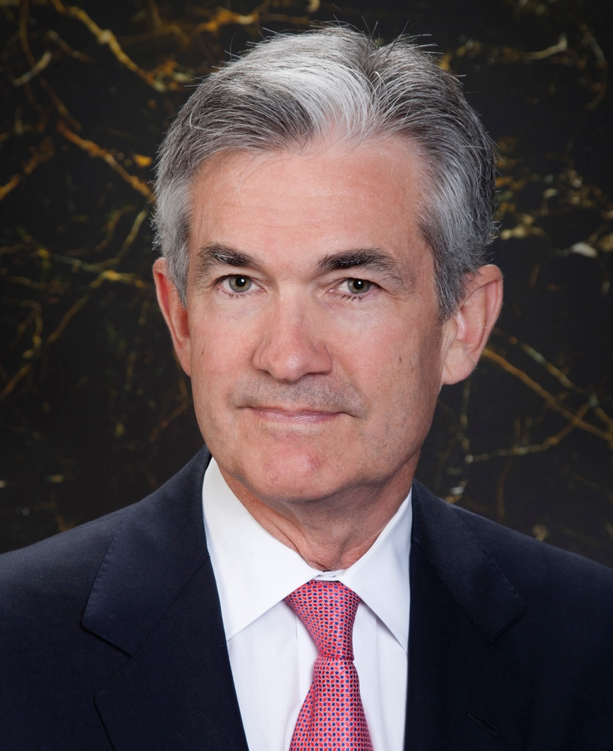
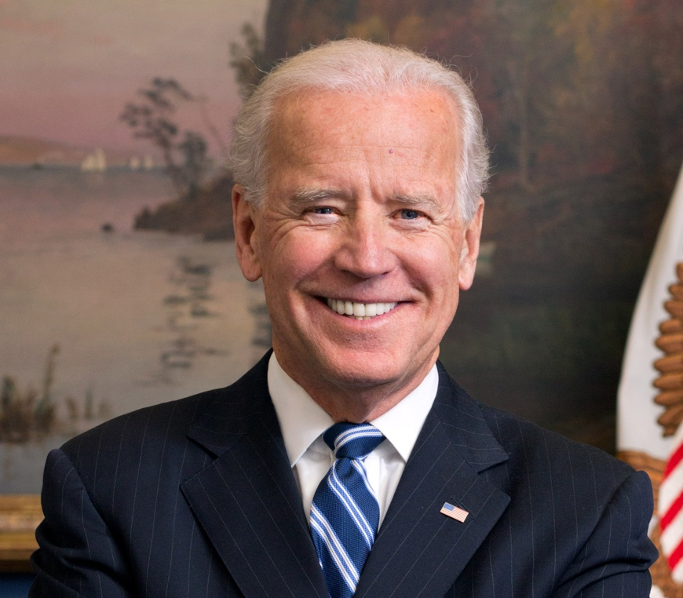
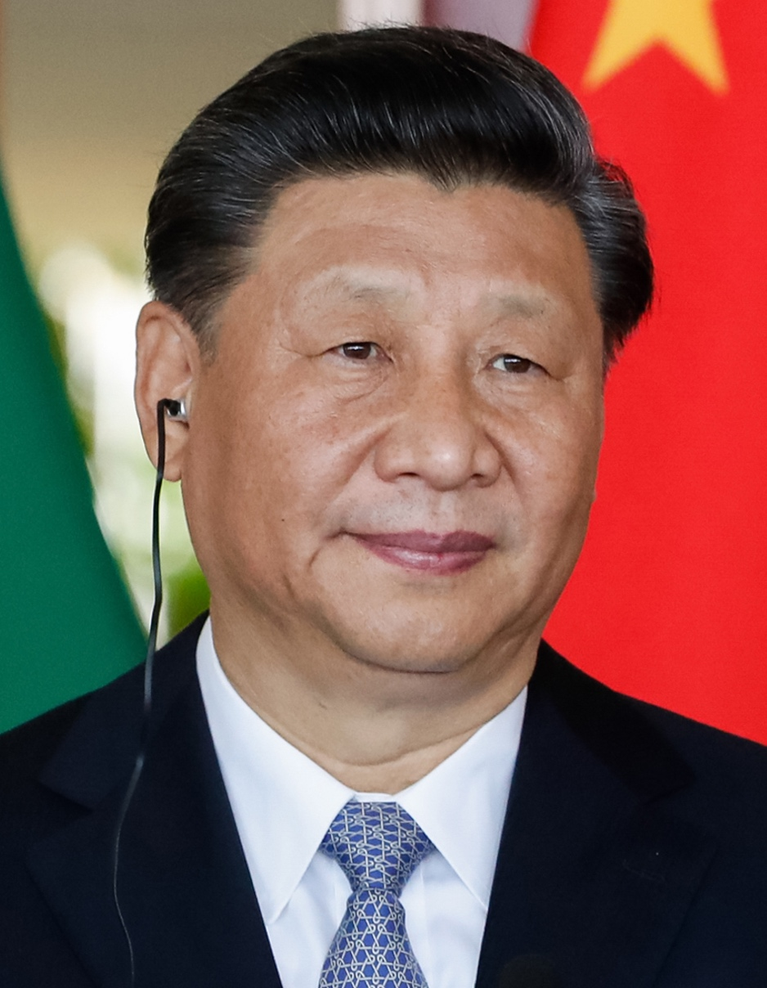
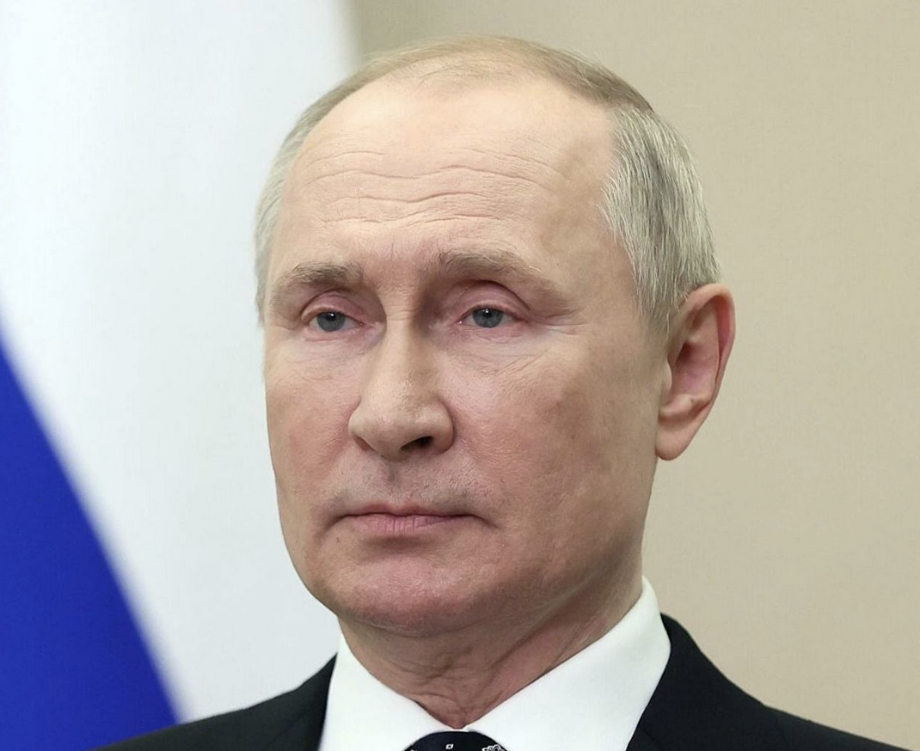
2022 Bear Market
What’s Happening
Where We’re Going
What to Do
Notes:
So why are we here? Most of us are probably aware of the market volatility we continue to experience this year. Our goal today to help you understand what is happening, how it impacts your financial situation, and what you might want to be doing.

Slide 5
What’s Happening
Notes:
Let’s start with what’s happening in the markets and the U.S. economy.

Slide 6
The Economy
Client Update: 2022 Bear Market
Notes:
Let’s start high-level with a quick recap about where the economy is.

Slide 7
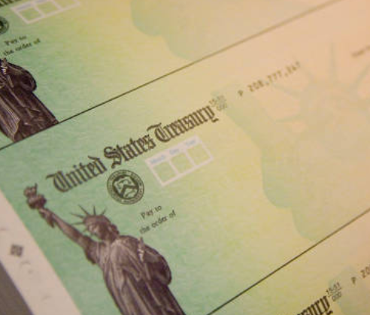
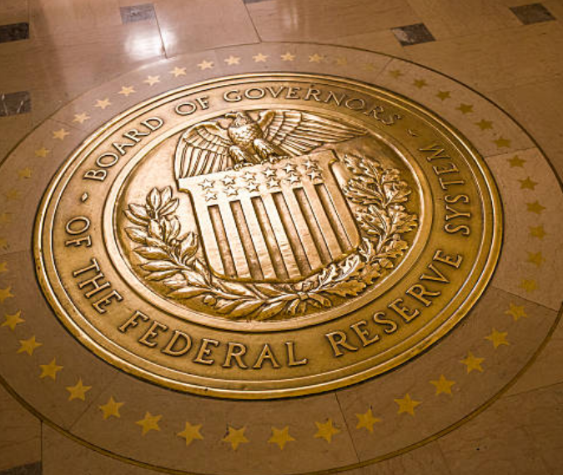


Tailwinds supported rapid economic recovery in the United States
Fiscal stimulus
Congress:
$5.7 trillion
Monetary policy
Fed:
Money supply +40%
COVID-19 cases slowed
Geopolitical stability
Notes:
At the start of the year, the U.S. economy was firing on all cylinders. Our country had recovered from the pandemic downturn faster than anyone expected because it was supported by strong tailwinds. The first tailwind was fiscal stimulus. The Trump and Biden administrations spent more than $5 trillion during the pandemic. The money went to individuals and households ($1.8T), businesses ($1.7T), airlines ($80B), healthcare (~$500B), state and local governments ($745B), schools and other institutions that were affected by Covid-19. Fiscal stimulus kept people who were in trouble afloat. It also put money in the pockets of people whose finances remained stable during the pandemic. The second tailwind was monetary policy. The Federal Reserve kept interest rates near zero and started buying bonds – a policy that’s called quantitative easing. The Fed increased the nation’s money supply by 40 percent as it tried to support the economy through the pandemic. A third tailwind was the development of vaccines and treatments that helped slow the spread of Covid-19 and reopen the economy. The final tailwind was geopolitical stability. U.S.-China trade tensions were creating some rough waters and Russia was massing troops near Ukraine, but everyone was recovering from the pandemic and there was hope that trade issues would be resolved and Russia would back off. Together, these forces helped lift the economy out of recession in record time.
Photo sources: : https://www.gettyimages.com/photos/federal-reserve-governors?assettype=image&family=editorial&phrase=federal%20reserve%20governors&sort=mostpopular; https://www.gettyimages.com/photos/us-government?assettype=image&family=editorial&phrase=US%20government&sort=mostpopular; https://www.gettyimages.com/photos/world-cooperation?assettype=image&license=rf&alloweduse=availableforalluses&family=creative&phrase=world%20cooperation&sort=mostpopular; https://www.gettyimages.com/photos/supply-chain?assettype=image&license=rf&alloweduse=availableforalluses&family=creative&phrase=supply%20chain&sort=mostpopular
https://www.gettyimages.com/photos/pandemic-map?assettype=image&phrase=pandemic%20map&sort=mostpopular&license=rf%2Crm
Sources: https://www.nytimes.com/interactive/2022/03/11/us/how-covid-stimulus-money-was-spent.html
https://www.washingtonpost.com/business/2022/02/06/federal-reserve-inflation-money-supply/

Slide 8

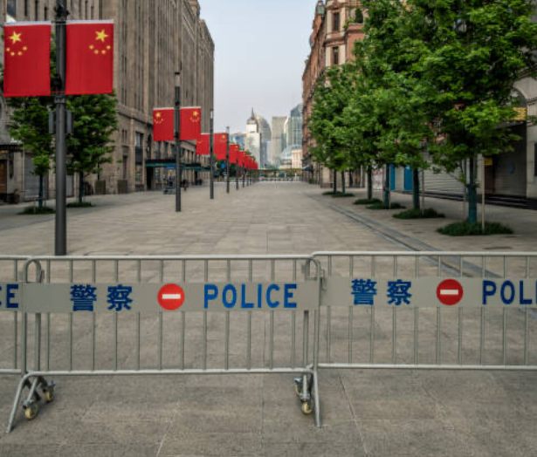
Tailwinds became headwinds
Geopolitical instability
China
lockdowns
Fiscal stimulus ends
Fed tightens
Notes:
Things have changed. We no longer have geopolitical stability. Russia’s invasion of Ukraine disrupted global food and energy markets, damaging the world economy, and sanctions imposed by other nations created additional distress. China's zero-COVID policy led to lock downs of 45 cities – more than 400 million people. In some cases the cities were locked down for months. That meant supply chains were disrupted again, and supplies of many goods were cut off again. The lockdowns hurt China's economy and the global economy. China, like the United States, is one of the world's main economic engines. This year, the U.S. is expected to grow faster than China for the first time since 1976. Fiscal stimulus and monetary policy also became headwinds. Fiscal stimulus ended, although it had put additional money in the pockets of people who were eager to spend it. As a result, we saw high demand for goods at a time when supply was low and prices rose. To tame inflation, the Federal Reserve began to tighten monetary policy.
Photo sources: : https://www.gettyimages.com/photos/federal-reserve-governors?assettype=image&family=editorial&phrase=federal%20reserve%20governors&sort=mostpopular; https://www.gettyimages.com/photos/us-government?assettype=image&family=editorial&phrase=US%20government&sort=mostpopular; https://www.gettyimages.com/photos/inflation?assettype=image&license=rf&alloweduse=availableforalluses&family=creative&phrase=inflation&sort=mostpopular; https://www.gettyimages.com/photos/russia-ukraine-war?assettype=image&license=rf&alloweduse=availableforalluses&family=creative&phrase=Russia%20Ukraine%20war&sort=mostpopular; https://www.gettyimages.com/photos/covid-19-china--lock-down?assettype=image&license=rf&alloweduse=availableforalluses&family=creative&phrase=covid-19%20China%20%20lock%20down&sort=mostpopular&suppressfamilycorrection=true&clarifications=lock%20down%3A91419
Sources: https://thedocs.worldbank.org/en/doc/18ad707266f7740bced755498ae0307a-0350012022/related/Global-Economic-Prospects-June-2022-Topical-Issue-2.pdf
https://www.bloomberg.com/news/articles/2022-05-20/us-growth-seen-outpacing-china-s-for-first-time-since-1976#xj4y7vzkg
https://www.npr.org/2022/04/19/1093620434/45-cities-in-china-are-in-some-sort-of-covid-lockdown-heres-the-toll-thats-takin

Slide 9
Inflation
Inflation 2022, year-over-year | PCE Price Index | Core PCE (Excludes energy and food)
January | 6.0% | 5.1%
February | 6.3% | 5.3%
March | 6.6% | 5.2%
April | 6.3% | 4.9%
May | 6.3% | 4.7%
An increase in the average price of goods and services
A function of supply and demand, as well as money supply
PCE is a broader index than CPI
U.S. Bureau of Economic Analysis
Notes:
Let’s talk a little about inflation – it’s an increase in the average price we pay for goods or services and it has been a thorn in the paw of U.S. consumers since last year. Inflation is affected by supply and demand, as well as the money supply. It has been increasing because of fiscal and monetary stimulus. American households and businesses were flush with cash and credit was readily available. Also, demand for goods was booming but there weren’t enough goods available because of supply chain issues. High demand and low supply caused prices to rise. This year, inflation intensified after Russia invaded Ukraine, and China began locking cities down.
The table shows changes in the Personal Consumption Expenditures (PCE) Price Index. This is the Fed's preferred inflation measure because it offers a broader and more timely measure of consumer behavior than the Consumer Price Index, which only reflects price increases in cities. This chart also shows changes in core PCE, which excludes food and energy prices. The core PCE is important because food and energy prices are volatile and often change swiftly. As a result, they can distort long-term pricing trends. The PCE was 6.3 percent in May, while the Core PCE was 4.7 percent. The Fed's goal is to keep inflation around 2 percent. It considers many inflation measures and emphasizes core PCE.
Rising prices have hurt consumer sentiment.
Sources: https://www.bls.gov/news.release/cpi.nr0.htm
https://www.bls.gov/bls/news-release/cpi.htm#2022

Slide 10
Inflation affects the way people think and spend
Source: April 21-May 12, 2022, Washington Post-Schar School poll of 1,055 U.S. adults with an error margin of +/- 4 percentage points.
Notes:
Source: https://www.washingtonpost.com/business/2022/06/09/inflation-worse-poll-americans/
Inflation changes the way people think and spend. A recent poll conducted in April and May by The Washington Post and George Mason University’s Schar School of Policy and Government found that:
87 percent of those surveyed were making a bigger effort to find the cheapest products
74 percent were delaying planned purchases
59 percent were saving less
59 percent were driving less
52 percent were buying products in anticipation of prices going higher.
That last one may be the most important. It suggests that inflation psychology is beginning to take hold.

Slide 11
This situation has been termed ‘inflationary psychology.’ Consumers purposely advance their purchases in order to beat anticipated future price increases. Firms readily pass along higher costs to consumers, including the future cost increases that they anticipate…Expected inflation [becomes] a self-fulfilling prophecy.
Richard Curtin, Chief economist University of Michigan Surveys of Consumers, Barron’s, April 7, 2022
Source: https://www.barrons.com/articles/inflation-consumer-prices-sentiment-51649268928?mod=Searchresults
Notes:
In an op-ed for Barron’s, Richard Curtin, Chief economist University of Michigan Surveys of Consumers explained, “This situation has been termed “inflationary psychology.” Consumers purposely advance their purchases in order to beat anticipated future price increases. Firms readily pass along higher costs to consumers, including the future cost increases that they anticipate…Expected inflation becomes a self-fulfilling prophecy.”

Slide 12
The Fed is tightening monetary policy
No more bond buying (quantitative easing)
Beginning to shrink its balance sheet (quantitative tightening)
Raising the federal funds rate
Federal Reserve Bank, CME Group
Notes:
Sources: https://www.federalreserve.gov/monetarypolicy/fomccalendars.htm
https://www.cmegroup.com/trading/interest-rates/countdown-to-fomc.html
The Federal Reserve was late to act on inflation and now it is responding aggressively. The Fed stopped buying bonds, began to shrink its balance sheet. It also began increasing the federal funds target rate, which influences interest rates. Last December, the fed funds rate was near zero. In March, the Fed raised it to 0.25 to 0.50 percent. In May, it lifted the rate by half a point to 0.75 to 1.0 percent. And, in September, the Fed increased the fed funds rate again. This time bringing it to 3.0 to 3.25 percent. By the end of this year investors anticipate the fed funds target rate will be 4.25 to 4.5 percent. That’s a significant increase for a single year. But it isn’t even close to the highest fed funds rate ever. That happened in 1980 when inflation was at 13.5 percent. The Fed raised the federal funds rate from 14 percent to 20 percent – a 6 percent bump – in a single year.

Slide 13
The economic outlook
Soft landing
Stagflation
Recession
Economy slows
Inflation falls
No recession
Economy slows or contracts
Inflation persists
Economy contracts
Inflation slows
Notes:
Source: https://www.barrons.com/articles/fed-economy-soft-landing-stagflation-crash-51653086991
Right now, there is a lot of uncertainty about and second-guessing of the Fed's monetary policy. Federal Reserve tightening could result in:
A soft landing is the Goldilocks ideal. If everything goes “just right,” the Fed will slow economic growth and contain inflation without leading the country into a recession.
Stagflation is another possibility. Stagflation is a combination of stagnant and inflation. It occurs when a country has slow economic growth and high inflation.
The Fed’s action could trigger a recession, which is often defined as two or more quarters of economic contraction. Recessions cool off the economy, lower demand for goods, and slow inflation. They also create financial challenges for many people.

Slide 14
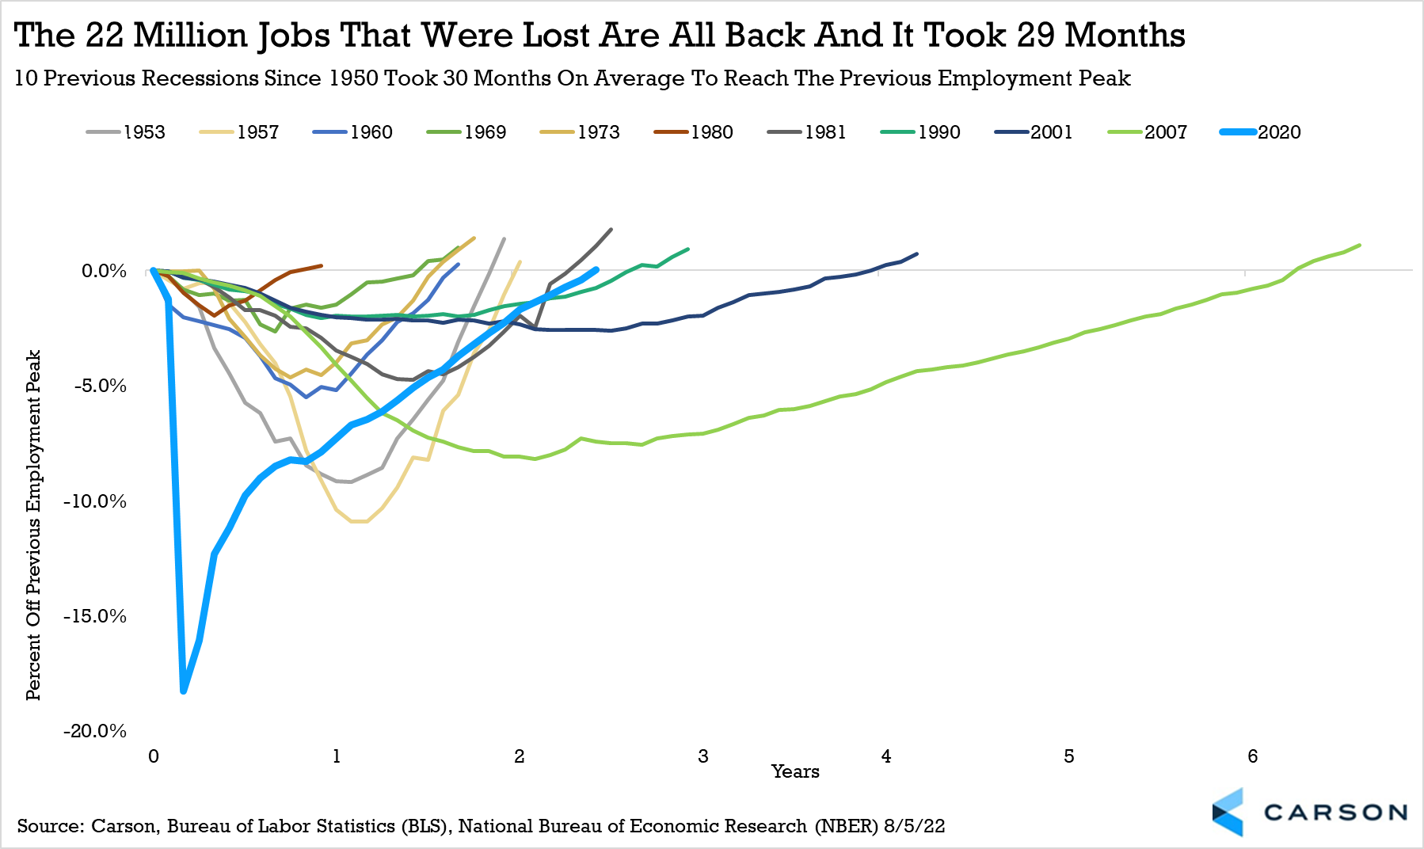
Are we in a recession?
Notes:
So the question we’ve been getting is, “Are we in a recession?”
The odds of a recession in 2023 have unquestionably gone up, as the Fed continues to hike rates. But currently, we do not see the economy in a recession. The main reason is the employment backdrop is so strong. More than 3.5 million jobs have been created this year, one of the most ever and not at all recessionary. Additionally, industrial production has been very strong, another important component to the economy. Even consumer spending has remained stubbornly strong amid all the concerns.
Now there are obvious worries, as consumer confidence has been very low (but has been improving with gas prices falling), while manufacturing has slowed, and housing data is tanking due to higher mortgage rates. Currently, we think this could be more of a midcycle slowdown versus the start of a recession. A similar period to now is the last time the Fed was this aggressive back in 1994. Back then we saw a midcycle slowdown before the economy began to grow in the mid to late ‘90s.

Slide 15
The
Economic
Cycle
Peak
Expansion
Recession
Trough
Notes:
Source: https://www.investopedia.com/terms/e/economic-cycle.asp
No matter what happens, it’s important to remember that it’s not permanent. Economies typically cycle through four phases – expansion, peak, recession, and trough.
Now, let’s take a look at how financial markets feel about all of this.

Slide 16
The Markets
Client Update: 2022 Bear Market
Notes:
Now let’s move on to how all of this has impacted the financial markets.

Slide 17
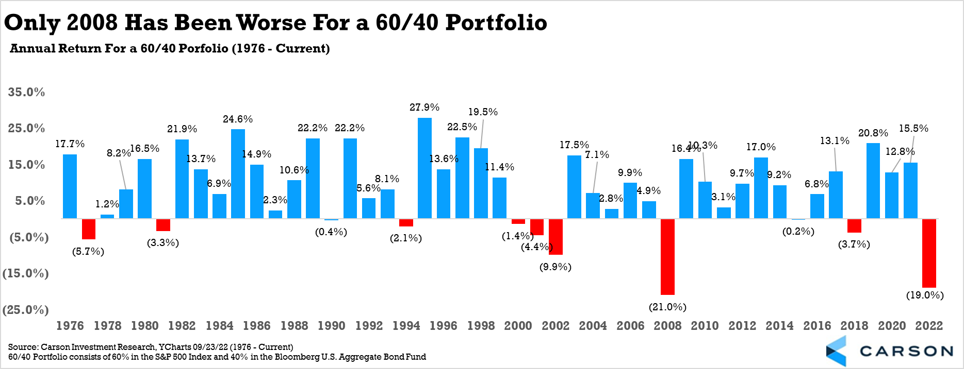
2022 YTD: A Rough Year for Investors
Source: https://www.marketwatch.com/investing/index/spx/charts
Notes:
2022 has been historically difficult for investors so far. From massive inflation, to soaring yields, to a slowing economy, to a bear market for stocks, to one of the worst years ever for bonds, there are many worries for investors.
Bonds historically have done well when stocks don’t do well, but this year that isn’t happening. In fact, the five previous times the S&P 500 lost 10% or more for the year, bonds (as measured by the Bloomberg U.S. Aggregate Bond fund) gained every time, up 7.7% on average.
With the S&P 500 price index down 22.5% for the year and bonds down 13.8%, only 2008 was a worse year for a 60/40 portfolio. A 60/40 portfolio has 60% in stocks and 40% in bonds.

Slide 18
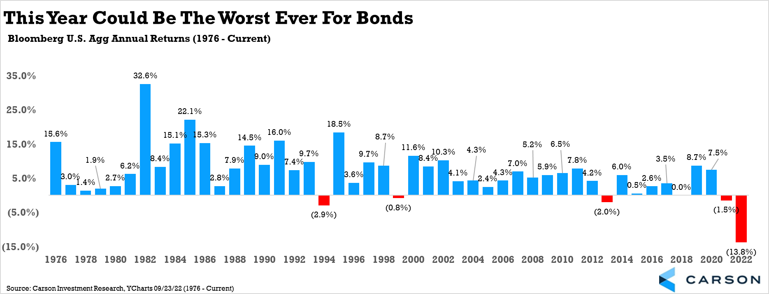
Bonds
Notes:
When it comes to bonds, yields have soared this year on higher inflation expectations and a hawkish Federal Reserve, as a result bonds have been historically bad. Remember, yields and bond prices historically trade inversely. The Bloomberg U.S. Aggregate Bond Fund is currently down nearly 14% for the year, far and away the worst year ever (since 1976 when the Agg began trading). To put things in perspective, it had never been down two years a in row (which will likely happen this year) and the previous worse year ever was a 2.9% drop in 1994.

Slide 19
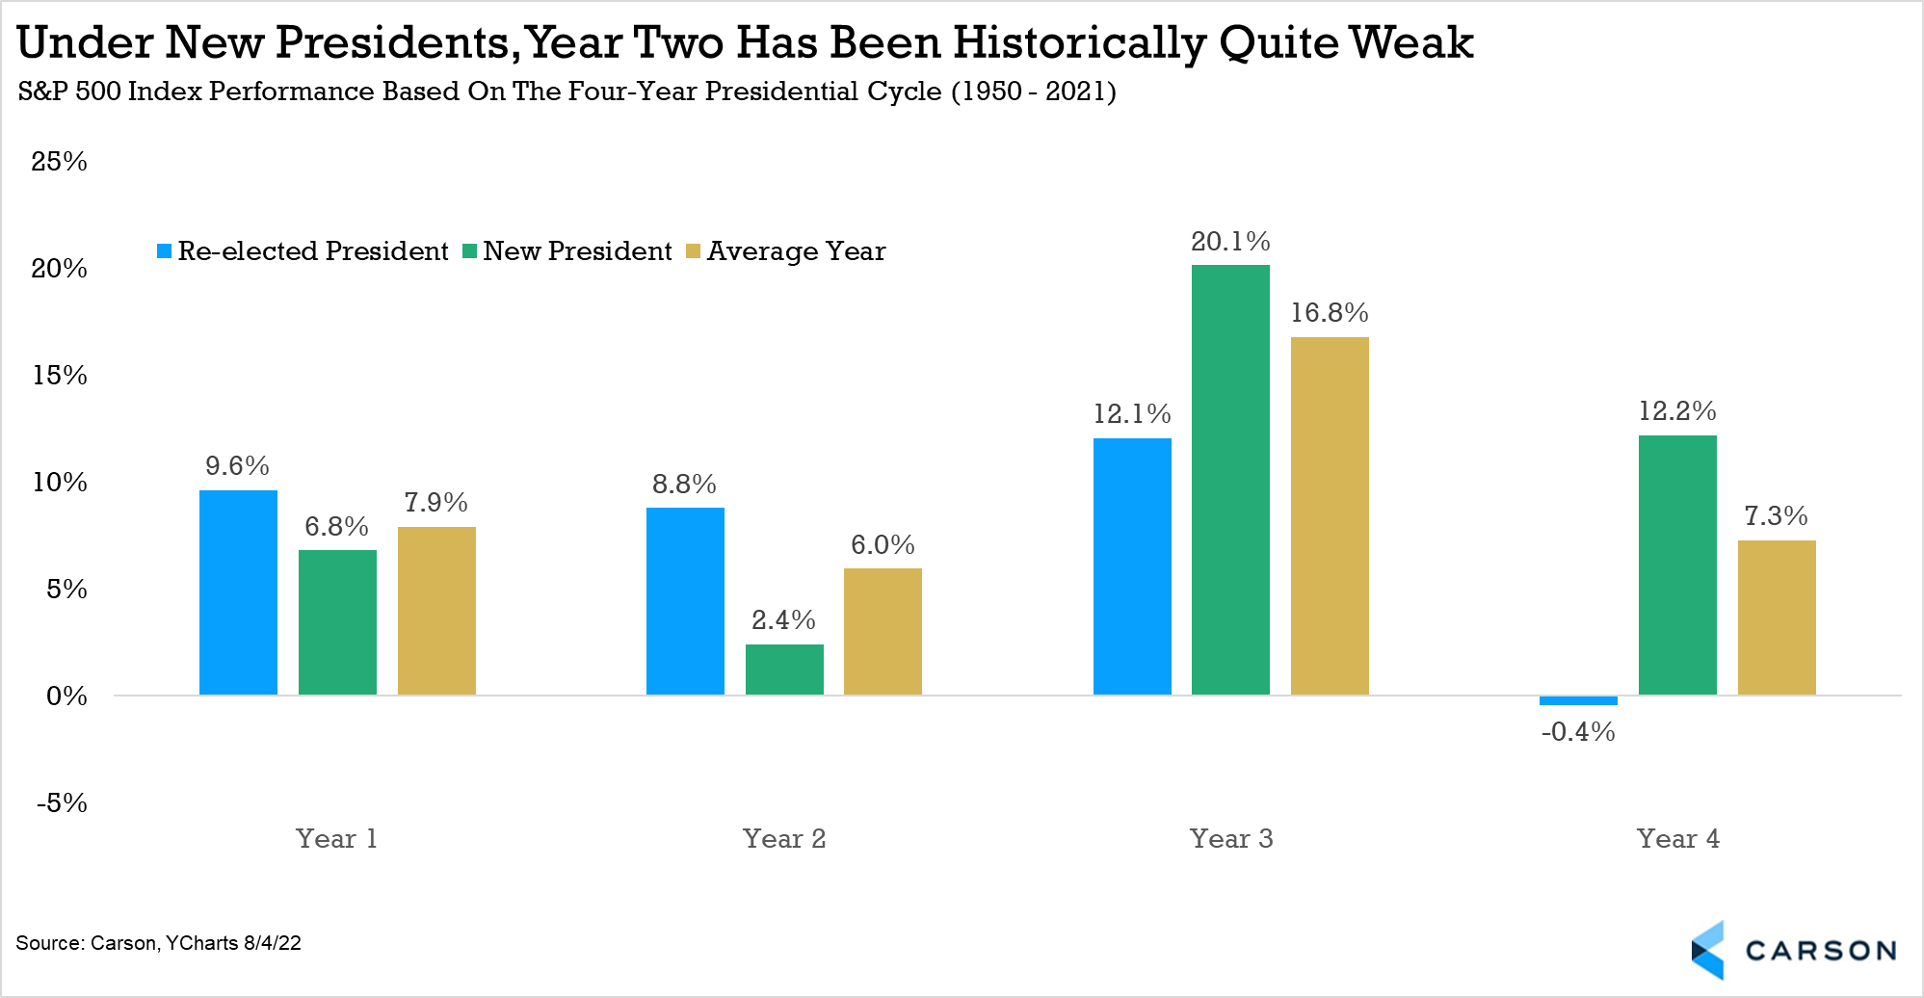
Some weakness wasn’t surprising
Notes:
Although the size of the drop in stocks and bonds is surprising, to see some weakness this year wasn’t overly surprising. As the chart above showed, some of the worst quarters of the four-year cycle took place during this year. Adding to that, below we show that the second year (so this year) under a new President tend to be quite weak as well. The good news is look how well stocks do the following year under a new President.

Slide 20
Where We’re Going
Notes:
So on that note, let’s look ahead to see where we may be headed.

Slide 21
Looking back as we look ahead
Notes:
There’s an old saying that the stock market is the only place where when things go on sale, everyone runs out of the store screaming. Things are no doubt on sale and investors with a long enough investment horizon should be looking at this weakness as an opportunity.
As mentioned, we don’t think the economy is in a recession. If that is the case, it likely means stocks won’t fall significantly from here. Looking at all the bear markets that took place without a recession showed stocks falling about 24% on average. In fact, only once did stocks fall more than 30% without a recession and that was the 1987 crash. Investors need to know more near-term pain is always possible, but a major low could be quite near.

Slide 22
Stocks tend to do well after bear markets
Notes:
As much as we would love to have a crystal ball, no one knows when this current bear market will end, but investors should be open to significant gains coming off of the bear lows. And that is always a “bright spot at the end of the tunnel.”

Slide 23
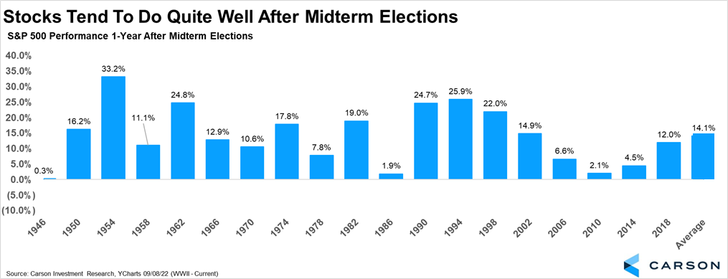
Looking back as we look ahead
Notes:
While past performance is certainly no guarantee of future results, we can often gain a lot of perspective when looking at what has happened to the markets in the past.
Let’s start with the fact that 2022 is a midterm year. Markets don’t care about what just happened -- although investors do-- they are more focused on what is next. The truth is stocks historically haven’t done very well the first few quarters of a midterm year, but they do quite well once the midterm election is over.
In fact, since World War II, the S&P 500 has been higher a year after the midterm election every single time, up 14.1% on average. If an investor is worried about things right now, they need to know much better times could be coming and soon.

Slide 24
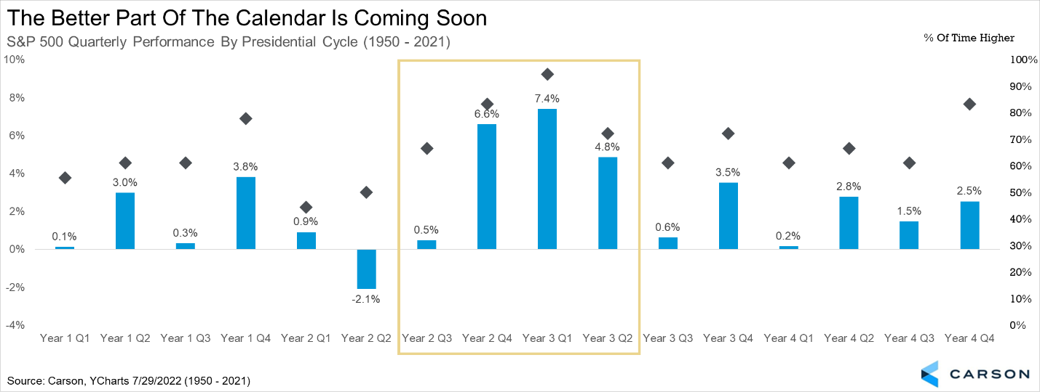
The full presidential cycle
Notes:
Building on this, if you look at the entire 4-year Presidential cycle, the upcoming quarters are some of the very best out of 16 total quarters.

Slide 25
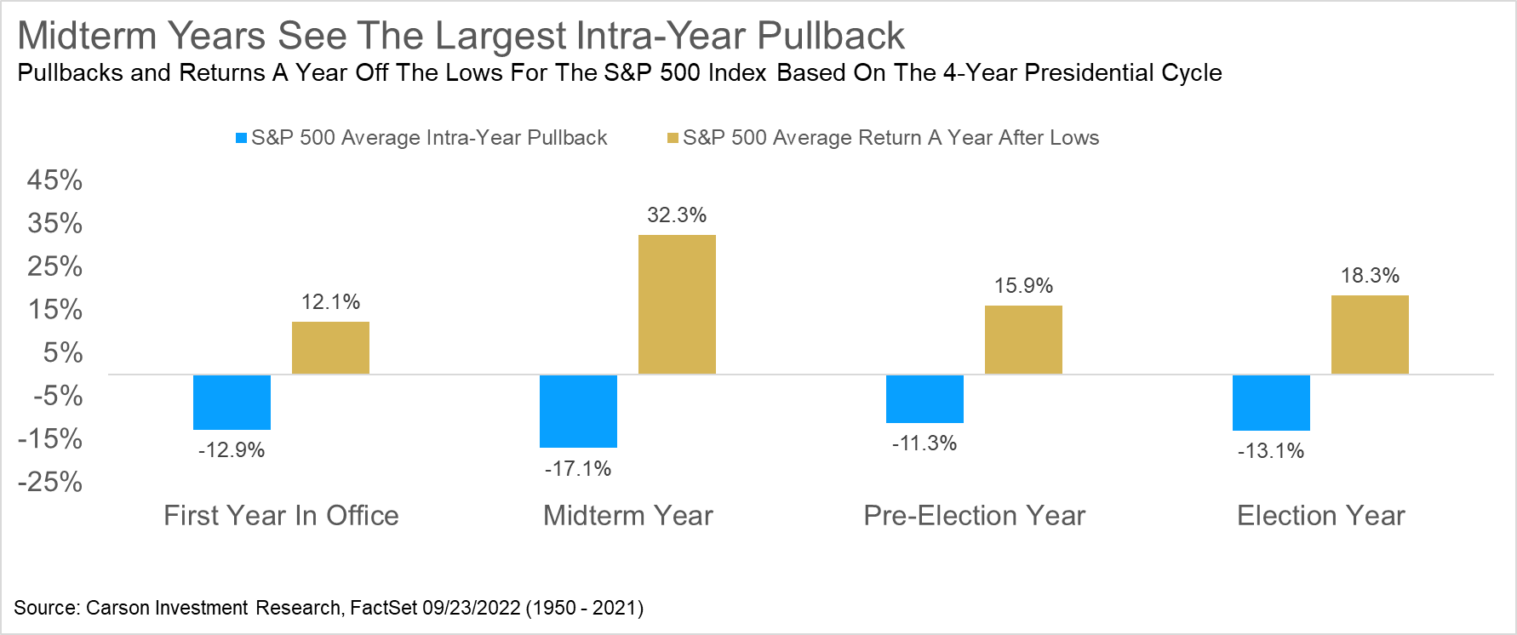
Gains from lows
Notes:
One final reason investors may want to remain optimistic and not sell now is that historically, stocks do very well off of a midterm year low. In fact, the S&P 500 has gained more than 32% on average off the lows and have never been lower a year later since 1950. The June lows are not far away from current levels and should new lows be made, this could be another positive for investors going out a year or more.

Slide 26
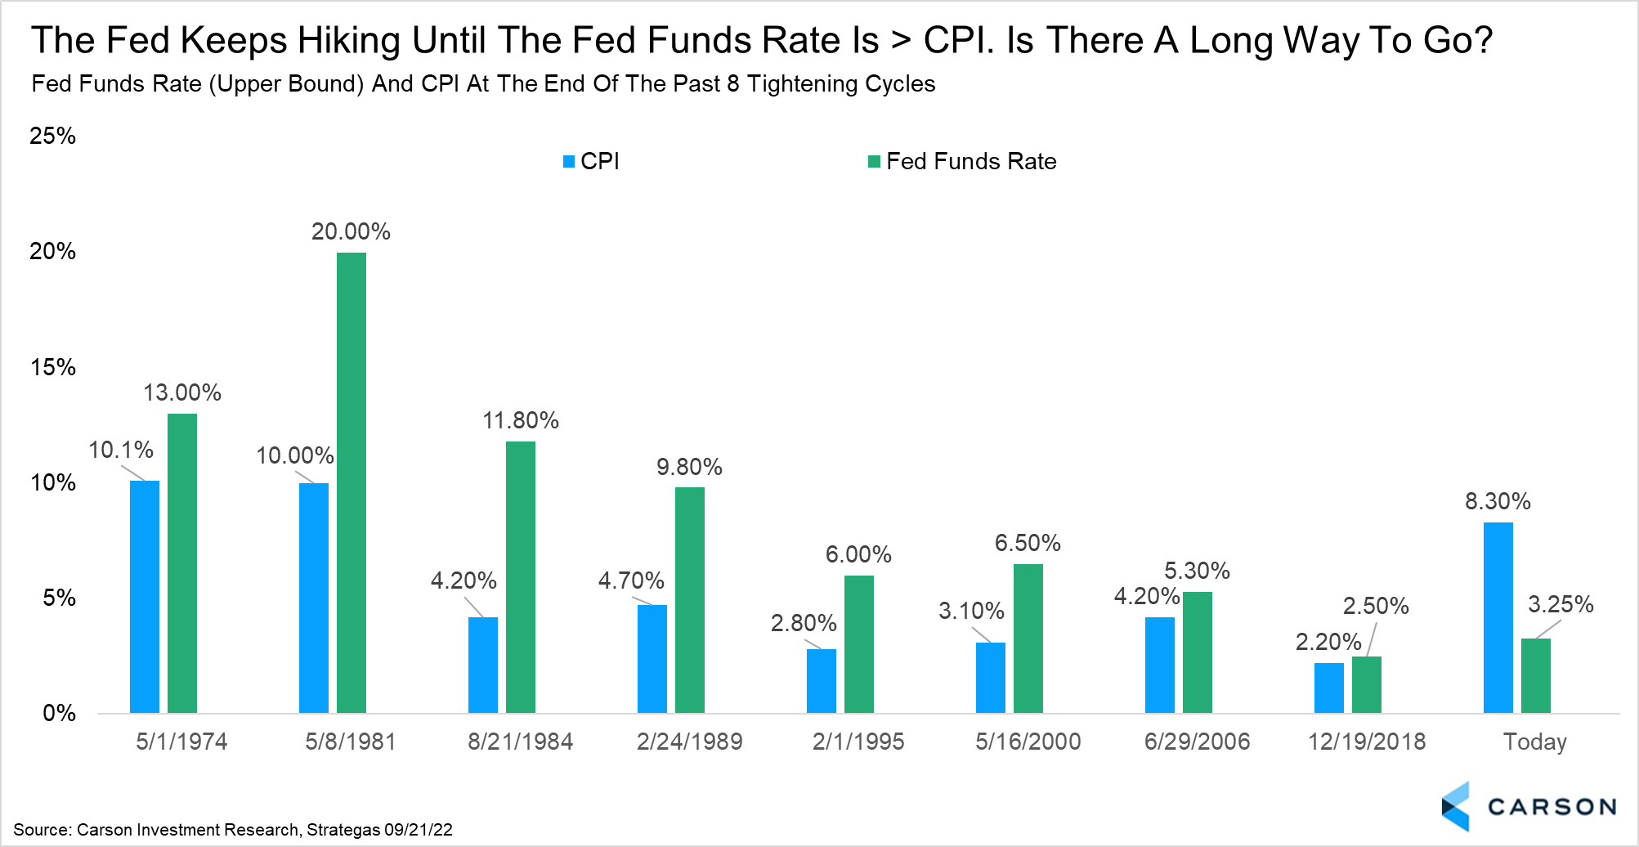
What will the Fed do?
Notes:
The Fed has made it very clear that they would be ok with some pain (think a mild recession) to put a lid on inflation. There is no easy answer here, but Chairman Powell knows history and knows that the Fed didn’t increase rates enough or keep them high for long enough in the 1970s, which led to massive inflation in the late ‘70s and early ‘80s. The truth is the Fed might break something and that might be part of their plan.
Looking back at the previous eight rate hike cycles shows that the Fed hikes until rates get above the headline CPI number. With inflation still running at 8.3% and rates at 3.25%, more hikes could be in the cards. And the Fed’s latest projections suggest we’ll see at least another 125-150 basis points of rate hikes.

Slide 27
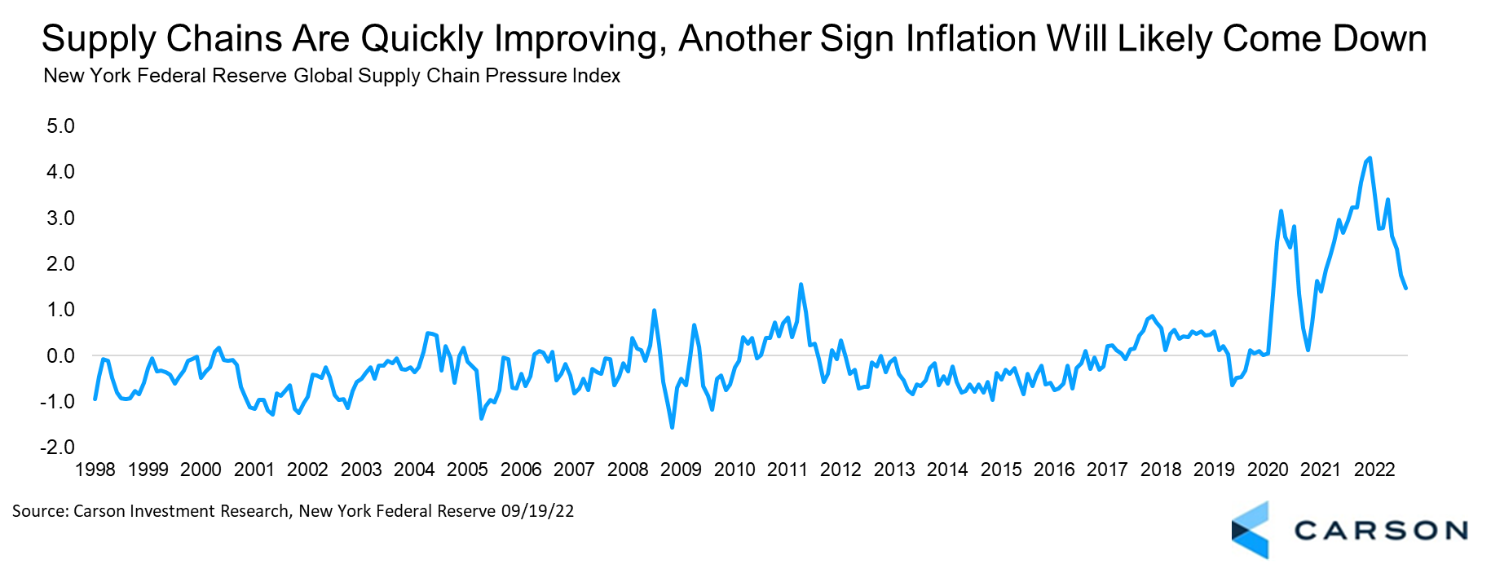
Will inflation ever come back down?
Notes:
The recent CPI number was disappointing, showing prices for many goods and services at the consumer level were increasing more than expected. The good news is various other inflation measures are coming back and quickly in many cases. For starters, energy prices have fallen and in many cases are lower than before the war started, a good sign.
Additionally, prices paid components in various surveys have pulled back quickly. Given this tends to lead CPI by a few months, it could be a good sign. Meanwhile, supply chains are improving, as this survey by the NY Fed shows.

Slide 28
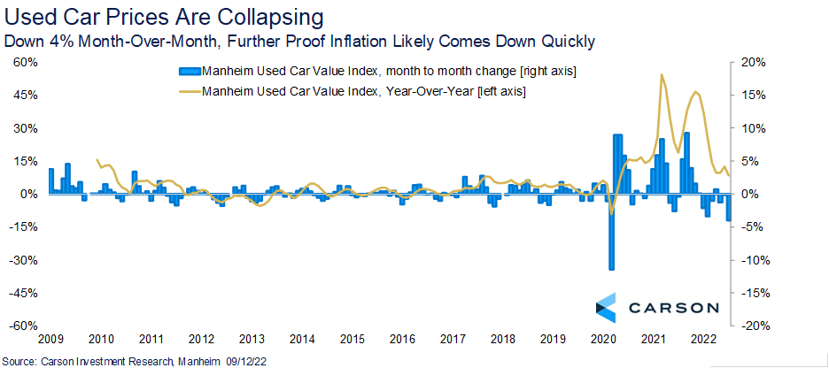
Used Car Prices Are Collapsing
Notes:
Lastly, one of the main reasons we are optimistic inflation could be about to come down quickly is used car prices are rapidly dropping. The recent Manheim Used Car Value Index fell 4% last month, one of the largest drops ever. Used cars make up a large part of inflation readings and this should provide a nice tailwind going forward.

Slide 29
What to Do
Notes:
As always, we need to focus on what we CAN control.

Slide 30

Your Financial Situation
Avoid fear-based decisions
Stay the course
Keep your eyes on the end goal
Trust the plan
Be mindful in spending
Notes:
So, what to do?
It’s no surprise that our advice to you is to think long-term. Our advisors build financial plans to account for the ups and downs of the market. Here’s what we recommend to our clients:
Avoid fear-based decisions. Emotional decision-making can cause us to make irrational decisions that hurt us in the long term. We believe that this volatility is a short-term situation, yet your financial plan is built for the long term. As the markets rebound, making major adjustments to your plan could result in missing out on the next rise in the markets. As always, we need to rely on our process to make good decisions for you.
Stay the course. It can be difficult to see your account values drop significantly, and we understand. We’re here to help you through these challenging markets so you can stay on track.
Keep your eyes on the end goal. What’s important to most of our clients isn’t making the most money they possibly can – it’s achieving the goals that are important to you. Things may get bumpy along the way, but its important to stay focused on your destination.
Trust your plan. Your financial plan is built on diversification and longevity, both of which protect you from volatility. We can’t emphasize this enough: we stress test your plan, so volatility is already built in. ‘
Be mindful in your spending. When costs for goods and services are high, it’s easy to overspend, and when we overspend, it can cause us to take on debt – which has high interest rates right now – or sell investments when their value is down.
In a stormy market, a plan is essential. We build plans that help our clients weather both shaky and smooth conditions.

Slide 31

Your Wellbeing
Exercise
Get plenty of sleep
Try breathing exercises or meditation
Keep a gratitude journal
Get outside in nature
Listen to uplifting music
Laugh
Connect with friends and loved ones
Notes:
In stressful times, it’s even more important to take care of ourselves. Beyond the general health recommendations we’ve shared, we also want to share a few of our favorite ways to focus on your well-being and reduce stress and anxiety:
Exercise
Get plenty of sleep
Try breathing exercises or meditation
Keep a gratitude journal
Get outside in nature
Listen to uplifting music
Laugh
Connect with friends and loved ones
https://www.skillsyouneed.com/ps/stress-tips.html
https://www.heart.org/en/healthy-living/healthy-lifestyle/stress-management/spend-time-in-nature-to-reduce-stress-and-anxiety
https://www.heart.org/en/healthy-living/healthy-lifestyle/stress-management/3-tips-to-manage-stress
https://www.webmd.com/balance/guide/blissing-out-10-relaxation-techniques-reduce-stress-spot#1

Slide 32
THANK YOU
Notes:
Before we wrap up today, we want to say thank you for being clients. We know there is a lot of fear and uncertainty in the world right now, and we don’t take lightly the trust you place in us. My team and I are here for you, and we’re committed to doing what is needed to take care of you and your family.

Slide 33
Questions?
Notes:
We’ve spent time today discussing what is happening in the markets, what could be causing the volatility, and what clients should be doing right now. We understand that you may still have questions or concerns about the markets and your accounts. Since this is a public presentation and every client’s situation is different, we will not be taking questions about your personal situation at this time. Please contact our office to schedule a time for us to connect so that we may answer your questions.
If you are listening in but are not a current client, we understand that you may have questions about your situation, and may not be receiving the service and advice you need during challenging times. We are offering complimentary consultations with our clients’ friends and family to help you navigate the volatility. Please contact our office to schedule a time to discuss your questions with one of our advisors.
Thank you all so much for joining us. Stay calm, stay healthy, and stay well.
Photo Source:

Slide 34
Thank you For Joining Us!
Phone: 000.000.0000

